Slide 1



ITU-ML5G-PS-018: DNN Inference Optimization Challenge
(Adlik/ZTE)
17 July 2020
https://wiki.lfai.foundation/display/ADLIK/DNN+Inference+Optimization+Challenge
Liya Yuan, ZTE yuan.liya@zte.com.cn
Sponsors
Organizer
Register here
Join us on Slack

Slide 2



Background
Trained DNN models
Inference
Cloud Deploy
Edge Deploy
On-device Deploy
AI Applications
High accuracy
High complexity
Computationally expensive
Memory intensive
Rapidly rising data-center consumption
Development of edge computing
Resource constraint in edge devices
Efficient inference:
Computation cost
Memory footprint
Latency

Slide 3
DNN inference optimization
Model optimization
Kernel optimization
Hardware optimization
Efficient model design
Model pruning
Model quantization
Knowledge distillation
Intel MKL-DNN
Nvidia TensorRT
Intel Knights Landing CPU
NVidia PASCAL GP100 GPU
Google TPU
Nvidia Tegra

Slide 4
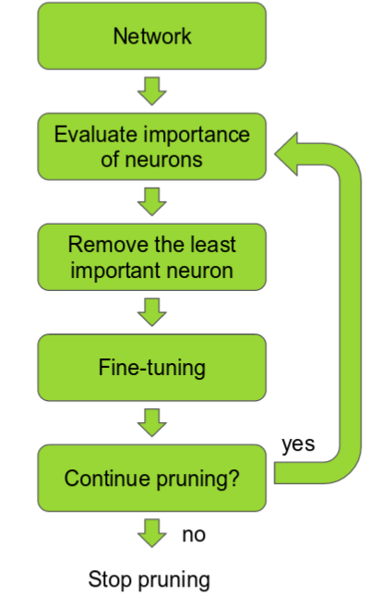
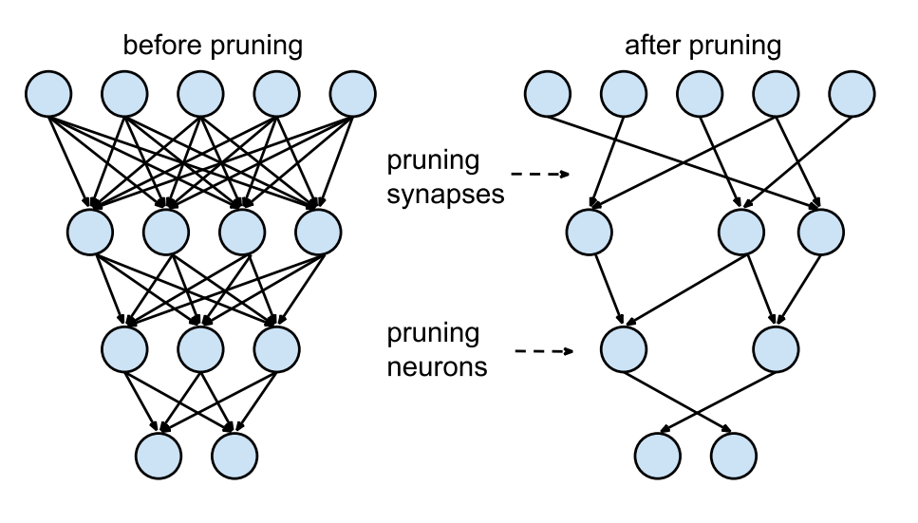
Model pruning
Pruning:
Removing redundant connections
Challenges:
How to evaluate importance of parameters?
How to effectively reduce computation and latency?
How to recover accuracy?
Source: http://cs231n.stanford.edu/slides/2017/cs231n_2017_lecture15.pdf
https://jacobgil.github.io/deeplearning/pruning-deep-learning

Slide 5
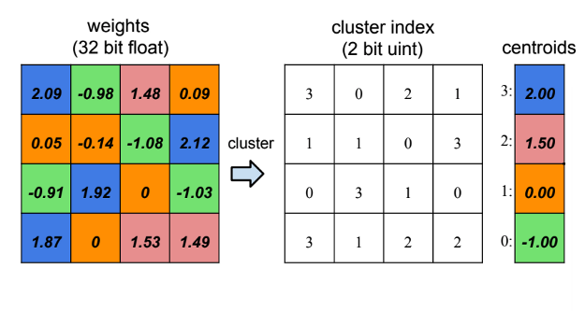
Model quantization
Quantization:
Reduce the precision requirements for the weights and activations
Challenge:
What to quantize?(Weight, activation, gradient)
To what degree? (8 bit, 4 bit, 2 bit, 1 bit)
With what parameters? (step size, clipping value)
How to balence trade-Off between compression and accuracy?

Slide 6
Adlik pruning & quantization
Pruner:
Support channel pruning and filter pruning, reducing the number of parameters and flops.
Quantizer:
Supporting 8-bit Calibration Quantization
Pre-trained FP32 Model
Prune Filter
Pruner
ResNet-50 | Top-1 | Parameters | MACs | Size
baseline | 76.19% | 25.61M | 5.10*10⁷ | 99MB
pruned | 75.50% | 17.43M | 3.47*10⁷ | 67MB
pruned+quantized(TF-Lite) | 75.3% | 17.43M | 3.47*10⁷ | 18MB
Quantize with Calibration
Quantizer
INT-8 Inference
https://github.com/Adlik/model_optimizer

Slide 7
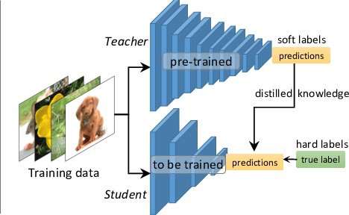
Knowledge distillation
Knowledge distillation:
Model compression by teaching a smaller network, step by step, exactly what to do using a bigger already trained network
Challenge:
Introducing multiple teachers
introducing a teaching assistant

Slide 8
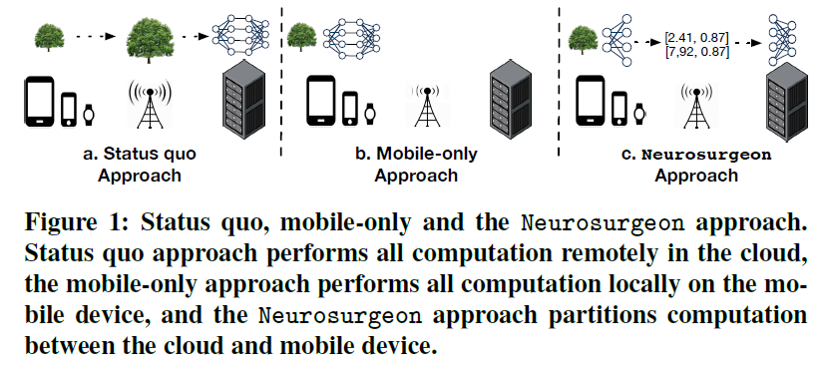
Model partitition
Neurosurgeon: Collaborative Intelligence Between the Cloud and Mobile Edge

Slide 9
Task
Target models: BERT; MobileNet-V3; ResNet 50
Design and implement optimization solution
Boosted computing efficiency; Reduced memory footprint; Improved Latency

Slide 10
Submitting
How?
1) Create a private Github repository to contain their work.
2) Add AdlikChallenge as a collaborator. The repository must be made public before submission deadline and should be accessible till the end of the final event of the ITU challenge.
What?
1) Source code
  The whole optimzation solution
  Performance test demo
2) A description document.
  Instructions on how to verify the optimization performance with the source code
  Other contents of the document include but are not limited to: insight, opinion and analysis of model optimization; selected target model and reason; base model; solution, algorithm used; description and comparison of optimization results, etc.

Slide 11
Evaluation criteria
Effect of model optimization (50%):
Reasonable trade-off between accuracy and efficiency. The selected model type, loss of accuracy, compression rate of model parameters and computation will be taken into account.
Solution advantage (30%):
Whether the solution is reasonable and whether the solution has enough practicability, innovation and universality.
Problem analysis (10%):
Whether there is a deep original insight into the problem, and whether the analysis of the key elements of the problem is accurate and reasonable.
Completeness (10%):
Whether the requirements of the competition are fulfilled according to the proposed scheme and design.

Slide 12
Tips
1) See the problem statement on Adlik wiki.
2) If you don't have an ITU account, please follow the guidance to create one for challenge registration.
3) Register on ITU AI/ML in 5G challenge website with your ITU account.
4) Fill out the ITU AI/ML in 5G Challenge Participants Survey​​ to select problem statement ITU-ML5G-PS-018. You can enroll as a team with 1-4 members.
5) Begin to work on this problem and submit your results. We will begin to accept submissions from July 1st, 2020 and the submission deadline is October 10th, 2020.

Slide 13
Q & A

