Slide 1

Financial Inclusion
Moving the Needle
Ronald Webb – Director of Financial Services

Slide 2




CUSTOMERS USING M-PESA
24,698,200
AVERAGE TRANSACTIONS
390m tpm
13m tpd
ANNUAL TRANSACTION GROWTH
34%

Slide 3



AGENTS
114,000
MERCHANTS
254,000
BILLERS
11,000

Slide 4
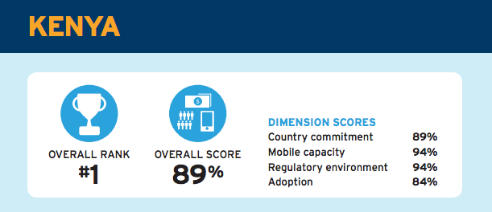
KENYA – NUMBER 1
on the Global Financial Inclusion Rankings
The 2015 Brookings Financial & Digital inclusion Project Report

Slide 5
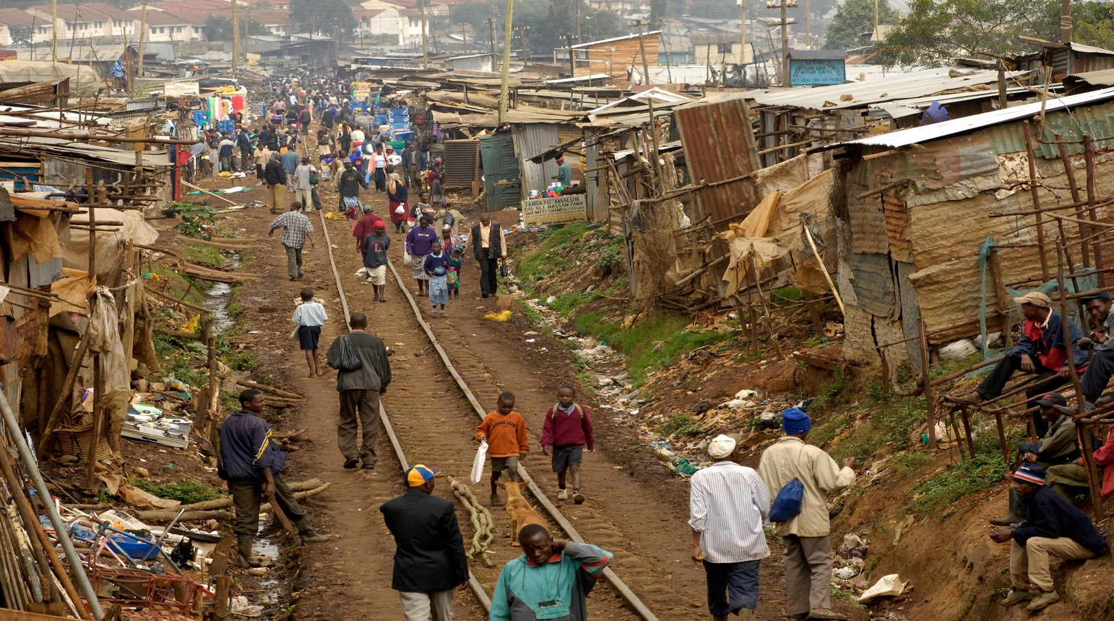
48%
Kenyans living on less than $100 per month
Up from 44% in 3 years
77% cook in the same room, 56% using wood and 17.2% using charcoal

Slide 6
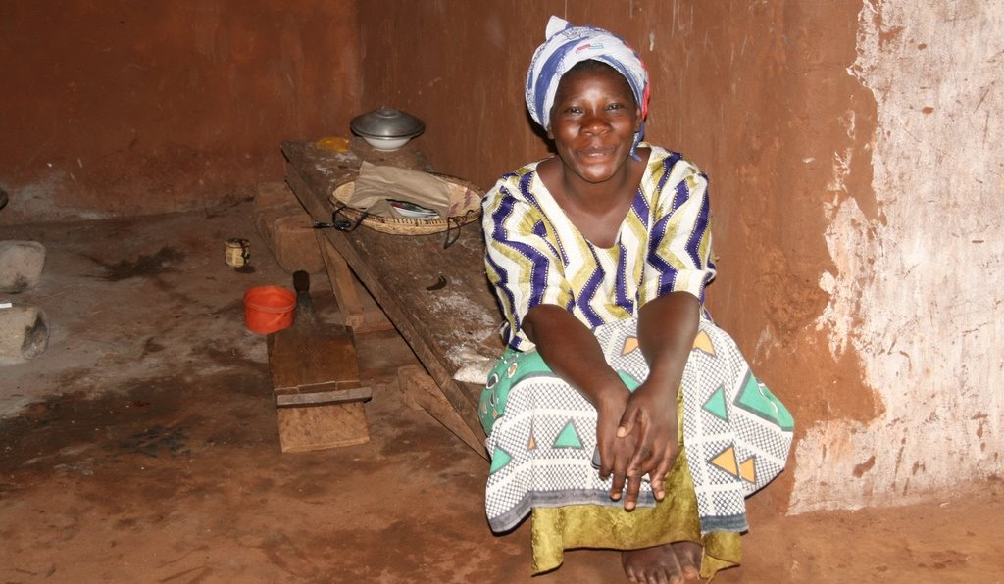
53%
Kenyan families sleep in a common room underscoring high levels of poverty. Up from 49%.
Overcrowding increases risk of spreading infectious diseases
Flooring Material
29.6%
Earth & Sand
17.7%
Dung
46%
Cement
3.5%
Ceramic Tiles
0.3%
Polished Wood
2%
Carpet

Slide 7
Payments by Volume
GSMA, CBK

Slide 8
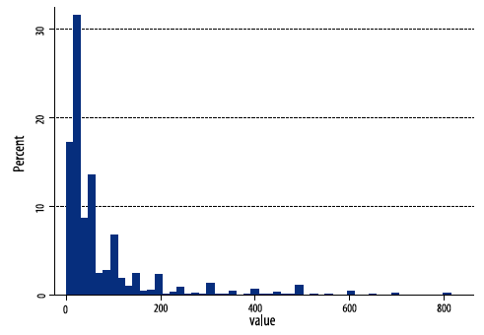
Transaction Value
85% of transactions below $5, 48% below $2
Financial Diaries, DFID/FSD

Slide 9
Transactions > $10
Transactions < $10

Slide 10
Four Pillars of Success
Payments Ecosystem
Success
Certainty
Critical Mass
Price
Reward

Slide 11
Thank You

