Slide 1
Broadcasting in times of Crisis
Security related crisis

Slide 2
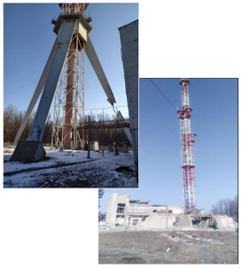
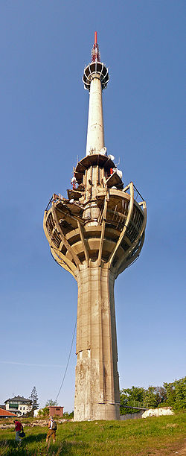
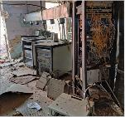
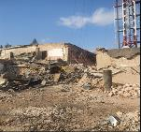
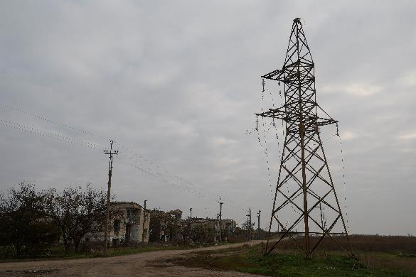
Man made disaster
Infrastructure damaged
Power systems damaged
Communications damaged
Iriški Venac Tower - Wikipedia
REUTERS/Valentyn Ogirenko/File Photo

Slide 3
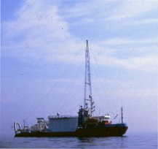
Radio Brod
720 kHz Medium Wave
97.8 MHz FM
1st June 1993 – 28th February 1994
Radio Brod History (offshoreradiomuseum.co.uk)
UNTV

Slide 4
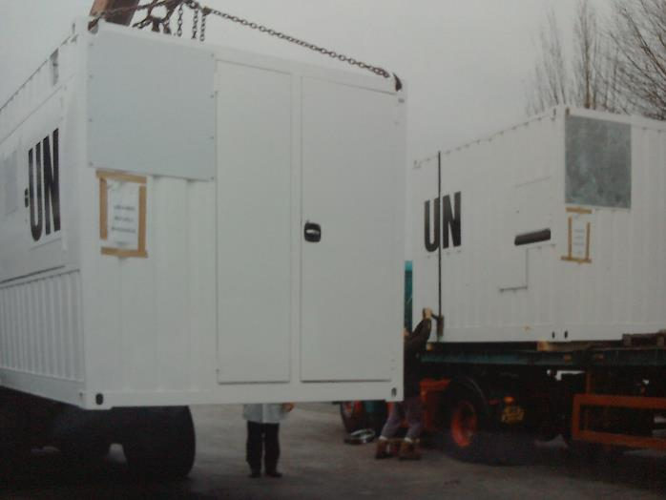
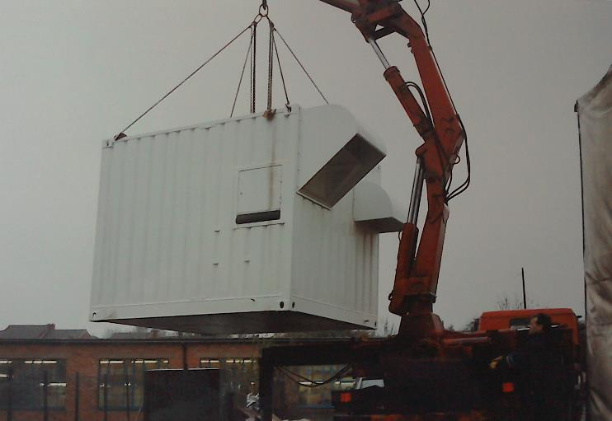
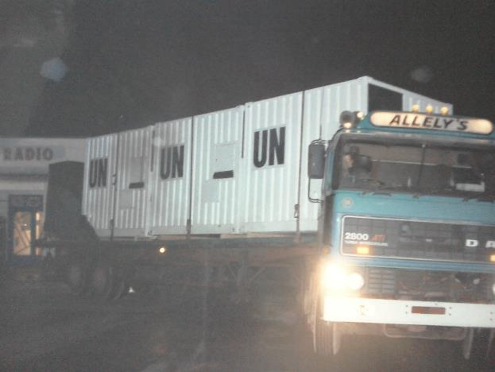
UN Radio Rwanda

Slide 5
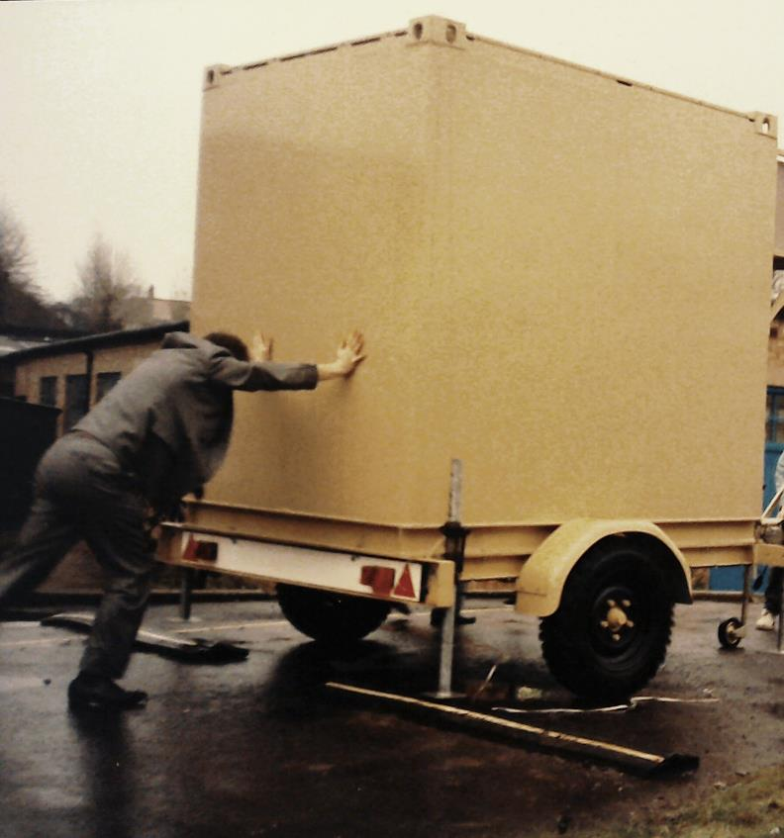
Gulf War
Afghanistan
Towed trailer solution

Slide 6
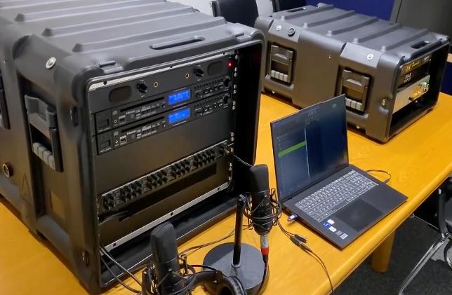
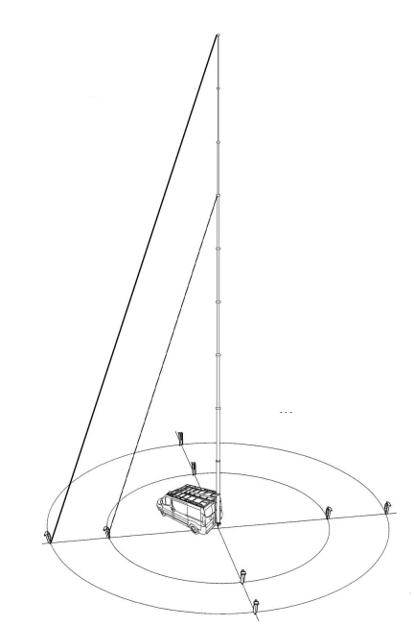
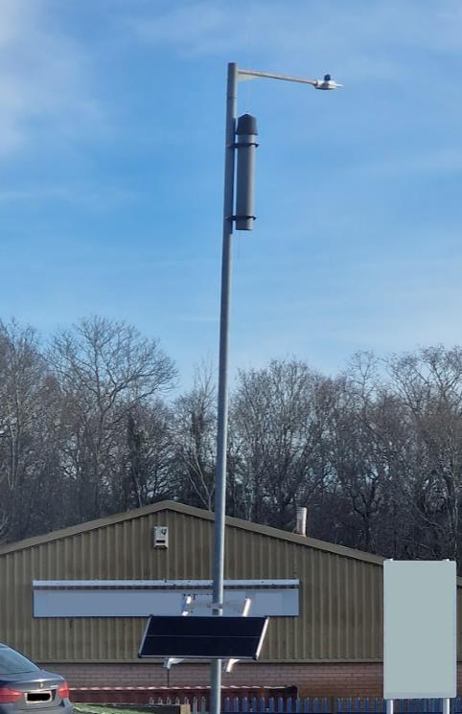
VHF/FM
Portable
Mobile
Independent

