Slide 1
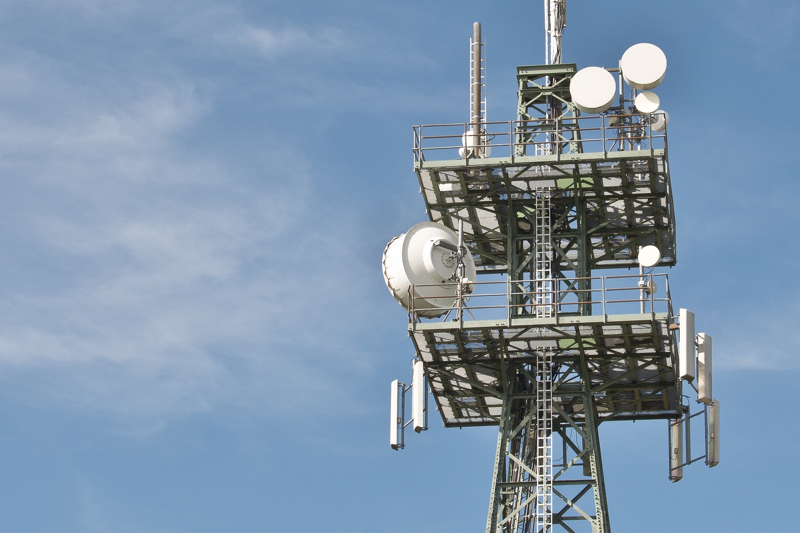
Evolution of
Fixed Services for wireless backhaul
of IMT 2020 / 5G
ITU-R Workshop
Geneva, 2019.04.29

Slide 2





Evolution of Fixed Services for wireless backhaul of IMT 2020 / 5G
Wireless Backhaul for IMT 2020 / 5G - Overview and introduction
by Renato Lombardi, Huawei
Wireless X-Haul Requirements
by Nader Zein, NEC
Microwave and millimeter-wave technology overview and evolution
  by Mario Frecassetti, Nokia
Operator’s view on frequency use related challenges for microwave and millimeter-wave in IMT 2020/ 5G backhaul/X-Haul
by Paolo Agabio, Vodafone
Panel discussion:
Economics on deployment and operational aspects of microwave and millimeter-wave technology in IMT 2020 / 5G mobile backhaul/X-Haul network

Slide 3
Evolution of Fixed Services for wireless backhaul of IMT 2020 / 5G
The presentations in this workshop are held by representatives of individual companies who present an agreed industry view on behalf of the following companies:
BT
Ceragon
Commscope
DT
Facebook
Ferfics
Filtronics
Huawei
IMEC
Infineon
MaxLinear
NEC
Nokia
NPL
Siae Microelettronica
Siklu
Vodafone

Slide 4
Evolution of Fixed Services for wireless backhaul of IMT 2020 / 5G
Wireless Backhaul for IMT 2020 / 5G - Overview and introduction
by Renato Lombardi, Huawei
Wireless X-Haul Requirements
by Nader Zein, NEC
Microwave and millimeter-wave technology overview and evolution
  by Mario Frecassetti, Nokia
Operator’s view on frequency use related challenges for microwave and millimeter-wave in IMT 2020/ 5G backhaul/X-Haul
by Paolo Agabio, Vodafone
Panel discussion:
Economics on deployment and operational aspects of microwave and millimeter-wave technology in IMT 2020 / 5G mobile backhaul/X-Haul network

Slide 5
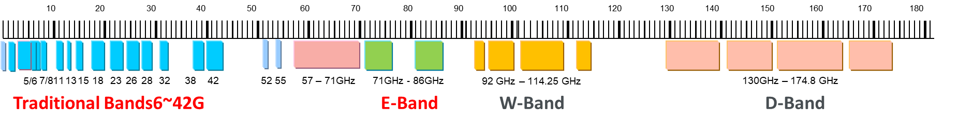
Role of wireless backhaul in Mobile Networks
Over 70% of macro sites connected with microwave backhaul, with significant regional differences
There will always be a huge percentage of areas where the fiber connection is not feasible or too expensive
Proper spectrum regulations and licensing permit a fast Time To Market of microwave backhaul and the deployment of high throughput 4G and 5G services
Remove current spectrum bottlenecks for an affordable deployment of wireless backhaul
>75%
>25%
<20%
>80%
>85%
>85%
>90%
4 Million links in operation worldwide

Slide 6
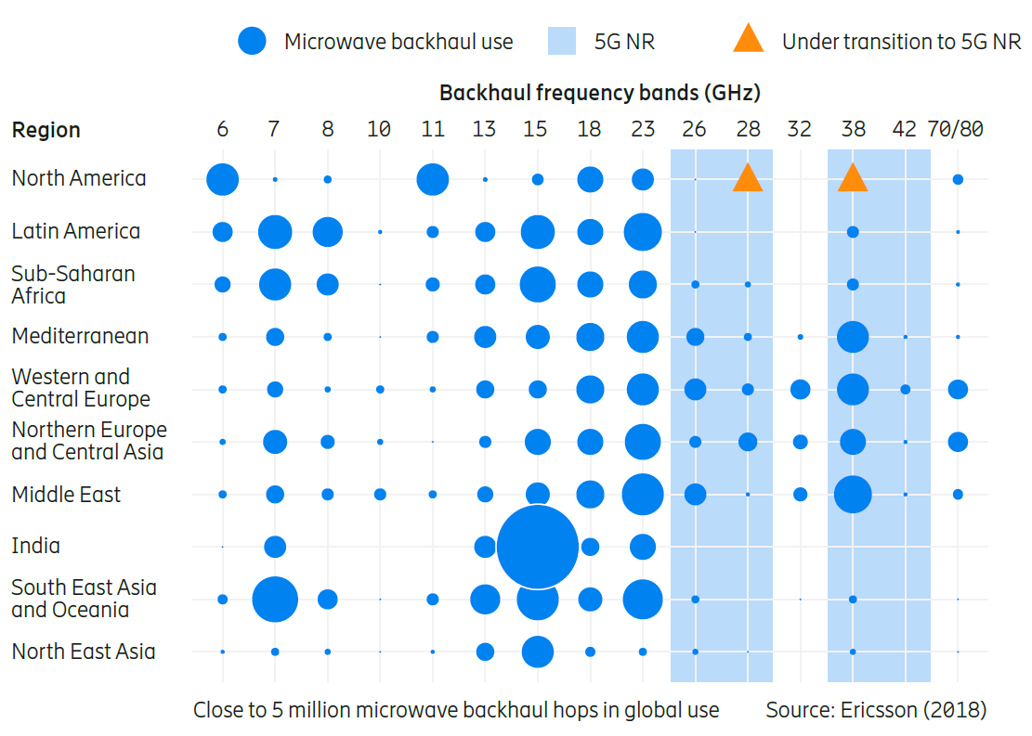
Spectrum for wireless backhaul in Mobile Networks
Most of the links in bands below 23 GHz
Significant regional differences deriving from rain intensity statistics
  Europe mostly on 26 and 38 GHz after 15, 18 and 23 severely crowded
  Far East and Latin America mostly on 7/8, 15, 18 and 23 GHz
E-Band growing fast
Huge potential in tropical countries (i.e. India,..) in still untapped bands above 23 GHz and E-band

Slide 7
Spectrum for wireless backhaul in Mobile Networks
Frequency Bands
71-76
76-81
81-86
86-92
92-94
94-94.1
94.1-95
95-100
100-102
102-109.5
109.5-11
111.8-114.25
130-134
134-141
141-148.5
151.5-164
167-174.8
E-band
mature technology and applications
W-band: CEPT ECC released Recommendation (18)02.
Propagation characteristics and technology availability make W-Band as a sort of extension to E-Band
D-band: CEPT ECC released Recommendation (18)01.
The availability of huge amounts of spectrum in the D-band and its favourable propagation characteristics, makes this a high priority band for the industry
W-band
D-band

Slide 8
Backhaul Network Topology Evolution
Radio site connected with fiber
Radio site connected with microwave
Network topology change
    Network densification
    RAN sharing and operators consolidation
    Fiber penetration from core to edge
New Radio site connected with microwave

Slide 9
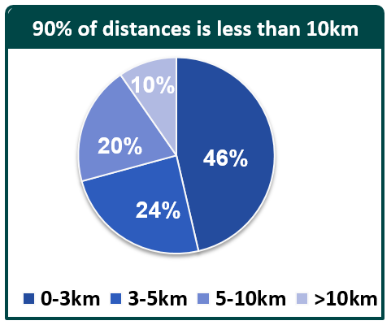
Backhaul Network Topology Evolution
Radio site connected with fiber
Radio site connected with microwave
Network topology change
    Network densification
    RAN sharing and operators consolidation
    Fiber penetration from core to edge
New Radio site connected with microwave
‘’Shorter networks’’ and shorter hops
    Shortening of microwave chains
    Star topologies from the fiber PoP
New network topology drives BH to the higher part of the spectrum

Slide 10
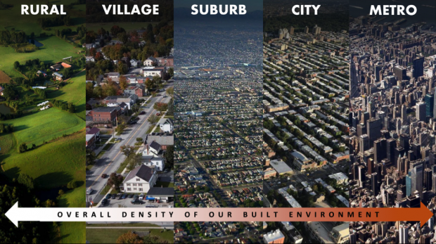
5G Access Sites Configurations and Network Segments
RURAL
SUB-URBAN
URBAN
DENSE URBAN
Transmission
Distance
>7 km
<7 km
<3 km
<1 km
Site distribution by segment
>40%
>25%
>30%
5%
Wireless Backhaul
  Fiber
Small Cells at street level for densification

Slide 11
Microwave Technology Map
Capacity
More Spectrum
Modern Regulation
5G MW
Multi-band
Multi-Carrier
CS 112, 224 MHz
E-band, D-band
Lower TCO
Efficiency
Algorithms
Components
Performant
High Modulations
Interf. Canceller
New MIMO
GaN
Efficient
Networking
Density
Agility
Innovation
10GE Connectivity
50 µs Latency
Network Slicing
SDN
Future-proof

Slide 12
Economics of Backhaul are Changing Rapidly
5G
During the past 10 years
MW capacity needs for Mobile Operators increased x 15 for delivering increased peak speeds
MW Spectrum in the 6 – 42 GHz is not always enough for delivering today LTE peaks; that’s why offload to E-Band spectrum is taking place
4G+
Dual Pol (XPIC)
LTE
E-Band
HSPA
IP MW (ACM)
Spectrum fees have grown into one of the major single items in an Operator’s TCO
Raw cost of spectrum per MHz is sometimes based on formulas born when 3.5 – 7 – 14 MHz were the channel sizes of choice

Slide 13
Backhaul spectrum licensing schemes and fees
License scheme | Application | Coordination (interference check) | Cases | MNO’s preference
Individual Licensing | link-by-link | by the Administration | Most used
Light Licensing | link-by-link | licensee responsibility | E-Band in some countries
Block Assignment | public auction, direct assignment | Guard Band and OOB | FWA (26, 28, 32 GHz)
License Exempt | free | no guarantee | V-Band
Euro/year | APAC 1 | APAC 2 | APAC 3 | Europe 1 | Europe 2 | Europe 3
28 MHz @15GHz | 1300 | 651 | 1720 | 231 | 156 | 763
56 MHz @38GHz | 2600 | 887 | 2880 | 203 | 247 | 558
250 MHz @80GHz | 2600 | 887 | 800 | 319 | 100 | 577
2nd Polarization | x2 | x2 | x2 | x2 | x1.5 | x2
Huge variations country by country
In most of the used formulas the license fees grow linearly with channel width but do not properly incentivize spectrum efficiency that is related to the channel re-usability from geographical perspectives
License fees cannot linearly scale with capacity and/or channel width

Slide 14
Evolution of the Backhaul Requires an Evolution of Rules too
During the past 10 years
MW capacity needs for Mobile Operators increased x 15 for delivering increased peak speeds
MW Spectrum in the 6 – 42 GHz is not always enough for delivering today LTE peaks; that’s why offload to E-Band spectrum is taking place
Looking to next 10 years
LTE / LTE-A and 5G backhaul needs can are supported by
  Using the ample available E-Band spectrum
  Making available wider channels in MW spectrum below 42 GHz
E-band spectrum fees shall take into account Mobile Operators needs (1-10 Gbps) in terms of peak speeds
Licensing schemes should incentivize spectrum efficiency from geographical perspective

Slide 15
Next
Importance of microwave and millimeter-wave backhaul in current and future mobile networks
Current microwave and millimeter-wave solutions capable of meeting early stage 5G deployment
Technology roadmap deploying features to match the most challenging requirements of mature 5G networks in terms of capacity, latency, densification,..
Spectrum regulations and licensing need to evolve promoting innovation and making backhaul/X-Haul economically sustainable

Slide 16
Evolution of Fixed Services for wireless backhaul of IMT 2020 / 5G
Wireless Backhaul for IMT 2020 / 5G - Overview and introduction
by Renato Lombardi, Huawei
Wireless X-Haul Requirements
by Nader Zein, NEC
Microwave and millimeter-wave technology overview and evolution
  by Mario Frecassetti, Nokia
Operator’s view on frequency use related challenges for microwave and millimeter-wave in IMT 2020/ 5G backhaul/X-Haul
by Paolo Agabio, Vodafone
Panel discussion:
Economics on deployment and operational aspects of microwave and millimeter-wave technology in IMT 2020 / 5G mobile backhaul/X-Haul network

Slide 17
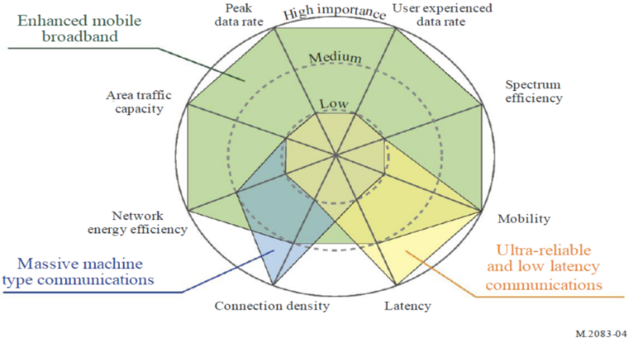
5G Requirements to wireless backhaul
New Challenges
5G Impact on Wireless-BH/XH
    Capacity
5G Use Cases
    Latency
    Link Density (W-BH/XH)
    Synchronization
    Increased Density
5G RAN
    Network Coordination
    Advanced Packet Networking
    Operational Simplification
OPS
    Services Setup Acceleration
    Automated Network Management
Source: ETSI mWT ISG

Slide 18
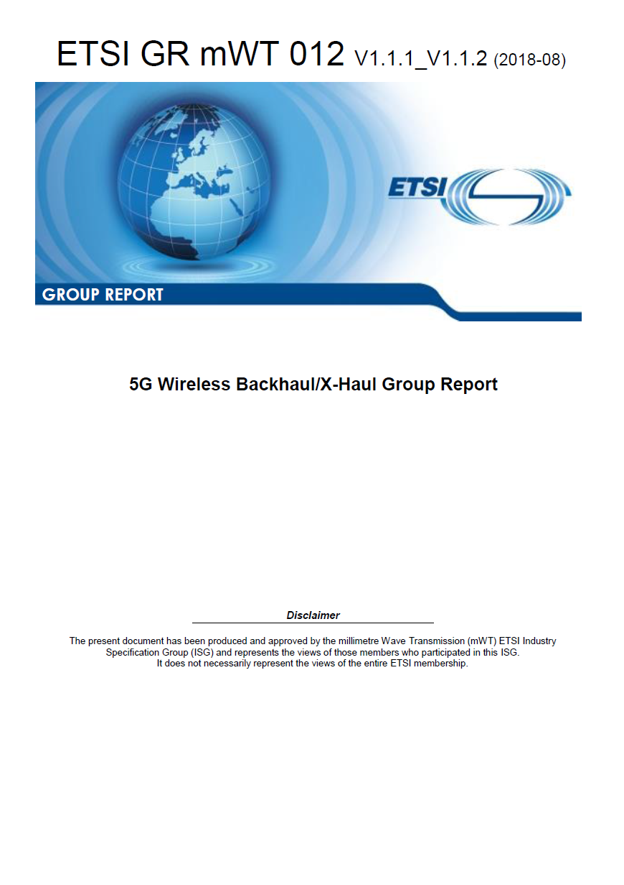
5G Access Sites Configurations
Based on 3GPP, TR 38.913, V14.3.0, 2017-06, “Study on scenarios and requirements for next generation access technologies” and ETSI ISG mWT view.
Area Type | Sites Configurations (indicative) | Cell Type
Dense Urban ('DU') | 5G 100 MHz 16L MIMO ~4 GHz 5G ≤ 800 MHz 4L MIMO ~30 GHz | Small-cell
Urban ('U') | LTE 50-100 MHz 5G 100 MHz 16L MIMO ~4 GHz 5G ≤ 800 MHz 4L MIMO ~30 GHz | Macro-cell
Sub-Urban ('SU') | LTE 50-100 MHz 5G 100 MHz 8L MIMO ~4 GHz | Macro-cell
Semi-Rural ('SR')
Rural ('R') | LTE 50-100 MHz 5G 50 MHz 4L MIMO ~2 GHz 5G 20 MHz 4L MIMO ~700 MHz | Macro-cell
Each macro-cell site consists of three (3) sectors, serving 5G and 4G services, whilst small-cells, namely, outdoor pico-cell sites, are assumed as single-sector 5G NR only

Slide 19
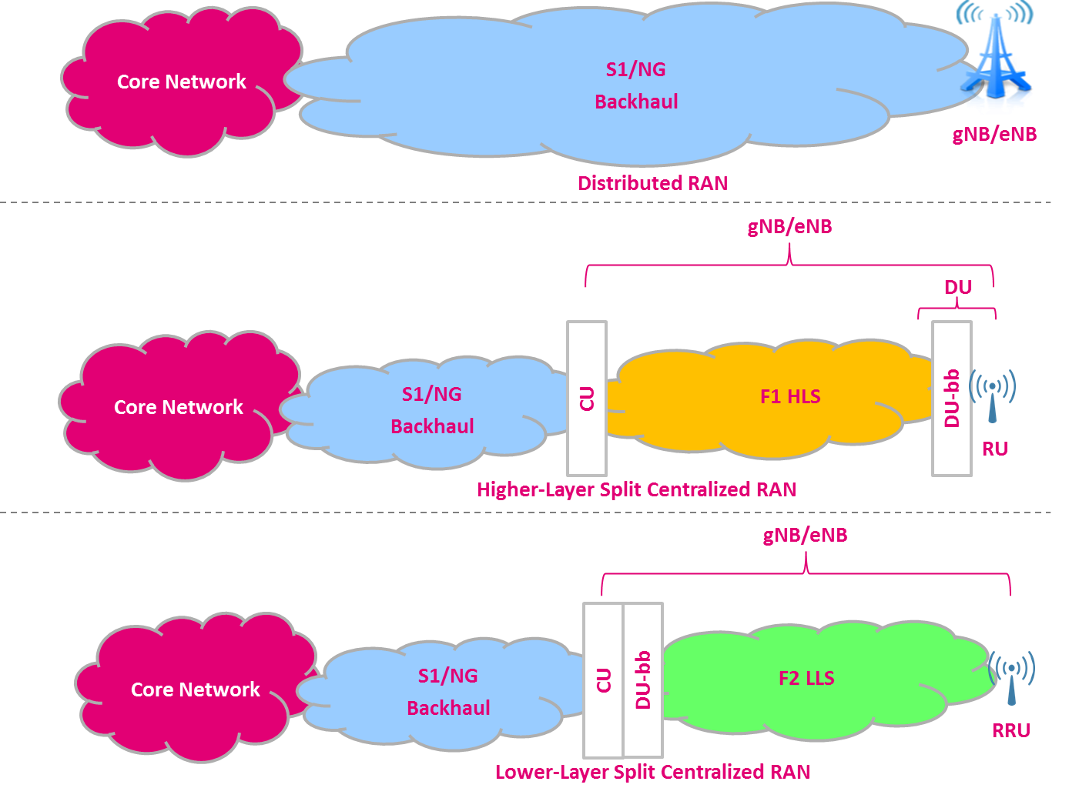

5G RAN Architecture Options and X-haul
In D-RAN architecture, gNB/eNB is/are located at the RF site and connected to core network (EPC, NGC) via S1/NG interfaces.
In the concept of Centralized RAN architecture, the decomposition of conventional RAN functions disaggregates gNB functions with two new entities, CU and DU.
CU to be placed in a (more) central location to enable optimal radio network coordination and to realize the benefits of virtualisation.
New X-Haul interfaces between CU and DU (i.e. F1 HLS) and between DU and CU (i.e. F2 LLS) are under discussion, whilst S1/NG interfaces are still employed for the connection between CU and core network.
Another possible deployment architecture, in which CU in the cloud, DU at the Edge and the RU at site.
CU in the cloud and DU/RU are co-located
CU and DU co-located in the cloud and RU at site.

Slide 20
Backhaul Network Topology Evolution
Backhaul Network Topology Evolution
Network topology change
    Network densification
    RAN sharing and operators consolidation
    Fiber penetration from core to edge
‘’Shorter networks’’ and shorter hops
    Shortening of microwave chains
    Star topologies from the fiber PoP
Radio site connected with fiber
Radio site connected with microwave
New Radio site connected with microwave

Slide 21
5G Access Sites Configurations and Network Segments
RURAL
SUB-URBAN
URBAN
DENSE URBAN
Transmission
Distance
>7 km
<7 km
<3 km
<1 km
Capacity
Initial phase
Mature phase
<1 Gbps
<2 Gbps
<5 Gbps
<2 Gbps
<5 Gbps
<10 Gbps
≥25 Gbps
Site distribution by segment
>40%
>25%
>30%
5%
Wireless Backhaul
  Fiber
Small Cells at street level for densification

Slide 22
5G Advanced Packet Networking
5G network requirements goes beyond capacity and latency enhancement, and encompass the provision and management of end-to-end traffic and services delivery via the access and through the transport networks.
Advanced packet networking could be accomplished by utilising the following Advanced Networking Functionality:
  Ultra-low and deterministic transmission latency (a few tens of us) and jitter
  Ultra-high precision time/phase packet-based synchronisation
  10GE and higher-speed ports
  SDN automation & advanced packet networking (L3VPN MPLS, RSVP-TE, Segment Routing, etc.)

Slide 23
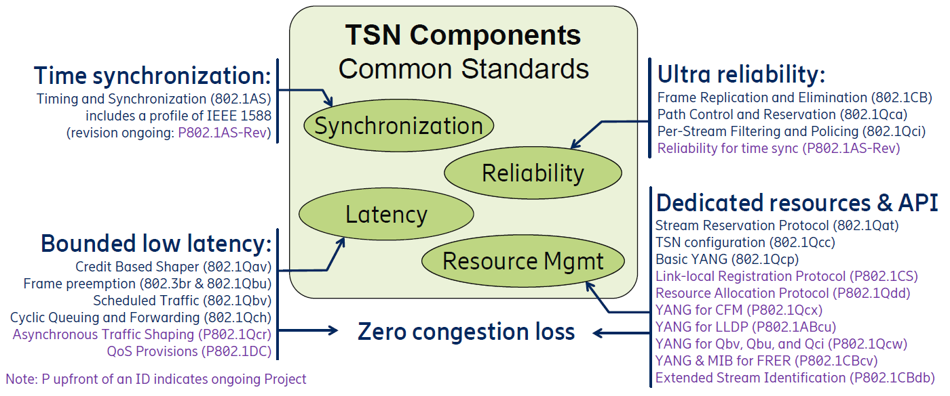
5G Advanced Packet Networking
Ultra-low and deterministic transmission latency (a few tens of us) and jitter can be achieved by utilising IEEE 802.1 TSN standards and tool box:
Relevant IEEE 802.1 Profiles (utilising TSN components from above):
IEEE Std802.1CM TSN for Fronthaul (for cellular networks)
P802.1DF TSN Profile for Service Provider Networks
Ultra-high precision time/phase packet-based synchronisation are accomplished based on the IEEE Std 1588TM and The relevant parts of the ITU-T G8262/G.8271/G.8272/G.8273/G.8275 Recommendations

Slide 24
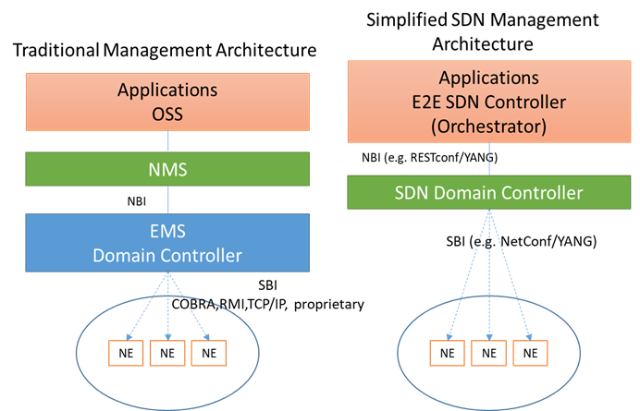
5G Network Management Automation Requirement
Mobile networks are evolving to a more complex topology mix and dense network elements deployment.
Transport SDN management based systems are becoming a necessity to meet the emerging requirements for support of variety of services, and efficient utilization of network resources while ensuring high level of reliability, robustness, fault predictability and preventions by dynamically configuring and reconfiguring network elements and managing end to end traffics delivery and routing.
Examples of applications and tools enabled by Transport SDN :
Connection and configuration of new microwave devices
Closed Loop automation
Synchronisation management of PTP-capable devices
Management of Ethernet-capable devices (setup and management of Ethernet services etc.)
Congestion management and avoidance by Path re-routing
Plus many more new emerging applications …

Slide 25
Conclusions
5G evolution will have significant impact on wireless backhaul/x-haul.
Various developments in the domains of technology, regulation and standardisation are in progress, including respective activities on the wireless backhaul/X-haul domain.
  microwave and millimetre wave transmission technologies satisfy 5G “Early Stage” requirements.
To satisfy 5G “Mature Stage” requirements, innovations on wireless backhaul/X-haul technologies will continue towards 5G, focusing on capacity, latency, spectral efficiency, higher transmission distances, synchronization and networking functionalities.
Wireless backhaul/X-Haul technologies will continue to be an essential solution pillar, since they will be able to address the most stringent future requirements of 5G access efficiently and timely.

Slide 26
Evolution of Fixed Services for wireless backhaul of IMT 2020 / 5G
Wireless Backhaul for IMT 2020 / 5G - Overview and introduction
by Renato Lombardi, Huawei
Wireless X-Haul Requirements
by Nader Zein, NEC
Microwave and millimeter-wave technology overview and evolution
  by Mario Frecassetti, Nokia
Operator’s view on frequency use related challenges for microwave and millimeter-wave in IMT 2020/ 5G backhaul/X-Haul
by Paolo Agabio, Vodafone
Panel discussion:
Economics on deployment and operational aspects of microwave and millimeter-wave technology in IMT 2020 / 5G mobile backhaul/X-Haul network

Slide 27
Microwave and millimeter-wave technology overview and evolution Introduction
To cope with future 5G transport network requirements, two main points should be considered including their impact on solution TCO :
  Availability of suitable “Spectrum” → New Bands are needed
    Specific spectrum for different use cases
    New mmW Bands to address forthcoming 5G use cases
  Capacity & Spectral efficiency (spectrum is a scarce resource)
    Channel size & Modulation schemes (bit/s/Hz)
    XPIC, BCA, LoS-MIMO, OAM
    Geographical spectral efficiency: Dense reuse of channels
Overview of current technology capabilities
    Capacity
    Latency
    SDN

Slide 28
Microwave and millimeter-wave technology overview and evolution Introduction
To cope with future 5G transport network requirements, two main points should be considered including their impact on solution TCO :
  Availability of suitable “Spectrum” → New Bands are needed
    Specific spectrum for different use cases
    New mmW Bands to address forthcoming 5G use cases
  Capacity & Spectral efficiency (spectrum is a scarce resource)
    Channel size & Modulation schemes (bit/s/Hz)
    XPIC, BCA, LoS-MIMO, OAM
    Geographical spectral efficiency: Dense reuse of channels
Overview of current technology capabilities
    Capacity
    Latency
    SDN

Slide 29
New mmW Bands to address forthcoming 5G use cases
Available
Spectrum / Channels
Link
Capacity
GHz
Latency
Hop length
New
mmW
Bands
D-Band
170
30GHz – Up to 2GHz
Up to 100
Gbps
<10us
<1 km
W-Band
115
Millimeter
Waves
92
E-Band
80
10GHz - Up to 2GHz
Up to 20
Gbps
10us
< 7 Km
V-Band
60
38
Microwave
Bands
32
25
1-5
Gbps
50us
7-150Km
23
1GHz - Up to 224MHz
18
15
13
11
10
7/8
6
5
3

Slide 30
5G Access Sites Configurations and Network Segments
RURAL
SUB-URBAN
URBAN
DENSE URBAN
Transmission
Distance
>7 km
<7 km
<3 km
<1 km
Capacity
Initial phase
Mature phase
<1 Gbps
<2 Gbps
<5 Gbps
<2 Gbps
<5 Gbps
<10 Gbps
≥25 Gbps
Site distribution by segment
>40%
>25%
>30%
5%
Wireless Backhaul
  Fiber
Wireless BH distribution
>90%
>70%
>30%
0%
Backhaul
IAB
MW + BCA (low+mid bands)
6 to 23 GHz
18 to 42 GHz
BCA (E-Band + Traditional MW)
15/18 GHz + 80 GHz
18/23 GHz + 80 GHz
E-Band
W/D-Band
V/D-Band
(mesh)
Longer hops and high rain region require lower bands
Small Cells at street level for densification

Slide 31
Microwave and millimeter-wave technology overview and evolution Introduction
To cope with future 5G transport network requirements, two main points should be considered including their impact on solution TCO :
  Availability of suitable “Spectrum” → New Bands are needed
    Specific spectrum for different use cases
    New mmW Bands to address forthcoming 5G use cases
  Capacity & Spectral efficiency (spectrum is a scarce resource)
    Channel size & Modulation schemes (bit/s/Hz)
    XPIC, BCA, LoS-MIMO, OAM
    Geographical spectral efficiency: Dense reuse of channels
Overview of current technology capabilities
    Capacity
    Latency
    SDN

Slide 32
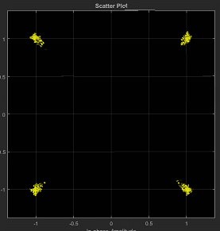
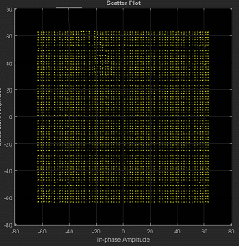
Capacity & Spectral efficiency
Larger channels → not anymore a technology limit
  In MW bands recent regulatory limit shifted up to CS=224MHz, but not everywhere. Up to CS=2000MHz in EBand and above 100GHz
  TCO: N*CS means N*capacity within one RTX. But licence fees increase usually *N
  Where larger CS are needed: Carrier Aggregation, in same band or adjacent band
1
28 MHz
2
56 MHz
4
112 MHz
8
224 MHz
9
250 MHz
36
1000 MHz
72
2000 MHz
Higher Modulation schemes → Reached the reasonable top
    4096QAM (and more) → Channel spectral efficiency reached substantially the top
    After 1024QAM spectral efficiency gain is less than 10% ever step
    Adaptive Modulation introduced everywhere
    Penalty on System Gain to be considered
    TCO: High modulations RTX at the same cost
QPSK (2b/s/Hz)
4096QAM (12b/s/Hz)

Slide 33
Capacity & Spectral efficiency
Frequency Reuse (XPIC) → well known technique doubling the spectral efficiency
    Well known approach
    Spectral efficiency *2
    TCO: Need two RTXs and one antenna per site. TCO’s advantage is reached only if license fees are reduced for second polarization
V CH2
V CH2’
H CH2
H CH2’
XPIC – Cross Polar Canceller

Slide 34
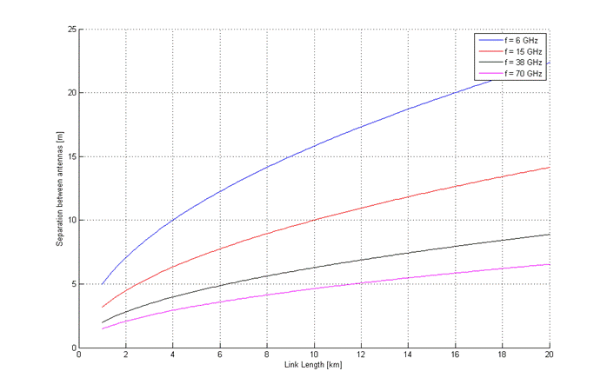
Capacity & Spectral efficiency
LoS-MIMO → Line of Sight Multi-Input Multi-Output
    Exploiting link geometry deployment two different signals in the same channel can be transmitted. 4x4 LoS-MIMO is obtained with LoS-MIMO 2x2 plus XPIC
    LoS MIMO needs optimal antennas separation.
      Under optimal conditions, spectral efficiency close to x4 improvement, lower performance in case of suboptimal conditions
    Not yet massively deployed
    TCO: RTX cost per bit is the same (4 RTX). Spectrum fees approach will play a role in LoS-MIMO future success
D=Optimal separation
FDD – LoS-MIMO 4X4
Optimal antennas separation

Slide 35

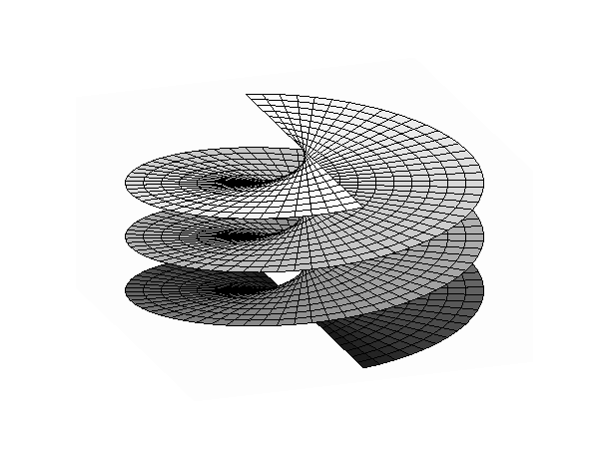
Capacity & Spectral efficiency
OAM → Orbital Angular Momentum
  Using different antennas, multiple OAM signals with different spiral phase front (mode) can be transmitted. OAM modes are orthogonal of each other
  OAM promises then to be able to transmit N different signals in a single channel and single polarization
  Today, experimental results with 16 streams. No commercial product on the market
  TCO: Spectrum fees approach will play a role in its future success
y
Equi-Phase Plane
x
z
λ
$$E_{x}\left(z, t\right)$$
Equi-Phase Plane of Plane wave
S1
OAM
MUX
(DSP)
Tx1
Rx1
OAM
DEMUX
(DSP)
S1
Mode+1
Mode+2
Equi-Phase Plane of OAM Signal
Sn
Tx8
Rx8
Sn
n≦8

Slide 36
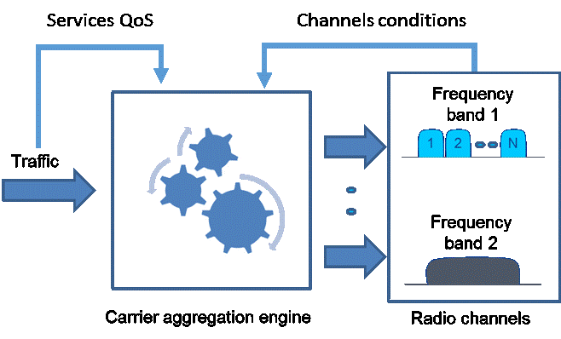
Capacity & Spectral efficiency
Bands & Carriers Aggregation (BCA)
  BCA joins different channels that may be even in different bands, providing a single big capacity pipe. Lower band will provide capacity pipe’s segment with high availability, while higher band the best effort capacity pipe segment. Packets may be adaptively re-routed among different channels according to their priority and channels condition
  One of the most valuable approach is 15/18/23 GHz with E-Band where dual band antennas are available:
    Links up to 7-10Km are feasible. Capacity may even exceed 10Gbps
    High spectral efficiency obtained because E-Band can reach longer links than in traditional approach.
  BCA among two MW bands is another variant when distance becomes more challenging i.e.: rural application
BCA - Bands and Carriers Aggregation
V
Lower Band
XPIC
H
E-Band

Slide 37
Capacity & Spectral efficiency
Geographical spectral efficiency: Dense reuse of channels
  To better exploit the scarce resource (spectrum) it is advisable to increase not only the single channel spectral efficiency but also the channel reusability in a given area, guaranteeing the “interference free operation”
  Nodal configuration is the key point to understand the concept
    Better antenna class are introduced (e.g. ETSI Class 4), reducing a lot the minimum angle between two links using the same/adjacent channels (angle discrimination)
    Cross polar (XPIC) can here help in reducing angle discrimination
    Co-Channel Interference Canceller (CCIC) further improve the re-use of channels with very narrow angle discrimination
    TCO: Investments and efforts to be spectral efficient should be rewarded through adequate policy fees (discount/license per node/area)

Slide 38


Capacity & Spectral efficiency
Geographical spectral efficiency: Dense reuse of channels
f1
f1
f1
f1
f2
f2
f3
f2
f1
f1
f1
f1
f2
f2
f3
f2
Today to avoid interference:
Ch1 reused but with different polarization
Ch3 must be used because too close to Ch1
Class 4 antenna enable:
Ch1s can be used with same polarization
Ch2 can be used instead of Ch3
Increase nodal capacity is now easy at no additional spectrum (*) with XPIC
(*) In this region no other operator can use the H spectrum, so no additional spectrum is consumed

Slide 39
Capacity & Spectral efficiency
Geographical spectral efficiency: Dense reuse of channels
f1
When additional capacity is needed and then additional channels shall be used, CCIC permit an optimal re-use of channels with very narrow angle discrimination
f1
f2
f2
f1
f1
f3
f1
f1
f3
f2
f4
f2
f2
f4
f2
f1
f3
f1
f3
f2
f4
f2
f4
License fees made to incentivize “geographical spectral efficiency” thanks to higher channel re-usability (more directive or smart antennas, interference cancellation)

Slide 40
Microwave and millimeter-wave technology overview and evolution Introduction
To cope with future 5G transport network requirements, two main points should be considered including their impact on solution TCO :
  Availability of suitable “Spectrum” → New Bands are needed
    Specific spectrum for different use cases
    New mmW Bands to address forthcoming 5G use cases
  Capacity & Spectral efficiency (spectrum is a scarce resource)
    Channel size & Modulation schemes (bit/s/Hz)
    XPIC, BCA, LoS-MIMO, OAM
    Geographical spectral efficiency: Dense reuse of channels
Overview of current technology capabilities
    Capacity
    Latency
    SDN

Slide 41
Overview of current technology capabilities
  Possible “basic” solutions to address the different scenarios
  Capacity and latency already capable to address 5G Phase 1
Backhaul Technology | Configuration (indicative) | Backhaul Capacity (typical) | Backhaul Latency One-Way (typical) | 5G “Phase 1” | Cell Type | Area
6-15GHz | 4+0 56MHz or 2+0 XPIC 56MHz | 2 Gbps | <250us | <2 Gbps | Macro-cell | Rural
18-42GHz | BCA MW 56MHz + E-band 500MHz | 3.7 Gbps | <250us | <3 Gbps | Macro-cell | Sub-Urban/ Semi-Rural
V-band (PtP 60GHz) | 200MHz | 1 Gbps | <500us | <5 Gbps | Small-cell | Dense Urban/ Urban
E-band (70/80GHz) | 500MHz-2GHz | 3-10 Gbps | <50-100us |  | Macro-cell

Slide 42
Overview of future technology capabilities - Capacity
  Evolution to enhance performance combining latest capabilities
  Microwave (MW) and mmWave evolution represented
MW Backhaul Technology | 56 MHz BW | 112 MHz BW | 224 MHz BW | +XPIC | + LoS 2x2 MIMO | + BCA (with higher MW Band) | + BCA (with mmW Band)
6-15GHz | 0.5 Gbps | 1 Gbps |  | 2 Gbps |  | 3-4 Gbps
18-42GHz | 0.5 Gbps | 1 Gbps | 2 Gbps | 2-4 Gbps | 4-8 Gbps |  | 4-10 Gbps
mmW Backhaul Technology | 500 MHz BW | 2 GHz BW | 4 GHz BW | +XPIC | +LOS 2x2 MIMO/OAM
V-band (60GHz) |  | >4 Gbps
E-band (70/80GHz) | 3.2 Gbps | 12.8 Gbps |  | 25.6 Gbps | 51.2 Gbps
W-band (100GHz) | 3.2 Gbps | 12.8 Gbps | 25.6 Gbps | 51.2 Gbps | 102.4 Gbps
D-band (150GHz) | 3.2 Gbps | 12.8 Gbps | 25.6 Gbps | 51.2 Gbps | 102.4 Gbps

Slide 43
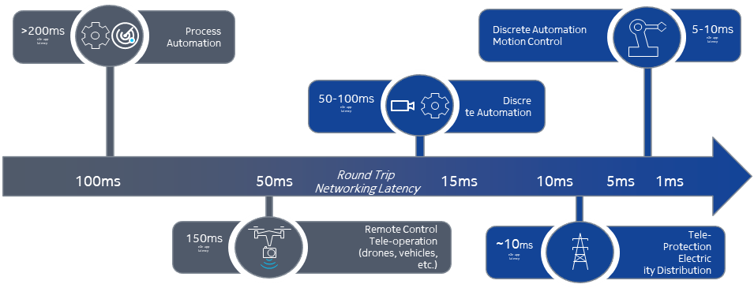
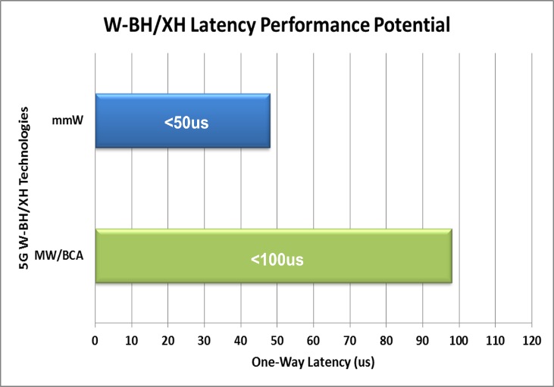
Overview of future technology capabilities - Latency
  Target end to end latency:
    eMBB use cases (max ~10ms RTT)
    URLLC use cases (max ~1ms RTT)
  MW latency can go down to 100us per hop, mmW is able to reach down to 10us (but always less than 50us)
  Fundamental for network slicing evolution

Slide 44
SDN use cases for mobile backhaul
SDN Evolution
Manage
Automate
Optimize
Network slicing
Network and service discovery
Smart fault management
Analytics
FCAPS
Service automation (L2 and L3)
Automated SW upgrade
Service migration
Zero-touch commissioning/audit
Self-healing
Efficient power consumption
Traffic re-routing
Interference handling
Enable demanding 5G services
Dynamic path selection
SLA monitoring

Slide 45
Conclusions
  Specific spectrum for different use cases and new mmW Bands to address 5G use cases are needed
  Pursuing solutions for increasing the spectral efficiency of single Channel and Geographical Spectral efficiency are a must that should be rewarded
  We believe that only a coordinated approach involving all stakeholders will enable this view
  Manufacturers → to invest in innovation
  Operators → to adopt more spectral efficient approaches
  Regulators → to reward spectral efficient approaches, enabling innovation as well
Notes:
Conclusions:

Slide 46
Evolution of Fixed Services for wireless backhaul of IMT 2020 / 5G
Wireless Backhaul for IMT 2020 / 5G - Overview and introduction
by Renato Lombardi, Huawei
Wireless X-Haul Requirements
by Nader Zein, NEC
Microwave and millimeter-wave technology overview and evolution
  by Mario Frecassetti, Nokia
Operator’s view on frequency use related challenges for microwave and millimeter-wave in IMT 2020/ 5G backhaul/X-Haul
by Paolo Agabio, Vodafone
Panel discussion:
Economics on deployment and operational aspects of microwave and millimeter-wave technology in IMT 2020 / 5G mobile backhaul/X-Haul network

Slide 47
Backhaul spectrum licensing schemes as of today
License scheme | Application | Coordination | Cases
Individual Licensing (IL) | Link-by-link | By the Administration | Most used
Light Licensing (LL) | Link-by-link | Licensee responsibility | Limited (E-Band in UK)
Block Assignment (BA) | Public auction & Direct assignment | Guard Bands | FWA (26, 28 GHz)
License Exempt (LE) | Free | No guarantee | Very limited (V-Band)
Inefficient spectrum usage
Administrations (NRA) and Operators (MNO) share same goals to minimize
  Coordination burden = Costs & Time To Market
  Interference risk
  Inefficient spectrum usage
Unfortunately none of existing licensing schemes can minimize all the above
  License Exempt is not an option for Backhaul, especially moving towards 5G that shall support also mission critical applications
Licensing Scheme Goals
BA
LE
LL
IL
Coordination
burden
Interference risk

Slide 48
Backhaul spectrum licensing schemes: a new hybrid approach
License scheme | “Hybrid scheme” (HS)
Application | Block reservation for the MNO and link-by-link declaration by the MNO; NRA is aware of actual spectrum utilization (for assessing an efficient spectrum usage)
Coordination | MNO managing self-coordination within the Block; coordination among MNOs using adjacent blocks ensured by filter + antenna discrimination and guard bands (if needed)
Cases | Used (e.g. Romania, Turkey)
Inefficient spectrum usage
Licensing Scheme Goals
By leveraging and mixing the best of Individual Licensing and Block Assignment
“Hybrid Scheme” has the potential to achieve all three goals
  By managing the efficient spectrum usage by proper license fees rules
  with a low up-front fee for block reservation
  and additional fee per link that incentivize Operators to stay within the block as much as possible
BA
LE
LL
HS
IL
Coordination
burden
Interference risk

Slide 49
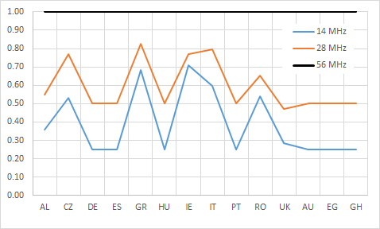
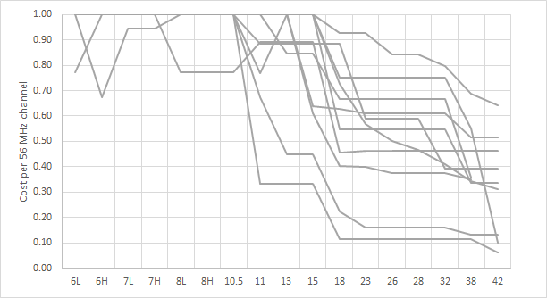
Backhaul spectrum licensing fees as of today: Individual licensing
15-23 GHz Band: channel width cost
In most of Countries license fees decreases linearly when moving to higher bands
56 MHz channel cost vs Band
In most of Countries license fees decreases linearly when moving to higher bands
This is not sustainable in the long term for 4G and 5G backhaul

Slide 50
Backhaul spectrum licensing fees: sustainability in the long term
License scheme | License fees – MNO considerations
Individual Licensing (IL) | Not sustainable with current approach
Light Licensing (LL) | OK
Block Assignment (BA) | Too high investments up-front
License Exempt (LE) | Not applicable
Hybrid Scheme (HS) | Opportunity for best trade-off
Individual Licensing and Block Assignment (as is today) are not affordable anymore
Light Licensing is OK from fee perspective but it does not guarantee an efficient spectrum use
License Exempt is not considered because of unaffordable interference risks
Hybrid Scheme is most interesting license regime to be considered, allowing to trade-off among up-front investments, efficient spectrum usage and overall spectrum cost for MNO
Huge spectrum cost variations Country by Country result in difficulties for Global MNO to develop a single strategy

Slide 51




New technologies, new bands and higher spectrum demand for 5G X-haul deserve new license fees approach
License F$ees=k×BCA×{\left(\frac{1}{fc}\right)}^{2}×\frac{BW}{Bsize}×\left(\frac{1}{N}\right)$
Including also incentives for geographical spectrum efficiency (MIMO, XPIC, CCIC, etc.)
`
 | Impact | How to consider it for License fee? | Formula factor
1. Larger spectrum availability | Cost per MHz in the shall be smaller when increasing the frequency | License fee proportional to the ratio between Channel bandwidth (BW) and overall Band size (Bsize)
2. Higher frequency re-use | More links per square km. The same spectrum can be licensed several times over the same area | Coordination area reduction goes with the square of carrier Frequency (fc). License fee proportional to inverse of coordination area.
3. Lower availability at top capacity (higher frequency) | When E-Band is used on links (Band & Carrier Aggregation, BCA) longer than dmax, license fee incentives should be considered | Administration to set dmax for E-Band stand-alone link BCA discount factor in case E-Band link distance (d) exceeding dmax
4. Channel re-use with smaller angles in nodal configurations | More links density in the same geographical area | Factor inversely proportional to number (N) of links / carriers in the same site / node / area re-using same channel | 1/N
$$\frac{BW}{Bsize}$$
$${\left(\frac{1}{fc}\right)}^{2}$$
$$BCA=\frac{dmax}{d}$$
Source “ISG mWT view on V-Band and E-Band Regulations”, mWT-0014v2.0.0, Dec 2017

Slide 52
Examples on how to incentivize “geographical spectrum efficiency”
  Below approach can be adopted today in any Band with individual licensing
N= 2
f1
f1
f1
MIMO
N= 2
f1
f1
f1’
XPIC
f1
N= 4
f1
f1’
XPIC + CCIC
Small angle
f1
f1’

Slide 53
Key Aspects for Identifying the Best Licensing
There is not one single best licensing approach for any Band in any Country
Build a benchmark of what spectrum usage and costs are for some significant Operators across different Bands
Assess usage of the Band today
  Greenfield: new Band (very limited deployments)
  Brownfield: huge installed basis from several Operators
Assess total amount of available spectrum compared with:
  Max channel size (as per spectrum regulations & technology)
  Number of Operators that might require block allocation

Slide 54
Possible ways forward towards Best Licensing
Option #1
Option #2
Band usage: Brownfield
Amount of Spectrum: Limited
Go with Individual Licensing
Improving license fee rules to incentivize “geographical spectrum efficiency”
Eventually moving to Hybrid Scheme in the long term in case of no spectrum limitations
Band usage: Greenfield
Amount of Spectrum: Large
Go with a new Hybrid Scheme
  With a low upfront fee for block exclusivity
  With additional fee per link (new formula and geographic spectrum efficiency) to ensure efficient spectrum usage
More innovative spectrum usage in some selected bands to better match downlink/uplink traffic asymmetry
OR
AND

Slide 55
Option #1 - Recommended Regulations for the E-band
In line with “Coordinated” spectrum approach
defined by ECC and FCC regulations worldwide
already implemented by majority of National Regulations
Source “ISG mWT view on V-Band and E-Band Regulations”, mWT-0014v2.0.0, Dec 2017
Rationale for Individual Licensing is limited spectrum (4.75GHz) vs max channel size (2 GHz)
  Light Licensing is a good alternative allowing lower spectrum fees & shorter time for spectrum acquisition
License fees approach to pursuit in the E-Band:
  Proper base line price according to formula presented before (to achieve a similar approach across Countries)
  Introduction of “geographical spectrum efficiency” (coefficient N) for 4G/5G dense urban deployments
  Introduction of “Band and Carrier Aggregation” (BCA factor) to incentivize E-Band in 4G/5G rural deployments

Slide 56
Option #2 - Efficient Use of Spectrum in high MW Bands and mmW
  Larger channel size in High MW Bands (23-42 GHz)
  Release 112 and 224 MHz channels
  Evaluating adoption of Hybrid Scheme in greenfield bands such as 32 GHz (in several Countries) and bands above 23 GHz in Far East Countries
  Open new mmW bands above 90 GHz
  Large spectrum availability: 15 GHz in W-Band and 30GHz in D-Band
  Already released to Fixed Service (primary use) – see ECC Rec(18)01 and Rec(18)02
  Hybrid Scheme should be first option to evaluate given the fact these bands are greenfield, spectrum availability is huge and spectrum regulations allow for PP/PMP and FDD/TDD usage

Slide 57
Conclusions
Today backhaul spectrum licensing schemes and fees are not suitable to address 5G X-haul deployments because license fees grow linearly with channel width and time to market is becoming a limiting factor
Spectrum regulations and licensing need to evolve promoting innovation and making 5G backhaul/X-Haul economically sustainable
Incentive for “geographical spectrum efficiency” shall be used for Bands with large installed basis or limited spectrum
New / Greenfield Bands (e.g. 32 GHz, W/D Bands) deserve considering a new approach such as Hybrid Scheme to address 5G economics as well as enabling more innovative X-haul technologies

Slide 58
Evolution of Fixed Services for wireless backhaul of IMT 2020 / 5G
Wireless Backhaul for IMT 2020 / 5G - Overview and introduction
by Renato Lombardi, Huawei
Wireless X-Haul Requirements
by Nader Zein, NEC
Microwave and millimeter-wave technology overview and evolution
  by Mario Frecassetti, Nokia
Operator’s view on frequency use related challenges for microwave and millimeter-wave in IMT 2020/ 5G backhaul/X-Haul
by Paolo Agabio, Vodafone
Panel discussion:
Economics on deployment and operational aspects of microwave and millimeter-wave technology in IMT 2020 / 5G mobile backhaul/X-Haul network

Slide 59
Thank You
Reports and White Paper on microwave and millimeter-wave backhaul from most of the content of the presentations has been taken can be found at ETSI ISG mWT portal
https://portal.etsi.org//tb.aspx?tbid=833&SubTB=833

