Slide 1
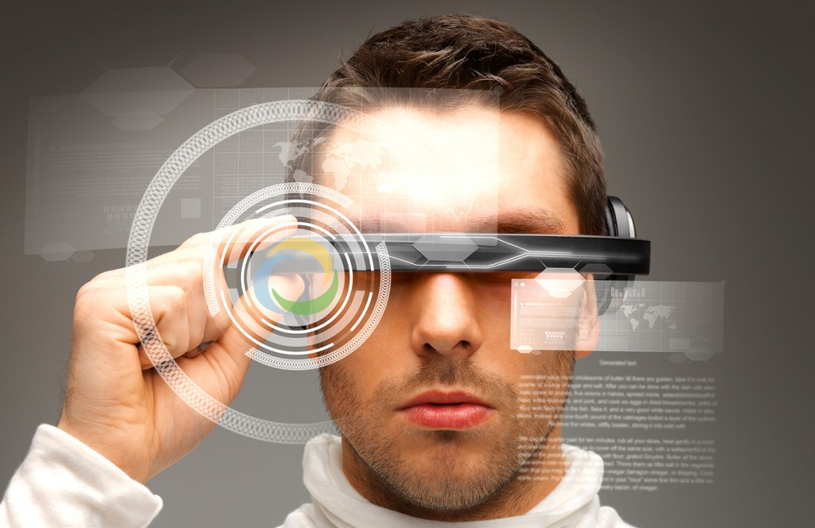
VR Interest Group >>> VR Industry Forum
17th October 2017
ITU : Geneva
David Price

Slide 2
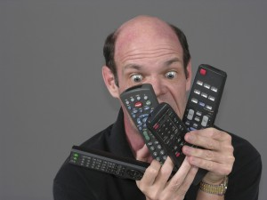
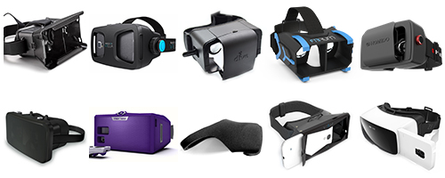
VR Interest Group
Members of the Interest Group share:
A common background in the TV and Media space
A desire to avoid market fragmentation through cross industry collaboration
A desire to accelerate the widespread consumption of immersive VR content
A desire to foster and advocate standards based solutions liaising with SDOs : MPEG, SMPTE, 3GPP, DVB
A desire to include future big VR platforms : Facebook, Google, ….
A desire to liaise with already established VR Forums : VR Society, ITA3D
What we ALL want to avoid
…going from this….
…to this….
For iPhone there are already
28 VR headsets
13 Cardboard headsets

Slide 3
What we ALL want to avoid
…going from this….
…to this….
For iPhone there are already
28 VR headsets
13 Cardboard headsets

Slide 4
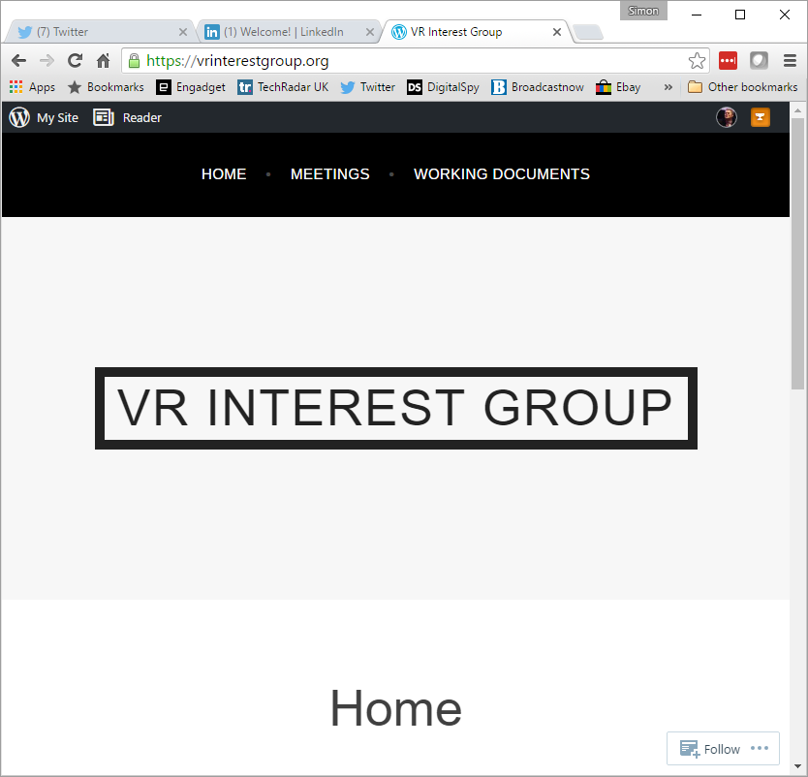
VR Interest Group - Status
Email reflector (VR360@dtg.org.uk) over 176 individuals from 74 organisations
Website with meeting information, previous minutes and working documents (https://vrinterestgroup.org)
Scope document in Google Docs
Meetings at CES, NAB and IBC
Bi-weekly conference calls

Slide 5
VR Industry Forum
A derivative from the VR Interest Group
27 Founding Organizations have agreed to move forward to establish an Industry Forum (studios, operators, technology vendors, academia…)
Inaugural Founders Conference Call this week
VR Industry Forum Bylaws and IPR Policy have been drafted
Preliminary plan is to launch at CES 2017
VR Interest Group may continue as a reflector but as:
a review body for WG output
A distribution for studies and white papers

Slide 6
Why move from VRIG to VRIF
We all believe that VR will thrive, but that we can accelerate the adoption by removing hurdles.
Our goal is to bootstrap an industry that will allow all of us, and consumers, to benefit.
Having a formal organization will provide a context to make this happen more efficiently

Slide 7
A Formal Organization
Provides a structure to conduct technical and communication activities
Makes it easier companies and other organizations to participate and allocate resources
Provides a context for dealing with IP
Provides context that respects competition law
Allows us to fund relevant activities
Host meetings, interop activities, professional communication and advocacy, liaisons, with a professional infrastructure to support the work
Allows us to command industry-wide recognition and credibility

Slide 8
VR work areas
Work Packages |  | Guidelines on…. | Potential SDO related | Note
0 | General | Overall structure of guidelines including scope and intent | Initial work in establishing the Lexicon
1 | Story Telling | How to write VR content Directing the viewer Freedom of viewing choice Standards based structure to story branching | DPP have done some work in this area | Need buy in from studios to include this section. Allowing viewer selectable scene position has a dramatic effect on content production, capture and encode. Could be part of VR Society
2 | Production | how to produce content: camera, 2D/3D , file formats, frame rates, interfaces, storage, archive | SMPTE Virtual Reality Society (part of AIS)
3 | Merged Graphics | Video and graphics merging using various techniques like overlay, 3D mapping,….. |  | VR experiences will include interactive elements rendered in real time and there is a need to harmonize dealing with those across platforms. Need to have a broader scope than pure video with standard graphics
4 | Content Mapping | Stitching and geometry mapping eye/iris tracking | Could be part of MPEG (OMAF, Video), JVET, and/or 3GPP, IETF | Fove, Eye Tribe, SensoMotoric, Tobii and others all working on proprietary iris tracking solutions
5 | Compression | Tiling, windowing, codec | MPEG (OMAF, Video, LightField exploration), JCT, VC, JVET, SCTE, ETSI | Efficient use of bits for the highest user experience, especially for “magic window” or iris tracking content
6 | Storage | File format encapsulation and metadata signaling | MPEG (File Formats, OMAF) | Metadata signalling (e.g., VR content indication, info needed for decoding, rendering and their optimizations), storage format
7 | Distribution | Broadcast, unicast, LTE Broadcast, CDN caching, low delay by design | DVB, CableLabs, MPEG (DASH), DASH, IF, SCTE, ETSI | Metadata signaling (e.g., VR content indication, info needed for content selection, transmission, adaptation, consumption), distribution format

Slide 9
VR work areas
Work Packages |  | Guidelines on…. | Potential SDO related | Note
8 | Decoder and Display | Rendering techniques: external (PC, game station) vs internal (built in Mobile) Resolution/frame rate for display device
9 | API | API for all devices interactions especially between HMD, hand/foot sensors and external signaling such as walls and objects |  | Facebook, Google (Daydream) , Apple (to come) , Unity
10 | UI / navigation | Rendering, navigation | W3C
11 | Motion sickness Vertigo, Audience ratings | Impact on the human balance, sensing vestibular system from experiencing VR where motion is seen but not sensed | BBFC have some work MPAA (potentially) | Studios already considering a rating system to provide user warnings
12 | Spatial audio | Spatial audio capture: microphone arrays, workflows, file formats for storage and transmission, encoding. Spatial audio rendering: proper head tracking and sound field rotation, sound source localization, latency constraints, ambisonics, audio objects and metadata to control them. | MPEG (Audio), 3GPP IETF, ETSI
13 | Security | Encryption including CENC support; Support for transformations in secure media path in players and devices; Verification of source and integrity of content | W3C (CENC, EME etc.), EBU, SCTE | Need to ensure any transformations, packaging etc. for VR and AR is supported in HW and SW for secure content, both server side an on the devices.
14 | Taxonomy | Creation of a lexicon and glossary for use by the other WGs and industry at large | DECE | Starting with the DECE glossary
15 | Requirements of Service Providers | Specific needs of broadcasters and OTT service providers for commercial success | EBU, NAB, ABU, ACT, NABA

Slide 10
WG 1: Comprehensive Lexicon
Fantastic starting point provided by DECE!
6 weekly calls to date
Moving to editing work
First draft released to VRIG Members for review
240 terms in a spreadsheet (v9)
Getting as reasonably exhaustive as possible
Will have to be maintained, periodically iterated/versioned over time

Slide 11
Lexicon Organization
Term: Word or phrase
Category: Classification of the term
Acronym: Abbrevated form of the term
Definition: Meaning and use of the term
Core: Applicability of the term to standards work.
Workflow: Categorization of the phase(s) of ecosystem workflow the term is most relevant to.
SDO Ref: Relevant standards-developing organizations or industry bodies

Slide 12
WG 1: Lexicon Categories
Artifact
Audio
Camera
Display
Interaction
Metric
Organization
Person
Physiology
Product
Sensor
Software
Technology
Other

Slide 13
WG 1: Lexicon Workflow
Capture Includes sensors, real-time stitching
Produce Includes data conversion, post-production, stitching, point clouds, 3D mapping, planar projection, and QC
Encode Includes transcoding, multiplexing, DRM license generation, encryption
Distribute Includes storage, CDN, streaming, download, broadcast
Decode Includes DRM license verification and decryption
Render display Includes HMD, light-field display
Interact Includes user input, latency
Experience Includes physiology, user acceptance

Slide 14
VR Interest Group >>> VR Industry Forum
17th October 2017
ITU : Geneva
David Price

