Slide 1
International Regulations for Nano/Pico Satellites
ITU Seminar, 14-16 April 2014, Cyprus
Dr. Tony Azzarelli FIET CEng MBA DrEng
Head of Space and Science, Spectrum Policy Group
15 April 2014

Slide 2
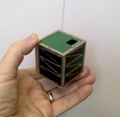
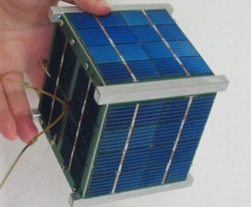
Content
2 - Picosat
What are Nano-Pico satellites
Advantages, Drawbacks and Concerns
International Spectrum
International/National Space Law
Conclusions
1 - Cubesat
1- http://www.bgdna.com/
2- http://news.softpedia.com/news/Nanosatellites-To-Take-Over-Space-Studies-149430.shtml

Slide 3
Typical Classification of Small Satellites
 | Mass (kg) | Altitude (km) Orb period | Project lifetime | Total Cost (M$) | Cost/Mass (k$/kg)
Mini | 100 - 500 | 1000 – 5000 (2 – 3 hrs) | 4 - 7 yrs | 10-150 | 200
Micro | 10 – 100 | 500 – 2000 (1.6 - 2 hrs) | 2 - 5 yrs | 1-30 | 400
Nano | 1 - 10 | 300 – 800 (1.4 – 1.7 hrs) | 2 - 3 yrs | 0.1-10 | 800
Pico | 0.1 – 1 | 200 - 400 (1.4 – 1.5 hrs) | 1 - 2 yrs | 0.05-2 | 1600
Femto | < 100 g | 200 – 400 (1.4 – 1.5 hrs) | 1 yrs | < 0.05 | 3200
1
1
1 – Indicative values

Slide 4
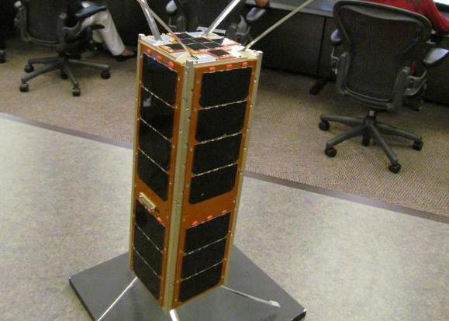
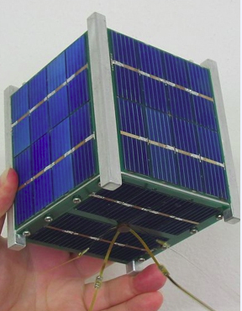
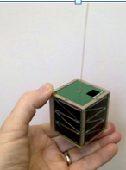
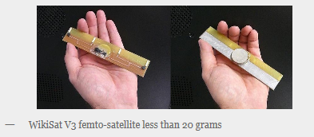
Some examples
nano-sat
1
Cubesat
(1-1.3 kg)
3
3U-sat
(6-7 kg)
4
2
Fempto-sat (18 g)
Pico-sat
(200 g)
1 – Ecole Polytechnique Fédérale de Lausanne (EPFL) Space Center
2 - http://news.softpedia.com/news/Nanosatellites-To-Take-Over-Space-Studies-149430.shtml
3 - http://dialogo-americas.com/en_GB/articles/rmisa/features/technology/2013/03/22/feature-ex-4021
4 – www.wikisat.org

Slide 5
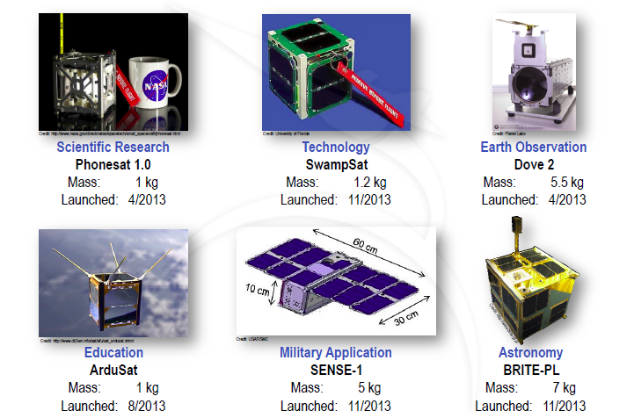
Some examples
Taken from the Space Work Presentation – “2014 Nano / Microsatellite Market Assessment”.
http://www.sei.aero/eng/papers/uploads/archive/SpaceWorks_Nano_Microsatellite_Market_Assessment_January_2014.pdf

Slide 6
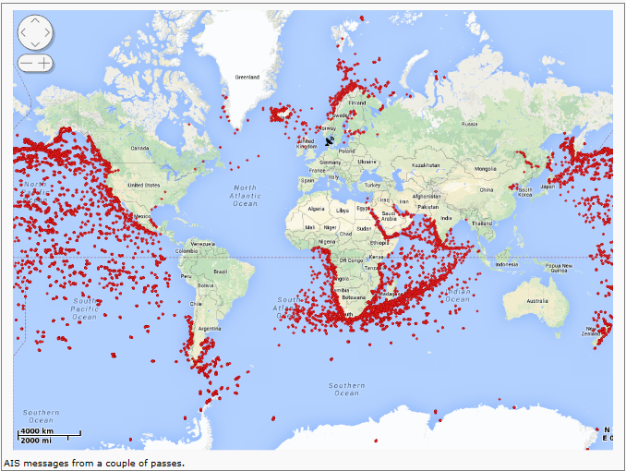
Example - Automatic Identification Service
AAUSAT-3 – Aalborg University, Denmark
Launched 25/02/12
Mission: AIS receiver
Orbit 781 km
Polar orbit
Department of Electronic Systems at Aalborg University (AAU), Aalborg, Denmark
1 - http://www.space.aau.dk/aausat3/

Slide 7
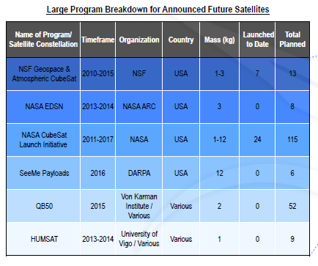
Example of Future Missions
We are looking at a
growth of about 500
in the next 5 years
Taken from the Space Work Presentation – “2014 Nano / Microsatellite Market Assessment”.
http://www.sei.aero/eng/papers/uploads/archive/SpaceWorks_Nano_Microsatellite_Market_Assessment_January_2014.pdf

Slide 8
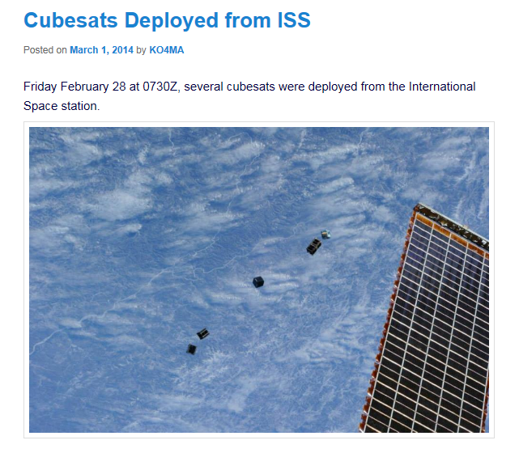
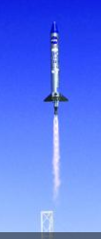
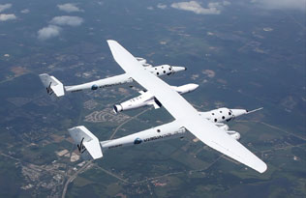
Launching
1 – http://ww2.amsat.org/
3
2
2 - http://www.virgingalactic.com/launcherOne/concept-of-operations/
3 - http://www.spacenews.com/article/launch-report/36741small-satellites-small-launchers-rocket-builders-scramble-to-capture

Slide 9
Advantages of Nano / Pico Satellites
Built for very specific purposes:
  testing technology, science, fun, military
  commercial purposes – e.g. M2M, AIS
Slogan “Faster, Cheaper, Better, Smaller”
  Faster to build & launch (<1 year)
  Cheaper to build & launch (as low as 10’s of k$)
  Better modular & standardised (e.g. CubeSats)
  Smaller latest COTS
They promote:
  Education, Earth Science, Testing innovative technologies,
  Technology transfer and Collaboration between:
    countries, universities, scientific organisations, …
1 - http://centaur.sstl.co.uk/SSHP/sshp_classify.html

Slide 10
Drawbacks
Few dedicated launches - piggyback
  mission delays; NGSO orbit uncertainty
No orbit control - too large or expensive
  higher collision risks, debris; potential interference
  limited visibility to user
Small power source – less than 1W RF
  limited bandwidth and data rates (< 10/15 kHz)
  low visibility, steerable and costly earth stations (25-50 k Euros)
Commercial Off The Shelf (COTS) electronics
  low reliability of electronics ( < 2 years lifetime)
Limited commercial mission types:
  low data rates of a few kbps (e.g. M2M, AIS)
Limited regulatory certainty
  Lengthy time required for Space Activity License (6m - 1 year)
  Costly 3rd Party liability insurance
  Lengthy ITU frequencies/coordination (API/Notification)
  Limited interference-free frequencies (e.g. Amateur, Science)
  High interference potential (to and from mission) – broad-beam

Slide 11
Regulatory Concerns
Potential Interference Risk: → Disrupt other services
  Before launch: unknown orbit trajectory
      Difficult frequency coordination
  After launch: Due to broad-beam antenna
      Satellite dipole; 1/4 wave antenna
      Earth Station: steerable Yagi antenna
Potential Collision Risks: → Damages / Liabilities
  In orbit – Collision with another space object
      As these are non-manoeuvrable
      Fault liability, in case of collision in outer space
  Upon re-entry – Collision on Earth
      Built to burns up on re-entry
      Absolute liability, in case of collision on re-entry

Slide 12
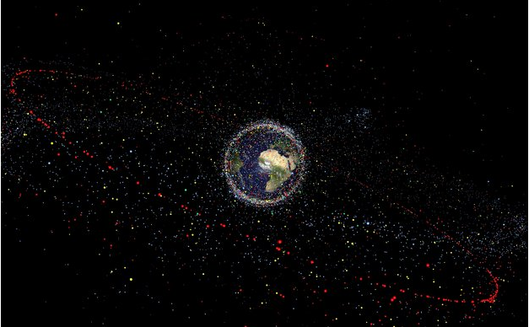
Space Debris
http://www.esa.int/spaceinimages/Images/2013/04/Distribution_of_debris

Slide 13
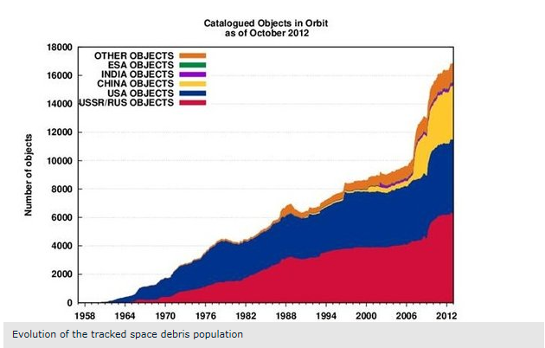
Space Debris
http://www.esa.int/spaceinimages/Images/2013/04/Distribution_of_debris

Slide 14



International Space Regimes
The ITU (Geneva)
  UN Specialised Agency on Information
  Communication Technology, with 193 MS;
UN Office for Outer Space Affairs (UN-OOSA; Vienna)
  Under which operates the UN Committee on the Peaceful Uses of Outer Space (UN-COPUOS; with 71 Member states).
Others
  Inter Agency Debris Coordination Committee (IADC)
    Space Debris Mitigation Guidelines

Slide 15

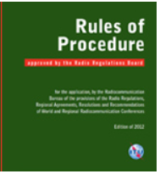
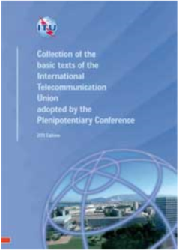
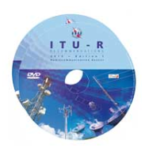
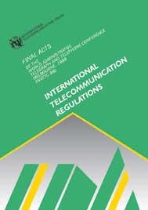
ITU-R
Instruments of the ITU
Treaty & Binding Status for 193 Member States
ITU-R
Constitution (CS)
Convention (CV)
Radio
Regulations
Administrative Regulations
ITU-R Recommendations
Reports
International
Telecommunication
Regulations
ITU-T
ITU-T Standards / Reports

Slide 16
International Regulations and International Law
ITU
ITU Radio Regulations
  Governs the rights and obligations of states on the rational equitable, efficient and economical use of orbital resources
  Art. 5: international frequency allocation table
  Art. 9: procedures for filings and international coordination
  Art. 11: procedures for frequency registration in the Master International Frequency Register (MIFR)
ITU Radio Regulations
  Also apply nano/pico satellites … which may not be known to the developers → may cause interference
  They may not be adequate for nano/pico satellites as:
    Timescale to notification is too long
    orbit unknown or uncontrolled
    frequencies may not be available

Slide 17
Developers may not know ITU procedures
ITU
Launch data from: Space Work Presentation – “2014 Nano / Microsatellite Market Assessment”.
API data from :Yvon Henri, “ITU Radio Regulations and Small Satellites”, ECSL/IISL Symposium, Vienna, Austria , 24/03/14

Slide 18
Example Frequency Bands Use by n/p-satellites
ITU
Amateur Bands (No. 5.282)
  Frequencies coordinated by International Amateur Radio Union (IARU);
  List of 235 satellites coordinated / 71 of which are still Active
  Uplink
    144-146 MHz
Science (Space Research) Bands:
  Frequencies coordinated by Space Frequency Coordination Group (SFCG);
  e.g. 400.15-401 MHz, 2025-2110 MHz, …
  Downlink
    144-146 MHz, 435-438 MHz
    2400-2450 MHz, 3400-3410 MHz

Slide 19
WRC-15 / WRC-18
Preliminary Draft of Agenda for WRC-18
Following proposals from 12 CEPT Administrations
resulted in a future Agenda Item for WRC-18, Resolution 808
to consider whether:
“2.2 the appropriate regulatory procedures for notifying satellite networks needed to facilitate the deployment and operation of nano- and picosatellites, in accordance with Resolution 757 (WRC‑12);”
ITU-R Resolution 757 (WRC-12), invites ITU-R:
to examine the procedures for notifying space networks and consider possible modifications to enable the deployment and operation of nano-satellites and pico-satellites, taking into account the short development time, short mission time and unique orbital characteristics,
instructs the Director of the BR
to report to WRC-15 on the results of these studies.

Slide 20
WRC-15 – SG7 2012-2015
ITU-R Question 254/7 – Assigned to WP 7B
1. What are the distinctive characteristics of nano and pico satellites and satellite systems in terms of their use of the radio spectrum as defined by data rates, transmissions time and bandwidths?
2. Taking into account such distinctive characteristics, what are the spectrum requirements for nano and pico satellite systems?
3. Under which radiocommunication services can satellite systems using nano and pico satellites operate?

Slide 21
WRC-15 – SG7 2012-2015
  ITU-R WP7B developing two ITU-R Reports:
    WDPDN Report ITU-R SA.[NANO/PICOSAT CHARACTERISTICS], which provides answers to the 3 questions asked as part of Question ITU-R 254/7.
    WDPDN Report ITU-R SA.[NANO/PICOSAT CURRENT PRACTICE] which is in response to the invitation to examine procedures for notifying space networks as called for in Resolution 757 (WRC-12).
  Draft CPM text for WRC15 developed
  Studies are ongoing

Slide 22
WRC-15
Preliminary observations in answering Question 254/7
Not easy to define nano/picosatellites based on Appendix 4 characteristics; e.g. unknown orbital characteristics.
These have distinct technical characteristics:
  Usually low transmitter power, low data rate, omnidirectional antennas, mainly NGSO systems.
These have distinct non-technical characteristics:
  Short development time (months to 2/3 years)
  “Opportunistic” launch arrangements meaning that the orbital parameters may be known at a late stage, which makes proper and timely publication, coordination and notification difficult.

Slide 23
WRC-15
Preliminary observations of regulatory issues for nano/pico satellites
which could be solved by regulatory change
Unknown orbital parameters → Difficulties in proper and timely publication → changes in Appendix 4.
Short development cycle → too short for the long regulatory process under Article 9 → propose a new notification process.
which could be solved by other means
Developer’s limited awareness/knowledge ITU process →
  May provide inadequate Appendix-4 data → Study
  May Not Operate in the appropriate frequency band or radiocommunication service → interference → Study.
Growing number of nano/pico-satellitess
  Require an easier notification process;
  Expanding needs of spectrum.

Slide 24
ITU Conclusions
WRC-15 Should Determine
  Characteristics, Spectrum Requirements, What type of services
  Examine the procedures for notifying space networks and consider possible modifications to enable the deployment and operation.
WRC-18 Should Address
  appropriate regulatory procedures for notifying satellite networks needed to facilitate the deployment and operation of nano- and picosatellites.
With immediate action, all States must:
  make filings for all satellites including nano/pico satellites;
  use appropriate frequency bands, amateur or scientific and coordinate use with IARU or SFCG.

Slide 25
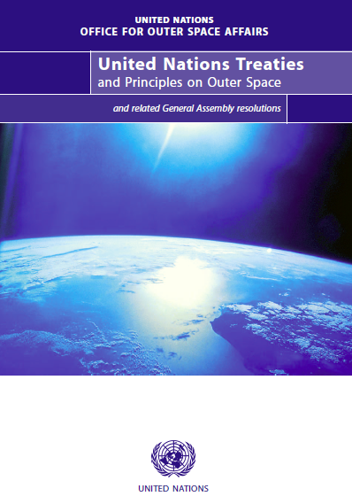
International Space Law - Corpus Juris Spatialis
UN Outer Space Treaties
Outer Space Treaty 1967 (OST)
Rescue Agreement 1968
Liability Convention 1972
Registration Convention 1975
Moon Agreement 1979
+ UNGA resolutions, sets of principles, guidelines (e.g. debris mitigation)
UNGA Resolutions 1721 (20/12/1961)

Slide 26

Secretariat
(Vienna)
UN Committee on the Peaceful Uses of Outer Space
(UN COPUOS)
Scientific and Technical
Sub-Committee
Legal Sub-Committee
International Space Law Based
  UNGA Resolutions 1721 (20/12/1961) – Registry space objects
  Outer Space Treaty 1967 – Ratified by 103 states
  Rescue Convention 1968 – Ratified by 94 states
  Liability Convention 1972 – Ratified by 90 states
  Registration Convention 1975 – Ratified by 61 states
Moon Treaty 1979 – Ratified by 15 states
http://www.oosa.unvienna.org/pdf/limited/c2/AC105_C2_2014_CRP07E.pdf

Slide 27
International Space Law - Corpus Juris Spatialis
The 1967 Outer Space Treaty (OST) – 103 Ratifications
Art I: Free use & non-appropriation of outer space, which facilitates/encourages collaboration between States.
Art VI: Promotes international (State) responsibility, authorisation & supervision of all national space activities.
Art VII: State liable for damages caused in OS and on Earth.
Art VIII: State retains jurisdiction & control and requires registration of space objects.
Art IX: States to avoid harmful contamination of outer space (space debris).
  UNGA Resolutions 1721 (20/12/1961) –Registry space objects
  … Obligations to all MS of the UN to register all space objects

Slide 28
ITU and UN-COPUOS
International Legal Framework
for Space Services
UN
Outer Space instruments
(on space objects)
ITU
Instruments
(on radio frequencies)
- free “exploration and use”
non appropriation
- under international law
CS Art. 44
- Equitable access and rational use of spectrum
- under international law
OST Art. I
State
- “responsibility” & “licensing”
- “jurisdiction & control”
State
- responsible to license transmitting radio stations
- shall not cause harmful interference
Art. VI
RR Art. 18
Art. VIII
Art. VIII
States
Registration OOSA
RR Art. 15
API/CR-C/MIFR
RR Art. 9, 11
States
“liable” for damage
Art. VII
No liability clauses

Slide 29
International Space Law - Corpus Juris Spatialis
OST Relevance to nano/pico-satellites
Small satellite fit well with Article I of OST
  promote collaboration
  promote space activities for developing nations
Authorisation (Art VI) & Registration (Art VIII)
  “space object” - applies also to small satellites
  registration is problematic:
    what orbit ?
    which state ?
  possible no control of the space object in orbit
For Liability (Art. VII)
  Main Risk is Collision in Orbit – Fault Liability Regime
  Most small satellites burn-up on re-entry
Avoid Harmful Contamination of OS (Art IX)
  Small satellites are a real issue for space debris

Slide 30
International Space Law
National Space Regimes
State Obligations toward UN Outer Space Treaty (ratified by 103 member states)
  Approximate 20 states on a world-wide basis, few European States have National Space Law and all have differing legal requirements;
  National Legal Instruments
    Europe: Au, Be, F, NL, S, UK;
      Lisbon Treaty (Art. 189) prevents EU from harmonising space laws/regulations of MS;
    Americas: US, Canada;
    Australia.
    Others.

Slide 31
International Space Law - Europe
State | Auth & Registrat |  |  |  |  |  |  | 3rd Party Liability |  |  |  | Cubesats
 | L | O | G | A | D | T | R | Liability | Ins. cover |  | Redress | (non manoevrable)
UK (1986) | √ | √ | - | √ | √ | √ | √ | [60M€] | 60M€ Launch & In-Orb-Op |  | Yes | No difference to large satellites; Max 25 year de-orbit
NL (2008) | √ | √ | √ | - | √ | N | √ | Limited to sum insured | Minister decides |  | Yes [up to max] | Considers not to be a launch state (possible changes)
 | Launch from NL
France (2008) | √ | √ | Return |  | √ | √ | √ | Limited to 60M€. Limited to 1 year after loss of control |  |  | Up to 60 M€ | Covered by Law. Possible exemptions for insurance.
Belgium (2005) | √ | √ | √ | - | √ | N | √ | Max 10% turnover |  | Not obliged | Yes | Allowed. May not consider being launch state. Being clarified.
 | From Belgium and effective control
Austria (2011) | √ | √ | √ | √ | √ | √ | √ | Limited to 60M€ |  |  | Up to 60 M€ | Allowed. Insurance exemption for research / education.
L=Launch; O=Operations; G=Guidance; A=Other; D=Debris; T=Transfer; R=Registration

Slide 32
International Space Law - Conclusions
UN Outer Space Treaty
  Launching state is internationally responsible and liable;
  All states are obliged to register space objects with UN-OOSA;
  State with control must license/authorise the space object;
  All states must avoid outer space contamination.
Developers
  Must be aware of state obligations toward the UN OST;
  Depending on the launching state, authorising state, control state, they may require to take insurance cover (up to 60M€). First year may be included in launch contract.
  May choose a flag of convenience (e.g. lowest insurance premium).

Slide 33
CONCLUSION
International treaties provide general legal framework
  Some issues for nano/pico-satellites
    ITU Coordination procedures and notification
    UN-OOSA Registration
Implementation needed at national level
  UN OST: only a few have implemented national regulations
  ITU RR: WRC15/WRC18 addressing issues
Small satellite Developers and Operators should review international legal and frequency issues, as well as state obligations at national level.

Slide 34
International Space Law
Q & A

