Slide 1
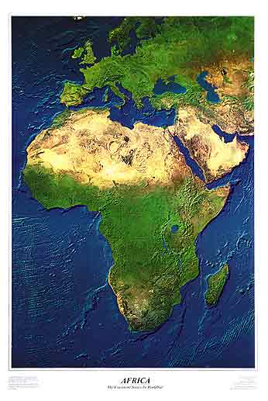

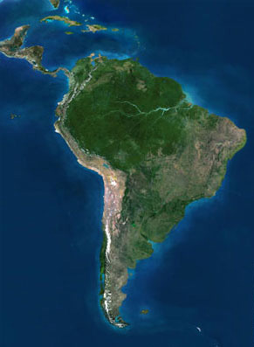
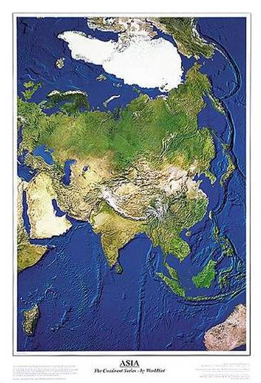
WRC-15 & AI 1.1:
The Fight to Save C-band for Hundreds of Millions of Users
David Hartshorn
Secretary General
GVF
Notes:
1

Slide 2
C-Band Satellites in Service
At least 169 C-band satellites in geostationary orbit today
  Represents about $42-51 billion of in-orbit investment, not including the investments in ground infrastructure.
Substantial ongoing investment in C-band satellite capacity worldwide
  At least 52 satellites with C-band payloads have been launched in 2007-2012, representing $12-15 billion in investments.
  At least 35 satellites with C-band payloads are under construction and are scheduled to be launched in 2012-2015, representing $9-10 billion in investments.
GEOs are long-lived assets; typical operational life is 15 years or more.
  Stable, consistent regulatory environment required throughout
Global Distribution of 36 MHz
Transponder-Equivalents
(TPE) per Band, Nov. 2011
Total 5,642 TPE in Use
Source: NSR
Note: TPE count does not include multi-spot beam high throughput satellites

Slide 3
SAMPLE USE OF 3625 – 4200 MHz BY THE FSS IN BRAZIL
Brazilian Contribution at June CITEL Meeting (OEA/Ser.L/XVII.4.2
CCP.II-RADIO/doc. 974/06):
No Better Band to Address Rain Attenuation
Exclusion Zones Unworkable
Developing Countries Can’t Afford Equipment Changeout
Conclusion: 3625-4200 & 4500 – 4800 MHz
Should Not Be Considered for IMT

Slide 4
The C-band Value Proposition
C/Ku-Band
Consumer
Point-to-Multipoint
Point-to-Point
Professional

Slide 5
The New Value Proposition
HTS
C/Ku-Band
Consumer
Point-to-Multipoint
Point-to-Point
Professional
MEO-HTS

Slide 6
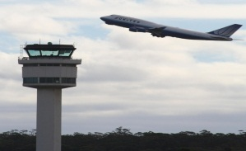
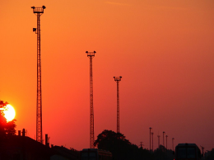
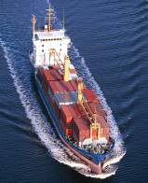

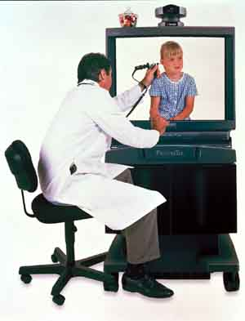
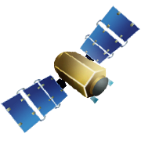
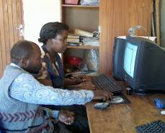
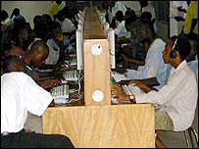
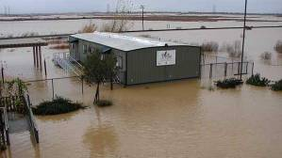
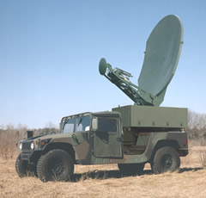

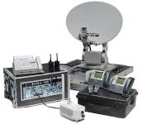
C-band Satellite Applications:
Achieving Policy Goals and Business Objectives
Maritime Communications
Aviation Security
Wireless Extension Services
Telemedicine
Corporate Networks
C-band
Distance Education
Internet Connectivity
Disaster
Preparedness
Peace Keeping
TV contribution
C-band satellite applications increase teledensity rates, provide distance education and telemedicine, enable broadband to rural areas, and more

Slide 7
Stakes & Stakeholders
Problem
Such use is not compatible with the existing operations in C-band, including FSS, radar systems and fixed point-to-point links.
Next Steps
The Satellite Industry and Its User Community – Representing Billions in Economic and Social Impact -- Are Standing Together… Again
  Broadcasters
  Humanitarian Organisations
  The United Nations
  Civil Aviation
  Military
Issue
WRC-15 Agenda Item 1.1 will consider additional spectrum generally for International Mobile Telecommunications (IMT) and other mobile broadband applications … including C-band
What More Can Be Done to Save the C-band User Community?

Slide 8
Why C-Band Remains a Mainstay
Wide Geographic Coverage C-band Beams
  Covers entire continents and oceans, offering an economical way of providing intercontinental and global communications
  Smaller or hard-to-reach markets and low density regions are covered as easily as metropolitan areas
  Ideal for point-to-multipoint applications (broadcast, widely-dispersed networks), and remote/rural deployment
Resistance to Rain-fade
  C-band is less susceptible to signal interruptions from heavy rains than higher bands (Ku, Ka), making it better suited for tropical or high-rain areas with high availabilities

Slide 9
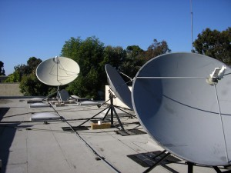
Key Services Supported by C-band Satellites
Media Distribution
  C-band is used to distribute media content around
  the world, including, e.g.
    Cable distribution to 7038 cable head-ends around
    the United States, serving 60 million U.S. households
    Cable distribution to 4711 cable head-ends in Latin America and
    the Caribbean, serving more than 29 million cable homes (2012)
    20 million receive-only C-band television dishes in
    Brazil alone
Media Contribution
  Special events coverage (e.g. Olympics)
  Satellite news gathering
Feeder Links for mobile-satellite services (MSS)
  Supporting public safety and emergency relief missions around the world.

Slide 10
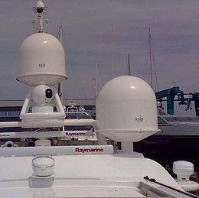
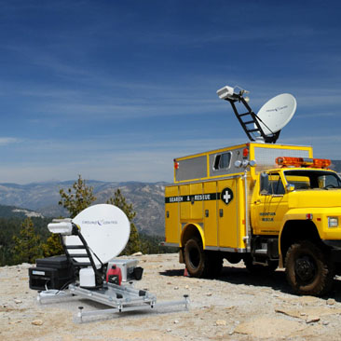
Key Services Supported by C-band Satellites
Rural and remote communications
  Internet and basic connectivity
  Cellular backhaul applications
Mobility
  3510 C-band Earth Stations on Vessels (ESVs) in 2012, providing video distribution, Internet and mobile backhaul
Other C-band services, including
  Disaster recovery and preparedness
  Tracking, Telemetry & Command (TT&C) for many satellite systems in other frequency bands, for example, for launches

Slide 11
Unique Attributes of C-Band Satellite Services
C-band satellite services cannot easily be replicated at other satellite bands or via terrestrial means
  Geographic reach. C-band easily covers entire continents and oceans and offers an economically viable way of providing intercontinental and global communications
    Smaller or hard-to-reach markets and low density regions are covered as easily as metropolitan areas
    Particularly ideal for point-to-multipoint applications (broadcast, widely-dispersed networks), and remote/rural deployment
  Resistance to rain-fade
    C-band is less susceptible to signal interruptions from heavy rains than higher bands (Ku, Ka), making it better suited for tropical or high-rain areas at high availabilities

Slide 12
WRC-15 and IMT
Under Agenda Item 1.1, ITU is tasked with identifying additional frequency bands for IMT
Working Party 5D (WP 5D) is to identify suitable IMT frequency ranges
  Consider only the technical feasibility of operating IMT in the specified frequency range. Will NOT consider impact to/from other incumbent services
  Update IMT bandwidth requirements
  Provide/Update IMT parameters
Joint Task Group 4-5-6-7 (JTG 4-5-6-7)
  Perform sharing studies
  Generate Conference Preparatory Meeting (CPM) Report
  Identify candidate frequency bands for IMT from the frequency ranges provided by WP 5D
    Administrations can propose IMT frequency bands – separate from the frequency ranges proposed by WP 5D

Slide 13
Sharing between FSS & BWA/IMT is not feasible
ITU studies – Studies have concluded that protection distances of between 51 – 430 km are necessary to allow co-frequency sharing between BWA/IMT systems and FSS earth stations, i.e. co-coverage sharing is not feasible
  Adjacent band protection distances to avoid LNB overload of FSS receivers are between 10 – 31 km
  Considering that a typical city has a radius of 15 to 30 km, sharing between BWA/IMT systems and FSS receive earth stations is not realistic
  See Reports ITU-R M.2109 & S.2199
Government, strategic, and commercial FSS services in the C-band will suffer
  Resulting interference can cause signal delays, synchronization loss, blackout periods, blackout areas, and total loss of transmission
  Many countries – Bolivia, Hong Kong, Indonesia, Fiji, to name a few – have experienced interference when deploying BWA systems in C-band
    WiMAX testing led to 30% of TV households in Bolivia missing some of World Cup 2006
    Similar testing in Hong Kong led to 300,000 households across Asia to lose their TV service

Slide 14
Sharing between FSS & BWA/IMT is not feasible
Sharing is exacerbated by a large number of receive only earth stations already deployed – many of which are unregistered
  Shielding, for example, requires knowing the location of every earth station
  Further, site shielding is expensive and infeasible on a regional or worldwide basis

Slide 15
Satellite Industry Concerns
Renewed efforts to identify the 3.4 – 4.2 GHz band for IMT
  WRC-07 studies demonstrated incompatibility of satellite services with IMT
    Interference from IMT transmissions into FSS receive stations
    Requires large distance separations between IMT stations and FSS earth stations
  No technology developments that change the compatibility analysis since 2007 to warrant different outcome at WRC-15

Slide 16
New Effort to Identify 5.85 – 6.725 GHz Band for IMT
  ITU has not conducted sharing studies for this band
  Aggregate interference from IMT systems to satellite receivers
  Receiving IMT stations are susceptible to interference from transmitting FSS Earth stations
  It is likely that large distance separations will be required
  Severely restrict placement of new FSS Earth stations
  Limits on the size of FSS Earth station antennas
    Restrictions on FSS applications

