Slide 1
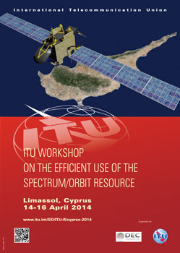
Workshop On The Efficient Use Of The Satellite Orbital Resource
Limassol, Cyprus
14 – 16 April, 2014
Mobility over Typical and High Throughput Spot-beam Satellites
Daryl Hunter
Sr. Director, Regulatory Affairs
ViaSat, Inc.

Slide 2
Traditional Satellite Coverage
Single beam with multiple transponders
Traditional means of covering a vast area such as trans-oceanic routes
Have supported mobility applications well for decades but some characteristics are not ideal for mobility
EIRP and G/T are lowered as coverage area of beam increases
Lower G/T typically requires BPSK and low code rate or spreading of return links to meet off-axis emission limits using low profile antennas
Limited number of aircraft or vessels served at acceptable data rates per transponder

Slide 3
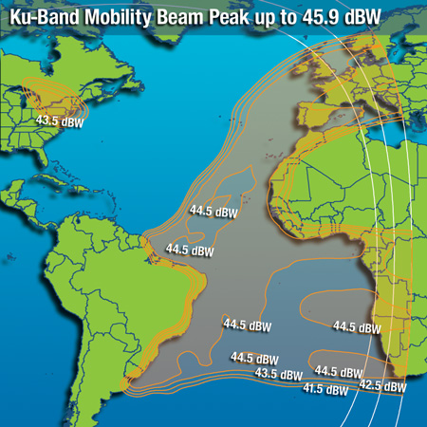
Intelsat 21 Mobility Beam

Slide 4
Traditional Mobility
National or regional mobility may occur entirely within a single beam
IP networking is easier when all traffic is within the same beam
Dense traffic may require multiple transponders and in some cases, more capacity than available on a single beam
Wider mobility requires stitching together coverage from multiple satellites
More complex antenna pointing and IP networking as traffic switches from satellite to satellite

Slide 5
ViaSat Ku band Mobility Coverage

Slide 6
Spot Beam Coverage
Coverage area comprises many beams from same satellite
Each beam may support one or more transponders
Higher EIRP and G/T achievable per beam as spot beam size decreases
Improved EIRP and G/T supports smaller user terminals while allowing operation at higher data rates
Available frequency band can be reused many times resulting in greater overall network throughput capacity
Network capacity increases faster than satellite cost enabling lower cost per bit to end user

Slide 7
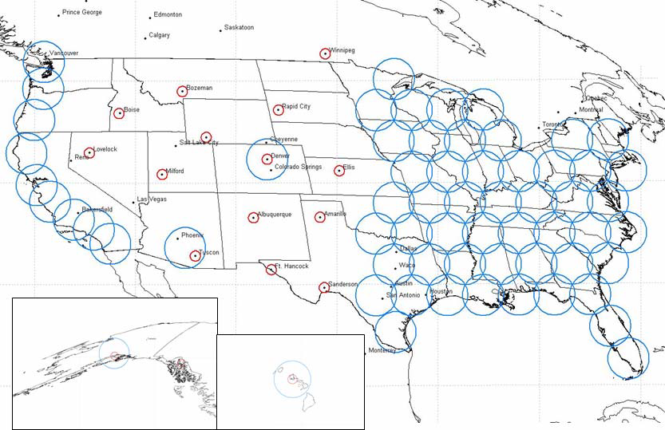
ViaSat-1 Spot Beams

Slide 8
Spot Beam Mobility
Many spot beams cover the national or regional service area
IP networking more complex as connectivity must be maintained when switching between spots
Each spot beam provides capacity similar to a traditional satellite, supporting even dense networks at a higher grade of service
Wider area mobility now requires stitching together both multiple satellites and spot beams
More complex IP networking but antenna pointing is similar to traditional satellite case

Slide 9
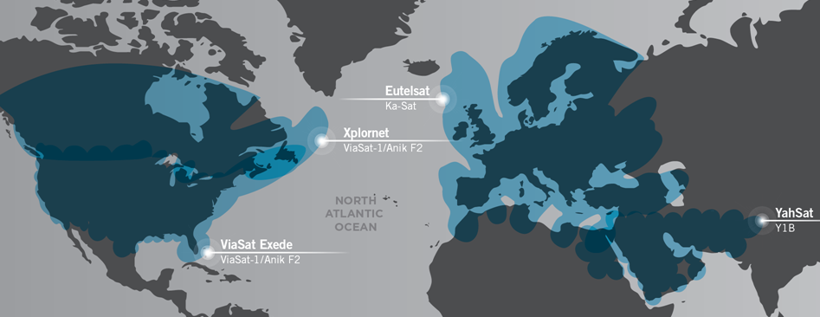
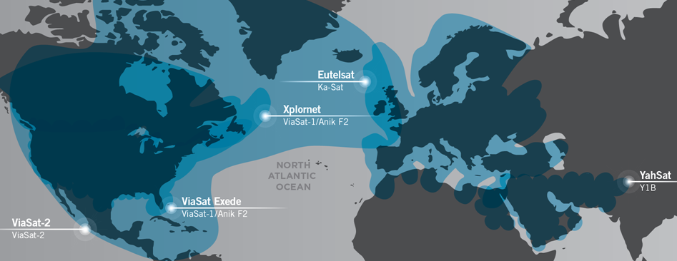
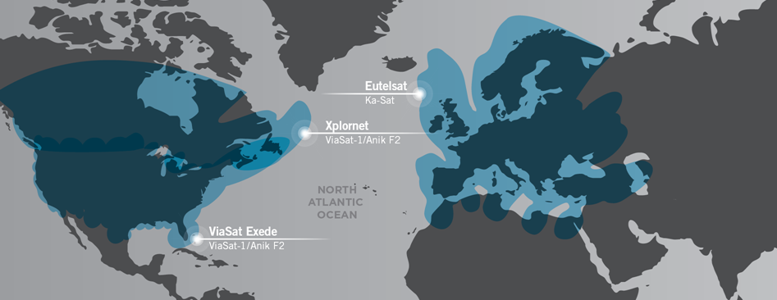
ViaSat High Capacity Ka-band Coverage

Slide 10
Hybrid Traditional / Spot Beam
Technology under development to allow blending of traditional and spot beam satellites
Use high throughput Ka band spot beam coverage where available
Switch to traditional Ku band coverage elsewhere
Allows users to take advantage of higher throughput Ka band satellites where available while still enjoying breadth of coverage from current Ku band fleet

Slide 11
KuKarray Hybrid Antenna

Slide 12
Ka band Frequency Reuse and Mobility
Frequency reuse achieved by alternating the frequency sub-band and/or polarization used by each spot beam across coverage area
Example, ViaSat-1 uses 28.1 – 29.1 and 29.5 – 30 GHz sub-bands
RR FN 5.526 applies to 29.5 – 30 GHz sub-band (Region 2)
RR 4.4 applies to 28.1 – 29.1 GHz sub-band
Results in Swiss Cheese Regulatory situation over coverage area

Slide 13
Conclusion
Traditional Ku band satellites can be used to assemble nearly global seamless coverage
High throughput Ka band spot beam satellites are coming which will significantly improve the user connectivity experience in fixed and mobile applications
Solutions exist to help bridge the gap – not an either/or situation
Regulatory changes still need to be made to facilitate efficient use of Ka band spectrum for mobility

