Slide 1
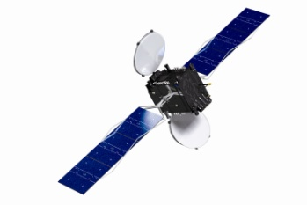
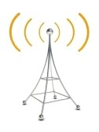
THE/DEC
ITU Workshop on the efficient use of the spectrum/orbit resource
Andronikos Kakkouras
Department of Electronic Communications
14 April 2014

Slide 2
Contents
Introduction
History
Responsibilities
Policy Goals
Satellite Communications
Space Policy

Slide 3
Introduction - History
The Department of Electronic Communications of the Ministry of Communications and Works was created in 2003 following a decision of the Council of Ministers.
Relevant legislation:
the Radiocommunications Laws based on EU Legislation
regulations and orders issued by virtue of the Law.
implementing Radio Frequency Spectrum Management as stipulated in ITU Radio Regulations, CEPT Decisions and Recommendations and the European Union specific Directives and Decisions.
ITU members since 1961

Slide 4
Introduction - Responsibilities
Radiocommunications
Satellite Communications
Information Society
Electronic Signatures
Space Policy

Slide 5
Introduction - Cyprus Facts
Fixed broadband
Fixed Coverage: 100% (EU → 95.3 %, 85.2 % rural) ≈2Mbps
NGA Coverage 73.1% 42% rural (EU →53.8%, 11% rural) ≈30Mbps
Households with Broadband connection 65% (EU →80%)
Fixed Broadband take-up 25.7% (per 100 people) EU → 30%
Enterprises with Fixed Broadband connection 92.9% (EU →90%)
Share of Broadband lines >=30Mbps 1.4% (EU → 18.2%)
Source Cyprus 2013 Scoreboard – Digital Agenda for Europe

Slide 6
Introduction - Cyprus Facts
Mobile broadband (3G/HSPA)
Coverage: 95.7% (EU → 90 %)
Mobile Penetration 131.2 lines/100 pop (EU → 130.4)
Market share of leading operator 70.2% (EU → 35.9)
Mobile broadband (3.5G/HSPA+)
Coverage: 87% (61% of territory)
Mobile broadband 4G

Slide 7
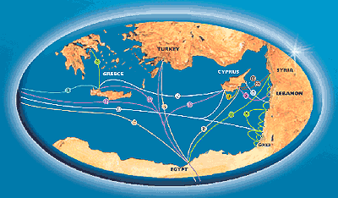
Introduction – Policy Goals
Our main objective is to make Cyprus a regional service center, especially for telecommunications services, taking advantage of our geographical location, favorable tax system, the harmonized European telecommunications regulatory environment, and our expertise and experience.

Slide 8
Cyprus International Network
Regional Internet Node
Four cable stations with 10 submarine cable systems
Global international connectivity
Direct circuits with major Operators
Full redundancy & diversity
Major international fiber systems connect Cyprus to Europe & the rest of the World

Slide 9
Cyprus International Network

Slide 10
Satellite Communications
Submission of fillings to the ITU
IFIC monitoring
Coordination of Satellite Systems
Under the ITU Radio Regulation procedures
Notification and Registration of Satellite Systems to ITU
Securing of satellite orbital positions in the name of the Republic of Cyprus
4 Satellite Companies have been licensed:
Hellas Sat Consortium Ltd – In-orbit Satellite
OverHorizon (Cyprus) Plc
AP Kypros Satellites Ltd
Olympus Satellites Ltd

Slide 11
Satellite Communications Satellite Uplink Fees
Fees for Satellite Links =
Σ_{number of Carries}(Bw * Ι * FC)
Bw = Bandwidth in ΜΗ_{Z,}
I = erp (emitted radiated power) in dBW
FC = Frequency Coefficient in Euro/(MHz *dBW) determined according with carrier frequency, whether in C or Ku or KA Band

Slide 12
Satellite Communications
Versatile License Regime
Authorisation of Satellite Uplinks
Earth Stations
VSAT’s
Gateways
TT&C services
Turn around services
Monitoring Services
Connection with all major satellite systems between the Atlantic Ocean up to Indian Ocean and Far East
Highly Equipped, State of the Art Ground Stations
CYTA
Hellas Sat Consortium

Slide 13
Satellite Communications AVANTI GATEWAY
The Gateway has been providing highly resilient and reliable access to customers using the HYLAS 2 satellite
Offers broadband access across large parts of the globe in Africa, the Middle East and Europe
Fiber Optic Connectivity
Ideal geographical location with optimal weather conditions and interference - free environment
Dedicated Earth Station facilities for satellite access
Field, Operational and equipment support

Slide 14
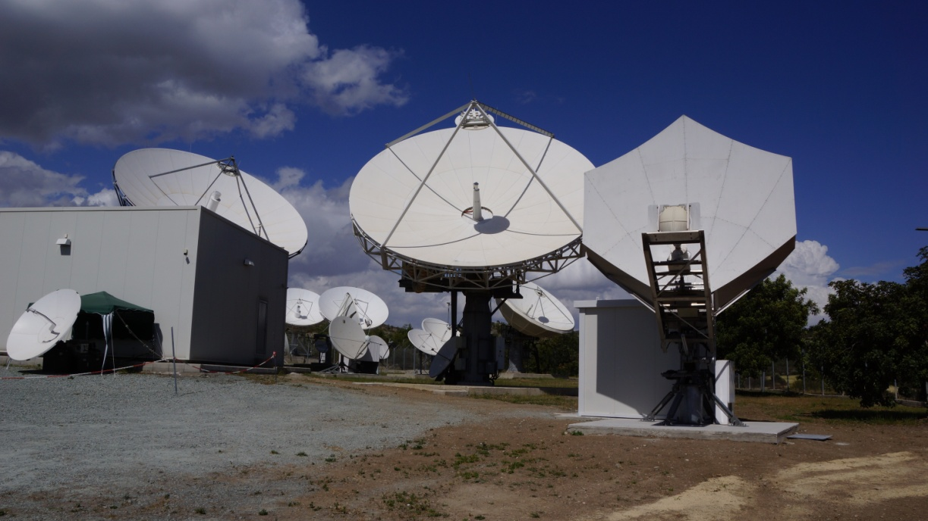
Satellite Communications HELLAS SAT TELEPORT FACILITIES

Slide 15
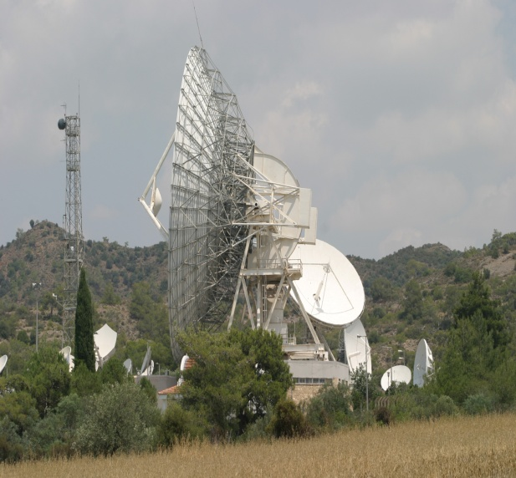
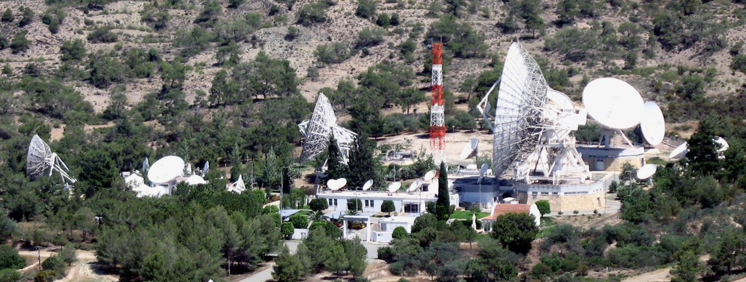
Satellite Communications(3) CYTA Teleport

Slide 16
Space Policy
By way of a Decision by Council of Ministers – DEC is responsible for
European Space Policy
Executive Body to formulate and implement the national policies.
Appointed as ESA counterpart for the implementation of the ESA – Cyprus cooperation
European Space Agency
2009 – Signed an agreement for cooperation with ESA.
Currently we investigating the possibility in taking our cooperation in the next level and becoming a member of ESA.

Slide 17
Space Policy(2)
Galileo
2010 –Republic of Cyprus and the European Commission reached an agreement on the establishment of a GALILEO ground station.
The Search and Rescue service of Galileo is implemented by a network of three European Medium Earth Orbit Local User Terminals (MEOLUTs) located in three different countries of the European Union. The MEOLUT shall be an integral part of the Galileo Infrastructure and it shall be a receiving station on the ground responsible for detecting and locating emergency beacons, and forwarding the appropriate information to its associated Mission Controlled Centre.
Cyprus as a Ground Segment Provider through a network of three European Earth Stations (MEOLUTs) who will be located in Cyprus, Norway and Spain.
Currently, the installation of the MEOLUT station in Cyprus has been completed and the testing operation of the system is expected to within 2014.

Slide 18
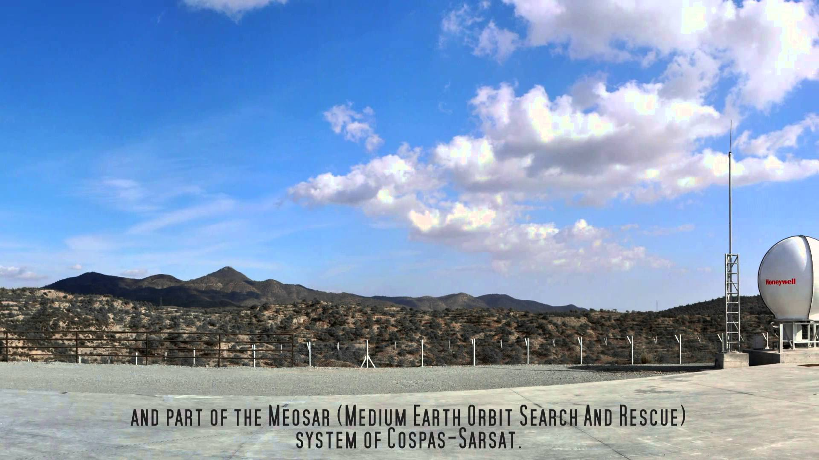
Space Policy(3)

Slide 19
Case Study - Satellite Broadband
In 2009 many rural areas not covered by broadband network (white areas)
Specifics: 153 communities (population 25,000 or 3% of total population) did not have broadband Internet access of which 105 opted for a satellite broadband scheme offered to them for free by the Government (service provided by Hellas Sat Consortium Ltd)
Each community covered by one or more (up to 17) 1 Mbps broadband satellite connection(s) (1024 kbps downlink / 128 kbps uplink) with external Wi-Fi access points to provide community-wide coverage.
Project ended in October 2013 Incumbent operator now provides fixed broadband access (xDSL) to all communities

Slide 20
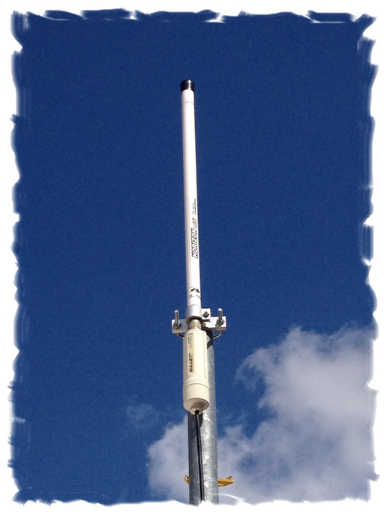
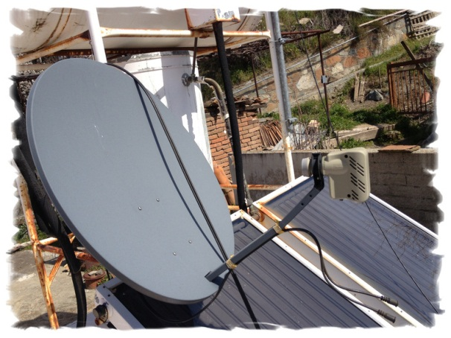
Case Study - Satellite Broadband

Slide 21
Thank You For Your Attention

