Slide 1

WRC-15 results
François Rancy
Director, ITU Radiocommunication Bureau
RRS-16 Americas – Port of Spain
20 July 2016

Slide 2
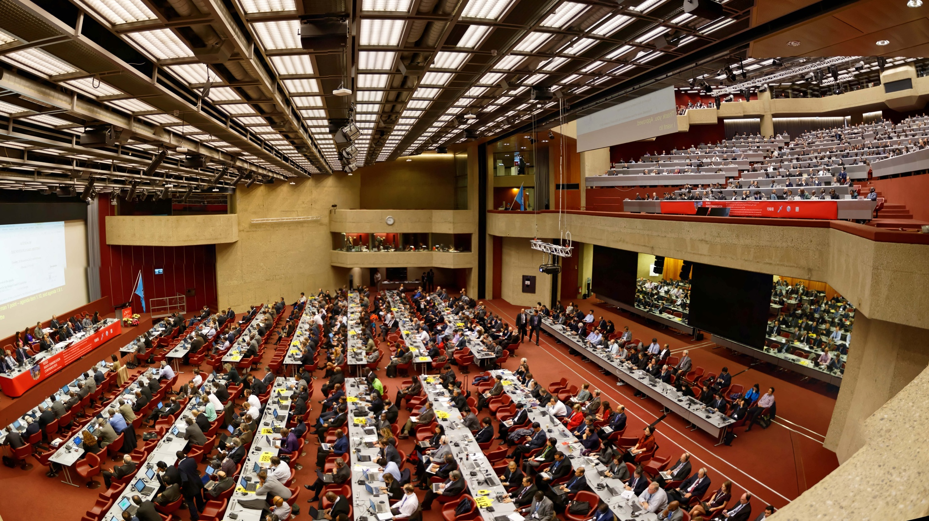
World Radiocommunication Conference, 2015
2- 27 November 2015, Geneva

Slide 3
Radiocommunications in the ICT ecosystem
Mobile Broadband networks: ubiquitous connectivity
Fixed Networks (mobile networks infrastructure, fixed wireless access, backbone lines)
Scientific satellites: Earth Observation, Meteorology (sources of high value information on space, natural resources, climate change, weather and disaster prediction)
Radionavigation systems (space and terrestrial) : Location and navigation, a key component of the connected society
Communication satellites: Broadband Mobile networks infrastructure, mobile and emergency communications in remote areas, Broadcasting infrastructure.
Radiolocation: transport safety, anti-collision devices for intelligent transport systems (ITS), air and maritime traffic control
Broadcasting and broadcasting satellite: TV and sound program delivery to population

Slide 4
The Sustainable Development Goals
In 2015, the United Nations adopted 17 Sustainable Development Goals (SDGs) as part of the Agenda 2030 to achieve a better future for all.
These goals apply to all countries, whether developing or developed.
Radiocommunication have a key supporting role in achieving each and everyone of these 17 SDGs.

Slide 5
The Sustainable Development Goals
Notes:
Line 1 – Basic needs
Line 2 – Basic rights
Line 3 – Organizing and enabling
Line 4 – Preserving the planet

Slide 6
Role of ITU in radiocommunicatons
Developing and updating international regulations on the use of orbit /spectrum
Applying these regulations
Developing and adopting standards and best practices on the use of orbit/spectrum
Disseminating information on these regulations, standards and best practices

Slide 7
Purpose of ITU WRCs
Create regulatory certainty for a multi-trillion dollars activity which plays a increasingly important role in the development of our societies
Strike the right balance bewteen the spectrum requirements of all radiocommunication services
Creating certainty requires consensus in order to achieve stable results on a sustainable use of orbit/spectrum resources
Reaching consensus requires time, efforts and patience.
This is the price to pay for developing and maintaining a sustainable ecosystem for radiocommunications and avoid massive disruptions.

Slide 8
Challenges
Everybody is in favor of spectrum harmonization
But
Everybody wants it to be his own way
The success of mobile broadband and its ubiquitous nature represents a threat of disruption to other services if IMT is identified in the same band, even though technical solutions may exist to share it between countries
The main and success of WRC-15 was to:
  Continue global harmonization for IMT and
  Secure future access to spectrum by other services

Slide 9
WRCs achievements for IMT
For the mobile industry, regional, and preferably global spectrum harmonization is essential to create economies of scale, interoperability and enable roaming
Since 1992, ITU World Radiocommunication conferences have worked to achieve this objective through new mobile frequency allocations and identifications of spectrum for IMT.

Slide 13
In Summary, WRC-15 identified for IMT
60% additional spectrum
39% additional globally harmonized spectrum

Slide 14
33.25 GHz of spectrum under study for IMT
12.25 GHz also under study for HAPS and/or NGSO FSS

Slide 15
Implications for mobile broadband users
Reduction of the digital divide and greater availability of the service (lower bands)
Greater capacity (higher bands)
More affordable prices (economies of scale through harmonized spectrum)
International roaming and interoperability
Additional spectrum for 5G (IMT-2020) will also be addressed by WRC-19
While securing the future of other services, which are key to the provision of broadband (broadcasting, fixed and fixed-satellite services)

Slide 16
IMT-2020 Standardization Process
Development Plan
Market/Services View
Technology/
Research Kick Off
Vision - IMT for 2020
Name
< 6 GHz Spectrum View
Process
Optimization
Spectrum/Band
Arrangements
Technical
Performance
Requirements
Evaluation Criteria
Invitation for Proposals
> 6 GHz Spectrum View
Proposals
Evaluation
Consensus
Building
Spectrum/Band
Arrangements
Decision & Radio Framework
Detailed IMT-2020 Radio Specifications
Future Enhancement/
Update Plan &
Process
2012-2015
2016-2017
2018-2019
2019-2020
Setting the stage for the future:
vision, spectrum, and
technology views
Defining the
technology

Slide 17
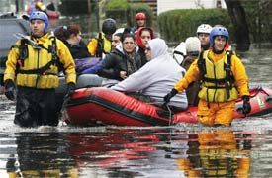
WRC-15 achievements for PPDR
  Revision of Resolution 647 on emergency and disaster relief radio communications. Reinforcement of main ideas of this Resolution:
    Importance of available emergency frequencies
    BR database on contact information of administrations and frequency bands (optional) relevant to disaster relief www.itu.int/ITU-R/go/res647
    Administrations are encouraged to submit information to the database
  Protection of 406-406.1 MHz (MSS reception of Cospas-Sarsat) via review Res. 205 to reinforce protection from out‑of‑band emissions.
  Revision of Resolution 646 resulted in harmonization of PPDR bands and provided flexibility for administrations
    Encouragement to use harmonized bands, especially for broadband:
      694 – 894 MHz – on a global basis
      380-470 MHz – in Region 1
      406.1-430 MHz, 440-470 MHz and 4 940-4 990 MHz – in Region 3
    Rec. ITU-R M.2015 for national planning

Slide 18
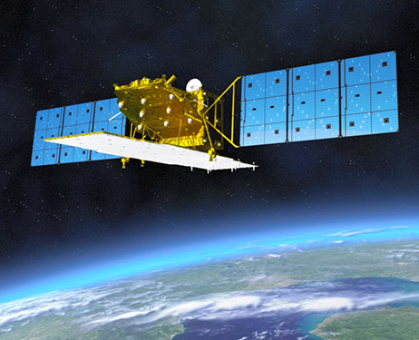
WRC-15 achievements for EESS (1/2)
Background
  The need for large amounts of uplink data for operations plans and dynamic spacecraft software modifications, which might not be accommodated by heavily used 2 025-2 110 MHz and 2 200-2 290 MHz TT&C bands
Results of WRC-15
  New primary EESS uplink allocation limited to tracking, telemetry and command (TT&C) in the 7 190-7 250MHz band (34% increase)
  Provision to protect existing and future stations in the fixed, mobile and space research services from the new allocation
Implications
  In combination with existing EESS downlink allocation in 8 025-8 400 MHz this new allocation will lead to simplified on-board architecture and operational concepts for future missions of EESS

Slide 19
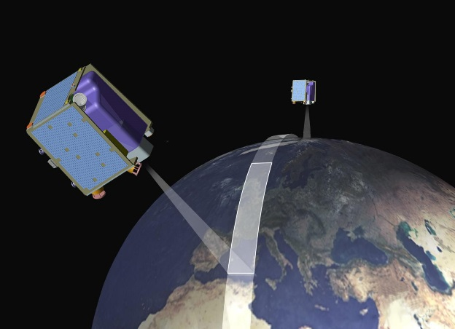
WRC-15 achievements for EESS (2/2)
Background
  EESS (active) bandwidth in 8-9 GHz was 600MHz. Growing demand for higher resolution to satisfy global environmental monitoring raised the need to increase the bandwidth up to 1200 MHz in total.
Results of WRC-15
  New primary EESS(active) allocations totally of 600 MHz in the 9 200-9300MHz, 9 900-10 000MHz and 10.0-10.4GHz bands (100% increase)
  Provision to protect existing and future fixed and mobile stations
Implications
  Development of modern broadband sensing technologies and space-borne radars on active sensing EESS that provides high quality measurements in all weather conditions with enhanced applications for disaster relief and humanitarian aid, large-area coastal surveillance

Slide 20

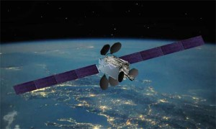
WRC-15 achievements for FSS (1/2)
Results of WRC-15
  New allocations for the FSS.
  Space-to-Earth direction (Downlink)
    13.4-13.65 GHz in Region 1
  Earth-to-space direction (Uplink)
    14.5-14.75 GHz, limited to 30 countries in Regions 1 and 2
    14.5-14.8 GHz, limited to 9 countries in Region 3
Comparison
  Before WRC-15, for unplanned FSS in the Ku band:
    Region 1: 750 MHz for uplink and downlink
    Region 2: 1000 MHz for downlink, only 800 MHz for uplink
    Region 3: 1050 MHz for downlink, only 750 MHz for uplink
  After WRC-15, improved balance between uplink/downlink:
    Region 1: 1000 MHz both for uplink and downlink
    Region 2: 1000 MHz for downlink, 1050 MHz for uplink
    Region 3: 1050 MHz both for uplink and downlink

Slide 21
WRC-15 achievements for FSS (2/2)
Conditions of utilization (to protect incumbent services)
  Downlink: 13.4 – 13.65 GHz
    Limited to GSO
    power flux density limits specified in No.21.16
    Coordination procedures under Nos.9.7 and 9.21
  Uplink: 14.5-14.8 GHz in Region 3 (Res. 164), 14.5-14.75 GHz in Regions 1 and 2 (Res. 163)
    Limited to GSO
    Limited to specific countries, subject to several limitations, e.g.:
    minimum earth station antenna diameter, power spectral density limits, power flux density limits towards the coast, power flux density limits towards the geostationary-satellite orbit, minimum separation distance of earth stations from the borders of other countries.
    Coordination procedures under No.9.7 and Article 7 of AP30A
Implications
  Increased and balanced allocations between uplink and downlink will facilitate development of various applications e.g. VSAT, video distribution, broadband networks, internet service, satellite news gathering, backhaul link etc.
868 684 2936. 868 684 2936. 868 684 2936.

Slide 22
WRC-15 achievements for the Civil Aviation
Wireless Avionics (WAIC)
  Background: A380: wire count 100 000; length 470 km; weight 5 700 kg
  WRC-15 results: Allocation of 4 200-4 400 MHz to AM(R)S reserved for WAIC and approval of Res. 424 with conditions for WAIC, including a non-interference basis vs. aeronautical radio altimeters, obligation to comply with ICAO SARPs
  Implications: WAIC technology can replace around 30% of cables and wires, making a new generation of aircrafts, more reliable, lighter, less fuel consuming and environmentally friendly
  Global Flight Tracking (GFT)
  Background: Need for continuous aircraft surveillance; satellite tracking complementing terrestrial tracking, e.g. radars, HF communications.
  WRC-15 results: primary allocation of 1087.7-1092.3 MHz for satellite reception ADS-B messages (5.328AA)
  Implications: improves aircraft tracking through utilization of an existing technology; especially important for polar, oceanic, remote areas

Slide 23
Thank you for your attention

