Slide 1
Effective policy and regulation of Big Data
ITU Regional Economic and Financial Forum of Telecommunications/ICTs for Africa
Victoria Falls, Zimbabwe
31 January 2017
David Rogerson, ITU Expert

Slide 2
Agenda
What is Big Data?
How and by whom is Big Data used?
What are the social and economic benefits of Big Data?
What concerns does Big Data arouse?
How can policy and regulation help?
Collaborative methods of regulating Big Data.

Slide 3
What is Big Data?
Many different definitions have been proposed; none has been universally accepted.
A range of common characteristics:
Scale: “datasets whose size is beyond the ability of typical software tools to capture, store, manage and analyze” (McKinsey, 2011)
Complexity: “large amounts of different types of data produced from various types of sources, such as people, machines or sensors” (EC, 2016)
Evolving: “Most definitions reflect the growing technological ability to capture, aggregate, and process an ever-greater volume, velocity, and variety of data” (White House, 2014)
It’s hard to describe, but you know it when you see it, and what really matters is how Big Data is used.

Slide 4
The Three Vs
Volume:
A vast quantity of data can now be gathered, stored and analysed cost-effectively
It is often cheaper to retain rather than destroy old data.
Velocity:
The speed at which organisations can accumulate, analyse and use new data
Improved analytical techniques harness the predictive power of data, sometimes instantaneously.
Variety:
The breadth of datasets, captured in different ways and from different places
Analysed together these greatly enhance the power of data, e.g. to establish preferences and predict behaviour.

Slide 5
A massive animal
Big Data is hard to describe, but you know it when you see it,
… and what really matters is how it is used.

Slide 6
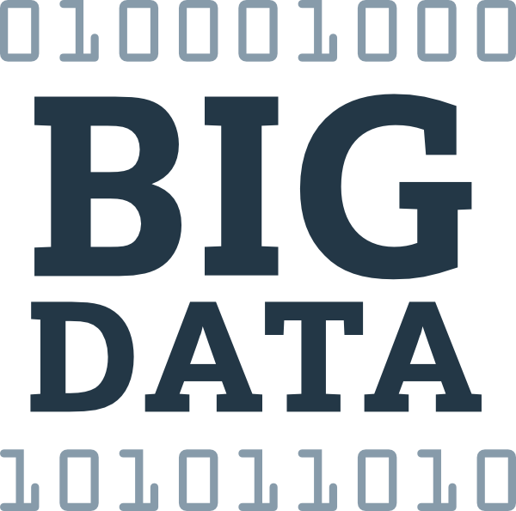
How and by whom is Big Data used?
Everyone collects data and almost all of us store data for later reference and use.
Most of us find we can only cope with so much … and start deleting/destroying data after a while. Other data lies idle.
But with Big Data collection is continuous across multiple devices, storage is virtually unlimited, and ever-more efficient analytical tools mean that it can be mined repeatedly for multiple purposes.

Slide 7
The who and why of Big Data
Organisations that use Big Data | Sample purposes for which they use Big Data
Governments | Identifying tax evasion, tracking suspects and predicting terrorist activities
Companies | Creating innovative products and targeting them to customers more precisely
Banks | Credit risk scoring and fraud detection
Educational establishments | Selecting students; identifying students at risk of drop-out
Healthcare providers | Predicting predisposition to disease and likely responsiveness to treatment plans
Big Data leads to better and more informed decisions

Slide 8
How does Big Data work?
Individual
Anonymised
Aggregated
Combined
Form filling
Form filling
Form filling
Mobile device
location
Mobile device
location
Mobile device
location
Purchases
Purchases
Purchases
Internet browsing
Internet browsing
Internet browsing
BIG DATA
Social media
Social media
Social media
Internet of Things
Internet of Things
Internet of Things
Sensors
Sensors
Sensors
CCTV
CCTV
CCTV

Slide 9
Transformational potential of Big Data
Archetype of disruption | Domains that could be disrupted
Business models enabled by orthogonal data | Insurance Healthcare Human capital/talent
Hyperscale, real-time matching | Transportation and logistics Automotive Smart cities and infrastructure
Radical personalisation | Healthcare Retail | Media Education
Massive data integration capabilities | Banking Insurance | Public sector Human capital/talent
Data-driven discovery | Life sciences and pharmaceuticals Material sciences Technology
Enhanced decision-making | Smart cities Healthcare | Insurance Human capital/talent
Source: McKinsey (2016)

Slide 10
What are the social and economic benefits of Big Data?
Predicting and warning:
Traffic jams; weather systems; climate change; seismic activity.
Better decisions, policies and laws – simulation of likely outcomes.
Personalisation:
Tailored adverts and offers; insurance and other financial products based on personal rather than group risk profile.
Research and development:
E.g. achieving the necessary scale for medical trials; understanding and controlling epidemics
Crime prevention:
Detecting patterns, deploying police resources, targeting searches
Innovation, cost reduction:
New services and lower prices as operational efficiency improves.
Source: ITU (2015)

Slide 11
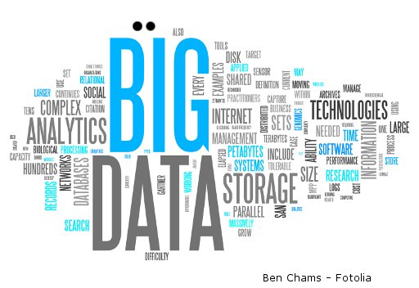
What concerns does Big Data arouse?
How anonymous is it?
Is personal data for sale?
Leaks, leaks and more leaks
Prediction is being treated as reality
Where has privacy gone?
Who is in control?
Big Data relies on trust (to obtain unbiased data) but
trust in Big Data is in danger of evaporating.

Slide 12
The Big Data balancing act
Huge potential
By 2020 personal data in the EU will be worth EUR 1,000 billion
EUR 206 million growth in EU GDP by 2020 from Big Data
Social costs
81% feel they do not have control of their online data
69% want to give explicit approval before their data is used
Just 24% trust online business
Source: EC (2016)

Slide 13
How can policy and regulation help?
The role of regulation is to ensure consumer trust in Big Data, so as to achieve its potential and avert its threat
There are four main aspects to this work:
Ensuring data protection and privacy
Informing consumers and giving them control
Limiting the use if probabilistic predictions
Keeping data markets fluid.
Tackling it seriously can attract new business
Some companies (e.g. Apple, Salesforce, Zettabox) have opened data centres in the EU attracted by its comprehensive data protection regulations.

Slide 14
Ensuring data protection and privacy
Data given by a consumer must be used only for the purposes authorised by the consumer
User consent must be reasonably obtained – not via legalese that no user can reasonably be expected to read
Consumers must be given an unconditional opt-out (or/and a proactive opt-in) for any usage of personal data
Opt-outs should be built into the design of devices and applications, so users can easily switch their consent on or off, either permanently or temporarily.

Slide 15
Informing consumers and giving them control
Anonymisation in data analytics is of limited value:
a person’s identity may be inferred by combining supposedly anonymous data sources, often without the user’s awareness.
Users must be informed in clear and simple terms how their data will be used:
“Big data analytics may create such an opaque decision-making environment that individual autonomy is lost in an impenetrable set of algorithms” (White House, 2014)
Unless there are over-riding public interest concerns (e.g. security) individuals should be informed of:
The data held
The source of that data
The logic of decision-making based on that data.

Slide 16
Limiting the use of probabilistic predictions
Secondary use of data for trend analysis should be functionally separated from any application of the data concerning the individual.
Organisations must be accountable for how they use secondary data for research purposes, beyond simple anonymisation:
Consistent with purpose for which the data was given and consent obtained?
Is there a legitimate interest in processing the data (absent explicit user consent)?
Is re-use of data in a new context adequate, relevant, and proportionate?
Accountability is to ethics boards internally and to regulatory authorities, and ultimately courts, externally.

Slide 17
Keeping data markets fluid
Users should have a right to data portability:
Access to all personal data in machine-readable format
Ability to modify, delete or transfer their own data
Allow them to switch providers
Allow them to use third-party applications to analyse their own data.
Data on an individual could be held in a personal data space:
User-centric safe and secure places to store and trade personal data
Allowing individuals to participate in and potentially benefit from the sharing of their own data.

Slide 18
Collaborative methods of regulating Big Data
BIG DATA
Companies
Government
Law enforcement
Sector regulators
Consumer bodies
Competition regulators
National security
Many groups are concerned about Big Data.
Their needs are different but not fully incompatible.
Collaboration is necessary to maximise national economic welfare.

Slide 19
General Data Protection Regulation is key
Without user confidence and trust Big Data will implode.
Other issues (e.g. analytical skills shortages; anti-competitive behaviour) are real but secondary concerns.
GDPR hangs on 5 principles for the use of data:
Necessity
Proportionality
Data minimisation
Purpose limitation
Transparency.
DAGDPRTA
(GDPR is at the heart of BIG DATA)
Source: EU, 2016

Slide 20
Thank You If you have any questions please contact me: dar@incyteconsulting.com David Rogerson, ITU Expert

Slide 21
Sources
http://www.mckinsey.com/business-functions/digital-mckinsey/our-insights/big-data-the-next-frontier-for-innovation (McKinsey, 2011)
https://www.whitehouse.gov/sites/default/files/docs/big_data_privacy_report_5.1.14_final_print.pdf (White House, 2014)
https://www.ftc.gov/system/files/documents/reports/big-data-tool-inclusion-or-exclusion-understanding-issues/160106big-data-rpt.pdf (FTC, 2016)
http://ec.europa.eu/justice/data-protection/files/data-protection-big-data_factsheet_web_en.pdf (EC, 2016)
http://www.mckinsey.com/business-functions/mckinsey-analytics/our-insights/the-age-of-analytics-competing-in-a-data-driven-world?cid=analytics-alt-mgi-mck-oth-1612 (McKinsey, 2016)
http://www.itu.int/pub/D-PREF-TTR.16-2015 (ITU, 2015)
https://secure.edps.europa.eu/EDPSWEB/webdav/site/mySite/shared/Documents/Consultation/Opinions/2015/15-11-19_Big_Data_EN.pdf (EDPS, 2015)
http://ec.europa.eu/justice/data-protection/reform/files/regulation_oj_en.pdf (EU, 2016)

