Slide 1
Hbb4All – Connected TV Accessibility 18/Mar/2015
Sam Fabra
Home Entertainment Engineering
Technology & Engineering Europe
Sony Europe Ltd

Slide 2
HbbTV support in Sony Bravia
2010
2011
2012
2013
2014
2015
2016
High
End
Models
HbbTV 1.1.1
(enabled for France and Germany only)
HbbTV 1.1.1
HbbTV 1.5
(for France and Spain)
HbbTV 1.1.1
HbbTV 1.5
(for France and Spain)
HbbTV 1.1.1
HbbTV 1.5
HbbTV level support for 2016 not decided yet
Mid
Range
Models
HbbTV 1.1.1
(enabled for France and Germany only)
HbbTV 1.1.1
HbbTV 1.5
(for France and Spain)
HbbTV 1.1.1
HbbTV 1.5
(for France and Spain)
HbbTV 1.1.1
HbbTV 1.5
Low
End
Models
No Connected TV for the Low-End models
No Connected TV for the Low-End models
No Connected TV for the Low-End models
No Connected TV for the Low-End models
HbbTV 1.5
HbbTV specification and deployment was led by Germany and France – Sony launched HbbTV compatible receivers in 2011 for these countries services – in 2012, support of HbbTV was extended to more EU countries
HbbTV1.2.1 (aka 1.5) was led by France TNT2.0 contribution and Spain TDT Híbrida logo – new features: adaptive streaming with DASH, and DRM
Connected TV also for the Low End models
HbbTV (1.5) to all range of connected TVs

Slide 3
HbbTV 2.0 new features and accessibility
New Features in HbbTV 2.0 (1/2)
HEVC video broadband
Subtitles with ISOBMFF content
Launching an application on a Companion Screen Device from an application on Hbb device (and viceversa)
Communication between applications on a hybrid terminal and applications on a Companion Screen Device or a second hybrid terminal
Insertion of adverts into on-demand content
Delivering A/V content via the broadcast (not in real-time) for later presentation
Synchronisation within a hybrid terminal between content delivered via broadband and other content delivered either via broadcast or broadband

Slide 4
HbbTV 2.0 new features and accessibility
New Features in HbbTV 2.0 (2/2)
Synchronisation between content presented on a hybrid terminal and applications or content presented on a Companion Screen Device or a second hybrid terminal
Caching of DSM-CC object carousels
Launching of an application resident on the CICAM
There are some new features in HbbTV v2.0 that can help to improve Accessibility features on hybrid TV receivers

Slide 5
HbbTV 2.0 Implementation Plan - Requirements Priority
HbbTV 2.0 specification roadmap
HbbTV 2.0 spec published on Jan 2015
HbbTV 2.0 Test Suite implementation to be ready by E/2015
First HbbTV 2.0 receivers expected on Spring 2016
Sony level of implementation of HbbTV 2.0 in 2016 still under study
Challenges of manufacturers:
Big changes in OS and architecture are frequent
New Requirements Implementation need business justification (optional requirements are always difficult to be implemented; legal requirements have always the top priority)

Slide 6
Accessibility features in new Sony Android TV models
2010
2011
2012
2013
2014
2015
2016
High
End
Models
HbbTV 1.1.1
(enabled for France and Germany only)
HbbTV 1.1.1
HbbTV 1.5
(for France and Spain)
HbbTV 1.1.1
HbbTV 1.5
(for France and Spain)
HbbTV 1.1.1
HbbTV 1.5
HbbTV level support for 2016 not decided yet
Mid
Range
Models
HbbTV 1.1.1
(enabled for France and Germany only)
HbbTV 1.1.1
HbbTV 1.5
(for France and Spain)
HbbTV 1.1.1
HbbTV 1.5
(for France and Spain)
HbbTV 1.1.1
HbbTV 1.5
Low
End
Models
No Connected TV for the Low-End models
No Connected TV for the Low-End models
No Connected TV for the Low-End models
No Connected TV for the Low-End models
HbbTV 1.5
Sony will launch Android TV BRAVIA products on the Mid and High End range in 2015 (Spring)

Slide 7
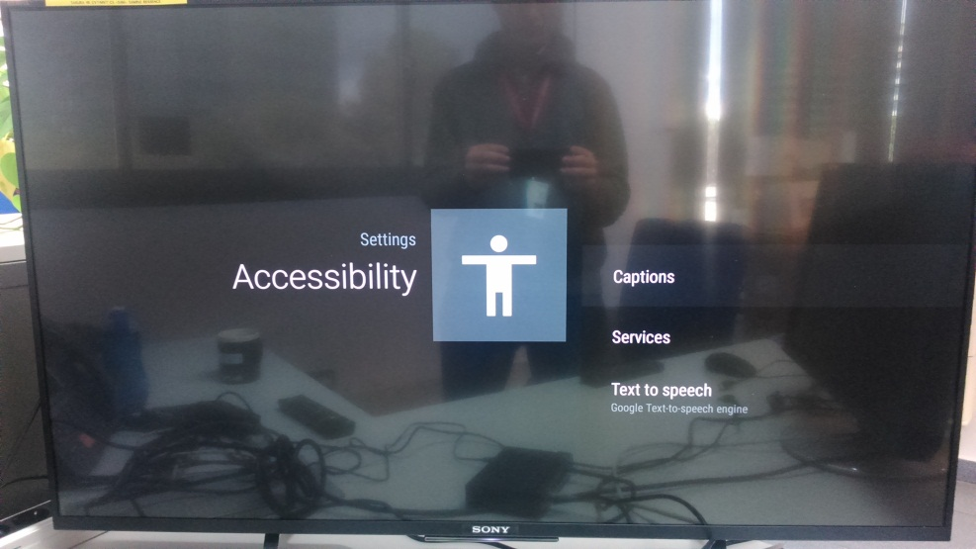
Accessibility features in new Sony Android TV models
Android TV enables different Subtitle features
Android TV includes Text to Speech feature for menu navigation

Slide 8
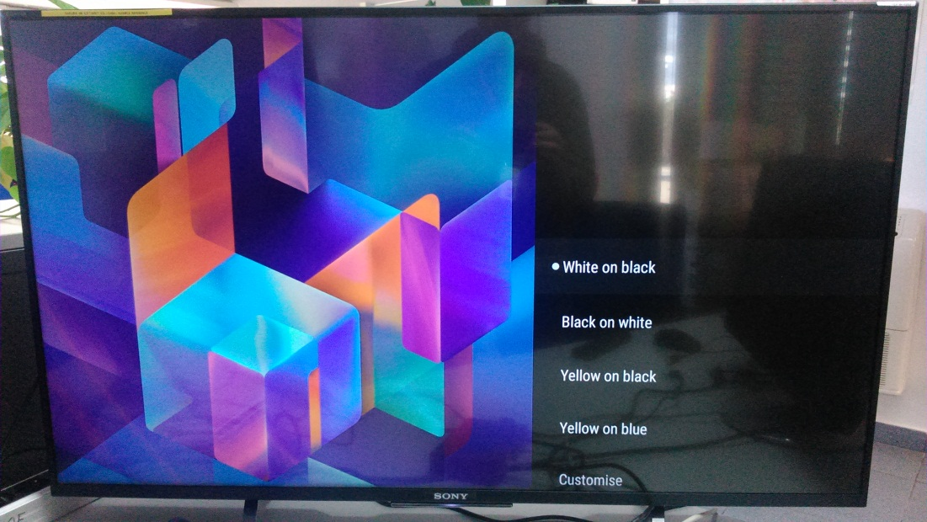
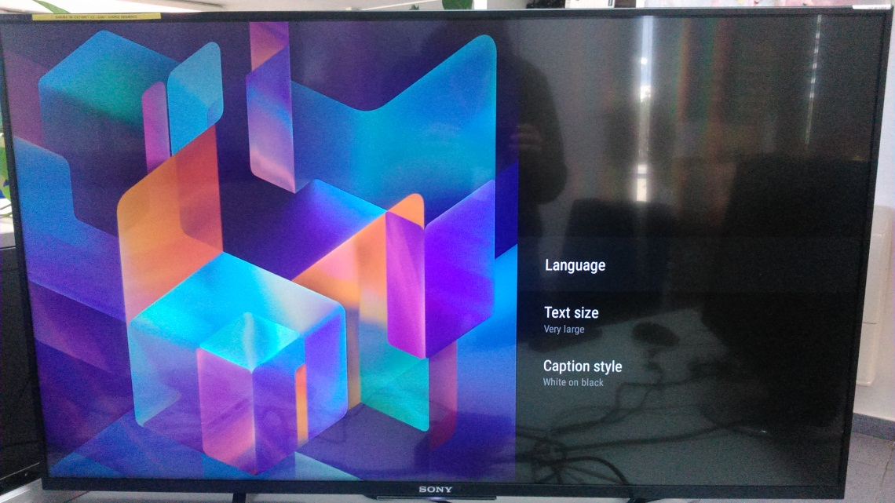
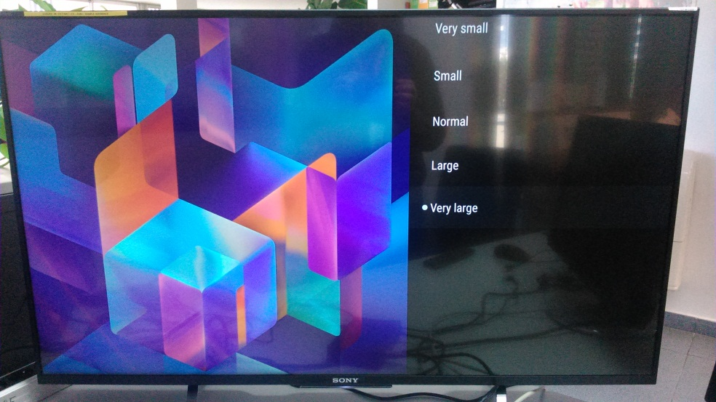
Accessibility features in new Sony Android TV models
User can select the Subtitles text size and the style for better reading

Slide 9
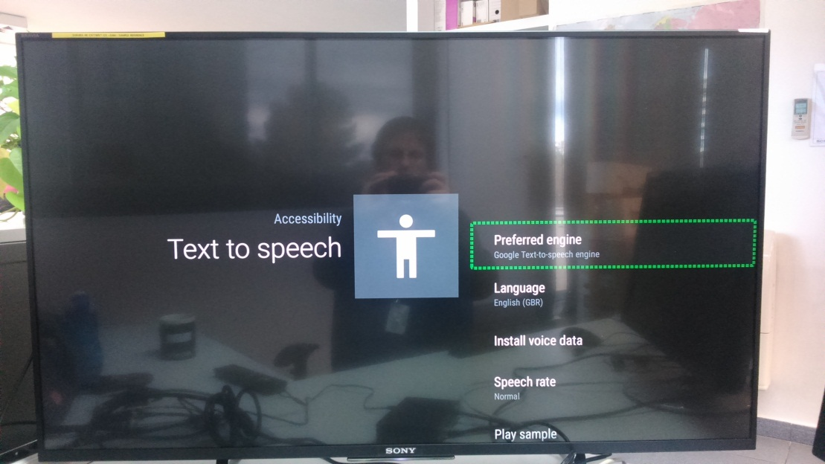
Accessibility features in new Sony Android TV models
With Text to speech, user can listen the displayed information on the screen

Slide 10
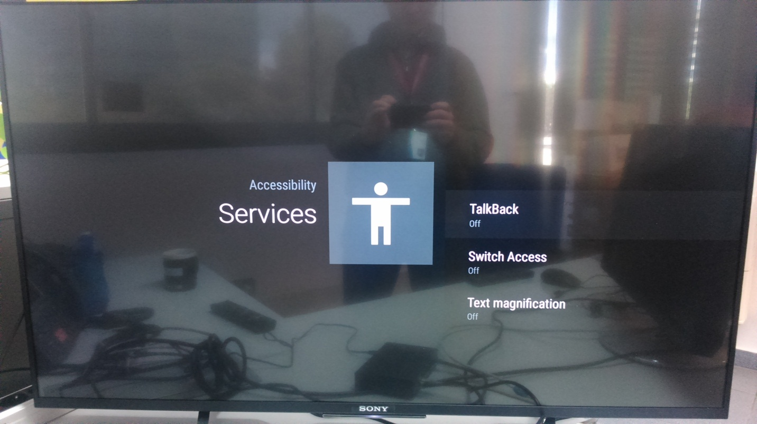
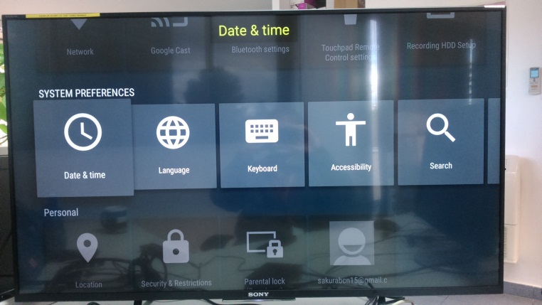
Accessibility features in new Sony Android TV models
Switch Access provides shortcuts to execute some actions
Text magnification feature helps the reading of menus

Slide 11
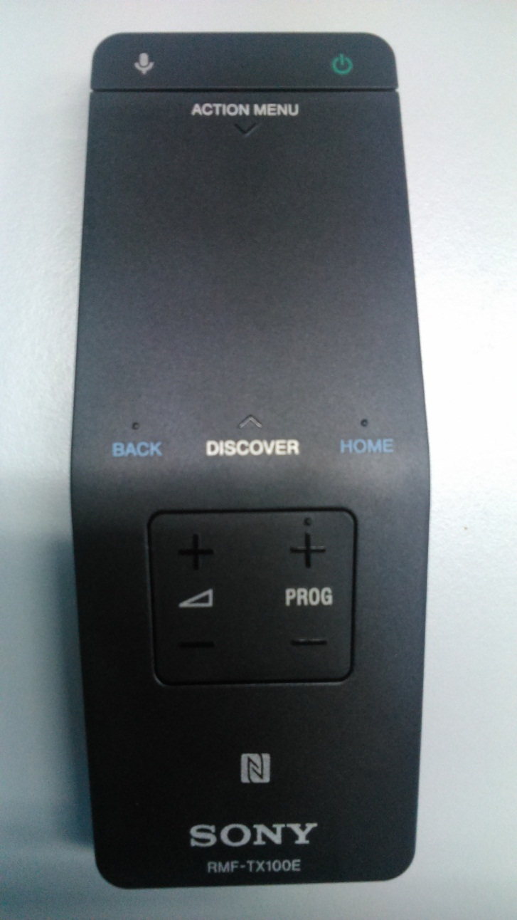
Accessibility features in new Sony Android TV models
Voice Search feature also helps to improve accessibility
Gesture Recognition will be also supported in Sony Android TV

Slide 12
Thank You!
Feedback, questions and comments are welcomed:
Contact: samuel.fabra@eu.sony.com

