Slide 1
Smart Accessibility on Connected TV Accessibility standards for audiovisual media
Simão Campos*
Counsellor, ITU-T Study Group 16 "Multimedia" Telecommunication Standardization Bureau, ITU
simao.campos@itu.int
----------------------------------------------------------------------------------------------------------------------------------------------------------------------
*Short version presented by Christoph Dosch (Chairman ITU-R SG 6 (broadcasting service) on behalf of Simão Campos
Notes:
https://www.itu.int/en/ITU-D/Regional-Presence/Europe/Pages/Smart-Accessibility-on-Connected-TV.aspx

Slide 2
Contents
Introduction to ITU
Importance of standardization
ICTs and rights of persons with disabilities
Accessibility standards and ITU
Extra slides
UN CRPD
Examples of ITU standards helping persons with disabilities

Slide 3
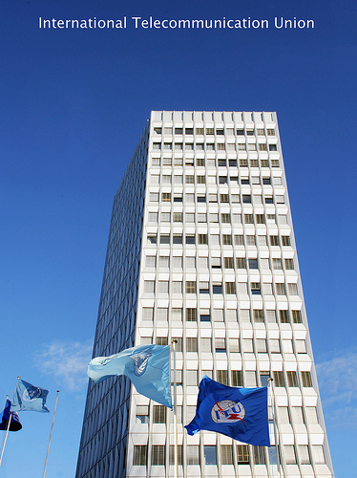
About ITU
The United Nations Specialized Agency for Information and Communication Technologies (ICTs)
Founded in Paris in 1865 as the International Telegraph Union
2015 marks 150 years of experience and innovation Video: http://youtu.be/JFI9EvPQdCw
Notes:
ITU was founded in Paris in 1865 as the International Telegraph Union.
It took its present name in 1932, and in 1947 became a specialized agency of the United Nations.
Although its first area of expertise was the telegraph, the work of ITU now covers the whole ICT sector, from digital broadcasting to the Internet, and from mobile technologies to 3D TV

Slide 4
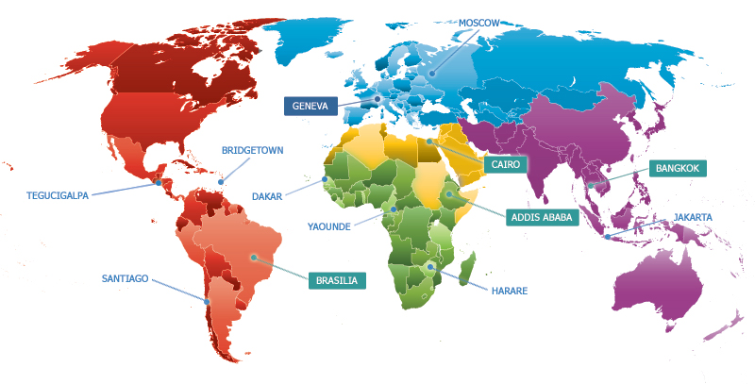
ITU’s Global Presence
Notes:
Headquarters in Geneva with Liaison Office in New York
Regional offices in Addis Ababa, Bangkok, Brasilia, Cairo
Area offices in Bridgetown, Dakar, Harare, Jakarta, Moscow, Santiago, Tegucigalpa, Yaoundé
As a UN specialized Agency, ITU works in 6 languages Arabic, Chinese, English, French, Russian, Spanish
ITU has 747 Staff from 106 Countries ! (numbers from HR on 23/10/2013)

Slide 5
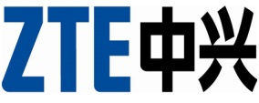
A sample of ITU’s private sector members

Slide 6
ITU’s Structure
Radiocommunication
ITU-R
Coordinates global wireless communication
Standardization
ITU-T
Produces interoperable technical ICT standards
Development
ITU-D
Provides assistance to the un-connected
The General Secretariat provides intersectoral coordination
for the whole organization
Notes:
ITU-T: production of standards covering all fields of telecommunications on a worldwide basis, as well as defining tariff and accounting principles for international telecommunication services
ITU-R: management of the radio-frequency spectrum and satellite orbits
ITU-D: improve telecommunication infrastructure in the developing world, Mobilizing resources and partners for project implementation, capacity building
The General Secretariat provides intersectoral coordination for the whole organization

Slide 7
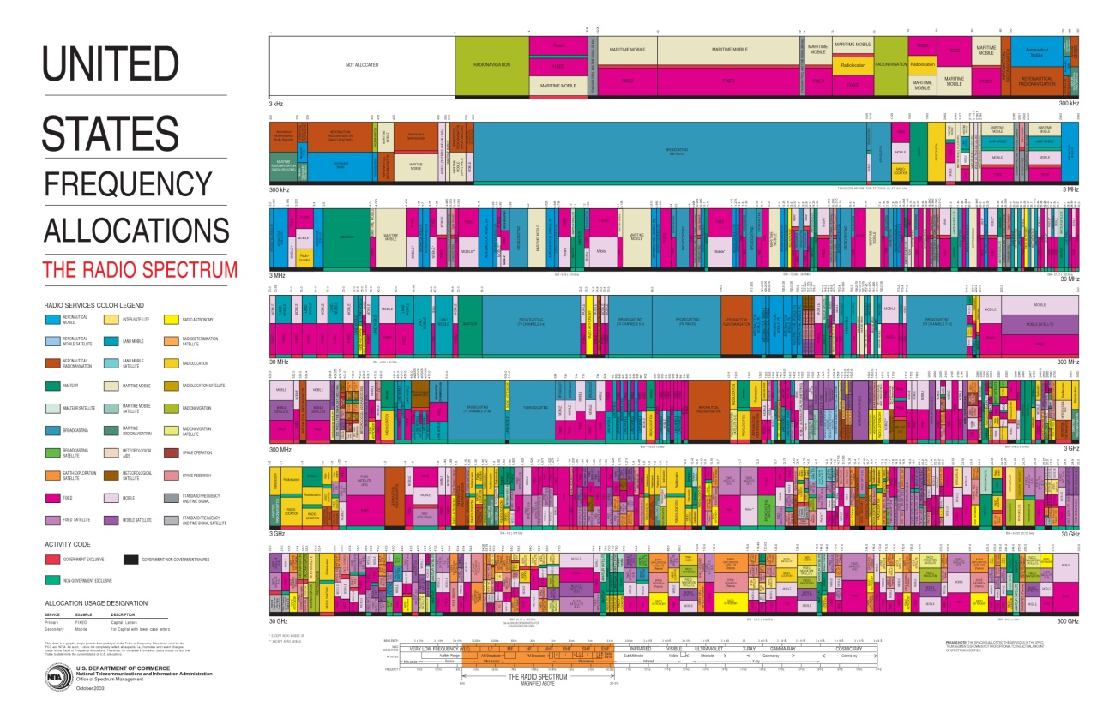
ITU-R: Radiocommunication Sector
Manages the radio-frequency spectrum and satellite orbits
NOTE (CD): For the broadcasting service. ITU-R SG 6 deals with all aspects end-to-end incl. signal production and aggregatipon.
Notes:
ITU-R
- Develop global regulations for spectrum and satellite orbit resources
- Establish harmonized, global standards for wireless systems
- Assist membership develop advanced radio-com systems
ITU-R Study Groups deal with themes such as: spectrum management, radiowave propagation, satellite services, terrestial services, broadcasting, science services (systems for space operation, space research, Earth exploration and meteorology).

Slide 8
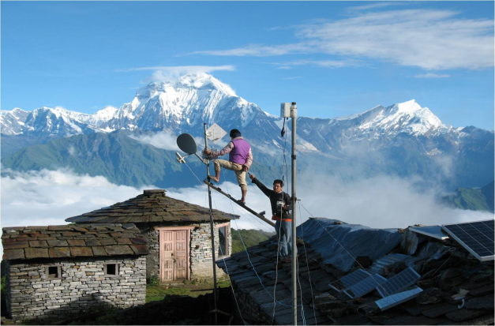
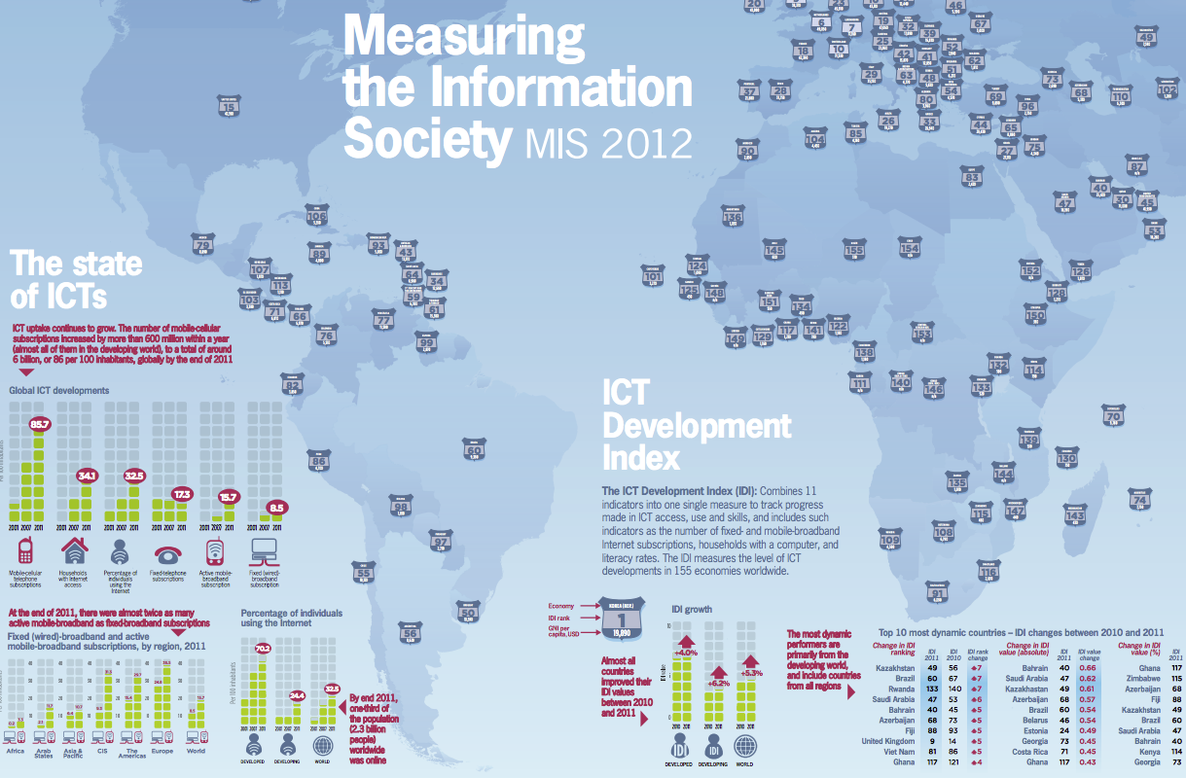
ITU-D: Development Sector
Fostering international cooperation and solidarity in the delivery of technical assistance and in the creation, development and improvement of telecommunication/ICT equipment and networks in developing countries.
Notes:
ITU-D: assists the development of ICTs
- Neutral broker for multi-stakeholder partnerships, resource mobilization
- Executing agency for project implementation
Building capacity among members: technical assistance, advice on policy-regulatory frameworks for investment
Statistics and policy/regulatory trends
Membership Benefits:
- Support your CSR agenda. Build profile and relationships in new markets.
ITU-D Study groups looking at issues such as policy and regulatory reforms needed to stimulate ICT investment. Public-private partnership models for infrastructure roll-out, such as infrastructure sharing. Tax incentives. Licensing. How to expand rural connectivity.
ITU-D publishes its very much acclaimed annual report “Measuring the Information Society”. The report, which has been published annually since 2009, features two benchmarking tools to measure the information society: the ICT Development Index (IDI) and the ICT Price Basket (IPB). The 2012 IDI captures the level of ICT developments in 157 economies worldwide and compares progress made during the last year. The 2012 IPB combines the consumer prices for (fixed and mobile) telephone and Internet broadband services for 161 economies into one measure and compares these across countries, and over time. The 5th edition of the ITU Measuring the Information Society (MIS) report was launched on 7 October 2013, at ITU headquarters, Geneva, Switzerland

Slide 9
ITU-T: Standardization Sector
Provides a neutral platform where governments and the private sector develop international standards covering all fields of telecommunications.
Defines tariff and accounting principles for international telecommunication services.
Notes:
ITU-T
- Develop interoperable, international standards (ITU-T Recommendations)
- Bridge standardization gap
- Cooperation among standardization bodies
ITU-T study groups look at issues such as: multimedia, security, environment and climate change, network and transport, broadband access, quality of service and experience, next generation networks, cloud compuring, intelligent transport systems, numbering and addressing, tarrif, security.
Some examples:
Internet Access through ITU standards
95% of all international traffic runs over fibre = ITU standards
Access:
ADSL: ITU-T G.992
Powerline Transmission:
ITU-T G.9960 (G.hn)
FTTX (Fibre to the <x>):
GPON (Gigabit Passive Optical Networks) ITU-T G.984
Bendable fibers: ITU-T G.657
Multimedia
Advanced video coding: ITU-T H.264
Used to compress billions of clips on YouTube, high-definition content on Blu-ray Discs
New work H.265:
Joint Collaborative Team (ITU-T, ISO/IEC) to reduce data rate by 50%

Slide 10
Importance of standardization

Slide 11
Why is standardization important?
Technical compatibility (Interoperability)
Standards promote innovation, competition and international trade
Allows end users to enjoy wider choice range of services and products, richer functionality and lower costs with mainstreamed accessibility features
Facilitates transfer of technology between developed and developing countries and reduces the digital divide

Slide 12
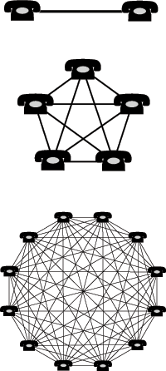
Open standards promote a "network externality effect"

Slide 13
Why accessibility?
Large number of persons affected
Disabilities touch 15% of world population; 80% live in low income countries
Increasing number of countries ratifying UN Convention on Rights of Persons with Disabilities
Consequences in legislation & regulation
It goes beyond persons with disabilities
Children, functional illiterate, elderly, …
Mainstreaming is important:
Human rights
Societal efficiency
Drives down cost, increases user base
An unanswered question: How to provide accessible ICT services in a cost effective manner?
Standards!
Universal design

Slide 14
Intersector Rapporteur Group on Audiovisual Media Accessibility (IRG-AVA)
Harmonized development of standards for audiovisual media accessibility across ITU-T and ITU-R
Survey of possible work items
ITU-R and ITU-T working together on making audiovisual media accessible
ITU-R Study Groups 6 (Broadcasting service)
ITU-T SG16 (Multimedia)
ITU-T SG9 (Broadband cable and TV)
Home page: http://itu.int/en/irg/ava

Slide 15
Other experts groups
Joint Coordination Activity on Accessibility and Human Factors (JCA-AHF)
Dynamic Coalition on Accessibility and Disability (DCAD) at the Internet Governance Forum (IGF)
ITU-T Focus Group on Audiovisual Media Accessibility (FG AVA) (concluded Oct. 2013; work transferred to ITU-T SG16)

Slide 16
ITU and IPC IPTV Application Challenge
Better quality of life with international standards: an accessible world for all
Raising awareness of the importance of multimedia and multimodal audio-visual accessibility for everyone, especially persons with a variety of levels and types of disabilities.
Promoting innovative accessibility ideas to be further developed for actual deployment in systems built to ITU-T’s IPTV specifications.
Awarding ceremony and showcase at Rio Paralympics Games 2016.
A first prize of USD 5,000 for individuals and small-to-medium enterprises (profit or non-profit).
Selected participants will have an opportunity to receive technical support to develop ITU-T IPTV application.
Call for Concept Papers at: http://itu.int/challenges/iptv

Slide 17
Conclusion
ITU has been a pioneer in ICT standards for accessibility
International standards are necessary for affordable, inclusive, accessible services
ITU 193 member countries have approved a number of key media accessibility standards
And Study Groups are working on more
ITU has embraced accessibility also at an institutional level

Slide 18
We are connecting the world by working on making technology accessible to all and by including persons with disabilities. Help us in this valuable work by joining us at the ITU. Thank you!

