Slide 1
Feasibility Study on the Establishment of Internet Exchange Point (IXP) in Montenegro
Prof. Božo Krstajić, PhD
University of Montenegro

Slide 2
Content
Analysis of current situation and feasibility of establishing IXP
Proposed implementation of the first IXP in Montenegro
Technical and commercial requirements for connection to IXP and draft agreements
Estimated budget for IXP set-up
Conclusion with recommendations

Slide 3
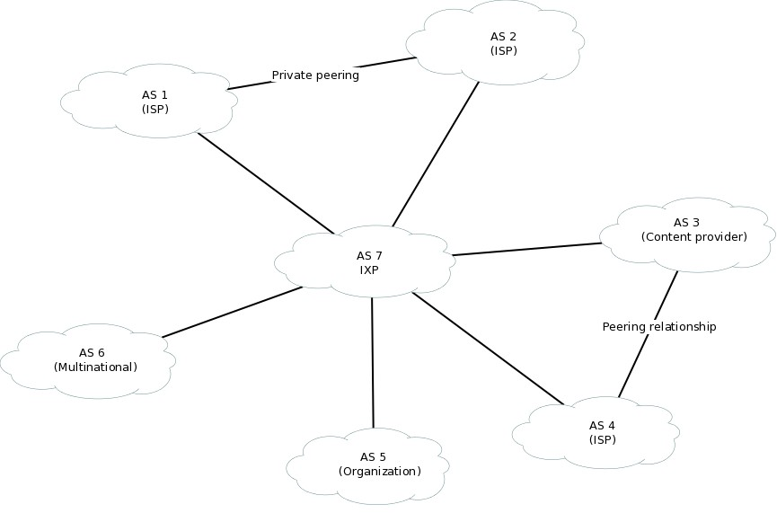
What is peering and IXP?

Slide 4
Analysis of current situation
Internet access services in Montenegro are currently provided by 11 ISPs.
Internet penetration is about 60.3% of the population.
The total capacity of international Internet links at the end of 2013 aggregate to about 20 Gbps .
The percentage of national Internet traffic in Montenegro is less than 10% of the total traffic.

Slide 5
Analysis of current situation
The national Internet traffic is routed through international links, which is a classic example of what is known as tromboning.
Some of the negative consequences of this situation are:
Increase of the distance and the number of additional hops for domestic traffic, i.e. increase of delays.
A larger number of services may significantly decrease QoS.
Additional costs for the services of ISPs and end users.
Risking the safety considerations of data of national importance.
Slows down the development of local content industries.

Slide 6
Benefits of establishing a national IXP
Reducing delays for local traffic
Reducing the cost of international transits
Increased autonomy for local communications
Services, especially e-government services, become safer and more feasible
Development and growth of local Internet ecosystem
International content providers can build a network infrastructure in the country in order to increase the user base.
Survey

Slide 7
Examples of IXPs
In Europe, by the end of 2012, 40 states had least one IXP and there were 146 in total
In the region, only Montenegro and Bosnia and Herzegovina have not so far established a IXP
The most common practice in Europe is that IXPs are managed by non-profit industry organizations of ISPs or academic institutions or networks.

Slide 8
Proposed implementation of the first IXP in Montenegro
IXP would be used to exchange national Internet traffic between ISPs who have signed peering agreements and transit of part of international Internet traffic as well as other types of traffic could flow through the IXP.
IXP should meet the minimum technical, staffing and organizational conditions

Slide 9
IXP location
Initial phase: Podgorica
Later phases: another cities (B. Polje, ...)

Slide 10
Spatial and technical requirements
ISO management standards: 9001–quality, 14001–environment, 27001–information security and 50001‐energy
Placement of equipment
Power supply
Communications
Security and control of access

Slide 11
Recommended technical solution
IXP based on Ethernet by using L3 ("one‐to‐many") design as a separate AS with a unique ASN and IPv4 and IPv6 addresses

Slide 12
Recommended technical solution
Advantages | Only one session towards the IXP is established. Simplicity of connection of service and service provider to the IXP. Peering is under complete control of the operator, with some less demanding hardware resources.
Disadvantages | The IXP team must be familiar with BGP or depend on external associates with good knowledge of BGP.

Slide 13
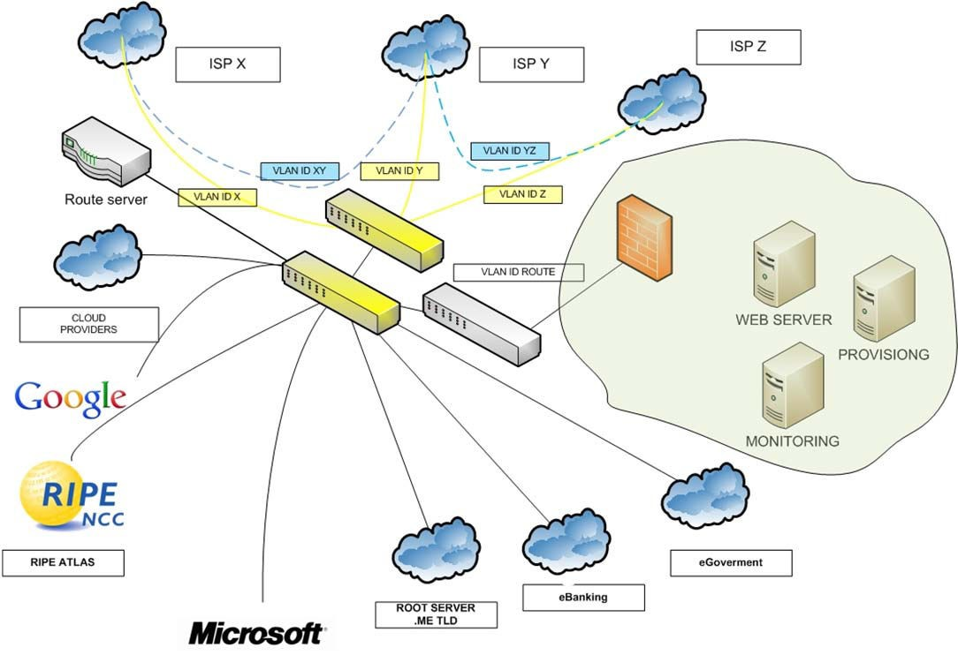
Basic and additional services

Slide 14
ICT infrastructure for IXP
Two (2) modular Ethernet L3 switches with 24 heterogeneous ports, with the possibility of operation in redundancy;
One (1) Ethernet switch with 24 Ethernet‐T ports;
Necessary modules with automated adjustment of access speed to 10/100/1000 Mbps. The access medium is a pair of single‐mode optical fibers with lasers needed for a distance up to 10 (or 15) km;
A router with software support for route-server operation mode;
Firewall to increase security of public and local IXP servers;
A host for servers for user services;
Necessary passive equipment (patch panel, patch cords...)

Slide 15
The IXP staffing and organizational needs
The first IXP in Montenegro should be operated by a company or an institution that is a legal entity registered in Montenegro and that performs the ICT activity:
three (3) engineers with relevant expertise to meet the requirements for IXP optimal functioning;
an experienced lawyer;
an expert manager - the IXP manager;
The advisory and supervisory board (IXP, The AEKIP,MIDT and operators)

Slide 16
Technical requirements for connection to IXP
Client is legal entity registered in Montenegro which has registered AS
Client is solely responsible for the establishment and subsequent maintenance of the communication link to the IXP
Client is responsible for the procurement, installation and maintenance of communication equipment on his side intended for the connection to the IXP

Slide 17
Commercial requirements for connection to IXP
Client sign a service agreement with IXP
Client has to pay a one-off connection fee (depending on the choice of link capacity)
Client has to pay monthly service

Slide 18
Estimated budget for IXP set-up
Equipment | Price – Alternative 1 | Price – Alternative 2
Passive equipment | 4.600€ | 4.600€
Switches | 12.500,00€ | 27.000,00€
SFP modules | 3.500,00€ | 3.500,00€
Router | 3.500,00€ | 3.500,00€
Firewall | 3.000,00€ | 3.000,00€
Servers | 4.500,00€ | 4.500,00€
TOTAL | 31.600,00 € | 46.100,00 €

Slide 19
Recommendation 1
The first IXP in Montenegro should be operated by a company or an institution that is a legal entity registered in Montenegro and that performs the ICT activity

Slide 20
Recommendation 2
Due to a relatively small number of Internet and content providers operating in Montenegro, as well as the currently low share of the national Internet traffic in the total Internet traffic, it is recommended that the first IXP in Montenegro works on non-profit basis (without residual income), with the initial assistance by the line Ministry or the competent Agency in the setup of the respective functionality.

Slide 21
Recommendation 3
3. According to the analysis of location of Internet and content providers, it is recommended that the first IXP with all described spatial and technical requirements is established in Podgorica.

Slide 22
Recommendation 4
IXP should be implemented on the basis of L3 model. The analysis shows that this solution provides full IXP functionality, provision of the proposed, and development of new services, as well as the flexibility and independence of providers-operators in the selection of connection and traffic exchange modes

Slide 23
Recommendation 5
The presented specifications and features of the ICT equipment guarantee the establishment of the full IXP functionality, proposed services, the development of new services, and the connection of all current and a certain number of future providers- operators.

Slide 24
Recommendation 6
6. The estimated value of the specified equipment ranges from 31.000,00€ to 46.000,00€. In accordance with market trends regarding ICT equipment and suppliers’ interest, the funds allocated for the purchase of this equipment estimated to 40,000.00€ or less.

Slide 25
Recommendation 7
In line with the recommendation no. 2 and the analysis of necessary human resources, suggestion is that the first IXP will be one of the existing and interested providers of Internet access services in Montenegro (the survey results of the AEKIP) which has the necessary human resources and that will hire 2 more engineers for the purposes of the IXP functioning..

Slide 26
Recommendation 8
8. For the purpose of regulating and coordinating the IXP functioning, guaranteeing the QoS, transparent achievement of the stated objectives for which the IXP is to be established, and the development of Montenegro as a digital society, it is necessary to set up a single body within the AEKIP to have the advisory and supervisory function.

Slide 27
Recommendation 9
The IXP services will be available to all legal entities that meet the aforesaid technical and commercial requirements, in accordance with the voluntary principle. The proposed technical requirements are essential, and the service fee amounts and associated contracts can be customized based on an additional market analysis after a period of implementation

Slide 28
CONCLUSION
Considering the recommendations listed above, the analysis of profiles of the existing providers of Internet access services in Montenegro and potential candidates for the first IXP in Montenegro, the optimum solution seem to be the creation of the first IXP in an academic environment (CIS UCG)

