Slide 1
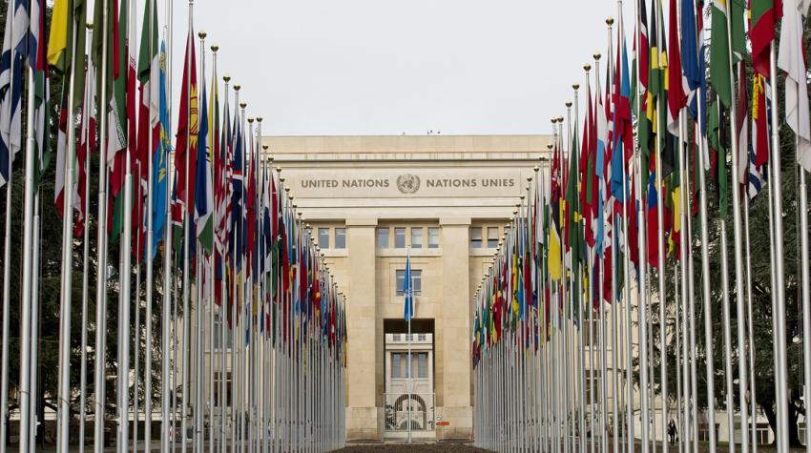


UN Digital Transformation Group for Europe and Central Asia (UNDTG4ECA)
Webinar Series for UNCTs
Debrief on AI
15 September 2026

Slide 2



Agenda
Opening remarks - Jaroslaw Ponder, Head, ITU Office for Europe
AI Debrief
  Mr. Preetam Maloor, Head, Emerging Technologies Division, ITU
  Dr. Luigia Di Gisi, Liaison Officer, Social & Human Sciences, UNESCO
  Mr. Benjamin Bertelsen, Manager, Digital Public Infrastructure (DPI), UNDP
  Ms. Maria Giulia Vitagliano, Digital Transformation Analyst, AI Hub for Sustainable Development, UNDP
  Mr. Frederic Werner, Chief, Strategic Engagement, ITU
Questions and discussion
Closing remarks - Jaroslaw Ponder, Head, ITU Office for Europe

Slide 3
Questions
&
Discussion

Slide 4
Thank you!

Slide 5
