Slide 1
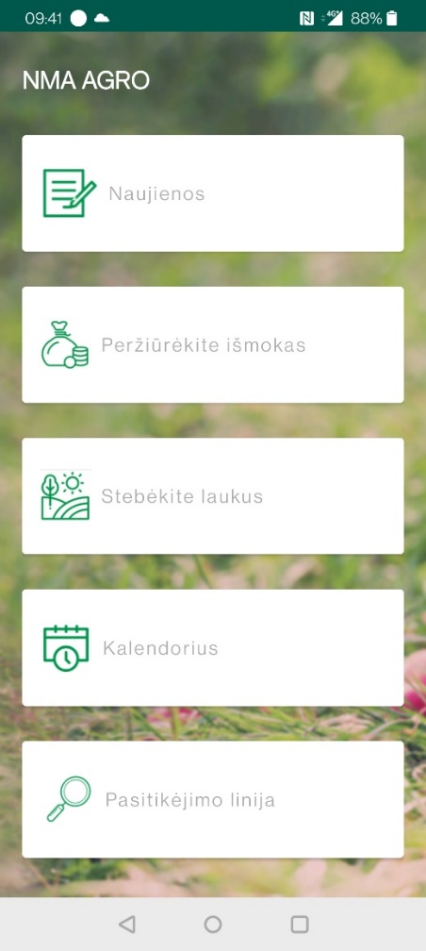
„NMA AGRO“ DEVELOPMENT: FROM GEOTAGGED PHOTOS TO OPEN DATA
NEW Front page!
NPA news, calendar
Portal integration (soon)
Weather forecast
20 000 users
New activities
Auto-Heading
5000 users
2018
2019
2020
2021
Location search
Increasing variaty of activities
Thematic layers
1000 OTSC replaced
11 000 users
3 layers
500 users
Geotagged photo solution
Notes:
Kaip keitėsi programėlė 2018-2021m.:
1.Android
1000patikrų: 500 inv 500 plotinių

