Slide 1
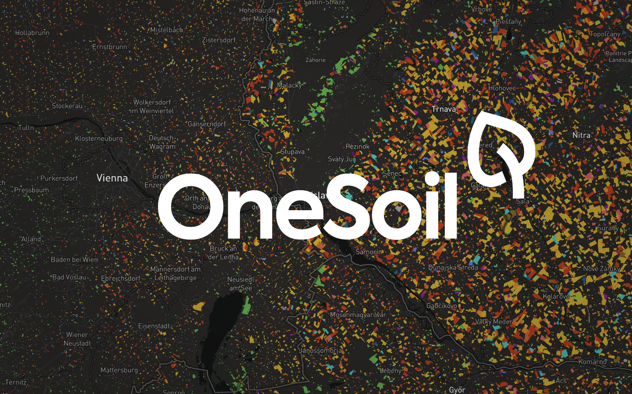

Slide 2
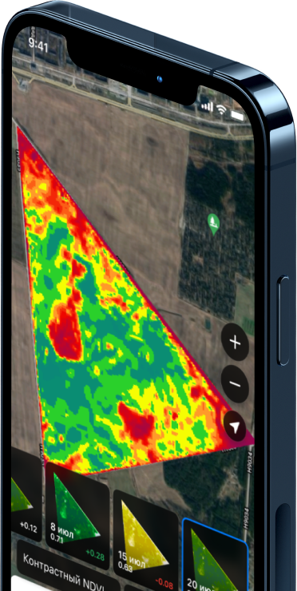
What is OneSoil?
Or what our team of 58 people does
Apps built on advanced technology
Made free for farmers
Embracing challenge

Slide 3
How OneSoil help farmers
To become more sustainable and profitable
VRA technology and productivity zones
Remote crop scouting
Yield maximization
Weather data and charts

Slide 4
OneSoil achievements
Since 2018 up to the moment
400k farmers from 180 countries use OneSoil apps
6% of all arable land in the world covered

