Slide 1
Future of ITU-D Study Question 8/1 Arseny Plossky, Vice-Rapporteur of Question 8/1, ITU/BDT Expert
1

Slide 2
Current Topics
Impact on developing countries of the coexistence of terrestrial television broadcasting with other terrestrial telecommunication services, taking into consideration relevant activities carried out in the other two ITU Sectors, including new uses for the digital dividend.
Analysis of gradual transition to digital terrestrial television broadcasting, focusing mainly on the activities necessary for the analogue switch-off, including:
a) analysis of ongoing progress in the quantity/availability of receiving terminals for reception by users of both sound and TV digital terrestrial broadcasts;
b) analysis of various analogue switch-off strategies, including economic/financial benefits granted to lower-income people for the acquisition of the necessary means for terrestrial reception of digital broadcasting signals;
c) analysis of spectrum re-planning strategies, such as the reallocation of existing broadcasting channels, to allow the coexistence of broadcasting and other services, considering new uses for the digital dividend; and
d) analysis of effective marketing strategies to accelerate the process of public awareness about digital broadcasting.
2

Slide 3
Current Topics (continue)
Spectrum planning for bands allocated to broadcasting services in preparation for the analogue switch-off, the digital dividend, and possible band plans, the planning of different services including allotment plans, and specific bands to be allocated to broadcasters after the analogue switch-off, within the purview of ITU-R.
The use of the digital dividend frequency bands resulting from the transition to terrestrial digital broadcasting, including technical, regulatory and economic aspects, such as:
a) status of the use of the digital dividend frequency bands;
b) standards/recommendations adopted or currently being studied by the other two ITU Sectors related to the topic;
c) sharing of the digital dividend frequency band;
d) harmonization and cooperation at regional level;
e) the role of the digital dividend in saving financing, cost savings on the transition to digital, and best experience and practice in this regard.
3

Slide 4
Report of Question 8/1 (2014-2017)
CHAPTER 1 Best Practices for the transition from analogue to digital television broadcasting, especially those to speed up the transition and to conclude the Analogue Switch off
CHAPTER 2 Marketing strategies to accelerate the process of public awareness about digital broadcasting
CHAPTER 3 Planning the use of spectrum for the Analogue Switch off
CHAPTER 4 The use of the digital dividend frequency bands
CHAPTER 5 Countries Case Studies on the Transition to Digital Broadcasting and the use of the digital dividend frequency bands
4

Slide 5
Additional outcome of Question 8/1 Guidelines on Communications Strategies for the Transition from Analogue to Digital Terrestrial Broadcasting
CHAPTER 1 Communication planning to accelerate the process of public awareness about digital broadcasting
CHAPTER 2 Information campaigns for the general public
CHAPTER 3 Media communication campaigns
CHAPTER 4 Communication strategies targeted to low income population
5

Slide 6
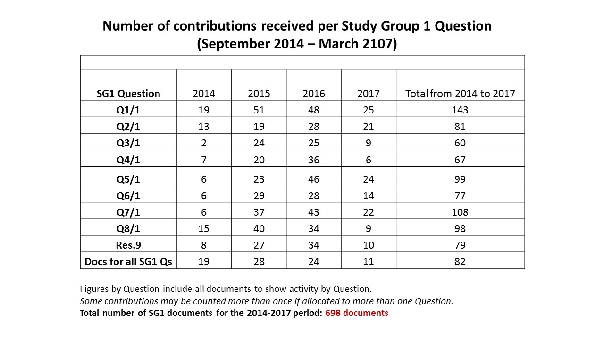
Number of contributions received per Study Group 1 Question (September 2014 – March 2017)
6

Slide 7
Analysis of feedback received through the global survey of Q. 9/2 on the work of ITU-D study groups (Question 8/1)
Purpose
In line with the ITU Telecommunication Development Sector’s (ITU-D) ongoing commitment to innovation, the purpose of the survey is to seek the views of ITU-D Study Group 1 and 2 participants on the groups’ activities and outputs for the 2014 –2017 study period, and on future activities for the next study period.
Comments received from the survey will be shared with ITU Members, particularly to benefit and inform those who may seek to formulate proposals on these issues at Regional Preparatory Meetings (RPMs) and at WTDC-17. The survey results are also intended to complement the feedback obtained from Member States through the survey initiated by ITU-D Study Group 2 Question 9/2 on these issues.
Audience: Participants in ITU-D Study Group and Rapporteur Group meetings
Survey period: 1 –28 February 2017.
Structure
Section 1: Contact information
Section 2: Analysis and proposals on ITU-D Study Group 1 and 2 study Questions
Section 3: Proposals to strengthen the activities of the ITU-D study groups during the next study period
28 responses received from entities in 22 countries and other organizations
https://www.itu.int/dms_ties/itu-d/md/14/sg01/c/D14-SG01-C-0458!N1!PDF-E.pdf
7

Slide 8
Analysis of feedback received through the global survey of Q. 9/2 on the work of ITU-D study groups (Question 8/1)
ADMIN
AFR Equipment producers and users need to move in the same ship.
The period that was set for migration to digital has passed so the Question needs to be reviewed to take that into account.
There are some countries that have not been able to meet the deadlines. Their challenges need to be explored.
ASP For the benefit of developing countries.
CIS Need to add additional new topics like transition on digital sound broadcasting.
EUR It is proposed to include the digital divide
ADMIN RELATED
AFR The transition from analogue to digital will be effective when analogue service is extinguished. So Question 8/1 deserves to continue because most countries are still in the experimental phase with new digital radio services.
Reports and direct assistance have been provided. It is time to move forward.
MINISTRY
ASP Encourage members to shift from analog to digital broadcasting to catch technology advances.
ROA
ASP Useless.
SIO
EUR Avoid duplication with the work of Q1/1 and Q2/1.
UNIVERS, RSRCH
AMS For the next study period the driver should be sound broadcasting.
8

Slide 9
Feedback received through the survey on ITU-D Study Group Questions, Procedures, and Proposals on Future Activities (Question 8/1)
21 responses:
Continue - 67%
Revise - 14%
Merge - 5%
Suspend - 14%
9

Slide 10
Report of Question 11-3/2 (2010-2014)
CHAPTER 1 Statement of the Situation, Introduction and Executive Summary
CHAPTER 2 Identification of Milestones for Successful Transition from Analogue to Digital Broadcasting
CHAPTER 3 Spectrum Planning Issues
CHAPTER 4 Impact of Convergence with Other Terrestrial Telecommunication Services and Interactive Multimedia Applications Enabled by Terrestrial Digital Broadcasting
CHAPTER 5 Key aspects of households' digital receiving terminal park
CHAPTER 6 Local Production and/or Adequate Supply of Equipment, Receiving Park Inclusive
CHAPTER 7 Best Practices (Production, Distribution, Multiplex and Broadcasting Networks), Public Policies and Case Studies
10

Slide 11
Management team discussion on the future of Question 8/1
Broaden the scope of the question not restricting it to Analogue to Digital Television Broadcasting:
Evolution of the Digital Transition in Broadcasting [DVB-T to DVB-T2, SD to HD, MPEG2 to MPEG4];
Digital Radio (Sound) Broadcasting;
Use of the released spectrum to new services and applications, including collection of case studies and best practice:
Bridging the digital divide;
Development of rural communications;
Collection of best practices and countries´ experiences on interference mitigation between broadcasting and new services;
Implementation of new services and applications:
Community and Regional TV on DTV;
New Broadcasting Services: 3D, 4K, 8K, etc; multimedia/interactive services; mobile television;
Economic aspects of the deployment of new broadcasting services and applications:
Deployment costs;
Impact of other television distribution platforms (IPTV, Cable, Satellite, etc) on terrestrial broadcasting market.
11

Slide 12
Discussion during Study Group 1 on the future of Question 8/1
Regarding the future of Question 8/1, while it was noted in the participant survey that many transition deadlines for analogue to digital terrestrial television had passed, many countries are still in the experimental phase with new digital sound/radio services.
New topics proposed during the Rapporteur Group meeting included broadening the scope of Q8/1 to include the evolution of the digital transition in broadcasting and digital radio/sound broadcasting, and how to use the released services and application; include economic aspects of the deployment of new broadcasting services and applications, as well as to study the impact of other television distribution platforms. Collecting countries’ experiences on interference migration between broadcasting and new service and the implementation of new services and applications (Community and regional TV on DTV and new Broadcasting services: 3D, 4K, 8K, etc.) were also deemed important. Including relevant issues related to people with disabilities was also supported.
The Rapporteur Group proposed to continue the study Question.
12

Slide 13
Proposals from Member states’ contributions (Russian Federation)
Changing the name of Question 8/1: Examination of strategies and methods of migration from analogue to digital terrestrial broadcasting and implementation of new services
Proposals:
Revise mandate of the Question.
Entitle the Question “Examination of strategies and methods of digital terrestrial broadcasting and implementation of new services”.
Assign the Question to new Working Party 1/1 “Reduce inequality (Goal 10), including the digital divide”.
Purpose: The need to expand the scope of the Question, in particular, on the use of Digital Dividend and the transition to digital audio broadcasting.
13

Slide 14
Proposals from Member states’ contributions (China)
Changing the name of Question 8/1: Examination of strategies and methods of migration from analogue to digital terrestrial broadcasting and implementation of new services Challenges and Opportunities for Video Services in ICT Applications
Topics be studied:
Estimate overall level of video services used to improve the social well-being, uplift the level of public services and enhance the productivity of different sectors and on the results achieved
To summarize successful cases and experiences on using video services
To study the prospects of new type of applications, which integrate video with ICT applications (such as e-government, distance education, and telemedicine), and their role in upgrading the level of video applications in developing countries.
How to build the ICT networks able to meet the needs of the development of video services. Provide guideline for the construction of future ICT networks.
To make policy makers, industry regulators, telecom operators, manufacturers understand the role of video services in improving people's living standards and manufacturing productivity and the role of ICTs in promoting the transformation and upgrading of enterprises. Cooperation in that field between abovementioned stakeholders as like as between developing and developed countries
14

Slide 15
Proposals from Member states’ contributions (Côte d'Ivoire)
It is proposed to continue the study Question.
Reason: The migration from analogue to digital TV will be effective when analogue will be turn out. Therefore, that Question deserves to be continued because most countries are still on experimental step with new digital radio services.
15

Slide 16
Thank you very much for your kind attention!
We are looking for your views and proposals!

