Slide 1
Accessibility policies and strategies, Montenegro
Belgrade, 7 October 2015

Slide 2
Montenegro, quick facts
Total surface of 13 812 sq km
Population: 620 029, Households: 192 242
Republican form of government
23 Municipalities
(The capital: Podgorica)
(The old Royal Capital: Cetinje)
Average number of household members: 3.2
Population density (per sq km): 44.9

Slide 3
Regulatory framework
The Law on Electronic Media
Rights, duties and responsibilities of AVM service providers (Radio and TV broadcasters, CATV providers)
Status and competencies of AEM
Other matters relevant for AVM service provision
The Law on Electronic Communications
Activities in the field of EC networks and services
Status and competencies of EKIP
Procedures for:
Operators and EC service providers
Right of users
Provision of Universal Service
Use of numbers and radio-frequency spectrum

Slide 4
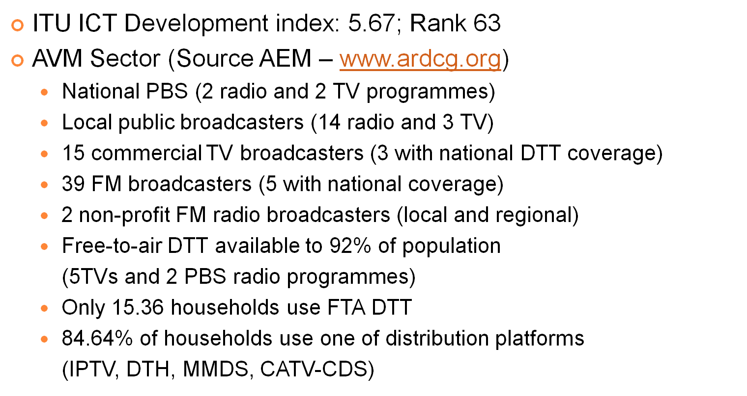
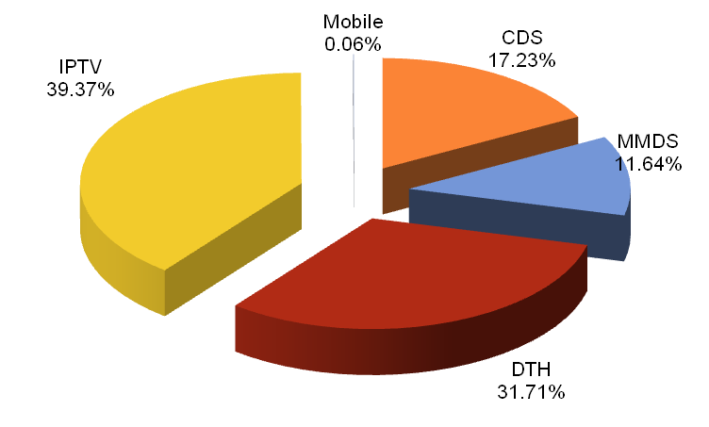
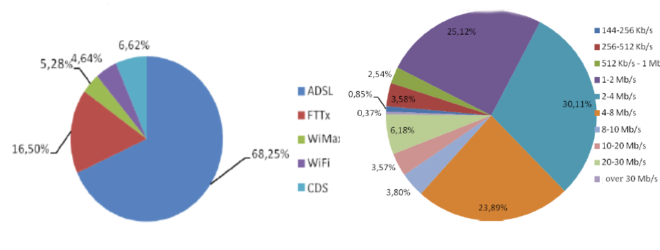
Electronic media and electronic communications market

Slide 5
Strategies
The Strategy for the Integration of Persons with Disabilities, 2007
(Social welfare, Education, Vocational rehabilitation and employment ,Accessibility...)
The strategy for the development of IS (2012-2016)
200 services provided by public administration
Better IT infrastructure
Reduced price of internet service
Encourage competition, increase investments in IT sector
E-inclusion program (persons from neglected social group, remote areas, persons with disabilities)
The rulebook on special measures to be taken to improve access to public communication networks and services for persons with disabilities.
Access to electronic communication network and services
Access to terminal equipment

Slide 6
Accessibility in the broadcasting
Provisions on the rights of persons with disabilities
Only few broadcasters provide minimum possibilities and dedicated programmes for persons with disabilities
Public service broadcasting
The Fund for Support Commercial Radio Broadcasters
The AEM activities in the future

Slide 7
Positive Examples
Radio HOMER non-profit broadcaster
(NGO Cultural Information Center – www.kichomer.org)
Available to 25% to 30% through terrestrial FM network
Also available via internet stream
Programmes fully dedicated to persons with disabilities
(Daily news, culture, sport, audio books, audio described movies, audio drama)
Disabilityinfo (www.disabilityinfo.me)

