Slide 1
European Commission Communications Networks, Content and Technology Converging Media & Content Thomas Küpper
The Role of Information and Communication Technologies in the Development of Inclusive Society for Persons with Disabilities Belgrade 08 OCT 2015

Slide 2
Agenda
Introduction
European Commission
Accessiblity, Research & Innovation
Industry Trends Media & Convergence
Challenges

Slide 3
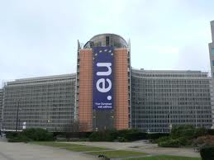
European Commission
Legislation
Regulation
Research

Slide 4
Communications Networks, Content and Technology
former DG Information Society and Media
Manages the Digital Agenda of the EU (internal name "DG Connect")
Digital Economy and Society: Mr Oettinger
Digital Single Market: VP Ansip
http://ec.europa.eu/ digital-agenda/

Slide 5
Unit Converging Media & Content
Regulation
eg AVMSD, Media Freedom, Media Literacy
Research & Innovation
HoU Ms Lorena BOIX ALONSO
DHoU Ms Krisztina STUMP
Notes:
Motivation: align policy with research
29 projects
Budget 98 MEUR

Slide 6
Audiovisual Media Services Directive (AVMSD)
Commissioner Oettinger Speech at Digital Assembly Riga 2015
Commission is assessing the functioning of the Audiovisual Media Services Directive (AVMSD) in the context of a so-called REFIT (regulatory fitness) evaluation.
A revision of the Directive is foreseen in 2016.
https://ec.europa.eu/commission/2014-2019/ oettinger/announcements/speech-digital-assembly-riga-2015_en
Ongoing public consultation closed 30-09-2015
http://ec.europa.eu/digital-agenda/en/news/public-consultation-directive-201013eu-audiovisual-media-services-avmsd-media-framework-21st

Slide 7
Research and Innovation
Portfolio 22 ongoing projects (FP7 and CIP)
One project cooperation EU Brazil
8 ongoing Grant Agreement Preparation H2020
3 Programme Officers
Volume our projects multi annually ~100 MEUR ~ 20MEUR in 2015, ~ 40 MEUR in 2016 planned.
2016 call to be announced at ICT2015 conference
http://ec.europa.eu/digital-agenda/en/ ict2015-innovate-connect-transform-lisbon-20-22-october-2015

Slide 8
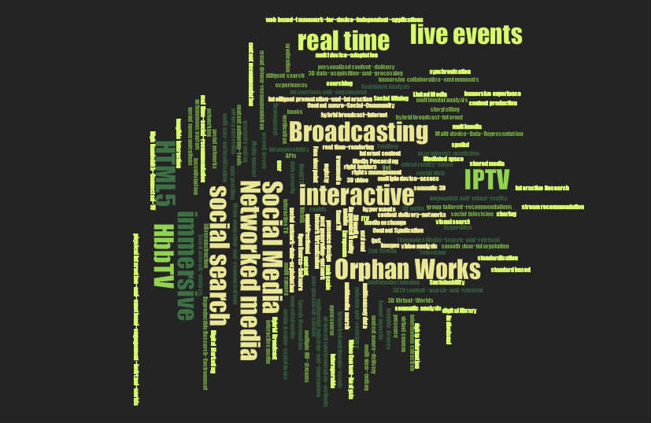

Slide 9
Horizon 2020
New single (financial) instruments for the EC
For research and innovation
Innovation is closer to market than research
Stimulation of Innovation, SME & gender balance
Major simplification - single set of rules & tools
Estimated 80 billion EUR funding
http://ec.europa.eu/research/horizon2020

Slide 10
G1 research focus
Social media
Immersive- and user experience
Broadcast and Internet convergence
Accessibility

Slide 11
Draft Work Programme 2016
Official title: Draft Horizon 2020 Work Programme 2016-2017 in the area of Information and Communication Technologies
"pre-publication" available on europa.eu https://ec.europa.eu/programmes/horizon2020/sites/ horizon2020/files/05i.%20LEIT-ICT_2016-2017_pre-publication.pdf
The word accessibility is mentioned 14 times
ICT-19-2017: Media and content convergence

Slide 12
ICT-19-2017: Media and content convergence
Quote from the work programme:
"Development and advancement of accessibility solutions specifically for converging media and content. This may include technologies for subtitles, sign language, descriptive language, automated graphical presentation of avatar character, automated translation and adaption, personalised setup in an accessibility scenario."

Slide 13
Industry trends (1) broadcasting
Broadcasting to IP: Minutes versus costs
New OTT players
Netflix, Google, Apple, Amazon etc.
Proprietary silo-technologies
Gatekeeper
Set-top box to puck to stick to software
HbbTV
The role of DTT?
Mobile cannot replace terrestrial with today's 4G

Slide 14
Industry trends (2) accessibility
Growing importance
Persons with special needs
Aging society
Migration, minority languages
Inclusion
Today often end-of-the-pipe technologies
Non-linear versus linear

Slide 15
Industry trends (3) data analytics
Big data sector growing 40% p.a.
Big Data in Media Workshop 24 SEP 2015
http://ec.europa.eu/programmes/horizon2020/en/news/big-data-and-media-content-workshop
Monitor everything including viewing habits IPTV, HbbTV
Recommendation / discoverability
Who controls the data? Open data?

Slide 16
Industry trends (4) interoperability
Interoperability versus proprietary systems: Open systems with open interfaces
Software of tv, stb
Who "owns" the customer?
Discoverability and change of provider issues
European (public) broadcasters regional mandate / focus
European Digital Single Market

Slide 17
What is your religion?

Slide 18
Today
Every TV can display all programs.
Level playing field
public broadcasters, commercial players and pay-tv
Typically only one pay tv operator per country
Common standards in Europe (DVB-X)
Broadcasters pays for broadcasting.
Reception is free

Slide 19
Market moving towards
Mobile operators owning more spectrum
Reception has to be paid
Media is biggest traffic driver in data networks (fixed and mobile)
Apple, Netflix and Amazon new gatekeepers
Who owns customer?
One box per service

Slide 20
Challenges
Accessibility?
How to assure European values and plurality?
Open standards and open interfaces, CA/DRM
Why separate networks for data, tv & radio in a converged scenario (5G for all)?
Hardware to software
European players regional mandate / focus
Discoverability
European Digital Single Market

Slide 21
thank you
Thomas Küpper
thomas.kuepper@ec.europa.eu
+32 2 29-88066

