Slide 1




Implementation of WTDC-10 RIs for Europe and WTDC-14 across the World
Jaroslaw K. PONDER
Europe Coordinator
EURregion@itu.int
Regional Development Forum for Europe
20-22 April 2015 / Bucharest, Romania

Slide 2



EUROPE – 2010 → 2014

Slide 3


Evolution of Regional Initiatives: 2010 → 2014
WTDC - 2010 |  | WTDC – 2014
RI-2 Facilitating the smooth transition from analogue to digital broadcasting | → | RI-1 Spectrum management and transition to digital broadcasting
 |  | RI-2 Development of broadband access and adoption of broadband
RI-1 Accompany efforts to improve E-accessibility in Central and Eastern Europe | → | RI-3 Ensuring access to telecommunications/ICTs, in particular for persons with disabilities
 |  | RI-4 Building confidence and security in using telecommunications/ICTs
 |  | RI-5 Entrepreneurship, innovation and youth
RI-3 Share best practices in the implementation of e-applications, including e-health

Slide 4
Regional Initiatives Adopted by WTDC-10
EUR1 Accompany efforts to improve E-accessibility in Central and Eastern Europe
Objective: To provide assistance to Member States in order to offer e-accessibility (including Internet and information access) for blind people and people with visual impairment problems.
EUR2 Facilitating the smooth transition from analogue to digital broadcasting
Objective: To assist Member States in Central and Eastern Europe in making a smooth transition from analogue to digital broadcasting, taking into account the GE06 Agreement on digital terrestrial broadcasting as well as the work undertaken by relevant European regional organizations and entities, to avoid duplication of effort.
EUR3 Share best practices in the implementation of e-applications, including e-health
Objective: To share best practices in the implementation of e-applications, including e-health

Slide 5

RI-1: E-accessibility in CEE (Internet and digital television) for blind people and people with visual impairment problems
Two Bulgarian schools, in Sofia (school for children with impaired vision, "Louis Braille") and in Varna (school for children with impaired vision, "Prof. Ivan Shishmanov ") equipped with 10 workstations with the necessary equipment, hardware, software and other facilities.
“Speech Synthesis in Macedonian” created, speech synthesizer which converts electronic Macedonian text into audio speech enhances accessibility of blind and visually impaired people to the benefits of using ICTs.
Administration of Bulgaria, Local Municipality, Home for Elderly People with Disabilities in the town of Dobrich, Bulgaira, teamed up with the ITU in order to empower inhabitants of the residence through the ICTs, creating a modern ICT center for elderly people addressing all types of dissabilities (ICT Center established and serving as best practice in the region)

Slide 6
RI-1: E-accessibility in CEE (Internet and digital television) for blind people and people with visual impairment problems
In December 2013, ITU - EBU Meeting for Central and Eastern Europe on e-Accessibility in Television Broadcasting was held in Zagreb, Croatia, upon the kind invitation of HRT Academy.
Curriculum of an Online course for TV broadcasters in Europe on audio description (AD) for blind and visually impaired consumers of audio visual media is under preparation. First course is planned for September 2015.
Curriculum of an online course on policy guidelines and legal and regulatory framework based upon the Model ICT Accessibility Policy Report is under development. It aims at helping policy makers and regulators develop their own accessibility policies and regulations. The online course (using ITU Academy platform) is planned for September 2015. It would cover chapters on Audio visual media accessibility and Public procurement.
The workshop on Smart Accessibility on Connected TV was held in Barcelona, Spain, on 18 March 2015. The workshop was organized by the Autonomous University of Barcelona in partnership with the International Telecommunication Union and European Commission.

Slide 7

RI-2: Regional Initiative Facilitating the smooth transition from analogue to digital broadcasting
In 2011, ITU Sub-Regional Seminar and Administration Round Table on Digital Terrestrial Television Broadcasting and Digital Dividend in Central and Eastern Europe, hosted by the Hungarian National Media and Infocommunications Authority (NMHH) which was held in Győr, Hungary. The meeting provided an opportunity for a high-level dialogue on the switchover from analogue to digital terrestrial television broadcasting and addressed the most important technical, regulatory and economic aspects. Based on the outcomes of the meeting and of the dedicated regional survey, a plan of action for the implementation of this regional initiative was established.
In 2012, ITU EUR, in collaboration with the Ministry of Administration and Digitization and the Office of Electronic Communication of Poland, organized the ITU Regional Seminar for Europe and CIS Countries on Transition to Digital Broadcasting, Borderline Frequency Coordination and Digital Dividend, that was held from 7 to 9 May 2012 in Warsaw, Poland.
The meeting was followed by the annual Regulatory Seminar for Europe on Transition to Digital Terrestrial Television Broadcasting and Digital Dividend that was hosted by NMHH of Hungary from
5 to 7 November 2012 in Budapest.

Slide 8
RI-2: Regional Initiative Facilitating the smooth transition from analogue to digital broadcasting
In 2014, in collaboration with the National Media and Infocommunications Authority of Hungary (NMHH), ITU organized the Regional Seminar for Europe on “Transition to Digital Terrestrial Television Broadcasting and Digital Dividend” in Budapest, Hungary. This Seminar was the final event of the European Regional Initiative on Digital Broadcasting for Europe and it helped consider how to develop further a unified approach in order to enhance the advantages that it will bring to the region of Central-Eastern Europe.
Following recommendations from the seminars, a survey on the status of the digitalization process in Central and Eastern Europe was carried out. Outcome to be launched at the upcoming Regional Seminar organized in collaboration with the National Media and Infocommunications Authority of Hungary (NMHH)to be held from 5-7 May 2015 in Budapest, Hungary.
In addition, a twinning programme between Albania and Poland was facilitated that led towards a study visit of a group of Albanian experts to Poland to exchange knowledge and experience in the field of digital broadcasting. The programme evolved into a sound framework for bilateral cooperation on related issues.

Slide 9
RI-2: Regional Initiative Facilitating the smooth transition from analogue to digital broadcasting
In 2012, direct assistance to Albania to advise on the type of monitoring system to implement in order to best support the regulatory authority’s mandate related to frequency planning, frequency engineering, licensing and enforcement
In September 2013, in collaboration with the Ministry of Infrastructure, Transport and Networks of Greece, organized a three-day intensive seminar on ITU Procedures and Digital Terrestrial Television held in Athens, Greece
Also in 2013, direct assistance to Bosnia and Herzegovina in assessing current practices in spectrum management and determining possible options for effective and efficient use of spectrum in the future
  In context of RI, and in accordance with Resolution 126 of the ITU Plenipotentiary Conference 2010, “Assistance and support to Serbia for rebuilding its destroyed public broadcasting system”, and Resolution 33 (Rev. Doha, WTDC 06), BDT has been assisting Serbia since 2011 with expertise and broadcasting equipment.

Slide 10

RI-3: Share best practices in the implementation of e-applications, including e-health
Network of m-health specialists has been established in order to address technical, policy, regulatory and business related issues of emerging technology.
In 2012, the ITU Experts Group Meeting on m-Health: Towards Cure, Care and Prevention was held at ITU Headquarters on 25-26 September 2012. The meeting addressed the challenges and opportunities arising from the rapid growth of the mobile health industry at the policy, regulatory, technical and business level.
In follow up to the meeting, a series of country case studies has been released and a roster of m-health experts created. In addition, a thematic study has been elaborated that is currently under review and will serve as a basis for the creation of a self-assessment toolkit for policy makers.

Slide 11
RI-3: Share best practices in the implementation of e-applications, including e-health
Furthermore, a Global eHealth Projects Repository was launched as a joint effort between ITU and the World Health Organization (WHO) in 2013. The repository collects and makes available information on validated, operational eHealth projects that demonstrate the effective use of ICTs for health. All administrations and stakeholders have been encouraged to submit eHealth projects that are evaluated and supported by governments. By contributing to this resource, administrations will raise the visibility of eHealth projects and enable an empowering sharing of experiences and good practices.
ITU discussion paper entitled “Filling the Gap: Legal and Regulatory Challenges of Mobile Health (mHealth) in Europe” has been elaborated and served as an input to the Public consultation on the Green Paper on mobile Health.

Slide 12
Additional Activities Related to New RIs
Broadband
  ITU Interactive Terrestrial Transmission Maps (http://www.itu.int/itu-d/tnd-map-public/ )
  As part of the Broadband Reports series, 9 country case studies have been developed in close collaboration with the Broadband Commission for digital development including 3 European countries, namely Albania, Romania and FYR Macedonia
  Special project on New Legislative Paradigms Fostering Broadband Development has been launched in 2011. A broadband case study on Poland was developed. A webinar for European administrations on Effective Solutions for Broadband Universalization was organized. Twinning between Poland and Moldova was organized.
  In September 2012, ITU EUR, in collaboration with the Minister for Innovation and Information and Communication Technologies of Albania, organized the Regional Forum for Europe on Broadband: A Pillar of Social and Economic Development which was held in Tirana, Albania

Slide 13
Additional Activities Related to New RIs
Broadband
  Regional Conference on Protection of the Interests of the Electronic Communication Users, in October 2013 in Budva, Montenegro, organized by ITU and EKIP.
  Regional European broadband conference was held April 2014 in Greece on the kind invitation of the Greek Ministry of Infrastructure, Transport and Networks.
  Regional Forum for CIS and Europe on Shared Use of Infrastructure as a Tool to Promote Development of Broadband Networks on 20-22 May 2014 in Chisinau, Republic of Moldova.
  Regional Conference on Regulatory Activity in the Electronic Communications Sector: Towards Mobile Broadband Ubiquity in Europe, 29 - 30 September 2014, in Budva, Montenegro, organized by ITU and EKIP.
  In 2012, assistance to Albania in the endeavor of setting up the national broadband plan. A policy paper prepared was officially handed over to the Albanian Administration on the occasion of the ICT Forum on Broadband held in Tirana in September 2012
  In 2014 assistance to Albania with regard to the measurement of the broadband ecosystem.
  Direct assistance to Montenegro: Establishment of the national IXP: Towards National Internet Exchange Point: Building enabling environment for effective IXP in Montenegro, 1 October 2014, Budva, Montenegro

Slide 14
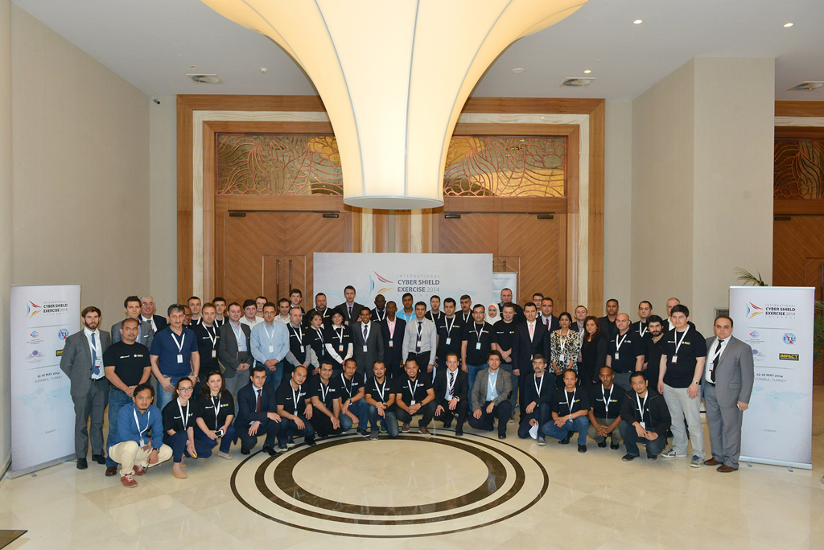
Additional Activities Related to New RIs
Cybersecurity
  In partnership with IMPACT, five European countries, namely Albania, Bosnia and Herzegovina, Montenegro, Serbia, and FYR Macedonia, benefitted from the readiness assessment in view of establishing a National Computer Incident Response Team (CIRT).
  In April 2011, a regional seminar on Child Online Protection was held in Odessa, Ukraine
  In 2012, Cross-regional seminar on Current Methods for Combating Cybercrime in Europe, Asia-Pacific and the CIS Region was organized in Odessa, Ukraine
  Regional European Conference on Cybersecurity has been held in April 2014 in Greece on the kind invitation of the Greek Ministry of Infrastructure, Transport and Networks
  International Cyber Shield Exercise, May 2014, Turkey
  In October 2014, Central European Congress, Public-Private
  dialogue platformon Cybersecurity was organized in Romania
ds

Slide 15
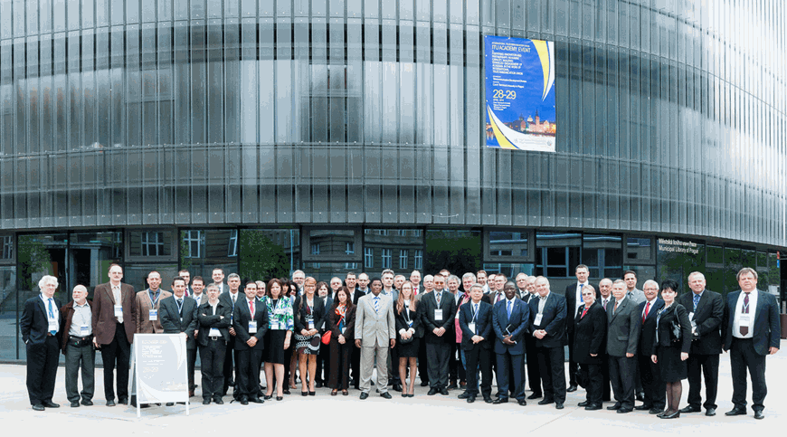
Additional Activities Related to New RIs
Innovation
  in 2012, ITU EUR organized the Experts Group Meeting for Europe on the Increasing Role of Public Private Partnerships in the ICT Ecosystem - 25 Years of Telecom/ICT Sector Reform in Europe and Beyond, held at ITU Headquarters
  Fostering Innovation and Partnerships in Human Capacity Building: Enhanced Engagement of Academia in the International Telecommunication Union and ITU Academy event (28– 29 April 2013, Prague, Czech Republic)

Slide 16

Additional Activities Related to New RIs
Human Capacity Building
  Since 2011, ITU EUR facilitated training opportunities for more than 500 professionals
  In 2011, the Polish National Institute of Telecommunications hosted a face-to-face event on Advanced Internet Technologies for Europe in Warsaw, Poland
  A distance learning course developed in collaboration with Ss. Cyril and Methodius University in Skopje (CMU) focused on Next Generation Mobile and Wireless Networks
  In 2012, INA Academy hosted a face-to-face event on the Digital Dividend: Challenges and Consumer Interests in Athens, Greece
  CMU facilitated distance learning courses on Mobile Broadband: LTE/LTE-Advanced, WiMAX and WLAN and Future Internet In 2013,
  In 2014 CMU provided a series of distance learning courses focused on Broadband and Next Generation Networks, 4G Mobile and Future Internet.

Slide 17
Evolution of Regional Initiatives: 2010 → 2014
WTDC - 2010 |  | WTDC – 2014
RI-2 Facilitating the smooth transition from analogue to digital broadcasting | → | RI-1 Spectrum management and transition to digital broadcasting
 |  | RI-2 Development of broadband access and adoption of broadband
RI-1 Accompany efforts to improve E-accessibility in Central and Eastern Europe | → | RI-3 Ensuring access to telecommunications/ICTs, in particular for persons with disabilities
 |  | RI-4 Building confidence and security in using telecommunications/ICTs
 |  | RI-5 Entrepreneurship, innovation and youth
RI-3 Share best practices in the implementation of e-applications, including e-health

Slide 18
Regional Initiatives Adopted by WTDC-14
EUR1 Spectrum management and transition to digital broadcasting
EUR2 Development of broadband access and adoption of broadband
EUR3 Ensuring access to telecommunications/ICTs, in particular for persons with disabilities
EUR4 Building confidence and security in using telecommunications/ICTs
EUR5 Entrepreneurship, innovation and youth

Slide 19
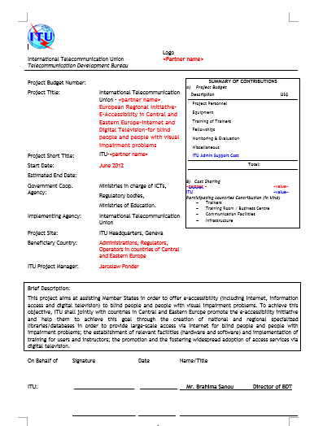
Bottom-up Approach
Five Regional Initiatives
Objective/Results
Implementation Period
2015-2017

Slide 20
Bottom-up Approach Open to All Stakeholders
Open Consultation
Kick-off at
CEPT ITU-Com
12 February
Preliminary
Commitments
Deadline
27 March
Expression of willingness to contribute to the implementation of RI
Regional Development Forum
20-22 April
Romania
Establishment of the Implementation Plan for Regional Initiatives (Project Documents/Concept Notes to follow)

Slide 21
Building Blocks and Impact of Regional Initiatives
Building R. Community
(Platforms / Workshops / Conferences / Expert Grups)
Building R. Capacities (Banchmarks/Studies/Roadmaps)
Regional Initiatives for Europe
Building Human Capacities
(Trainings / ITU Academy / Centres of Excellence)
Addressing N./R. Needs (Assistance / Transfer of Knowledge / Twinnings)
Fostering Regional Coordination and Cross-R. Coop.
(Know-how exchange with other R.)
Prop. 1
Prop. 2
Prop. 3
Prop. 4
Prop. 6
Prop. 5
Prop. ….
Programmes
Projects
Study Groups
ITU Academy
Academia
Membership
WSIS Action Lines

Slide 22
Regional Initiatives Adopted by WTDC-14
EUR1 Spectrum management and transition to digital broadcasting
EUR2 Development of broadband access and adoption of broadband
EUR3 Ensuring access to telecommunications/ICTs, in particular for persons with disabilities
EUR4 Building confidence and security in using telecommunications/ICTs
EUR5 Entrepreneurship, innovation and youth

Slide 23
GLOBAL OVERVEIW

Slide 24
Evolution of Regional Initiatives: GLOBAL OVERVIEW
AFRICA | AMERICAS | ARAB STATES | ASIA&PACIFIC | CIS | EUROPE
Strengthening human and institutional capacity building | Emergency telecommunications | Development of broadband access and adoption of broadband | Special consideration for least developed countries, small island developing states, including Pacific island countries, and landlocked developing countries | Creating a child online protection centre for the CIS region | RI-1 Spectrum management and transition to digital broadcasting
Strengthening and harmonizing policy and regulatory frameworks for the integration of African telecommunication/ICT markets | Spectrum management and transition to digital broadcasting | Building confidence and security in the use of telecommunications/ICTs | Emergency telecommunications | Ensuring access to telecommunication/ICT services for persons with disabilities | RI-2 Development of broadband access and adoption of broadband
Development of broadband access and adoption of broadband | Development of broadband access and adoption of broadband | Use of telecommunications/ICTs for smart and sustainable development and protection of the environment | Harnessing the benefits of new technologies | Introduction of training technologies and methods using telecommunications/ICTs for human capacity building | RI-3 Ensuring access to telecommunications/ICTs, in particular for persons with disabilities
Spectrum management and transition to digital broadcasting | Reduction of telecommunication service prices and Internet access costs | Smart learning | Development of broadband access and adoption of broadband | Development of broadband access and adoption of broadband | RI-4 Building confidence and security in using telecommunications/ICTs
Building confidence and security in the use of telecommunications/ICTs | Capacity building to engage in global ICT policy, with special focus on improving cybersecurity and developing countries' participation in the existing Internet governance institutions | Ensuring access to telecommunications/ICTs, in particular for persons with disabilities | Policy and regulation | Building confidence and security in the use of ICTs | RI-5 Entrepreneurship, innovation and youth

Slide 25

ITU Regional Development Forums Worldwide
​ITU Arab Regional Development Forum
(Amman, Jordan, 23-24 March 2015)
ITU Regional Development Forum for Members of CIS/RCC
(Chisinau, Republic of Moldova, 31 March to 1 April 2015)
ITU Europe Regional Development Forum
(Bucharest, Romania, 20-22 April 2015)
ITU Africa Regional Development Forum
(June 2015)
ITU Americas Regional Development Forum
(Mexico, 14 July 2015)
ITU Asia-Pacific Regional Development Forum
(Bangkok, Thailand, from 21 to 22 August 2015)
Creating Global
Impact and
Synergies

Slide 26
EUROPE – WTDC-2014 – Outcomes
2015-2016

Slide 27
RI-EUR1 – Spectrum management and transition to digital broadcasting / WTDC-14 Outcomes
Objective: To foster regional cooperation, mainly supplemented by direct assistance to the administrations in the process of analogue TV switch-off, and management of the frequencies in the digital dividend bands, which are to be utilized bearing in mind
the most effective use of radio spectrum.
Expected results:
Assistance to the countries in need in the following:
Transition from analogue to digital terrestrial broadcasting and switch-off process
Capacity building in spectrum management, including in the digital dividend band
Elaboration of studies, benchmarks and guidelines on the economic and policy aspects of the assignment and use of the radio-frequency spectrum.

Slide 28
RI-EUR2 – Development of broadband access and adoption of broadband / WTDC-14 Outcomes
Objective: Due to significant differences in European countries,
there is an urgent need to take steps and assist administrations in
every aspect of the practical implementation and development of
high-speed networks.
Expected results: Assistance to the countries in need in the following:
Creation of new legislative paradigms fostering broadband development, including cost-effective
solutions for remote and rural areas and models for infrastructure-sharing including
applications of smart grids
Establishment of national and local/regional broadband roll-out plans and monitoring of the
implementation and elaboration of relevant cross-sectoral policies and strategies, including
setting up national coordination mechanisms
Development of plans for broadband infrastructure roll-out, including in remote and rural areas
Mapping of broadband infrastructure across the region
Monitoring of the quality of services and consumer protection

Slide 29
RI-EUR3 - Ensuring access to telecommunications/ICTs, in particular for persons with disabilities / WTDC-14
Objective: To further promote e-accessibility in the ICT ecosystem, and provide the administrations with the most suitable solutions available.
Expected results: Assistance to the countries in need in the following:
Formulation of strategic plans and regulatory frameworks promoting e-accessibility and building confidence in ICT use at the national level
Creating the environment for the deployment of solutions for e-accessibility, including television/ICT applications for people with disabilities
Capacity building and promoting e‑education solutions.

Slide 30
RI-EUR4 - Building confidence and security in the use of telecommunications/ICTs / WTDC-14 Outcomes
Objective: To build trust and confidence in the use of ICTs among children and young people in Europe.
Expected results: Assistance to the countries in need in the following:
Utilizing the existing knowledge on risk and vulnerabilities to which children are exposed in cyberspace and providing best practices
Providing a platform to raise awareness on child online protection (COP) and safety issues
Developing and implementing roadmaps for national or regional COP initiatives.

Slide 31
RI-EUR5 - Entrepreneurship, innovation and youth
WTDC-14 Outcomes
Objective: To foster the creation of an enabling environment and build
capacities at the regional level, aimed at growth of entrepreneurship and
increased innovation in the ICT ecosystem, while encouraging empowerment
of young men and women and creating new opportunities for them in the
ICT sector.
Expected results: Assistance to the countries in need in the following:
A stronger and expanded regional network of ICT incubators
Improved performance, gender-responsiveness and sustainability of ICT incubators
across the region
Enhanced competitiveness and sustainability of small and medium enterprises
(SMEs) in the region
Integration of ICT professionals, including young people and students, into the employment market by providing them with appropriate skills and knowledge and promoting self-development to help them find employment or create their own businesses.

Slide 32
Thank You
Jaroslaw K. PONDER
Europe Coordinator
EURregion@itu.int
Regional Development Forum for Europe
20-22 April 2015 / Bucharest, Romania

