Slide 1




Regional Development Forum for Europe
"Broadband for Sustainable Development”
20-22 April 2015
Bucharest, Romania

Slide 2



EUROPE

Slide 3
Agenda
PP-14 & WTDC-14: Output 2.3 and RI-Eur5
Context and background
Approach and options
Unlearn-relearn with Regional Initiatives
Discussion panel and closing

Slide 4
PP-14 & WTDC-14: Output 2.3 and RI-Eur5

Slide 5





PP-14 Goals
EUR-5:

Slide 6
Output 2.3: Innovation and Partnership
Objective: Foster an enabling environment for ICT development and foster the development of telecommunication/ICT networks as well as relevant applications and services, including bridging the standardization gap.
Expected results: via initiatives, partnership and projects
Strengthened capacity of members to integrate telecommunication/ICT innovation in national development agendas
  internationally comparable measurements of ICT innovation capabilities
  guidelines on fostering ICT innovation in public services
  guidelines on creating ICT incubators
  guidelines on the gender responsiveness and sustainability of ICT incubators
  guidelines on how to enhance the competitiveness and sustainability of small and medium ICT enterprises
Enhanced public-private partnership to foster the development of telecommunications/ICTs
  cooperation and partnerships between developed and developing countries
  partnership development in the telecommunication/ICT ecosystem
  support ICT innovation and creative methodologies
  adoption of cost-effective ICT solutions
  Know how and tech transfer
Notes:
Expected KPI are:
Number of innovative initiatives and projects (e.g. youth, entrepreneurship, incubators, innovation parks and/or labs, etc.) within/between ITU membership and stakeholders
Number of public-private partnerships to foster the development of telecommunication/ICT networks as well as relevant applications and services
Number of partnerships and projects translated into action
Resources mobilized through partnerships
There is also a study and specific action on resource mobilization on output 2.3 that will be handled by the partnership division

Slide 7
RI-EUR5: Entrepreneurship, innovation and youth
WTDC-14 Outcomes
Objective: To foster the creation of an enabling environment and build capacities at the
regional level, aimed at growth of entrepreneurship and increased innovation in the ICT
ecosystem, while encouraging empowerment of young men and women and creating
new opportunities for them in the ICT sector.
Expected results: Assistance to the countries in need in the following:
A stronger and expanded regional network of ICT incubators
Improved performance, gender-responsiveness and sustainability of ICT incubators
across the region
Enhanced competitiveness and sustainability of small and medium enterprises (SMEs) in the region
Integration of ICT professionals, including young people and students, into the employment market by providing them with appropriate skills and knowledge and promoting self-development to help them find employment or create their own businesses.

Slide 8
Context and background

Slide 9
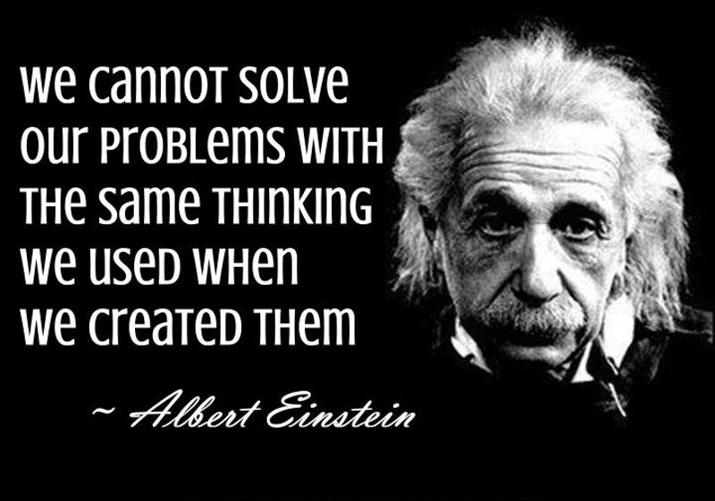
We need to rethink Innovation ecosystem basic functioning
Notes:
Solutions that have been used in past to address development problems must use new thinking to create results
Development problems are more urgent that ever with restless youth, economic problem, political problem

Slide 10

New opportunities in 21st century with striving open Innovation
We want entrepreneurs
  but not everyone can and should be an entrepreneur
We want jobs for Youth
  but they need to “unlearn” everything they “learned” in traditional institutions if any
  Tech-hubs and mhubs are the new NGO of the our new digital world trying to fill gaps (e.g. skills) desperately in the ecosystem
Many groups (e.g. gender) are left behind
Many institutions are not adapting quickly enough to the change from command and control dis-aggregation
  Academia as an example in journey from knowledge store, knowledge hub, and perhaps “entrepreneurial” universities
  Governments still operate same
Many markets never had the developed financial support like USA for filling gaps in funding

Slide 11
Innovation divide
Innovation divide is widening
  Every indicator from traditional indicators such as Intellectual properties, R&D investment, etc.
  30% of R&D in USA is government funded (e.g. NSF)
Core to the problem and the solution is ICT
  Scale dependence (e.g. Uber)
  Innovation as a market driven phenomenon
  Innovation as a community business
In close partnership with numerous actors
  Local , regional specificity
  Organic nature of innovation actors: an ecosystem concept (e.g. silicon valley)
*NSF: what is an innovation ecosystem
Notes:
On one hand we promote free market and expect rational players to come to stability between market players
Leverage pays off in ecosystems that uses public leverages to grow
70% of US research is private funded
On the other hand it took heavy intervention to get there
30% of all research in the USA was is federally funded via institutions like the national science foundation
behind the scene via academia, R&D, institutes.
Other countries in Asia or other location have even higher intervention rate
Korea heavy intervention in techno parks, science, etc.
Even developing countries who have institute solid ecosystem framework support are challenge because ecosystems today need to be more organic to help any participant
Innovation takes deliberate steps by policy makers, academia, businesses, and innovators
Innovation used to be an expensive endeavor, and may still be despite open innovation
New linkages and new ecosystem stakeholders are required to support entrepreneurs
There is an increasing return to scale for innovators too find a market and break even

Slide 12
We can boost innovation potential with the right focus
What are best practices from Member States?
What new role can we foster with academia -innovators- businesses-financial institutions-communities?
What new partnership can we promote with all stakeholders?
*NSF: what is an innovation ecosystem

Slide 13
Approach and options

Slide 14
A proposed approach to meet challenges
Innovation as ITU wide goal
Innovation and Partnership as output of ITU-D
Policy
  Identify policy coherent approaches to ICT innovation, based on best practices to be integrated into national development agenda
  Knowledge triangle focus with academia as key enabler
Foster Environment
Ecosystem
Seed Ecosystem
  On fostering ICT innovation in the public sector
  On creating ICT incubator, including youth, gender responsiveness and sustainability issues
  On enhancing competitiveness of SME ICT enterprises
Partnership
Nurture
Ecosystem
  Special emphasis on linkages for ICT Innovation ecosystem/culture
  New ways of investing and financing development initiatives
  Promoting cooperation, know-how, cost effective technology transfer
  Initiatives to foster ICT Innovation in converged ecosystem
Notes:
Some policy tools for closing
Technology transfer
Knowledge transfer
Innovation capacity
Increasing interplay between public , business and non profit academia

Slide 15
Some options depending on need
Policy & Governance toolkit
Ecosystem toolkit
  Policy roadmap
  Initiatives for national implementation
  Capacity building
  Incubators
  SME, ICT firms, ICT Entrepreneurs
  Specific groups (youth, gender, diaspora)
  Initiatives to seed missing layers (e.g. financing?)
A Service Platform
  National, regional and global context relevant events: facilitate linkages, innovation spill-over, global marketplace opportunities
  Capacity building, Networking, mentoring (e.g. diaspora) ;
  New Partnership(e.g. academia and/or private sector exchanges, government, community);
  resource mobilization to fill gaps of ecosystem
  Competition, ideation toward various needs (including social goods , government innovation)
  Promotion of a culture of innovation (government, academia, entrepreneurs, etc.)
Notes:
r clarification
These elements can be regional, national or global. Our aim to help bridge and facilitate the transformation

Slide 16
Key functions in a service platform
Objective is to:
facilitate and support the innovation in the converged ICT eco-system for sustainable and inclusive development
Aimed to
encourage transformation of ITU-D Membership,
facilitate initiatives on ICT innovation,
unlock more potential with other ITU-Ds initiatives,
promote participations of specific groups (youth, gender etc.),
and support start-ups, incubators, etc.
Promote a culture of Innovation
Advocacy
Transformation
Facilitation
Leverage existing events or new ones
Promote ICT creativity methodologies
Promote government services innovation
Promote a culture of Innovation (e.g. barrier to entrepreneurship)
Engage relevant stakeholders for sustainability (academia)
Use transformational processes (e.g. roadmap)
Specific to national and regional requirement
Innovation champions for sustainability
Leverage multi-stakeholders resource and capabilities
Help match supply and demand of knowledge, capacity building, projects, low cost tech transfers
Notes:
Our focus is global, but we can reinforce and start regional with the platform

Slide 17
Output 2.3: Innovation and Partnership
POSSIBLE ACTIONS
Expert contributions to policy toolkit
  Circular requesting contribution to policy toolkit developments
Assist Innovation champion
  With initiatives and transformational sustainable projects
Use of crowdsourcing platform to help scale change
  Competition
  Ideation
Global, regional, national events
  WSIS discussions around Innovations; ITU Telecom events opportunities
  Foster linkages; Facilitate skills building and exchanges
  Capacity building , boosting creative centers, Resource mobilization, CoEs, etc.

Slide 18
RI-EUR5: Entrepreneurship, innovation and youth
POSSIBLE ACTIONS
Development of the regional network of ICT incubators, tech hubs, and innovation hubs
Analysis, awareness raising and advocacy activities for inclusion of digital solutions as part of national youth employment and entrepreneurship policies & strategies
Analysis on enabling environment for small and medium enterprises in ICT ecosystem
Annual seminars/workshops
  Regional workshop on ICT innovation systems and policy making
  Regional workshop on Incubation in ICT Ecosystem: Best Practices
  Workshop for sharing best practices and creation of industry-university feedback loops.
  European Youth Forum
Twinning Programme strengthening exchange of know how between countries
Country assistance upon request
Training Programmes delivered under the ITU Academy, including CoE trainings

Slide 19
Unlearn-relearn with Regional Initiatives

Slide 20

Now we re-learn
Notes:
Wikipedia: Alvin Toffler (born October 4, 1928) is an American writer and futurist, known for his works discussing the digital revolution, communication revolution and technological singularity.
year kid will ask: how can I unlearn? The answer may be to shrink the brain to do so.
But the reality is that kids are better learner than all of us because they don’t carry the baggage we carry growing up

Slide 21
RI-EUR5: Entrepreneurship, innovation and youth
PROPOSALS/COMMITMENTS
ALBANIA: Ministry of Innovation and ICT
Proposal of the Conference on Innovation – December 2015
GREECE: Ministry of Infrastructure, Transport and Networks
Proposal to create Pan-European ICT Ecosystem Development Platform
POLAND: Office for Electronic Communication
“Girls in New Technologies” Traineeship Contest
SERBIA: Ministry of Trade, Tourism and Telecommunications

Slide 22
Discussion panel and closing

Slide 23
RI-EUR5: Entrepreneurship, innovation and youth
2015-2017 IMPLEMENTATION PLAN
2015
May: Innovation track at WSIS
June: Implementation Task Force on “ITU-ICT-Agora ” kickoff - Athens
August: End of consultation on the Implementation Plan
Sept: Benchmark of innovation capabilities in European ICT ecosystem
October: Launch of alpha version of “ITU-ICT-Agora ” platform – Budapest
Launch of regional competition of “Girls in new technologies”
Dec: Regional conference on ICT innovation ecosystem – Belgrade/Tirana

Slide 24
RI-EUR5: Entrepreneurship, innovation and youth
2015-2017 IMPLEMENTATION PLAN
2016
March: Implementation Task Force on “ITU-ICT-Agora ” meeting - TBD
Guidelines on ICT innovation ecosystem / self assessment toolkit
April: Girls in ICT Day: national winners announced
launch of the regional network (incubation opportunities or exchange or internship)
May: Innovation track at WSIS: global approach with regional seeds
June: Fostering knowledge triangle for unlocking entrepreneurship and innovation/ (academia/community) - Prague
Sept: Development of curriculum for training based on guidelines under ITU academy
October: Launch of operational version of “ITU-ICT-Agora ” platform – TBD (Telecom)
Launch of regional competition of “Girls in new technologies”
Dec: Regional conference on financing mechanisms for ICT innovation ecosystem – Tirana/Belgrade

Slide 25
RI-EUR5: Entrepreneurship, innovation and youth
2015-2017 IMPLEMENTATION PLAN
2017
February: Training on ICT innovation ecosystem under ITU academy
March: Implementation Task Force on “ITU-ICT-Agora ” meeting - TBD
April: Girls in ICT Day: national winners announced
Upscaling of the regional network (incubation opportunities or exchange or internship)
May: Innovation track at WSIS: shared learning with all regions on ICT innovation ecosystem
June: Impact assessment of “ITU-ICT-Agora ” platform
Sept: Upscaling of curriculum for training on ICT Innovation ecosystem under ITU academy
October: Review of “ITU-ICT-Agora ” platform – TBD (Telecom)
Launch of regional competition of “Girls in new technologies”
Dec: Side events on ICT innovation ecosystem at WTDC-17

