Slide 1

CHILD ONLINE PROTECTION AND SAFER INTERNET IN TURKEY
Gazali ÇİÇEK, Head of International Relations Department
Information and Communication Technologies Authority, Turkey

Slide 2
Scope
Child Online Protection and Safer Internet in Turkey
Challenges
Turkey’s Commitment for RI4
Expected Results

Slide 3
What We Do?
Public Awareness
Hotline: Website
Safer Internet Service (SIS)
Coordination with Domestic and International Institutions and Organizations

Slide 4


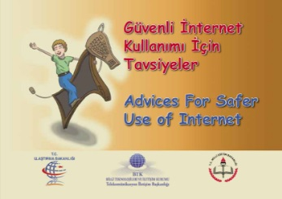

Public Awareness: The Guide Booklets
Guide booklets :
Advices for Safer Use of Internet
Advices to Parents for Safer Use of Internet

Slide 5



Public Awareness: Web Portals
Web site to promote Safer Use of Internet http://www.guvenliweb.org.tr
The web site http://www.guvenlicocuk.org.tr developed with a view to enable children to safely surf the cyber world.

Slide 6
Public Awareness: Seminars
Up to now;
Almost 300 seminars
More than 100 different points
over 40.000 participants

Slide 7
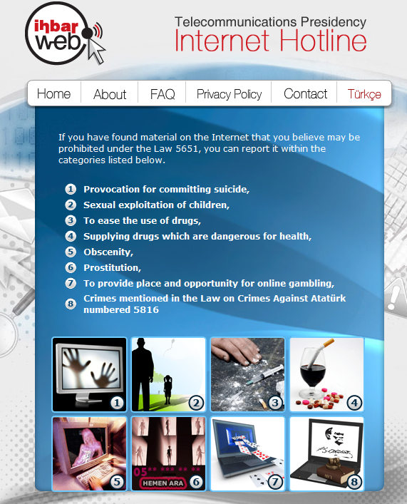
Internet Hotline Service
Turkey’s Internet Hotline : IhbarWeb

Slide 8

Safer Internet Service (SIS)
  ISP level parental control tool
  Option for the users
Voluntary to use
Free of charge
Two different profiles
  Child Profile
  Family Profile
Easy Opt In/Out
  The main goal of SIS is to protect children from harmful contents.

Slide 9

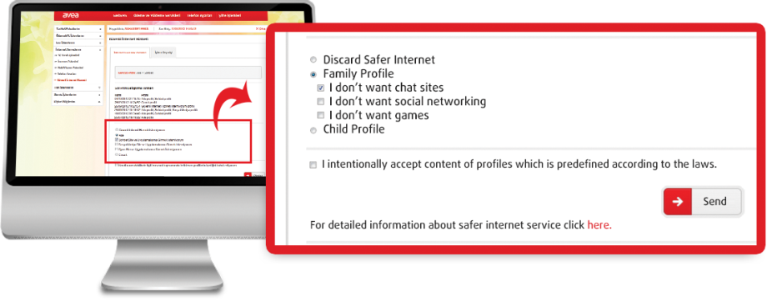
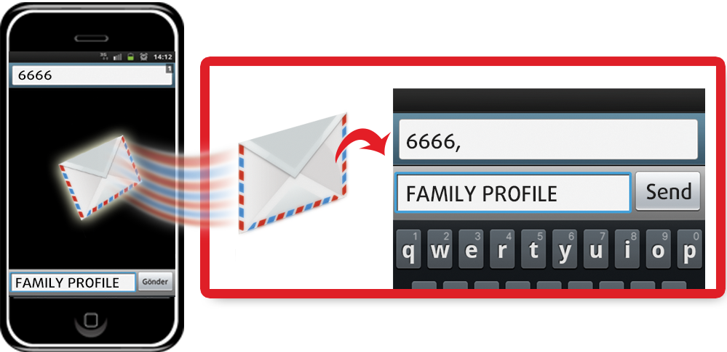
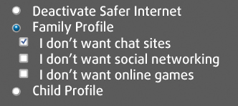
Safer Internet Service (SIS)
  Easy opt in, change or
  opt out via
    Internet
    Call Center
    SMS
Options :

Slide 10
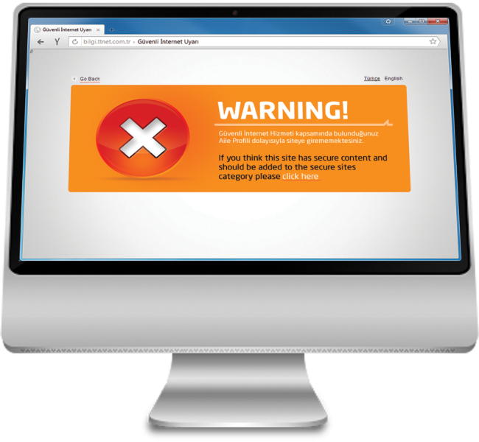
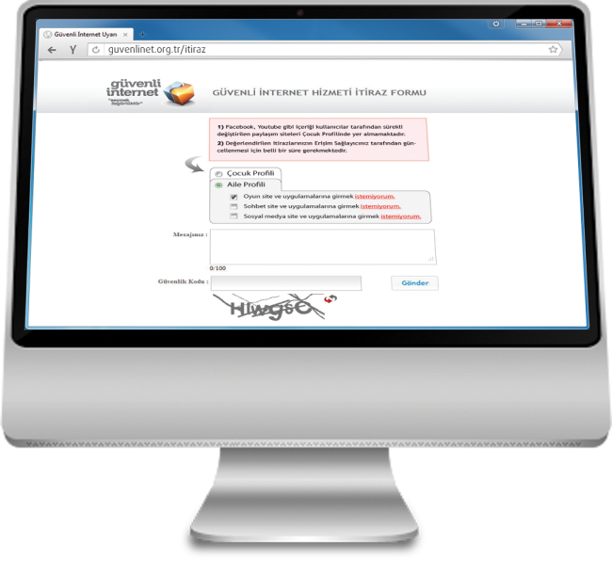
Safer Internet Service (SIS)
  USERS ARE ALWAYS INFORMED !

Slide 11
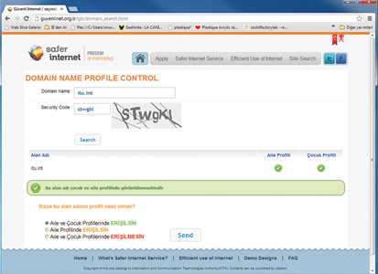
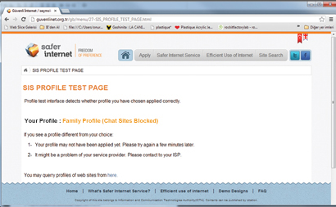
SIS – Interactivity and Transparency
Search domain name
Offer website in profile
Check if working properly
guvenlinet.org.tr

Slide 12
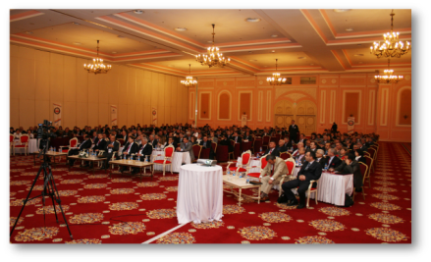


Expanding safer use of Internet
1.650.000 subscribers (nearly
5 million users) prefered SIS
Continue to develop projects on
safer Internet
Project with the Ministry of National
Education: ‘Training of Trainers’.
400 ICT teachers trained and they
trained almost 65000 teachers.

Slide 13
Challenges
More efforts are needed for building trust and confidence in the use of ICTs among children and young people.
The need for development and increase of local content on the perception of using internet conscious, safe and effective.
National and international cooperation is vital to provide positive content on digital citizenship and digital literacy.

Slide 14
Turkey’s Commitment to RI4
A two-day workshop on child online protection is planned to be organized in 2016 with support of ITU
First half of the year in Istanbul
Approximately 50 participants from the ministries, regulatory bodies, NGOs, operators and academic institutions from the region

Slide 15
Turkey’s Commitment to RI4
Preliminary Scope of the Workshop
  Conceptual and legislative aspects of COP
  Major players, roles and responsibilities
  National policies/strategies/roadmaps
  Technical implementation and process
  Capacity building
  Raising awareness
  International cooperation
  Challenges
  Best practices
Detailed programme of the workshop will be developed with support of ITU and by contribution of relevant parties in the region
Accommodation costs of participants to be covered by ICTA
No financial implication on the ITU budget

Slide 16
Expected Results
Contribution to raising awareness
Sharing best practices, knowledge and experience
Capacity building
Possible inputs for roadmaps to be developed for national and regional child online protection initiatives

Slide 17
Thank you

