Slide 1
The Child Online Protection (COP) Initiative

Slide 2
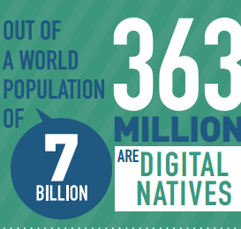
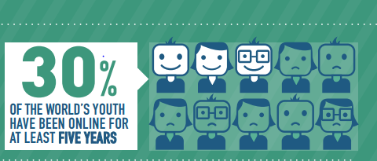
*ITU MIS 2013

Slide 3
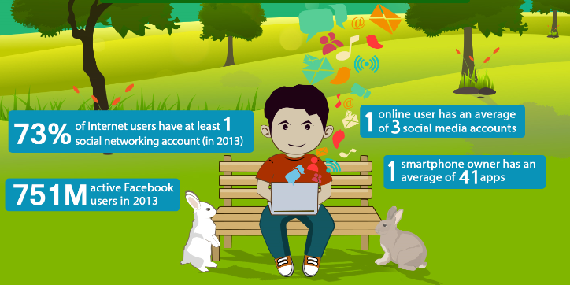
Data from Trend Micro Infographics released in June 2014

Slide 5
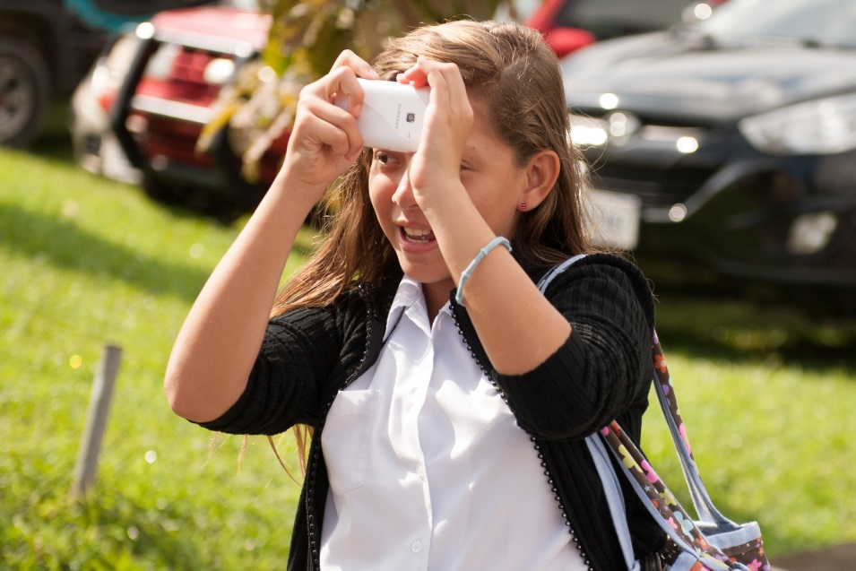
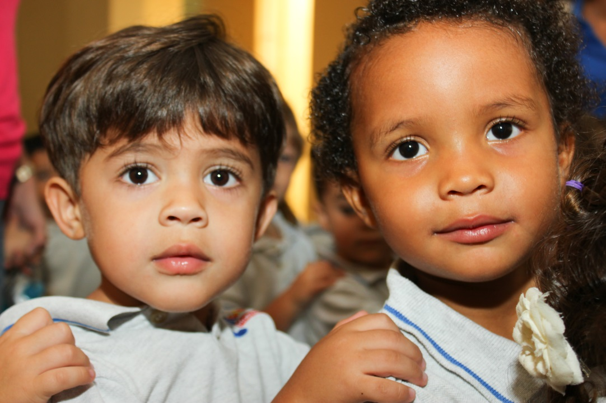
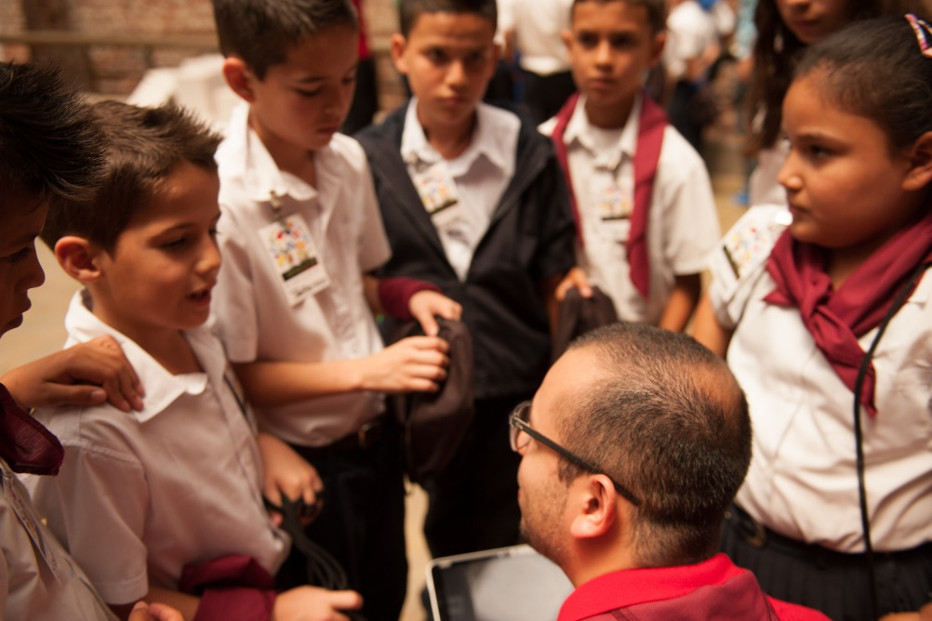
And Children?

Slide 6
Thanks to ICTs, education is being transformed and children access vast amounts of information, access to courses and teachers anywhere;
And even talk to the astronauts about space millions of miles away;
Social networks, gamification, apps… All part of a world in which they are not merely participants but create, share, collaborate;
Every day there is a new innovation with vast opportunities.

Slide 7
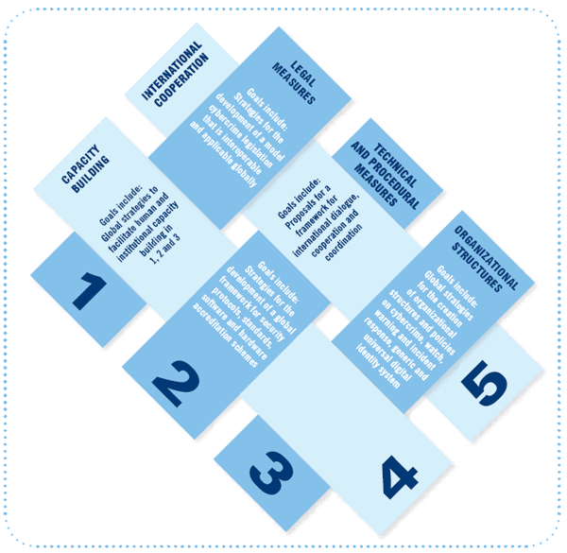
ITU and Cybersecurity
2003 – 2005
WSIS entrusted ITU as sole facilitator for WSIS Action Line C5
“Building Confidence and Security in the use of ICTs”
2007
ITU Secretary-General launched the Global Cybersecurity Agenda (GCA)
A framework for international cooperation in cybersecurity
2008 - 2010
ITU Membership endorsed the GCA as the ITU-wide strategy on international cooperation.

Slide 8
The Child Online Protection (COP) Initiative
The COP Initiative aims at bringing together partners from all sectors of the global community to ensure a safe and secure online experience for children everywhere.
Objectives
Identify risks and vulnerabilities to children in cyberspace;
Create awareness of the risks and issues through multiple channels;
Develop practical tools to help governments, organizations and educators minimize risk; and
Share knowledge and experience while facilitating international strategic partnership to define and implement concrete initiatives
Notes:
8

Slide 9
We count on the support of several partners…
International Organizations
Private Sector
Civil Society

Slide 11
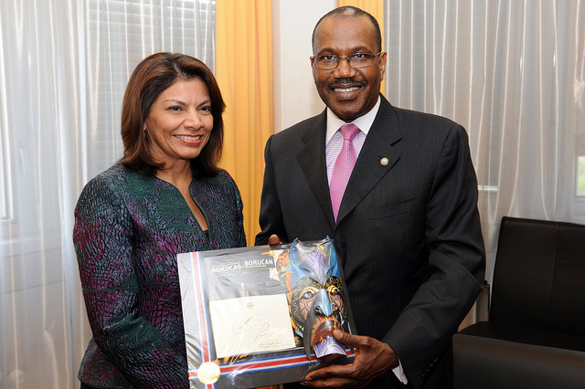
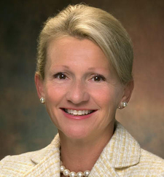
We also count on the support of global advocates
2010: H.E. Laura Chinchilla Former President of Costa Rica, COP Patron
2013: H.E. Dame Patience Goodluck Jonathan, First Lady of Nigeria, COP Champion
2010: Ms. Deborah Tate US FCC Former Commissioner, COP Special Envoy

Slide 12
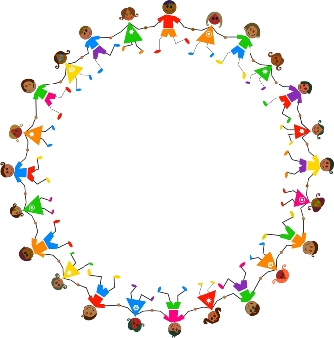
What do we do?

Slide 13
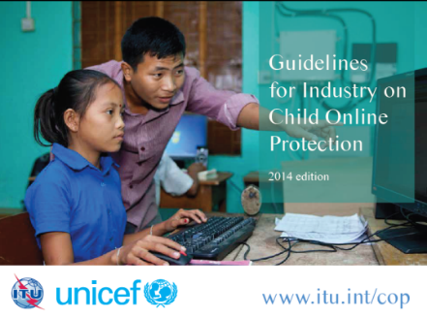
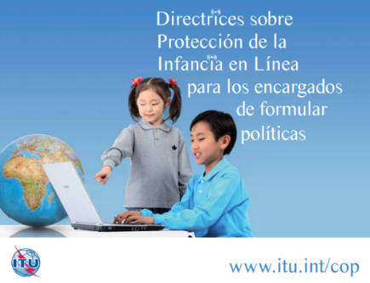
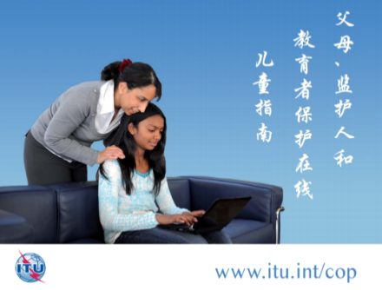
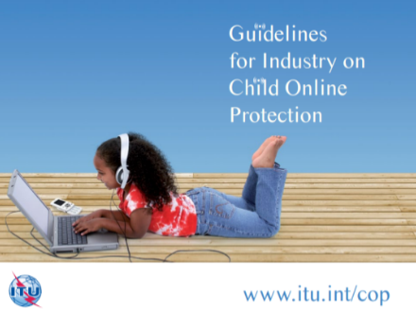
Capacity building activities
4 Set of Guidelines
Policy Makers
Children
Educators, Parents and Guardians
Industry
Developed in cooperation with COP partners
Available in the six UN languages
Updated version for Industry
launched jointly with UNICEF in 2014

Slide 14
ITU & UNICEF new version of the Guidelines for Industry
Structure
Policies and management processes
Child sexual abuse content
Safer and age appropriate environment
Educate children, parents and teachers
Promote positive use of ICTS
Sub-sector check lists
Mobile
operators
ISPs
Content providers, online retailers, app developers
Social media
Internet access in public places
Hardware manufacturers

Slide 15
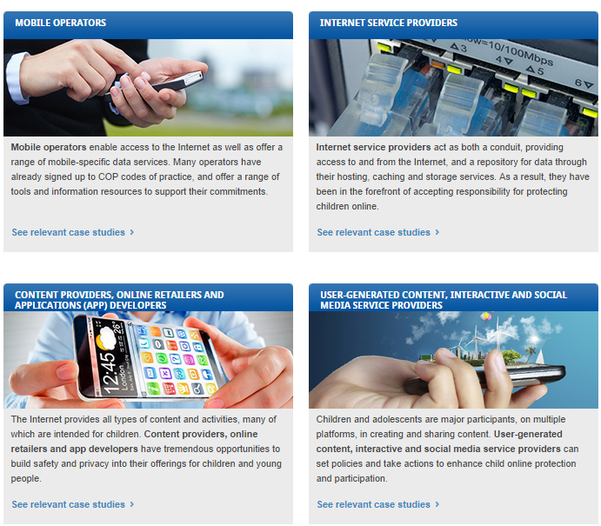
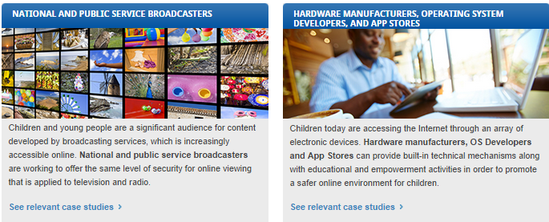
Online Platform
of Case Studies

Slide 16
Capacity building activities
2012
2013
2014
Establishing national strategies with COP Partners
Brunei Darussalam
Cameroon
Ghana
Mauritius
Sierra Leone
Gambia
Oman
Zambia
Bahrain

Slide 17
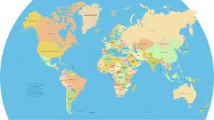
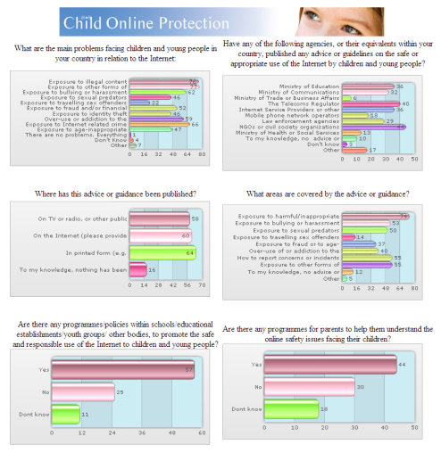
Capacity building activities
Share a platform of country profiles
Data collection
Run surveys with policy makers
Develop case studies

Slide 18
ITU/ACOPEA Pan African E-Safety pilot program in Ethiopia
Capacity building activities
Trainings for parents, teachers and children in Ethiopia in collaboration with Facebook and Acopea
Trainings for young children with the Walt Disney Company and UNICEF in Costa Rica
COP Challenge and other games with COP Partners

Slide 19
Technical Cooperation
The ITU-T Joint Coordination Activity on Child Online Protection (JCA-COP) was established in April 2012 under ITU-T Study Group 17. the Group is co-chaired by UK and USA. The rationale of the Group is:
a. Ensure information on COP activities are gathered
b. Understand what are the relevant stakeholders work and/or activities
c. Understand the legal/regulatory environments related to COP
d. Identify any principles underpinning the above COP activities

Slide 20
Joining forces with other organizations
ITU works closely with the Internet Watch Foundation (IWF) to establish a hotlines. The partnership drew on the expertise and resources of the IWF to establish efficient and cost effective methods of fighting against online child sexual abuse content.
ITU and Trend Micro agreed to establish a framework for collaboration in line with the mutual goal of creating a more secure and safer information society.

Slide 21
International Cooperation
Council Working Group(CWG) on COP
Platform which facilitates the membership's input and guidance on ITU's role in child online protection.
The Plenipotentiary Conference, held in Busan in 2014, made some important amendments:
participation in the Group meetings will be open to all stakeholders (both ITU members and non-members);
all documentation will be publicly available without password protection; and
conduct one-day online consultations for youth, prior to its meetings. This will allow the Group to be more inclusive and ever-more agile in responding to current and emerging technical and policy needs.

Slide 22
International Cooperation
WSIS+10 High Level Event
- The WSIS+10 High-Level Event, held in June 2014, was an extended version of the WSIS Forum to address the progress made in the implementation of the WSIS outcomes related to the WSIS Action Lines, while providing a platform for multistakeholder coordination of the implementation of the WSIS outcomes.
- The WSIS+10 High Level Event Outcome Documents revised the text of the Action Line C5 and recognized the importance of COP and youth empowerment.
The Annual WSIS Forum organized on an annual basis:
High Level Dialogues on Cybersecurity
AL C5 Facilitator’s sessions
COP Roundtable discussions
(Note: Details on the WSIS Forum available at the end of this presentation)

Slide 23
Partnership
Working together
to maximize impact
Working together on project-basis
Small group of partners
Impact of COP Initiative
Setting the global vision for child online protection
Enhancing synergies to achieve our goals
Joining forces to develop and implement an action plan
Building the partnership network
today
2008
2010
2014

Slide 24
Measuring global progress
ITU Member States committed to ensure the important role of ICTs as a key enabler to achieve the Post-2015 Development Agenda
Acknowledged ICTs as an important tool to achieve overall SDGs
Connect 2020 sets out the shared vision, goals and targets that ITU Member States have committed to achieve by 2020 in collaboration with all stakeholders across the ICT ecosystem

Slide 25
Connect 2020 Vision
ITU Member States committed to work towards the shared vision of:
“An information society, empowered by the interconnected world, where telecommunication/ICTs enable and accelerate social, economic and environmentally sustainable growth and development for everyone”

Slide 26
Connect 2020, Goal 3: Sustainability and COP
Connect 2020
ITU vision & mission
Strategic Goals
and Targets
Goal 3 Sustainability – Manage challenges resulting from the telecommunication/ICT development
Growth in the global use of ICT-enabled applications, apart from the great benefits, has also resulted in a number of challenges
One of the issues is building confidence and security in the use of ICTs (which includes protection of children online)

Slide 27
COP partnership framework
Child Online Protection
Proposed COP Goal & Targets
ITU Strategic Plan 2016-2019
International cooperation
ITU COP initiative
International Organizations
Governments
Private sector
Other stakeholders
Collaboration at national and regional level
Government agencies
Private sector
Civil society
Academia
Law Enforcement
Regional and international Organizations

Slide 28
Proposed COP Goal and Targets
Protect Children Online
80% of children should benefit from a basic level of protection online by 2020*
GOAL & COP TARGET
Focus from 2015-2020
Target 1
Target 2
Target 3
Target 4
Target 5
Worldwide, 90% of countries should set in place legislation addressing child sexual abuse material online by 2020
Worldwide, 70% of countries should set in place mechanisms to report online child sexual abuse content by 2020
Worldwide, XX% of countries with law enforcement using advanced digital forensic tools
Worldwide, XX% of countries should include safe online practices into schools curricula
Improved mechanisms used for international cooperation
Objective 1
Objective 2
Objective 3
Objective 4
Objective 5
Foster a comprehensive legal framework to efficiently address online crimes related to children
Promote active participation and interagency collaboration to support the monitoring, evaluation and reporting of inappropriate content
Reduce harmful online content in an efficient manner
Foster the acquisition and sharing of knowledge for children, individuals and institutions for achieving a safe online environment
Enhance harmonized international practices in online protection
Pillar 1: Legal Measures
Pillar 4: Capacity Building
Pillar 5: International Cooperation
Pillar 1: Legal Measures
Pillar 2: Tech. & Procedural Meas.
Pillar 3: Org. Structures
Pillar 4: Capacity Building
Pillar 5: Internat’l Cooperation
Pillar 2: Tech. & Procedural Meas.
Pillar 3: Org. Structures

Slide 29
Elaboration
Target 1
COP TARGET:
80% of children should benefit from a basic level of protection online by 2020*
Baseline: Current number of children who have a basic level of protection is 62%
Worldwide, 90% of countries should set in place legislation addressing child sexual abuse material online by 2020
Baseline for Target 1:
Current percentage of children is 83% (2014)
Current percentage of countries is 69% (2014)
Baseline for Target 2:
Current number of countries with Hotlines 51 (44 are members of INHOPE network ; 2014)
Current percentage of countries with Hotlines is 26% (2014)
Current percentage of children is 22% (2014)
Target 3 & 4:
Currently no data available
Will attempt to build data and create benchmark by 2020 with the help of COP partners
Target 5:
Qualitative approach to measurement
Target 2
Worldwide, 70% of countries should set in place mechanisms to report online child sexual abuse content by 2020
* Combination of Indicators of Target 1 & Target 2

Slide 32
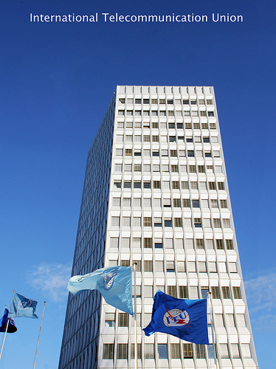
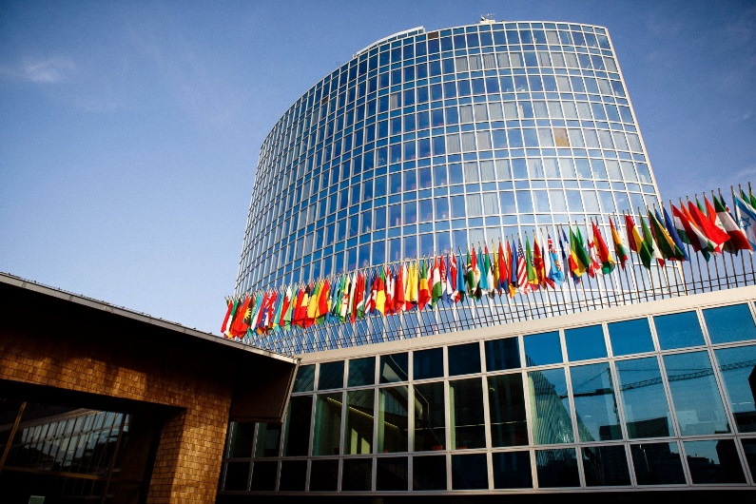
WSIS Forum 2015
Innovating Together: Enabling ICTs for Sustainable Development
25-29 May 2015, 26-27 High Level Track
Geneva, Switzerland
ITU Headquarters and WIPO Headquarters

