Slide 1
Accessibility in the Age of Convergence
Pilar Orero
Universitat Autònoma de Barcelona, Spain
Bucarest, 21th April 2015

Slide 2
Challenges in Europe
Convergence → HbbTV
Raising awareness → Education
Legislation → EU Directive
Quality → Benchmarking

Slide 3
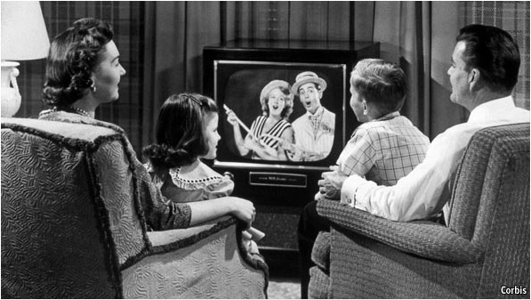
Traditional Broadcasting

Slide 4
HbbTV

Slide 5
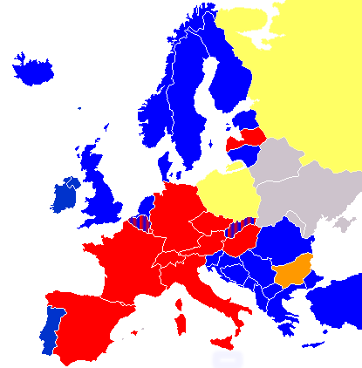
Access Services
Subtitling
Same language subtitling
Audio subtitling
Audio description
Audio description + audio subtitling
Sign language
Avatars
Clean Audio
Technology access in general: user interaction

Slide 6
Convergence
1. New communication opportunities
2. New accessibility solutions
3. New workflows
4. New working conditions

Slide 7
Legislation
EU Directive
German/Spanish new regulation
Quotas on services
Quality

Slide 8
Available information
3GICT Model Accessibility Report
http://www.itu.int/en/ITU-D/Digital-Inclusion/Persons-with-Disabilities/Documents/ICT%20Accessibility%20Policy%20Report.pdf
EBU 2004 report and recommendations
https://tech.ebu.ch/docs/i/i044.pdf

Slide 9
Raising awareness
Education
Workshops
Conferences
Examples

Slide 10
Opportunities
Funding by EU 2016 and 2017
ICT4.8 – 2016: Media and content convergence 38 Million
ICT4.9 – 2017: Tools for smart digital content in the Creative Industries 17Milliuon
ICT4.10 – 2016: Support technology transfer to the Creative Industries 414Million
ICT4.11 – 2016: Learning and skills 31Million
ICT4.12 – 2017: Interfaces for accessibility 12Million
Erasmus +
Erasmus KA2

Slide 11
Opportunities 2
COST
Getting together,
Learning from experience
Sharing knowledge

Slide 12
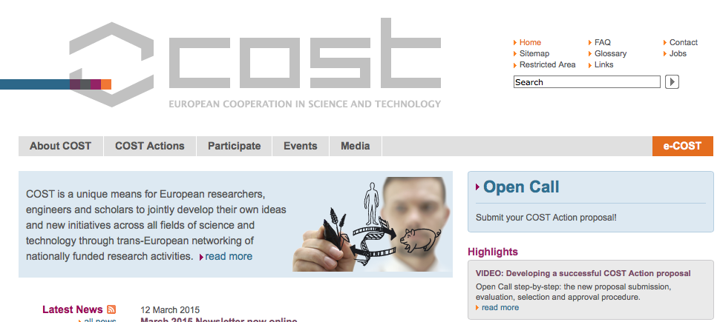
Next steps forward?
Conference on Subtitling by respeaking
June 2015 Rome
· MOOC on Media Accessiblity, ITU
·Call for COST

