Slide 1
Broadband Market in Monetengro Dragana Kaluđerović, B.Sc.E.E. dragana.kaludjerovic@ekip.me Milena Jelić, B.Sc.(Econ.) milena.jelic@ekip.me
MONTENEGRO
AGENCY FOR ELECTRONIC COMMUNICATIONS AND POSTAL SERVICES (EKIP)
www.ekip.me

Slide 2
MONTENEGRO
AGENCY FOR ELECTRONIC COMMUNICATIONS AND POSTAL SERVICE www.ekip.me
Contents
I Situation in the market of Internet and broadband Internet access in Montenegro
II Strategy for the Information Society Development in Montenegro in the period 2012-2016
III Spectrum auctions in 2015
IV International Conference of NRAs - Infofest 2015

Slide 3
MONTENEGRO
AGENCY FOR ELECTRONIC COMMUNICATIONS AND POSTAL SERVICES www.ekip.me
Situation in the market of Internet and broadband Internet access in Montenegro
In 2014 the number of users of fixed broadband access rose by 8.5%, and the number of users of mobile broadband access fell by 18.8% compared to 2013;
Penetration of fixed broadband access at the end of 2014 amounted to 16.8%, where the largest number of users (66.6%) were ADSL users;
Penetration of mobile broadband access at the end of 2014 was 10.4%.

Slide 4
MONTENEGRO
AGENCY FOR ELECTRONIC COMMUNICATIONS AND POSTAL SERVICES www.ekip.me
Fixed broadband Internet access via ADSL

Slide 5
MONTENEGRO
AGENCY FOR ELECTRONIC COMMUNICATIONS AND POSTAL SERVICES www.ekip.me
Internet access via fiber optic networks(FTTx)
Number of FTTx Internet access users in 2014 rose by 46.6% compared to 2013
FTTx users
2011 | 2012 | 2013 | 2014
1,029 | 4,745 | 8,610 | 12,605

Slide 6
MONTENEGRO
AGENCY FOR ELECTRONIC COMMUNICATIONS AND POSTAL SERVICES www.ekip.me
Internet access via WiMAX
Number of users of WiMAX Internet access in 2014 rose by 17.3% compared to 2013.
WiMAX users
2007 | 2008 | 2009 | 2010 | 2011 | 2012 | 2013 | 2014
1,707 | 5,520 | 6,271 | 6,789 | 7,296 | 5,769 | 6,049 | 7,097

Slide 7
MONTENEGRO
AGENCY FOR ELECTRONIC COMMUNICATIONS AND POSTAL SERVICES www.ekip.me
Internet access via cable distribution systems (CDS)
Number of users of CDS Internet access in 2014 rose by 24.3% compared to 2013.
CDS users
2008 | 2009 | 2010 | 2011 | 2012 | 2013 | 2014
328 | 466 | 1,528 | 3,338 | 5,337 | 7,680 | 9,544

Slide 8
MONTENEGRO
AGENCY FOR ELECTRONIC COMMUNICATIONS AND POSTAL SERVICES www.ekip.me
Other types of Internet access
Total number of Internet leased lines in 2014 amounted to 255;
Only 4 users had Internet access via MPLS network of Crnogorski Telekom or M:Tel;
Total number of wireless access points with 5 operators at the end of 2014 amounted to 238. All operators provide this type of access free of charge;
1 operator provided the service of satellite Internet access and it had 79 users at the end of 2014.

Slide 9
MONTENEGRO
AGENCY FOR ELECTRONIC COMMUNICATIONS AND POSTAL SERVICES www.ekip.me
Structure of users of fixed broadband Internet access

Slide 10
MONTENEGRO
AGENCY FOR ELECTRONIC COMMUNICATIONS AND POSTAL SERVICES www.ekip.me
Mobile broadband Internet access
Number of users of mobile broadband Internet access via data SIM cards during 2014 fell by 18.8% compared to 2013;
Operator M:Tel does not have data SIM cards in its offer, but by use of the total of 10,708 SIM cards of this operator only data traffic was carried out.
2014 | Postpaid | Prepaid | Total
Crnogorski Telekom | 11,480 | 12,674 | 24,154
Telenor | 13,901 | 26,782 | 40,483
Total | 25,381 | 39,454 | 64,637

Slide 11
MONTENEGRO
AGENCY FOR ELECTRONIC COMMUNICATIONS AND POSTAL SERVICES www.ekip.me
Internet penetration
On the basis of the research of the Statistics Office of Montenegro, 63.9% of population used Internet in past three months, which was a rise of 3.6% compared to 2013;
Penetration of fixed broadband access at the end of 2014 amounted to 16.8%, which was an increase of 1.4% compared to 2013;
When penetration is considered in relation with the number of households, it amounted to 53.3% which is an increase of 4.2% compared to 2013.

Slide 12
MONTENEGRO
AGENCY FOR ELECTRONIC COMMUNICATIONS AND POSTAL SERVICES www.ekip.me
Internet penetration
Penetration of mobile broadband access at the end of 2014 amounted to 10.4%, which was a fall of 2.4% compared to 2013 (in these calculations, only the users of data SIM cards included in the offers of two operators were taken into account);
If we take into account data SIM cards of the third operator through which only data traffic was carried out, then we get the information that the penetration of mobile broadband access at the end of 2014 was 12.2%.

Slide 13
MONTENEGRO
AGENCY FOR ELECTRONIC COMMUNICATIONS AND POSTAL SERVICES www.ekip.me
Penetration of broadband access (fixed and mobile) in relation with the population

Slide 14
MONTENEGRO
AGENCY FOR ELECTRONIC COMMUNICATIONS AND POSTAL SERVICES
II Strategy for the development of Information Society in Montenegro 2012-2016
FIVE PILARS OF DEVELOPMENT
ICT sustainability
ICT for community
ICT for Public Administration
ICT for economic development
Development of media and broadcasting market

Slide 15
MONTENEGRO
AGENCY FOR ELECTRONIC COMMUNICATIONS AND POSTAL SERVICES www.ekip.me
II Goals:
to increase the share of ICT industry in GNP by 50%,
to increase labor in ICT industry by 50%,
to improve opportunities of broadband access, i.e. access of high speeds by ensuring symmetrical, guaranteed broadband access (agnostic access) of at least: 10Mbps for 50% of population by 2014; 10Mbps for 100% population and 30Mbps for 50% of population by 2016
To achieve mass ICT and Internet use and improve digital inclusion, such as: Internet use of 70% by 2014 and 80% by 2016; broadband access of 25% by 2014 and 40% by 2016
To ensure wide availability of the most used electronic services of the state administration: ensure the availability of the 100 most commonly used services of state bodies and local self-government on the portal eGovernment by 2014, and 200 services by 2016.
Deadline for digital switchover is set on 17 June 2015

Slide 16
MONTENEGRO
AGENCY FOR ELECTRONIC COMMUNICATIONS AND POSTAL SERVICES www.ekip.me
III SPECTRUM AUCTIONS IN 2015
The Agency Council made a decision in March that in 2015 the process of assignment of radio frequency spectrum is to be launched through multiband auction (CCA method) for the following bands :
790-862 MHz (800 MHz band), for TRA-ECS systems;
880-915/925-960 MHz (900 MHz band), for GSM and TRA-ECS systems;
1710-1785/1805-1880 MHz (1800 MHz band), for DCS1800 and TRA-ECS systems;
1900-1920 MHz, 1920-1980/2110-2170 MHz and 2010-2025 MHz (2 GHz band), for IMT systems;
2500-2690 MHz (2.6 GHz band), for TRA-ECS systems;

Slide 17
MONTENEGRO
AGENCY FOR ELECTRONIC COMMUNICATIONS AND POSTAL SERVICES www.ekip.me
III SPECTRUM AUCTIONS IN 2015
Subject of the auctions will be a total of 460 MHz spectrum in the following 5 bands (the bands of 800 and 2600 MHz are already available, while parts of the bands of 900, 1800 and 2100 MHz will be available at the end of 2016 or in late January 2017 when the licenses of two existing operators are due to expire).

Slide 18
MONTENEGRO
AGENCY FOR ELECTRONIC COMMUNICATIONS AND POSTAL SERVICES www.ekip.me
III SPECTRUM AUCTIONS IN 2015
Taking into account the characteristics of the current state of the market of public electronic communications networks and services in Montenegro, the upcoming process of spectrum assignment will have the following goals:
maintenance / enhancement of competition in the electronic communications services in Montenegro, including the possibility of entry of a new mobile operator;
creating conditions for further undisturbed development of mobile electronic communications networks and services;
contribution to achieving the objectives of the Strategy for Information Society Development in the period 2012-2016;
enabling maximum revenue for the budget of Montenegro from one-time fees for granting licences for the use of radio-frequencies.

Slide 19
MONTENEGRO
AGENCY FOR ELECTRONIC COMMUNICATIONS AND POSTAL SERVICES www.ekip.me
IV International conference of regulatory authorities - INFOFEST 2015
This year again EKIP will, in cooperation with the ITU, organize 13th annual conference of national regulatory authorities, which is traditionally held within Infofest in Budva, Montenegro.
The Conference will be focused on the topic of broadband access and could be constituted as an important milestone for all stakeholders involved in the implementation of this regional initiative and will represent the activity related to Regional initiative EUR2 Development of broadband access and adoption of broadband.
We believe that this year’s conference will bring together a large number of administrations and other stakeholders who have so far taken part in the work related to the regional initiative on broadband access, but also those who have been traditional participants in these conferences, such as the representatives of relevant ministries, operators and renowned companies.

Slide 20
MONTENEGRO
AGENCY FOR ELECTRONIC COMMUNICATIONS AND POSTAL SERVICES www.ekip.me
IV International conference of regulatory authorities - INFOFEST 2015
This year, 22nd consecutive INFOFEST will be held from 27 September to 3 October 2015, at the hotel "Maestral" Miločer / Budva.
The opening ceremony of INFOFET with the artistic program and announcement of participants will take place on 27 September.
The Conference will take place on 28-29 September 2015.
In addition to a well-organized and interesting official program, the participants of the Conference will enjoy the friendly atmosphere and a number of social events (cocktail at the opening of INFOFEST, a dinner organized by EKIP and a boat trip across the Boka Kotorska Bay).

Slide 21
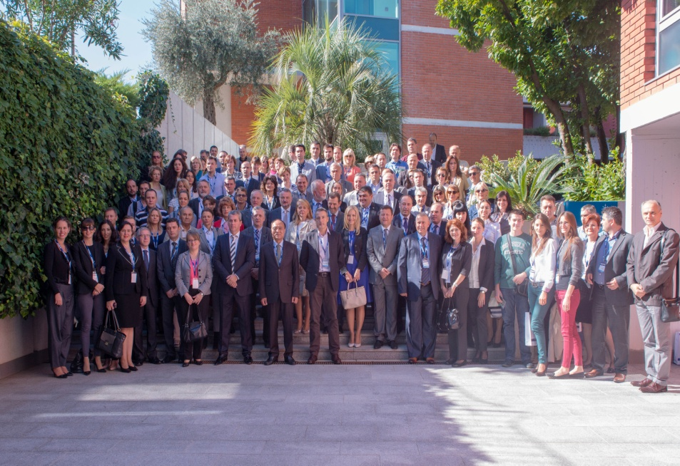
MONTENEGRO
AGENCY FOR ELECTRONIC COMMUNICATIONS AND POSTAL SERVICES www.ekip.me
IV INFOFEST 2015

Slide 22
MONTENEGRO
AGENCY FOR ELECTRONIC COMMUNICATIONS AND POSTAL SREVICES www.ekip.me
Thank you for your attention!
Dragana Kaluđerović, B.Sc.E.E. dragana.kaludjerovic@ekip.me Milena Jelić, B.Sc.(Econ.) milena.jelic@ekip.me

