Slide 1
IXP in Montenegro
Regional Development Forum, Bucharest
April, 2015
Viktor Berishaj
Ministry for information society and telecommunications

Slide 2
IXP in Montenegro
The goal is: “Montenegro – Digital state”
Developed ITC,
Internet
Broadband

Slide 3
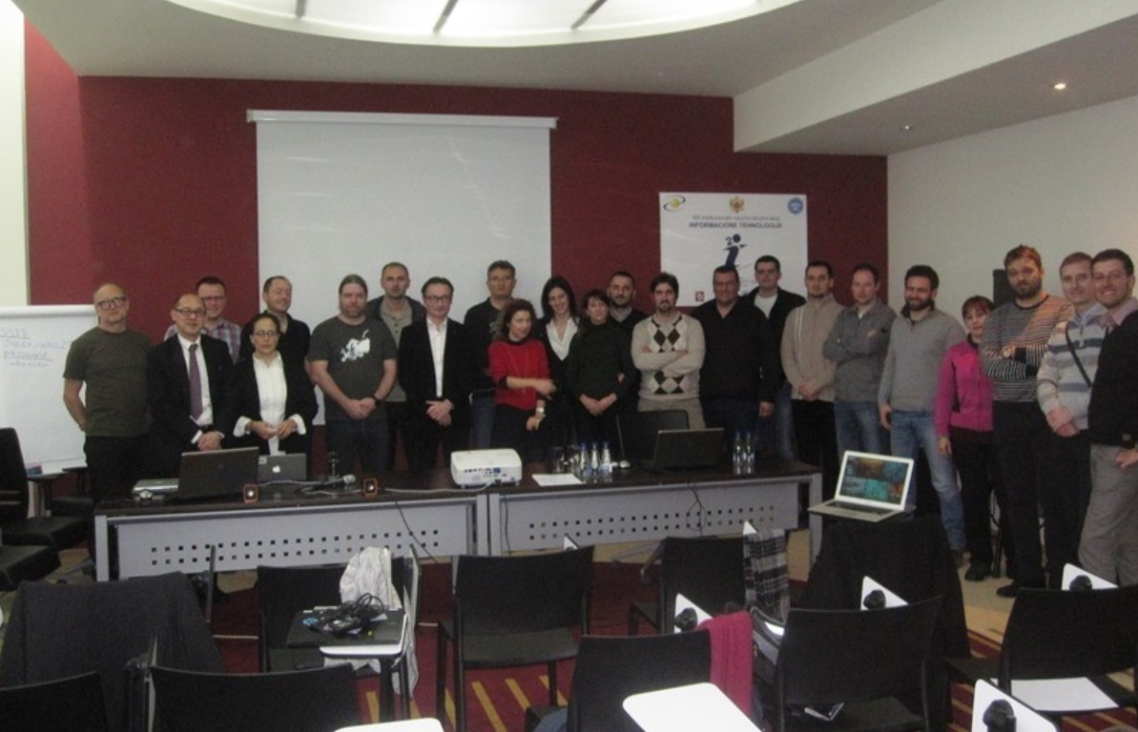
Initiatives
Ministry for information society and telecommunications
Agency for electronic communications and postal services
Round tables, meetings, conferences…
ISP-s
University,
IXP-s from Europe…

Slide 4
Collaboration
ITU (International Telecommunication Union)
ISOC (Internet Society)

Slide 5
IXP Montenegro
Feasibility study
Technical specification of equipment

Slide 6
IXP Montenegro
Working team
Ministry for information society and telecommunications
Agency for electronic communications and postal services
University of Montenegro, Center of information systems

Slide 7
IXP Montenegro
Legal frame
University authorization
Government approval

Slide 8
thank you
see you at INFOFEST
27.09 - 03.10.2015, Budva, Montenegro
www.infofest.com

