Slide 1
Importance and development of broadband access in Lithuania
Paulius Vaina
Communications Regulatory Authority
of the Republic of Lithuania
ITU Regional Forum for Europe (RDF-EUR) „Broadband for Sustainable Development”, Bucharest, Romania
20-22 April 2015

Slide 2
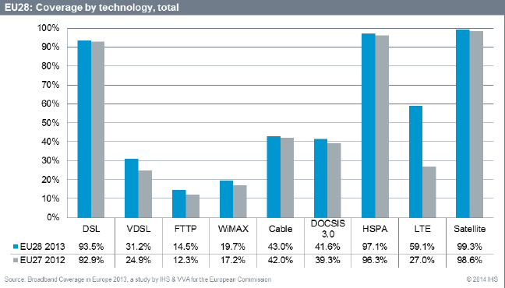
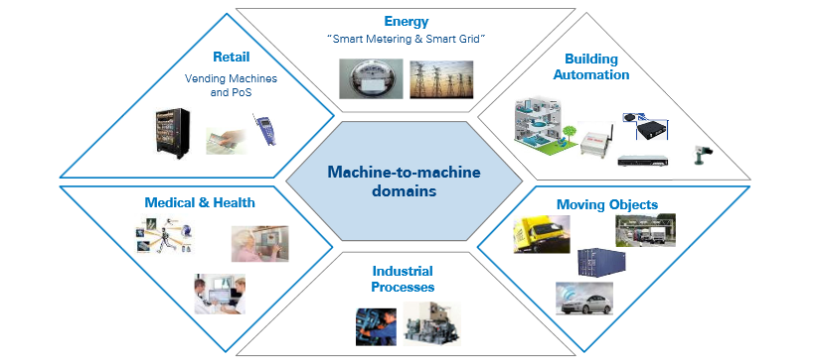
Development, demand and applicability

Slide 3
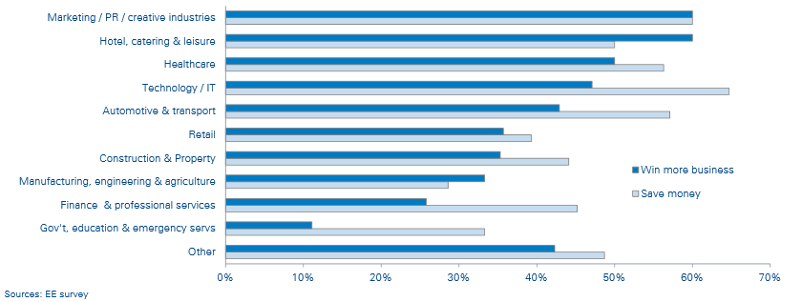
EU survey: Has BB helped your business to win more business or save money?
Broadband for Sustainable Development

Slide 4
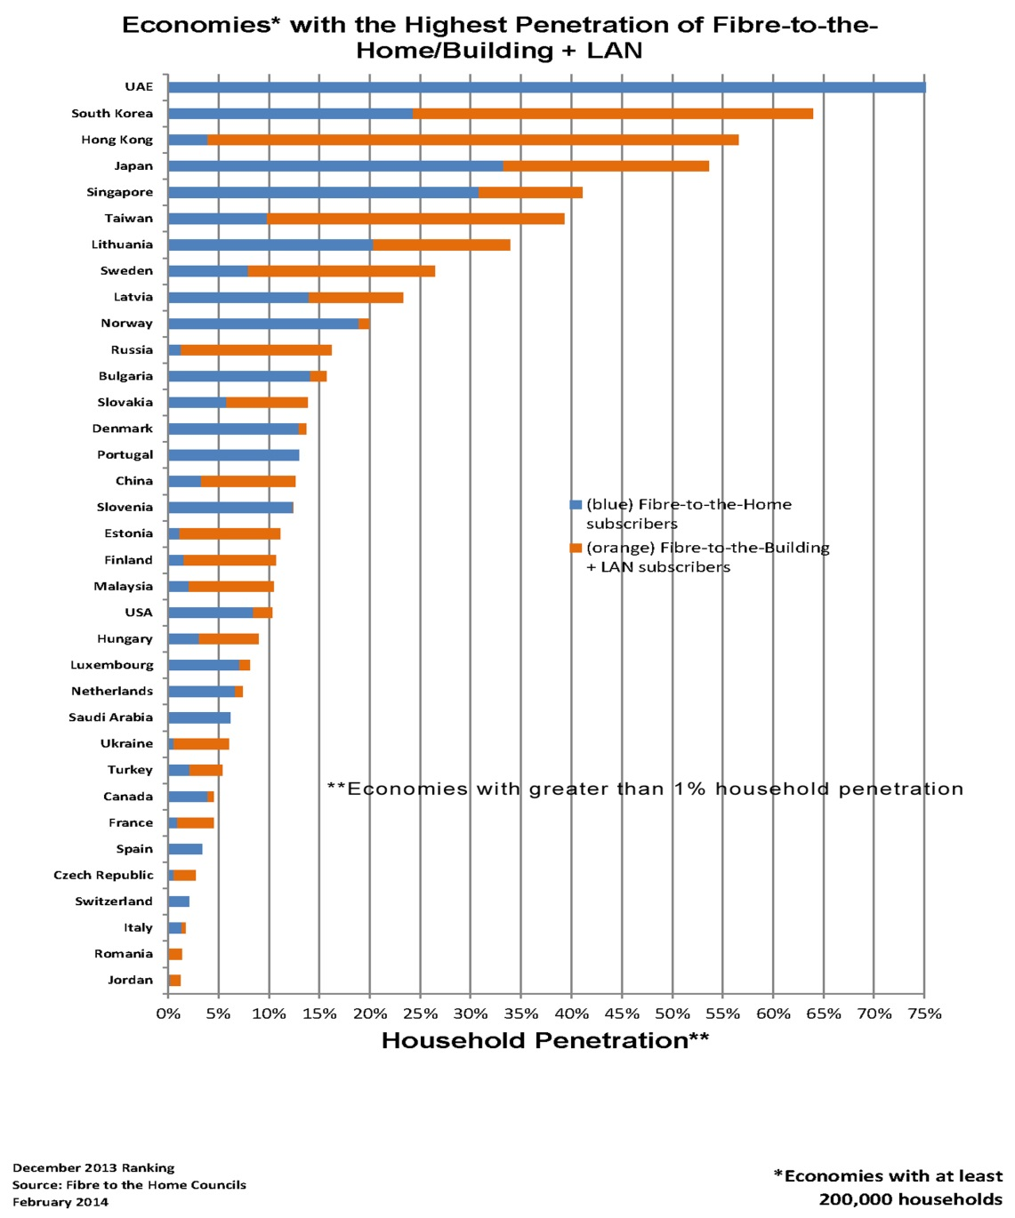
Dense Fiber networks assure reliable transmission in LTE Backbone network

Slide 5
Registration of Wimax and LTE base stations 2008-2014
Development of 4G/LTE/Wimax coverage in 2011-2014.
In 2014 – No. of LTE base stations grew by 7,5 times
LTE bands: 800 MHz, 1800 MHz, 2600 MHz, future 2300 MHz.
Wimax band: 3500 MHz.

Slide 6
Regulation and competition in LT
Population – 3 mln., territory 65.000 km2, rural population ~34 %
Regulation of access in LT started back in 1998 - Law on Telecommunications. Problem: to replace legacy copper infrastructure
BB strategy adopted in 2005-11
Investments started by the cable companies (not incumbent)
Today ~60 % of optic lines are owned by alternative operators develop own infrastructure and profit from being independent
Wholesale access products are not popular in LT
FTTx is being provided by ~60 market players

Slide 7
Regulation and competition – results
Duct rental price ~ 30 EUR/month/km, but only 500 km is rented annually
Around 2009 FTTx became a leading technology (over xDSL)
In 2014: ~40 % of internet users (with PCs) have FTTx connections, ~20 % uses wireless connection
Access to the physical infrastructure was and still is the essential enabler of alternative infrastructure roll-out
Also, BB mapping project (dedicated website for infrastructure available in municipalities) is being developed since 2011, 4 big cities joined so far.
Wireless BB speed measuring system is in place (NRI, measured at the postal offices)

Slide 8
high speed internet usage in LT

Slide 9
LT today: lowest prices in EU

Slide 10
Conclusions
Coverage of rural areas by developing wireless broadband and fiber networks
Further ensure necessary regulatory environment and promote investment
To foster competition in infrastructure sharing and e-communications
Responses from the users that do not have internet connection (data from Statistics Lithuania (2014):
65 %) responded that they do not need it (development of content in the EU and LT)
10 % responded that they use BB elsewhere, e.g. at work, and it is not necessary at home (content development)
19 per cent responded that equipment is too expensive (economic development)
0,5 % do not use BB because of security (education of users)

Slide 11
Our commitment to RDF initiative
Upon request to provide experts with our experience on BB development, infrastructure sharing, radio spectrum management
In 2016-2017 we are ready to host RDF meeting in Lithuania

Slide 12
Thank you for your attention!
paulius.vaina@rrt.lt
Communications Regulatory Authority of the Republic of Lithuania
www.rrt.lt

