Slide 1
Working with the European Bank for Reconstruction and Development
Information & Communication Technologies (ICT) Sector
April 2015

Slide 2
The European Bank for Reconstruction and Development (EBRD) at a glance
International Financial Institution
  Established in 1991 and owned by 65 countries and two inter-governmental institutions (EC and EIB)
  Operates in 35 countries from central Europe to central Asia and, since 2011, selected markets of the Southern and Eastern Mediterranean region (Morocco, Tunisia, Egypt and Jordan) with strong local presence
Solid financial position
  AAA / Aaa rating
  Capital base of EUR 30 billion
  Capacity to invest up to EUR 300 million in a single transaction
  The ability to bear risks allows to offer innovative solutions for complex investments
Development mandate
  Promotes projects that expand markets, and help build institutions that underpin the market economy
  Mobilises significant foreign direct investments
  Provides financing at reasonable terms reflecting project risk levels
  Ability to foster a policy dialogue
Largest investor in the region
  Since establishment invested nearly EUR 100 billion in more than 4,000 projects
  In 2014 alone, EBRD invested EUR 8.7 billion in 377 projects
  Private sector > 70% of EBRD finance

Slide 3
EBRD provides financing solutions
“Typical” investment profile
Typical Size
  Minimum ticket is equivalent to EUR 1 million with a maximum size in excess of EUR 200 million
Term/Holding period
  Debt instruments: typically from 4 to 10 years
  Equity Investments: typically from 4 to 7 years
Instruments
  Debt: public and private instruments, fixed and floating, syndicated loans, bonds
  Equity: Private Equity, IPO, Venture Capital
  Quasi Equity: convertible loans, subordinated loans, loans with warrants
Currency
  Local and major currencies (RUB, US$, EUR, CHF etc.)
Investments approach/Limits
  EBRD typically acts as a co-investor along other sponsors
  EBRD’s stake typically does not exceed 35% of the total investments (equity and debt) or 50% in case of syndication with other international banks
Applications
  Growth funding, consolidation, working capital, green/brown fields, JVs, privatization etc.
Exact financing terms are defined by existing market conditions

Slide 4
Co-operation with EBRD offers companies numerous advantages
Long-term investor
  EBRD aims to develop long-term relationships - typical investment horizon is up to 10 years with equity holding periods ranging usually 4- 7 years
  The Bank relies on a buy-and hold approach, which decreases its dependence on the short term market fluctuations
Trusted business partner
  Engaged minority business partner and debt provider, who shares risks
  Close working relationships with shareholders and management
  Strong, internationally recognised financial partner with long-term perspective
Sector knowledge & local expertise
  Deep knowledge and sector expertise proven by more than 150 executed projects in the ICT sector
Structured solutions
  Transactions are tailored to the needs of the clients and a variety of financial structures are considered
  Non-standard structures are welcome and a large range of transaction sizes
Other
  Catalyst to access additional equity or debt
  Guardian of high standards for corporate governance and compliance (highly valued by minority investors)
  Strong and long lasting connections with local and Federal Governments that allow the Bank to promote and defend interests of its portfolio companies

Slide 5
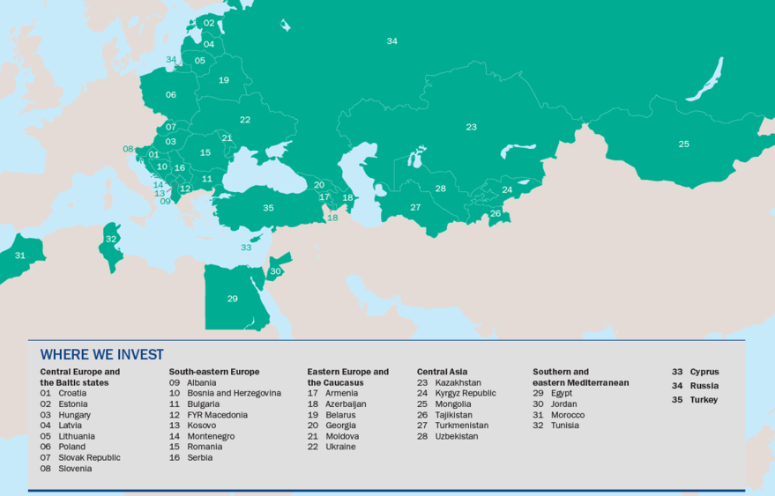
Where we operate

Slide 6
Information and Communication Technologies Team Portfolio
Cumulative financing to date: €3.65 billion
Current portfolio: €0.68 billion
Over 158 deals ranging from a few million to over 180 million EURO in 34 CEE/CIS countries
Selected Subsectors
Mobile & fixed line
ISPs
Cable TV
Digital Switchover
Towers
Satellites
Fibre
Wireless broadband
Data centers
MVNO
Pay-TV
Mobile payments
IT services
Software developers
Systems integrators
Call centers
Cinema chains
Outdoor advertising
Internet
Cleantech
Semiconductors

Slide 7



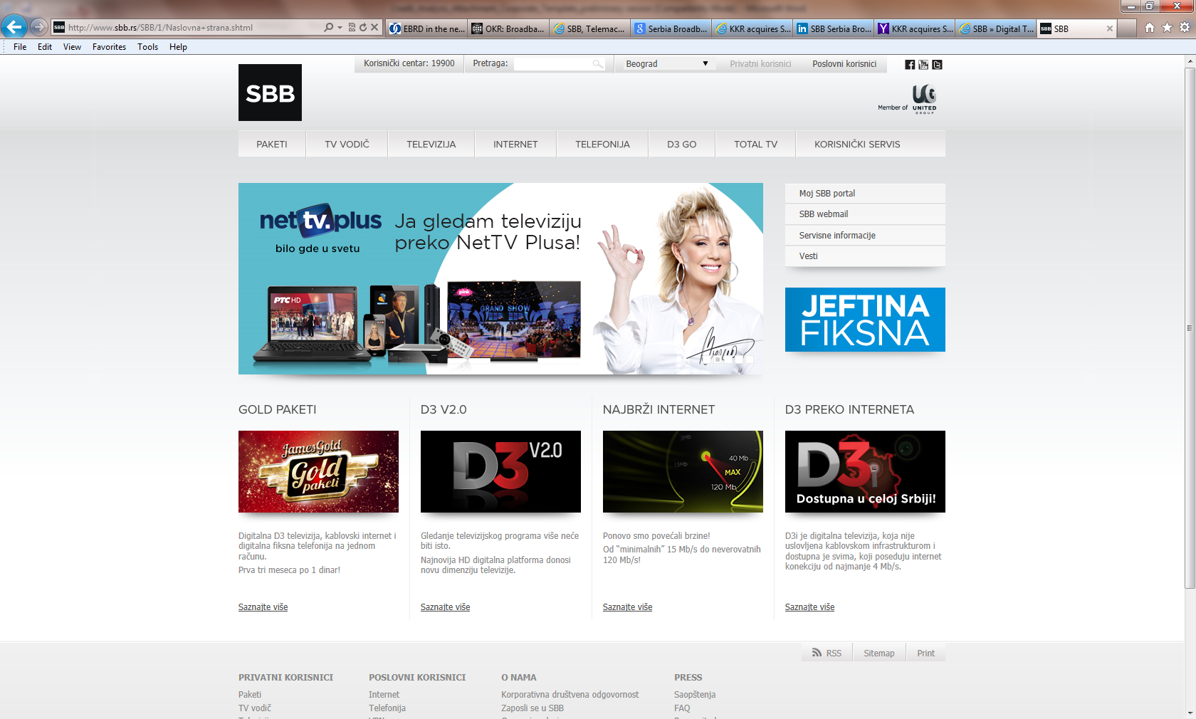



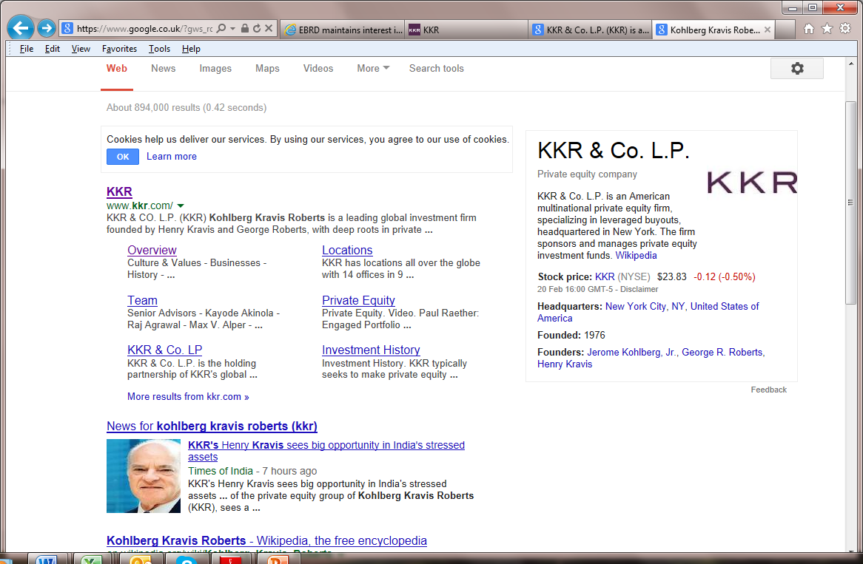






Selected projects the ICT team executed in the past across all countries of operations (1/2)
Virgin Mobile CEE
Turkey
Russia
Bulgaria
Serbia
Poland and Turkey
Equity Investment
via Venture Capital Facility as part of a total funding round of
Equity Investment
via Venture Capital Facility as part of a total funding round of
Turkey
Loan
Sovereign Guaranteed Loan
Equity Co-Investment
Loan
Euro 20 million
Euro 24 million
Euro 10 million
USD 20.6 million
USD 7 million
USD 50 million
2014
2014
2014
2014
2014
2014
Russia
Equity Co-Investment
with
Russia
Equity Investment
via Venture Capital Facility as part of a total funding round of
Regional
Equity Co-Investment
with
Turkey
Equity Investment
via Venture Capital Facility as part of a total funding round of
Romania
Turkey
Syndicated Loan
Loan
USD 7 million
Euro 50 million
USD 25 million
Euro 75 million
USD 5 million
Euro 9.5 million
2014
2013
2013
2013
2013
2013
Tunisia
Loan
Russia
Turkey
Equity Investment
via Venture Capital Facility as part of a total funding round of
Regional
Romania
Poland
Loan
Loan
Loan
Equity Investment
Euro 5 million
Euro 100 million
USD 38 million
Euro 43 million
Euro 15 million
Euro 200 million
2013
2012
2012
2012
2012
2011

Slide 8














Selected projects the ICT team executed in the past across all countries of operations (2/2)
Russia
Poland
Serbia
Russia
Russia
Russia
Investment in Bond Offering
Equity Investment
Convertible debt and Equity
Equity Investment
Convertible Loan
Syndicated Loan
Euro 10 million
Euro 7.5 million
Euro 30 million
USD 20 million
Euro 258 million
2011
2011
2009
2011
2010
2009
Russia
Poland & Balkans
Albania
Russia
Ukraine
Kazakhstan
Equity Investment
Loan and Equity Investment
Privatization - Syndicated Loan
Loan and Equity Investment
Equity Investment
Syndicated Loan
USD 11 million
Euro 22 million
Euro 27 million
USD 35 million
Euro 22.3 million
Euro 130 million
2009
2009
2008
2007-2008
2007
2005-2007
Regional
Bulgaria
Kazakhstan
Albania
Regional
Regional
Syndicated Loan
Privatisation – Loan and Equity Investment
Syndicated Loan
Syndicated Loan
Equity Investment
Loan
EUR 50 million
Euro 93 million
USD 110 million
Euro 100 million
Euro 32 million
Euro 81 million
2006
2004
2003
2003
1999
1998

Slide 9
EBRD and Digital Switchover (DSO)
EBRD has played a two-fold role in the DSO process to date:
EBRD
Financing
Technical assistance support to design, administer and implement the process
&

Slide 10
EBRD & DSO - Financing
On the financing/investment side:
Financing for state multiplexer transmission company(ies) (e.g. Serbia, Romania);
Financing of successful bidder where there is an open tender for multiplexers to be made available for private investment (e.g. Georgia).
The manner and extent of any such financial support would be determined according to the role envisaged for EBRD by the stakeholders involved;
As with all financing by EBRD, it is subject to approval by the Bank’s management and Board of Directors as being consistent with EBRD mandate.

Slide 11
EBRD & DSO – Technical Assistance
On the technical assistance and process side (insofar as the following have yet to be achieved and are consistent with national policy) EBRD can help with:
Option evaluation and policy development;
Preparation of the technical specifications defining the main design parameters for digital terrestrial broadcasting networks;
Design of a competitive tender process for the selection of suitable privately funded digital multiplex platform provider(s) – (where government policy supports such);
Adjustment of the legal and regulatory framework to accommodate DSO;
Administration of a competitive tender to select additional digital multiplex platform provider(s), including assistance in the promotion of the contest to a national and international audience of potential bidders;
Monitoring of the network planning stages of the winning operator(s) to ensure compliance with the implementation requirements of their networks;
Communications and consumer relations aspects;
Set-top box procurement, testing and distribution.
Examples of EBRD support………./

Slide 12
EBRD & DSO – (Serbia 2014/15)
EUR 16m financing to finalise Multiplexers 2 and 3 helped Serbia to complete by internationally agreed deadline;
EBRD support allowed for the commercialisation of the new over-the-air television transmission market;
Access to EBRD financing and technical assistance helped speed up a quasi-stalled process;
Technical assistance financed consultants Grant Thornton for financial due-diligence;
Technical assistance supported procurement preparation;
EBRD involvement helped facilitate regular working group meetings;
Financing helped enhance the market for new services: improved quality of SD picture/sound, HD broadcasting, possibility for a larger number of over-the-air channels, translation/captions services, programme guides

Slide 13
EBRD & DSO – Georgia (2013 – 15)
EBRD technical assistance and financing helped Georgia to implement DSO:
EBRD technical assistance supported:
Ministry for Economy and Sustainable Development (MESD) in examining options and define policy (hybrid public and private operations – 1 State multiplexer, 3 private multiplexers);
MESD, Georgia National Communications Commission (GNCC) and Ministry of Justice in amending law and drawing up regulations;
GNCC in defining specifications and tender process for 3 private multiplexers;
GNCC in administering tender process;
GNCC in monitoring implementation by winning private operator;
MESD’s Digital Switchover Agency in testing and procuring set top boxes, and developing and administering communications campaign;
EBRD finance:
Is funding the winning bidder in the tender for private multiplexer operator

Slide 14
EBRD and Broadband, Generally
EBRD is looking at developing a support programme to help accelerate Broadband roll-out in its countries of operation:
Approach based on adapting successful experience from within European Union;
Combination of grant-funded technical assistance and commercial financing;
Technical assistance for policy/strategy development, implementation planning and execution;
Financing to support private operators to extend and accelerate investment into commercially viable areas;
Technical assistance to help optimise regulation to the extent necessary to minimise barriers to private investment (e.g. infrastructure sharing, spectrum re-farming, rights-of-way);
Potential financing to help government supported efforts to accelerate broadband deployment beyond urban centres.

Slide 15
EBRD and Broadband - Financing
Potential clients among:
Existing private operators building out own networks, ideally consistent with national broadband plan;
New entrants, network or service providers, ideally consistent with (and attracted by) national broadband plan;
Government sponsored broadband incentive schemes (e.g. second national infrastructure networks), which feature as part of a coherent national broadband plan.
The manner and extent of such financial support would be determined according to the role envisaged for EBRD by the stakeholders involved
As with all financing by EBRD, it would be subject to approval by the Bank’s management and Board of Directors as being consistent with EBRD mandate.

Slide 16
EBRD and Broadband – Technical Cooperation
Grant-funded technical assistance support to help with:
Policy development, based around Digital Agenda for Europe 2020 targets (though, perhaps with longer time horizons in some countries);
Demand study;
Supply analysis;
Network modelling and design;
Implementation planning;
Network costing;
Cost and revenue, business and investment modelling
Overall economic cost and benefit analysis
Legal, regulatory & investor perception review
Legal and regulatory adjustment to accommodate (e.g. infrastructure sharing, rights-of-way)
Implementation programme (e.g. subsidy auctions)

Slide 17
EBRD and Broadband – Türk Telekom (2012)
EBRD provided a EUR 100m loan to Türk Telekom in 2012 to finance regional broadband expansion by Turkey's largest fixed line provider.
The Project consists of the expansion of the reach and capacity of Türk Telekom’s fixed broadband networks in the remote provinces of Turkey.
By expanding its core network to remote regions of the country, the Company will also contribute to the growth of smaller ISPs which will be able to use TT’s expanded network to provide services in these regions as well.
By Q3 2014 – broadband subscribers reached 40 million (6 million in 2006)
Annual growth rate of internet subscribers 28.2%
By Q3 2014 – 16% of fixed broadband subscribers had fibre, compared to 4.9% in 2012. xDSL over same period declined from 78.2% to 65% of fixed broadband subscribers.
Number of homes passed by TT’s fibre network increased from 7.1m (June 2013) to 9.5m (December 2013)

Slide 18
EBRD and Broadband – Other Examples
Broadband investment forms part of EBRD’s Knowledge Economy Initiative, which aims to foster growth through innovation. The four pillars of the KE Initiative are (1) innovation policy (2) information infrastructure (3) technological upgrading and (4) financing for small innovative tech companies.
Under information infrastructure pillar, EBRD makes debt and/or equity investments which directly or indirectly support broadband development:
Alternative fixed broadband providers – e.g. Atlant Telecom (Belarus), Bulstatcom (Bulgaria), Orion (Serbia).
CaTV operators – providing broadband as part of triple play offering e.g. SBB Telemach (West Balkans), DCS (Romania), Sun Communications (Moldova), Volia (Ukraine).
Wireless fixed broadband providers e.g. Enforta (Russia).
Data Centres – e.g. GTS (CEE), ITG (Russia), Kriz DC (Croatia)

Slide 19
Contact Details
Financing:
Constantinos Shiatis
Principal Banker
ICT Team, Banking
Tel: +44 20 7338 6831
email: shiatisc@ebrd.com
Technical cooperation:
Paul Moffatt
Senior Counsel
Legal Transition Team
Tel: +44 20 7338 7453
email: moffattp@ebrd.com
European Bank for Reconstruction and Development
One Exchange Square | London EC2A 2JN | United Kingdom

