Slide 1


ITU and Academia

Slide 2

04
Our proposal
ITU ACADEMIA MEMBERSHIP PROGRAM

Slide 3

01
Meet us
WHO WE ARE
Our numbers
193
700
90
MEMBER STATES
PRIVATE SECTOR
ACADEMIA
MEMBERS

Slide 4

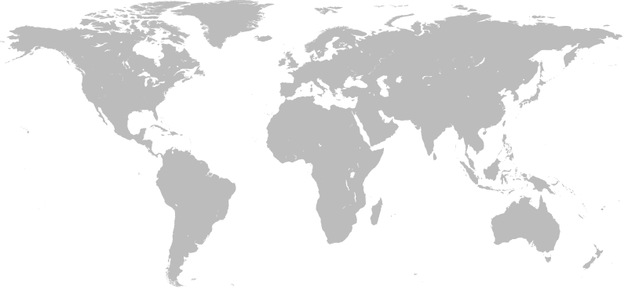

Introduction to ITU
04
ITU Academia Membership
CIS
6 members
Europe
17 members
Arab States
3 members
North and South America
33 members
Asia and Pacific
20 members
Africa
11 members
90 Academia Members (as of Feb.2015)

Slide 5

ITU & ACADEMIA
04
ITU Academia Membership
ITU STUDY GROUPS
Key Themes
Cybersecurity
Future Networks
Climate Change
Broadband
Smart Sustainable Management
Spectrum and Satellites
Broadcasting
Multimedia
and more…
Each Sector of ITU has a number of study groups that discuss current
ICT trends, and develop Recommendations and Standards for the global ICT sector.
ITU Academia members can participate all study group meetings and submit their contributions.

Slide 6

ITU & ACADEMIA
04
ITU Academia Membership
ITU ACADEMY
ITU Academy provides education, training courses and information resources on information and communication technologies
Academia has the opportunity to contribute to development of the content as well as learn more skills and knowledge about ICTs

Slide 7

ITU & ACADEMIA
04
ITU Academia Membership
ITU KALEIDOSCOPE CONFERENCE
An excellent platform for academia to facilitate networking with other experts and discuss ways to enrich the ITU standardization process
Total prize of USD 10,000 for top 3 papers
Best papers published in IEEE Communications Magazine
Global recognition for your research/and your top students

Slide 8
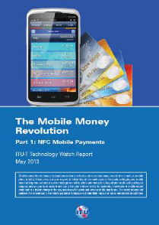
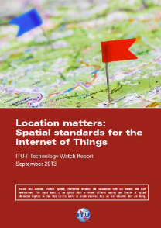


04
ITU Academia Membership
ITU PUBLICATIONS
Academia members have the unlimited access
to all ITU publications
Moreover,
ITU Academia members have the opportunity to
- Author a Recommendation
- Publish an article in ITU-T Tech Watch
- Contribute to toolkits and reports
- Give tutorial at Study Group meetings

Slide 9
04
ITU Academia Membership
IN SUMMARY
You can…
Enrich Your Technical Knowledge
Contribute to global standards and best practices
Become an editor or rapporteur of ITU documents
Raise the profile and recognition of your institution
Share your expertise and engage in global debates
Launch innovative public-private partnerships
Get access to world-leading ICT statistics
For only:
Institutions in developing countries:
CHF 2,000/year
Institutions from developed countries:
CHF 4,000/year

Slide 10



ITU & ACADEMIA
04
ITU Academia Membership
WHAT OUR MEMBERS SAY…
“In addition to falling closely in line with Georgia Tech’s strategic vision…our collaboration with ITU also aims at fostering productive relationships with industry, academia and other organizations actively working in the ICT arena”
- Georgia Tech, Center for the Development and Application of Internet of Things Technology
“We strongly believe that ITU has been playing and will continue to play an important role for shaping the whole IT industry and therefore the human's life”
- Tsinghua University, Tsinghua DTV Technology R&D Center
“We are proud to partner with ITU in the areas of information technology and telecommunication policy where ITU is the uncontested leader”
- EPFL, Institute of Technology and Public Policy

Slide 11
Thank you!

