Slide 1
ITU Centre of Excellence @ the Czech Technical University in Prague
Matěj Rohlík
itu@comtel.cz

Slide 2
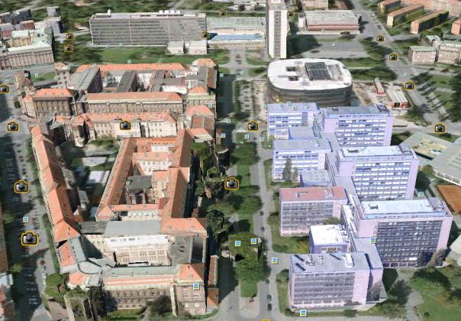
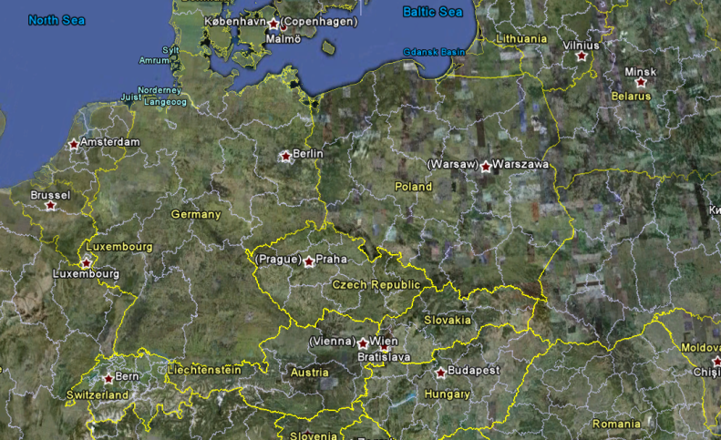
Czech Technical University in Prague
Among oldest technical universities in Central Europe
Established 1707
Edict of Joseph I, Holy Roman Emperor
8 Faculties
Electrical Engineering (since 1950)
Architecture
Biomedical Engineering
Civil Engineering
Information Technology
Mechanical Engineering
Nuclear Sciences and Physical Engineering
Transportation Sciences
Approximately 21.300 students
Top 400 Worldwide, Top 170 TU – and climbing (Times Higher Education Supplement)

Slide 3
Faculty of Electrical Engineering
19 + 4 departments
Department of Telecommunications Engineering
Department of Circuit Theory
Department of Computer Graphics and Interaction
Department of Computers
Department of Control Engineering
Department of Cybernetics
Department of Economics, Management and Humanities
Department of Electric Drives and Traction
Department of Electroenergetics
Department of Electromagnetic Field
Department of Electrotechnology
Department of Informatics
Department of Languages
Department of Mathematics
Department of Measurement
Department of Mechanics and Materials Science
Department of Microelectronics
Department of Physics
Department of Radioelectronics
Centre for Business Cooperation
Centre for Knowledge Management
Development and Implementation Laboratories
Education Support Centre

Slide 4
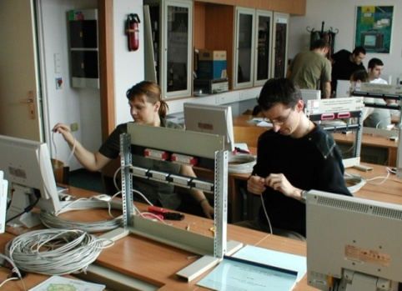
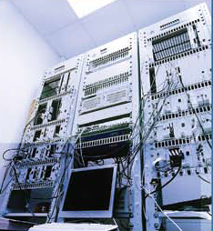
Dept. of Telecommunications Engineering
Staff
3 full professors
8 associate professors
Approx. 20 researchers, fellows
Approx. 30 PhD students
Research topics (research teams)
Transmission Media and Systems
New Generation Networks – NGN
Security
Mobile Communications
Internet of Things and RFID
Industrial Applications
Digital Signal Processing
ICT Systems Management
Educational Systems
Assistive Technologies and eHealth
Cloud computing
https://comtel.fel.cvut.cz/en/

Slide 5
Laboratory Equipment
Mobile communications
GSM to LTE
Femtocells, Smallcells
Security
Deep packet inspection
Data communication inspection and mining
RFID
Academies (more than 10 years of experience)
Cisco, Juniper
Cedupoint
Technical courses
Professional training environment

Slide 6
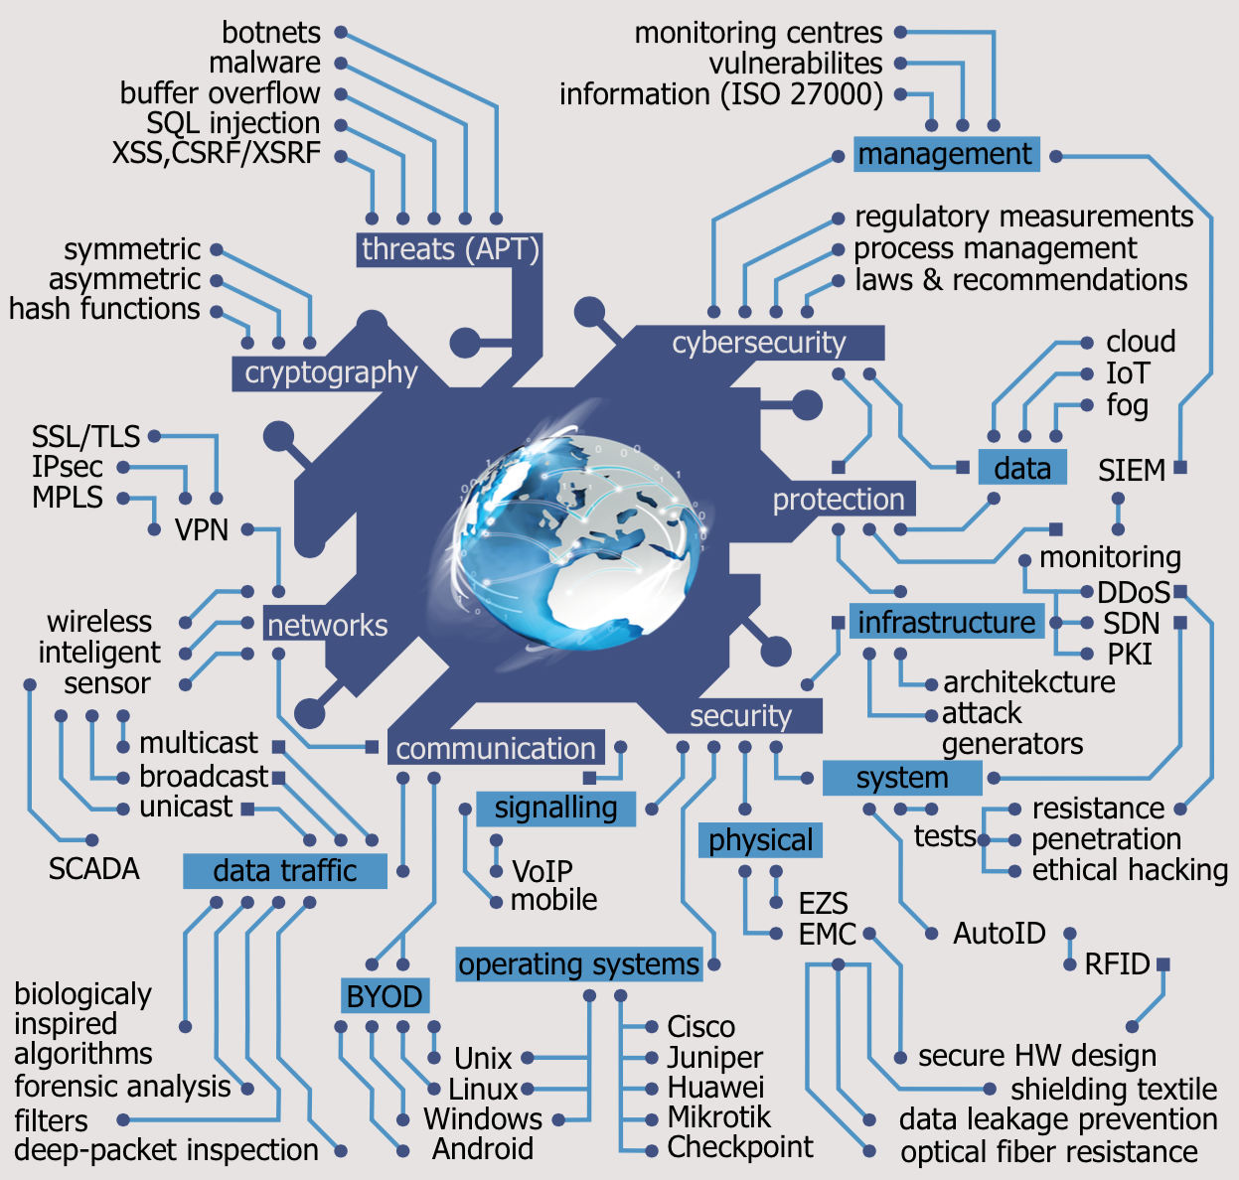
(Cyber) security

Slide 7
ITU CoEs Around the Globe
Cybersecurity

Slide 8
CoEs Across the Globe 1/2
 | Institution | State | Priority Area(s)
Africa Region | DBI | Nigeria | Policy and Regulation
 | E.S.M.T. | Senegal | Broadband Access Digital Broadcasting
 | ESATIC | Côte d'Ivoire | Cybersecurity
 | URCST | Rwanda | Cybersecurity
 | Telkom SA | South Africa | ICT Applications and Services
 | AFRALTI | Kenya | Spectrum Management Broadband Access
Americas Region | INICTEL UNI | Peru | Broadband Access
 | UNLP | Argentina | Cybersecurity
 | CINTEL | Colombia | Spectrum Management
 | INATEL | Brazil | Digital Broadcasting
 | CCAT LAT | Argentina | ICT Applications and Services
 | CITIC | Ecuador | ICT and Climate Change Mitigation and Adaptation
Arab Region | INPT | Morocco | Policy and Regulation
 | CIFODE'COM | Tunisia | Broadband Access
 | CERT | Tunisia | Conformance and Interoperability
 | NTI | Egypt | Spectrum Management
 | SUDACAD | Sudan | ICT Applications and Services
 | TRA | Bahrain | Capacity Building in Internet Governance

Slide 9
CoEs Across the Globe 2/2
 | Institution | State | Priority Area(s)
Asia‐Pacific Region | MICT | Thailand | Policy and Regulation Broadband Access
 | NIA | Republic of Korea | Policy and Regulation
 | ALTTC | India | Broadband Access
 | IMPACT | Malaysia | Cybersecurity
 | MIIT | China | Conformance and Interoperability
 | SRMC | China | Spectrum Management
CIS Region | ONAT | Ukraine | Policy and Regulation Digital Broadcasting
 | KSTU | Kyrgyz Republic | Broadband Access e‐Waste
 | MTUCI | Russian Federation | Cybersecurity ICT Applications and Services
Europe Region | CTU | Czech Republic | Cybersecurity
 | FEEIT | The Former Yugoslav Republic of Macedonia | Broadband Access
 | NIT | Poland | Capacity Building in Internet Governance
 | TUC | Germany | Cybersecurity Broadband Access
 | ISQ | Portugal | e‐Waste Conformance and Interoperability

Slide 10
Training Proposals

Slide 11
Cybersecurity Training #1
Cyber Security Awareness Training for SMEs
a comprehensive „cookbook“ for small business enterprises with the aim to identify particular pitfalls while implementing security measures
topics for a one week intensive workshop:
network infrastructure Ethernet, IP, WiFi, mobile, cloud
VLAN, remote access, VPN, IPS/IDS, BYOD
data and information security administered locally and remotely (3rd party cloud), advance persistent threats (malware and botnets)
datacenter security (servers, apps, DBs and virtualization)
security lifecycle (management of processes, events and incidents)

Slide 12
Cybersecurity Training #2
Cyber Security Lifecycle of the New Millennium
advanced technologies, hacking techniques and implementation of corresponding countermeasures
topics for a one week intensive workshop:
mobile devices management and risk mitigation
Internet of secure things (Cloud, Fog, AutoID, NFC vs. DDoS, privacy)
advanced datacenter security (software defined networking, data deduplication, data mining)
security lifecycle (management of processes, events and incidents – SIEM)
penetration testing (servers, firewalls, applications and services), risk and vulnerability management

Slide 13
Thank you for your attention ... questions …
Matěj Rohlík
itu@comtel.cz

