Slide 1
Early Warnings for All Initiative & Cell Broadcast for ECTEL
Dr. Amélie Grangeat
Disaster Preparedness Specialist,
Environment and Emergency Telecommunications Division, BDT
International Telecommunication Union (ITU)

Slide 2
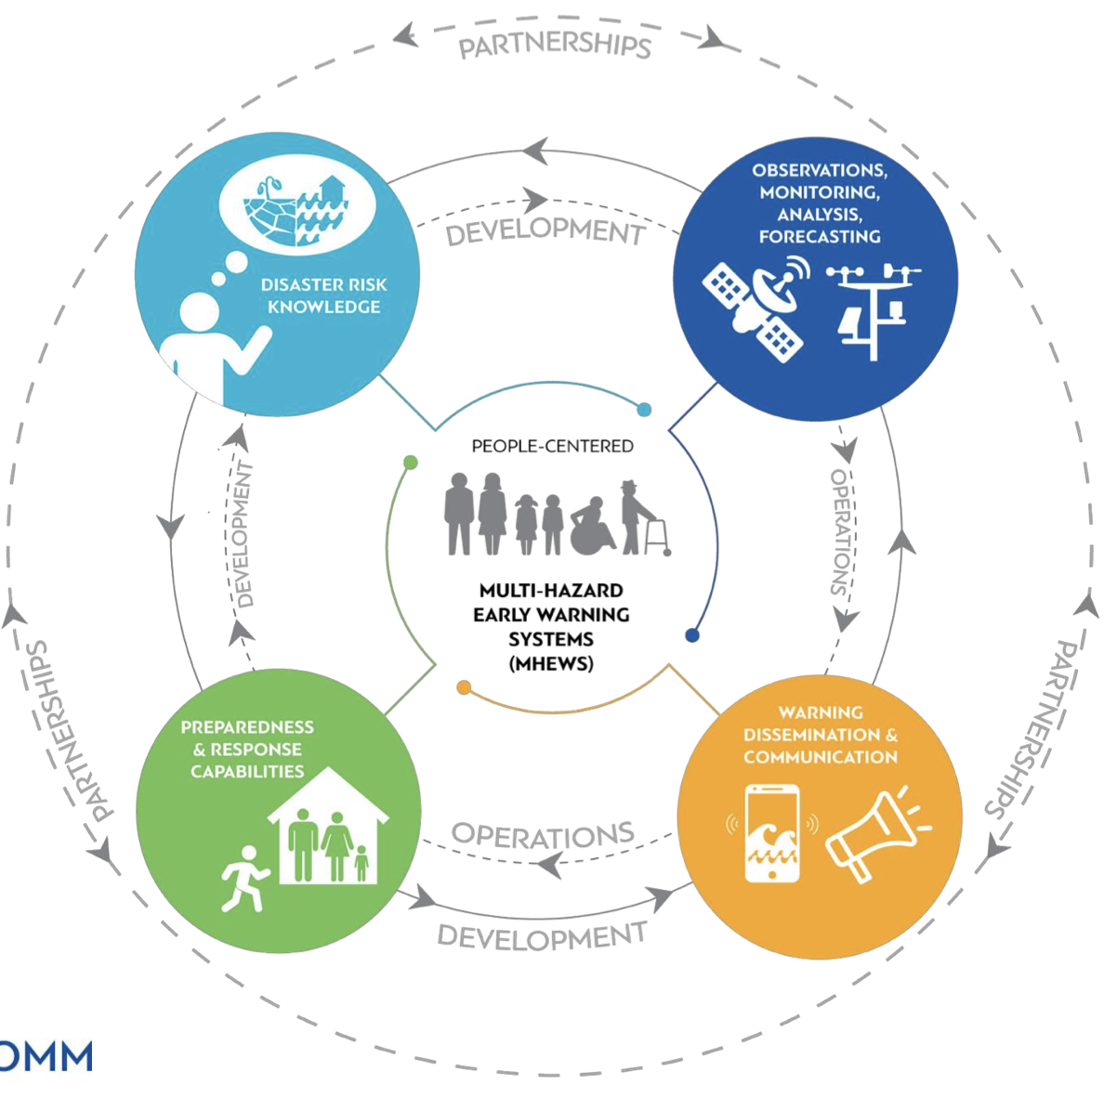
Early Warnings for All
In March 2022, the UN set a new target to ensure that everyone on Earth should be protected by early warning systems by 2027.
Multi-Hazard Early Warning System(MHEWS) Value Cycle – 4 pillars
Notes:
Background
At current levels of global greenhouse gas emissions, the world is not on track to meet the climate targets, which would increase the risks of pervasive climate change impacts beyond what is already seen. Early Warning systems are a proven, effective, and feasible climate adaptation measure. In March 2022, the UN Secretary-General set up the UN Early Warning Initiative, which stipulates that by 2027, every person in the world should be protected by an early warning system.
EW4All is promoting programmes to strengthen climate mitigation in developing countries thanks to 4 pillars. The United Nations Office for Disaster Risk Reduction (UNDRR) leads the first pillar on the risk knowledge. World Meteorological Organization (WMO) leads the second pillar on the observation, monitoring and forecasting of the risks. ITU is the leader of the 3rd Pillar, on the alert dissemination. The International Federation of Red Cross and Red Crescent Societies (IFRC) leads the 4th pillar on the response and the engagement of the communities.
ITU as the lead of Pillar 3
ITU’s Membership has provided the Union with a clear mandate to support countries in implementing early warning systems, including through PP Resolution 136 (Rev. Bucharest, 2022) which focuses on “the use of telecommunications/information and communication technologies for humanitarian assistance and for monitoring and management in emergency and disaster situations, including health-related emergencies, for early warning, prevention, mitigation, and relief.” Likewise, the last ITU World Telecommunication Development Conference (WTDC) also adopted Resolution 34 (Rev. Kigali, 2022), on “the role of telecommunications/information and communication technology in disaster preparedness, early warning, rescue, mitigation, relief and response.”
As the lead for Pillar 3, which is the 'Warning Dissemination and Communication' pillar within the early warning value cycle (see Figure below), ITU collaborates closely with co-leads IFRC, WMO, UNDP, IOM, and REAP to ensure that last-mile connectivity is available once a risk is identified, and the need for an alert is established.

Slide 3
4 Outcomes for Pillar 3: Warning Dissemination and Communication
Outcome 1: Governance
All countries have agreed on functions, roles and responsibilities for each actor in the warning dissemination process and this is defined through government policy
Outcome 2: Infrastructure networks and services
Last-mile communication - All countries have multichannel dissemination and communication alerting to ensure the warnings reach those at risk.
Outcome 3: Inclusion and people-centered approach
Strengthened and expanded alert dissemination and feedback channels reaching all people with actionable information.
Outcome 4: Quality and trust
All countries have the capability for effective, authoritative emergency alerting that leverages the Common Alerting Protocol (CAP), suitable for all media and all hazards.
BDT 2023 Publication : background paper on mobile early warning systems
Notes:
Source: EW4All action plan

Slide 4
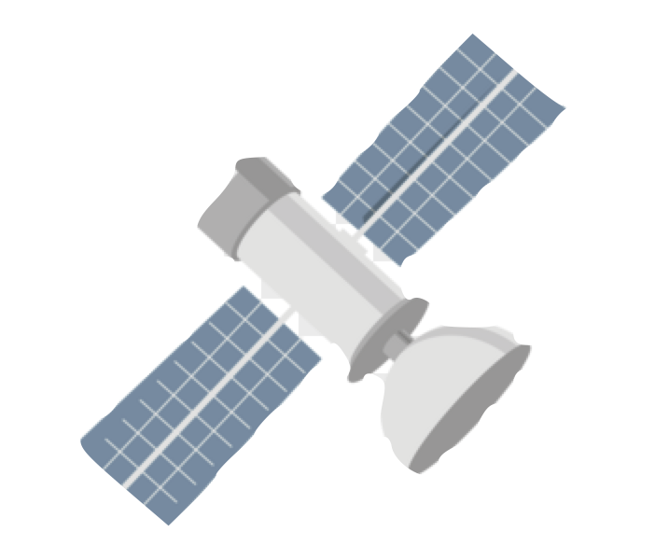
Multi-channel Approach for Warning Dissemination and Communication
Satellite
In warning dissemination and communication, a multi-channel approach increases the effectiveness of an alert and help address the diversity of communities at risk.
Digital transformation is bringing huge opportunities in strengthen this pillar and allows us to reach more people through information and communication technologies (ICTs) --such as sending alerts to the phone.

Slide 5
95% of the world population is covered by mobile network
4 out of 5 people in the world own a mobile phone
Cell-Broadcast (CB)
Wide reach:
Send geo-located messages to users within risk areas, including roamers
Opt-in challenges limited(as opposed to mobile-apps)
Compatible on most devices
No risk of congestion
No subscription needed
Supports multi-language alerts
A “blind technology” that does not allow 2-way communication
Standardized Cell Broadcast 3GPP
…making mobile network an effective channel to reach people!
Source: ITU, Facts and Figures 2023; Photo credit: Dimone Hogan/Shutterstock

