Slide 1
Manufacturers promoting connected TV accessibility
HBB4ALL Workshop – Barcelona,18th March

Slide 2
AMETIC (Asociación de Empresas de Electrónica, Tecnologías de la Información, de la Comunicación, de las Telecomunicaciones y de los Contenidos Digitales)
It is the Spanish ITC Sector Trade Association. Its main goal is to represent the legitimate interests of:
Electronics Industry (consumer & industrial)
Information Technology Enterprises
Telecom Operators
Digital Contents & Services Enterprises

Slide 3
WHY ACCESIBILITY?
Accesibility is good for all

Slide 4
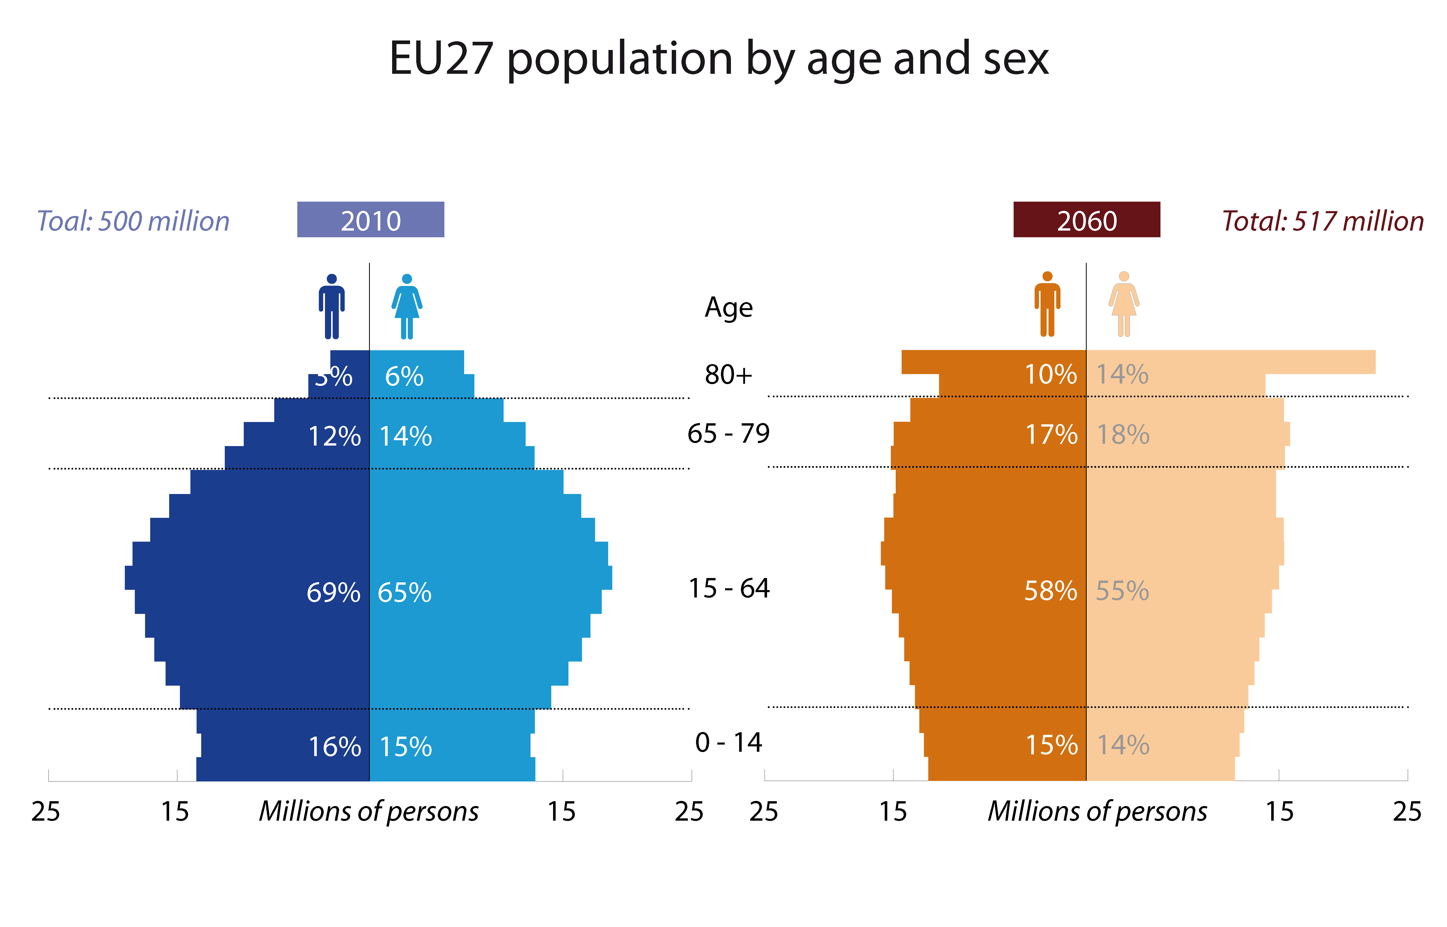
A FEW FIGURES…
In Spain there are now around 4 million of persons with some physical disability ( data from Predif, Spanish Platform of Persons with Physical Disability)
Demographic change in Europe go fast: en 2010, 20% of population was 65 years old. In 2060, 30% of european population will be more than 65 years old.

Slide 5
GENERAL LAW of RIGHTS of PERSONS with DISABILITIES and its SOCIAL INCLUSION
Royal Legislative Decree 1/2013, of 29 November of 2013 , approving the revised text of the General Law on the Rights of Persons with Disabilities.
Background: legislative framework
Law 13/1982, dated April 7, social integration of people with disabilities.
Law 51/2003 of December 2, equal opportunities, non-discrimination and universal accessibility for people with disabilities.
Convention on the Rights of Persons with Disabilities, adopted on 13 December 2006 by the United Nations General Assembly (UN), ratified by Spain on December 3, 2007 and entered into force on May 3, 2008 .
Law 27/2007, dated October 23, by which the Spanish sign languages are recognized and regulated means of support for oral communication of the deaf, hearing impaired and deafblind.
Law 26/2011, of August 1, for regulation at the Convention on the Rights of Persons with Disabilities adaptation.

Slide 6
2014-2016 ACTION PLAN OF THE SPANISH DISABILITY STRATEGY (Conseil of Ministers , September 12th 2014 )
96 measures and more than 3.093 million euros
Based on the PRINCIPLES of GENERAL LAW of RIGHTS of PERSONS with DISABILITIES and its SOCIAL INCLUSION.
These principles include:
Universal accesibility
Universal design (Design for all )
Mainstream policies

Slide 7
2014-2016 ACTION PLAN OF THE SPANISH DISABILITY STRATEGY (Conseil of Ministers , September 12th 2014 )
What are the Principles of Universal Design?
Equitable use
Flexibility in use
Simple and intuitive
Perceptible information
Tolerance for error
Low physical effort
Size and space for approach and use

Slide 8
2014-2016 ACTION PLAN OF THE SPANISH DISABILITY STRATEGY
(Conseil of Ministers , September 12th 2014 )
ACCESIBILITY ACTION PLAN TARGETS
STRATEGIC TARGET
Promote goods and services accesibility
OPERATIONS TARGETS
Fostering ICT´s accesibility
Accesibility Special Plan (TV, radio)
Promoting offer of services and devices, fostering ICT research
Promoting universal accesibility in public policies and business strategies
Advancing in universal accesibility and design for all.
Promoting information system accesible about disability

Slide 9
AMETIC & Digital Europe Vision
e-Inclusion and Accessibility through global standards
Many information and communication technologies offer a wide range of accessibility and inclusion benefits to users with specific profiles of abilities and preferences, such as deaf, hard of hearing, blind or partially-sighted users, other disabled users as well as ageing citizens.
Digital technologies have enabled wider participation in work, social and leisure activities, everything from home working, online shopping and social media have improved engagement and provided new opportunities for these users.
Recognising the challenging change in demographics, the ICT industry continues to develop and deliver improved accessible solutions to the market, improving mainstream products and broadening the range of targeted solutions. Competition and voluntary action have led to the rapid provision and improvement of general usability as well as specific e-Accessibility features. Industry's aim is to ensure the market delivers the highest possible level of accessibility while minimising the burden on consumers, public agencies and industry.
Industry is committed to improving standardization and voluntary activities that will allow the deployment of accessible solutions as main selling points in a rapidly growing and very competitive market.

Slide 10
AMETIC & Digital Europe Recommendations
Industry clearly understands the importance of accessibility expectations from policy makers and users.
While the overall population that benefits from accessible ICT is large, each individual group of users with disabilities (e.g. mobility, sensorial or cognitive) may be better served by avoiding market fragmentation and focusing on the use of globally recognized standards.
Any future legislation addressing accessibility should be limited to public procurement and dealt with only at the European level. It should reference globally recognized standards using public procurement as the catalyst so as to enable a single design to be shipped to the largest possible market. This would encourage accessibility features to be included in mainstream products at affordable prices. Regulations adopted at the member state level would lead to fragmentation, increased cost and less choice for consumers. Furthermore, European legislation should aim to outline what accessibility needs should be met without detailing the exact methods for reaching them, using design-orientated standards such as WCAG 2.0.
A globally consistent regulatory approach focusing on standards for public sector procurement and accessible public sector services is essential to encourage the development and deployment of suitable accessibility solutions. It will also help to minimise the cost of accessible solutions without affecting more innovative areas that aren’t subject to such universal requirements.

Slide 11
One last update
The 6th of March 2015, The United States of America have sent a Notification to the Committee on Technical Barriers of Trade (WTO) notifying that both their standards:
For electronic and information technology developed, procured, maintained or used by federal agencies, and
Its guidelines for telecommunications equipment and customer premises equipment
Will be revised and updated.
The purpose of these revisions is to ensure that information and communications technology covered by the respective statues is accessible to and usable by individuals with disabilities.

