Slide 1
Spectrum Management Trends: towards 2020
Arturas Medeisis ITU Expert (VGTU, Lithuania)
István Bozsoki, BDT, ITU

Slide 2
time to crank efficiency of spectrum use, time to share it even more…
Radio spectrum - a most crucial resource to ensure stable operation and further development of wireless communication services and applications: from high-tech interstellar science research to humble garage door openers

Slide 4
Presentation outline
Role of Spectrum Management (SM)
Institutional best practices of SM
Forward-looking planning of frequencies
Novel licensing approaches
Economic aspects of SM
Interference monitoring and enforcement
International harmonisation

Slide 5
Presentation outline
Role of Spectrum Management (SM)
Institutional best practices of SM
Forward-looking planning of frequencies
Novel licensing approaches
Economic aspects of SM
Interference monitoring and enforcement
International harmonisation

Slide 6
Role of spectrum management
Features | Natural Resource
 | Spectrum | Land | Oil | Water
Is the resource varied? | YES | YES | Not very | Not very
Is it scarce? | YES | YES | YES | YES
Can it be made more productive? | YES | YES | YES | NO
Is it renewable? | YES | Partially | NO | YES
Can it be stored for later use? | NO | NO | YES | YES
Can it be exported? | NO | NO | YES | YES
Can it be traded? | YES | YES | YES | YES

Slide 7
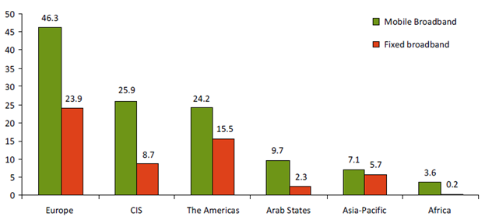
Broadband penetration across the globe
Broadband may be seen as key driving force for development of consumer wireless service.
Figure shows percentage of penetration, source: ITU

Slide 8
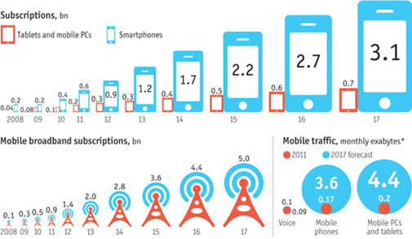
ForecasteD Explosion of Wireless data
Future traffic is going to be driven by predominant smartphone and mobile PC/tablet market segments.
Source: Ericsson/The Economist (Oct. 2012)

Slide 9
Presentation outline
Role of Spectrum Management (SM)
Institutional best practices of SM
Forward-looking planning of frequencies
Novel licensing approaches
Economic aspects of SM
Interference monitoring and enforcement
International harmonisation

Slide 10
Institutional best practices (I)
Setting up efficient SM organization:
  Achieving streamlined and efficient SM on both short-term and long-term basis, allocating spectrum in an economic and efficient manner, and by relying on market forces, economic incentives and technical innovations
Transparency of SM operations:
  Promoting transparent, non-discriminatory, economically efficient and effective SM policies, that provide regulatory certainty
Technological neutrality and flexible spectrum use:
  Promoting wireless innovation, by creating conditions for the development of new services, reducing investment risks and stimulating competition among different technologies, including facilitating entry into market of new competitors

Slide 11
Role of SM: Vision towards 2020
Radio spectrum shall continue playing ever more vital role in provisioning of broad variety of radiocommunications services - public, private and governmental alike
Especially the continued growth of public demand for mobile broadband services shall be putting pressure on spectrum managers, requiring them to find solutions to ensure unrestricted long term growth of those services, through allocating new bands and finding innovative ways of more efficient utilisation of spectrum

Slide 12
Institutional best practices (II)
Timely availability and efficient use of spectrum:
  Facilitating timely introduction of new applications and technology, while protecting existing services from harmful interference; ensuring most efficient use of radio spectrum
International harmonization:
  Aligning domestic spectrum policies with internationally recommended, in order to achieve faster take-up of new bands and economies of scale
Affordable and fair spectrum access:
  Reducing financial barriers for new wireless entrants to the market and promoting development of wireless technologies, especially in less developed areas
  Ensuring that all wireless players have equitable and fair access to spectrum resources

Slide 13
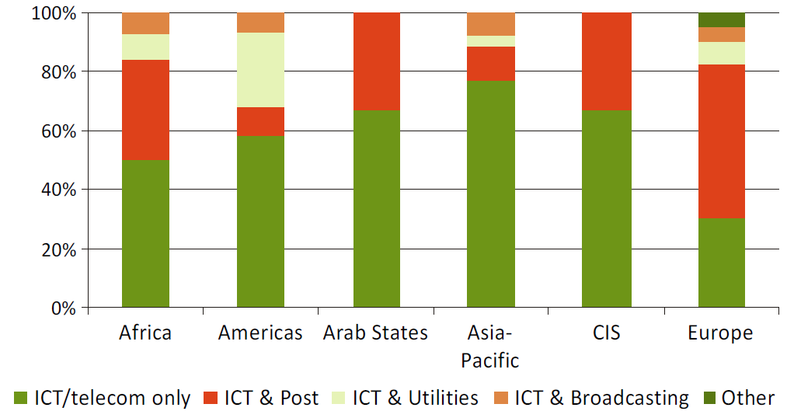
Mandate of modern NRA
Increasing trend towards seeing ICT policy and regulation as integral part of overall national infrastructure provisioning platform.
Source: ITU, based on data from 158 countries

Slide 14
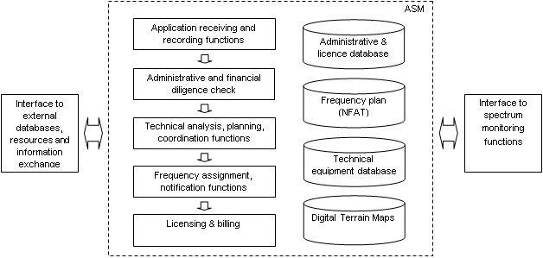
Typical Automated Spectrum Management System (ASMS)
ASMS is today a critical constituent element of a lean and efficient SM organisation.
NRAs will be able to increasingly use public web interfaces to their ASMS with the aim of providing broad set of spectrum use data for transparency purposes and making use of self-service opportunities.

Slide 15
SM Organisation towards 2020
To stay current with time, modern NRA will be an independent professional organization, operating within a lean structure of national SM governance and using automated tools with increased transparency
It will be increasingly important to study and where found appropriate, implement recommendations from ITU and learn from elsewhere as regards best SM practices to ensure transparency and soundness of operations, while maintaining confidence and respect of the wireless industry stakeholders
The key to efficient spectrum utilisation will be in developing system of incentives for market players

Slide 16
Presentation outline
Role of Spectrum Management (SM)
Institutional best practices of SM
Forward-looking planning of frequencies
Novel licensing approaches
Economic aspects of SM
Interference monitoring and enforcement
International harmonisation

Slide 17
Planning of frequency use
Market consultations and self-regulation as means of deciding the most economical way to utilise spectrum are gaining importance
Yet centralised planning will retain its role where broader objectives of spectrum allocation and use efficiency may be at stake
SM method | % of spectrum allocated in the UK (source: Ofcom)
 | Year 2000 | Year 2010
Administrative | 96 % | 22 %
Market | 0 % | 71 %
Commons | 4 % | 7 %

Slide 18
Impact of new technologies
Advanced wireless technologies increasingly possess features of dynamic re-configurability and “intelligent” spectrum access agility
This leads to new spectrum use concepts such as Dynamic Spectrum Access or White Space utilisation

Slide 19
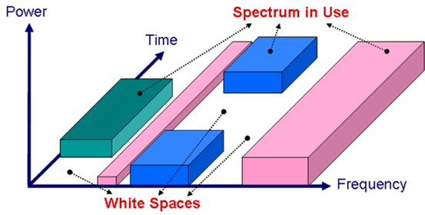
The concept of white spaces
Source: CEPT, ECC Report 159

Slide 20
Frequency planning towards 2020
Existing administrative national and international frequency planning processes shall retain their relevance especially as regards any re-alignment of spectrum allocations at the level of ITU Radio Regulations and establishment of regional plans for harmonised frequency use by broadcasting and other services
Nevertheless, the proportion of flexible allocations allowing markets to self-determine the best utilisation of spectrum will continue to grow, empowered by emergence of new technologies such as Geolocation databases and Cognitive Radio, which may be expected to gain widespread use by the end of the decade

Slide 21
Presentation outline
Role of Spectrum Management (SM)
Institutional best practices of SM
Forward-looking planning of frequencies
Novel licensing approaches
Economic aspects of SM
Interference monitoring and enforcement
International harmonisation

Slide 22
Spectrum licensing
The borderline between traditional polarised approaches of exclusive licensing vs. licence-exempt use is gradually becoming diluted by appearance of novel compromising solutions that promote various forms and degrees of organised sharing of spectrum:
  Light-licensing
  Authorised Shared Access/Licensed Shared Access
  Pluralistic Licensing, etc.

Slide 23
Different dimensions of spectrum licensing
The pyramid depicts the hierarchical view of spectrum access licensing forms, complemented by reference to other commonly used terms that refer to identical, yet sometime subtly different licensing types.
Source: adapted from US PCAST report 2012.

Slide 24
Licensed Shared Access concept
Licensed Shared Access (LSA, similar to ASA, Authorised Shared Access) envisions possibility of centrally controlled dynamic sharing of spectrum. This concept is especially suited for adaptable spectrum consumption by future “Heterogeneous Networks” (HetNets)
Incumbent spectrum holder
ASA/LSA license holder
Agreement
Multi-technology
multi-band
macro-cells
Real time spectrum use info
NRA
Real time spectrum demand info
GDB
Pico- and
femto-cells
Spectrum use spot permits
ASA/LSA network controller
3G/4G network

Slide 25
Licensing towards 2020
NRAs shall retain principal use of both auctions and “beauty contests” as main tools for awarding of operating licenses
Similarly, the existing radio apparatus licensing/authorization schemes will all retain their value and use depending on the circumstances of specific bands and services
Moreover, the NRAs’ authorization toolbox shall be enriched by further additions of licensing schemes that will allow various arrangements and degrees of shared use of spectrum resource

Slide 26
Presentation outline
Role of Spectrum Management (SM)
Institutional best practices of SM
Forward-looking planning of frequencies
Novel licensing approaches
Economic aspects of SM
Interference monitoring and enforcement
International harmonisation

Slide 27
Economic aspects of sm
Various economic SM tools are by now well established and tested
Can be invoked in three different stages of the spectrum use cycle:
  to increase efficiency of initial spectrum distribution in the licensing process (cf. auctions)
  to increase efficiency of spectrum use by the license holder (cf. Administrative Incentive Pricing)
  to increase timeliness and efficiency of re-distribution of inefficiently used spectrum (cf. AIP and re-farming tools)

Slide 28
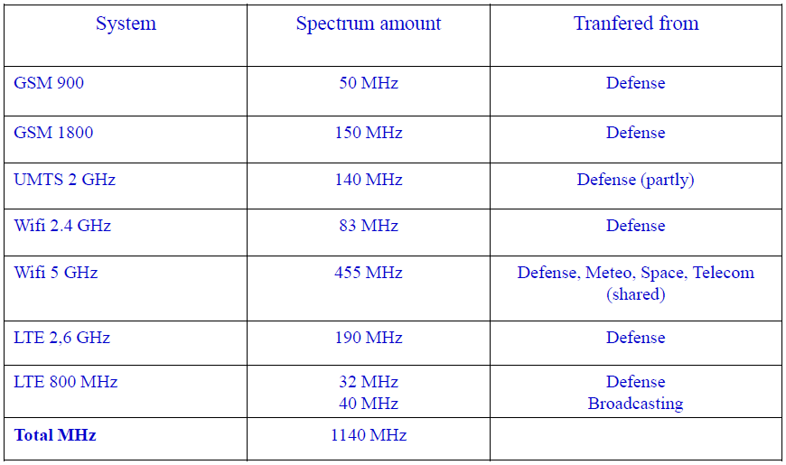
Spectrum re-farming In France
One of global success stories in applying economic tools to increase efficiency of spectrum use, French administration succeeded in timely re-allocation of more than 1 GHz of spectrum over a decade since1998
Source: ANFR, 2011

Slide 29
Economic methods towards 2020
Economic tools and methods will continue providing crucial basis for transparent award of frequencies in highly contested bands and for subsequently creating incentives for most efficient utilisation of spectrum resource
The auctions are likely to get more widespread use, especially for flexibly termed frequency assignments (spectrum usage rights)

Slide 30
Presentation outline
Role of Spectrum Management (SM)
Institutional best practices of SM
Forward-looking planning of frequencies
Novel licensing approaches
Economic aspects of SM
Interference monitoring and enforcement
International harmonisation

Slide 31
Monitoring and enforcement
Monitoring, market-supervision and enforcement become increasingly integrated fields of operation
Most NRAs today will have some monitoring facilities at or near their headquarters as well as a set of regional stations spread throughout the country
It is important that each station becomes a generic hub for control and enforcement functions, whereas one or more teams of inspectors would carry out regular inspections of:
  Licensed radio stations: prior and at regular intervals during their operation
  Vendors of radio equipment in order to control whether they put on the market suitable (type approved) equipment
  Assessment of interference complaints

Slide 32
Typical monitoring set-up in a larger country
Main Control Center
(NRA HQ)
RFMS
MMS
RDFS
TRMS
PME
Regional Center
RFMS
MMS
RDFS
TRMS
PME
ARFMS
ARFMS
ARFMS
Key:
RFMS: Regional Fixed Monitoring Station
ARFMS: Automated Remote Fixed Monitoring Station
RDFS: Remote Direction Finding Station
MMS: Mobile Monitoring Station
TRMS: Transportable Monitoring Stations
PME: Portable Monitoring Equipment
ARFMS

Slide 33
Market self-regulation
Due to explosive growth in trade and proliferation of wireless uses and consumer devices, in some cases (frequency bands) regulators see benefits in promoting self-control by the markets
This trend is exemplified by gradual change from ex ante regulation (i.e. strict regulation and controlling beforehand) to ex post regulation (i.e. letting market forces work and only intervening in cases of reported problems)

Slide 34
Monitoring & Enforcement trends
Radio monitoring will remain important operational function of NRAs also in the future, however its technical and staff complement may see change due to changing efficiency and increasing automation of radio monitoring equipment, including “cloud” monitoring by dispersed nodes
Market self-regulation is likely to be an increasing trend, especially for the highly congested bands used by a limited set of professional operators
In the latter cases the NRAs will still retain the overall important oversight role, such:
  Wireless equipment market inspection
  Agents for consumer protection, e.g. impartial market supervision and auditing of quality of public wireless services delivered to end-users

Slide 35
Presentation outline
Role of Spectrum Management (SM)
Institutional best practices of SM
Forward-looking planning of frequencies
Novel licensing approaches
Economic aspects of SM
Interference monitoring and enforcement
International harmonisation

Slide 36
International harmonisation
Remains an ever important issue even after a century of efforts in this area, since the 1906 signing or Radio Telegraph Convention aiming to align international use of radio frequencies
Two main avenues:
  International harmonisation of radio spectrum allocations and use on global (ITU) and regional (CITEL, CEPT, ATU, APT) levels
  Cross-border agreements for efficient utilisation of frequencies between countries

Slide 37
Harmonisation of allocations
Today faces a challenge of finding a balance between degree of harmonisation vs. degree of technological neutrality, while reaching towards the overall objective of most efficient spectrum utilisation and highest socio-economic benefit:
  Importance of continued international collaboration with active involvement of all relevant stakeholders
  Harnessing the enabling new agility and re-configurability features of modern wireless technologies

Slide 38
Cross-border Agreements
Well established practice that most optimal approach is to set out a priori bi- or multi-lateral coordination agreements on frequency use in border areas in order to:
  Ensure equal distribution, and
  Speed up the day-to-day frequency assignments in border areas
New technologies create new challenges, such as it is not enough to agree on a single channel raster, but provide options for different bandwidth, partitioning of CDMA access codes, special OFDMA signals and sub-carriers, etc, etc.

Slide 39
Harmonisation towards 2020
International harmonisation will become even more important with the ever growing globalisation of business, trade and peoples’ mobility
Recent examples with WiMAX and LTE developments show that multi-band operability is not a panacea and mass market momentum and economies of scale could only be achieved by harmonising frequency bands. To this end the ITU and regional organisations will retain their vital role as mediators for harmonised spectrum use
The use of cross-border agreements will remain the key for ensuring efficient spectrum use in border areas

Slide 40
Summary and Conclusions
SM remains a vibrant sphere of activities that makes an important constituent part of ICT industry functioning and innovation
Some of the most general trends for SM towards the year 2020:
  Radio spectrum shall continue playing ever more vital role, such as to accommodate unrelenting growth of public demand for broadband services
  The key to further increasing efficiency of overall spectrum utilisation would be through better sharing, enabled by continued international collaboration and innovation in SM
  Proportion of flexible allocations allowing markets to self-determine best utilisation of spectrum will continue to grow, helped by emergence of new empowering technologies such as Geolocation databases and Cognitive Radio
  The NRAs’ authorization toolbox shall benefit of wider use of licensing schemes that create market incentives and allow various degrees of shared use of spectrum resource, such as light-licensing, ASA/LSA etc.

Slide 41
Thank you !

