Slide 1

Recycling Infrastructures and Private Public Partnerships
Daniel Ternald – UNEP IETC
November 27th 2019

Slide 2

Why should PPPs be envisaged for e-waste recycling?
Public Sector | Private Sector
+ Implements waste management policies + Ensures coordination amongst stakeholders - May not sustain costs of investment and maintenance - May lacks knowledge and key competencies | + Access to new market + Improves operating efficiency + Provides technical and management skills - Dependent on policies issued by the government
PPPs are contractual arrangements between the public sector and a private sector party for the private delivery of public infrastructure services or other basic services
Table 1. Data retrieved from ADB

Slide 3
Specificities of e-waste PPPs
Decentralized | Centralized
+ Greater integration of informal workers + Lower operational expenditure | + Economies of scale + Greater extraction of value through technological solutions
Composition of waste -> hazardous, difficult to recycle
2. International buyers’ market
3. High-cost technologies

Slide 4
Business and Administration Use
Buyers
E-products producers / sellers
Primary Waste Segregation and Collection (decentralized)
Secondary Waste Segregation and Recycling/Disposal (centralized)
Official Takeback system (see case study 1)
Private Use
Private partner to Collect and Segregate waste.
This stage should involve local communities (see case study 2)
Private partner to Recover/Recycle/ Dispose (see case study 3)
Final Disposal
E-waste Exports
1st and 2nd step can be conducted by one or more partners

Slide 5

Case study 1. HP Takeback Programme
Improve recyclability, reduce use of toxic materials
Recovery of scrap materials
Share responsibility between stakeholders through Extended Producer Responsibility (EPR) principle
Hewlett-Packard partners with 76 countries to collect used products
2019: Samoa’s Ministry of Natural Resources and Environment (MNRE) partners with HP to reduce e-waste in the country

Slide 6
Legislation and Regulations | Availability of a National Recycling System | Supervision and Compliance
+ E-Waste (Management) Rules of 2016 in India: Introduces EPR principle Introduces recycling targets - Lack of guidelines and financial resources | - 95% of recycling handled by the informal sector: not included on the 2016 Law - No incentives for the informal sector to formalize or sell formal sector - Not economically viable for small or medium sized companies to establish individual or collective recycling units | - No supervision of system operations such as collection fees - No enforcement of treatment standards and sale bans on non-complying manufacturers

Slide 7
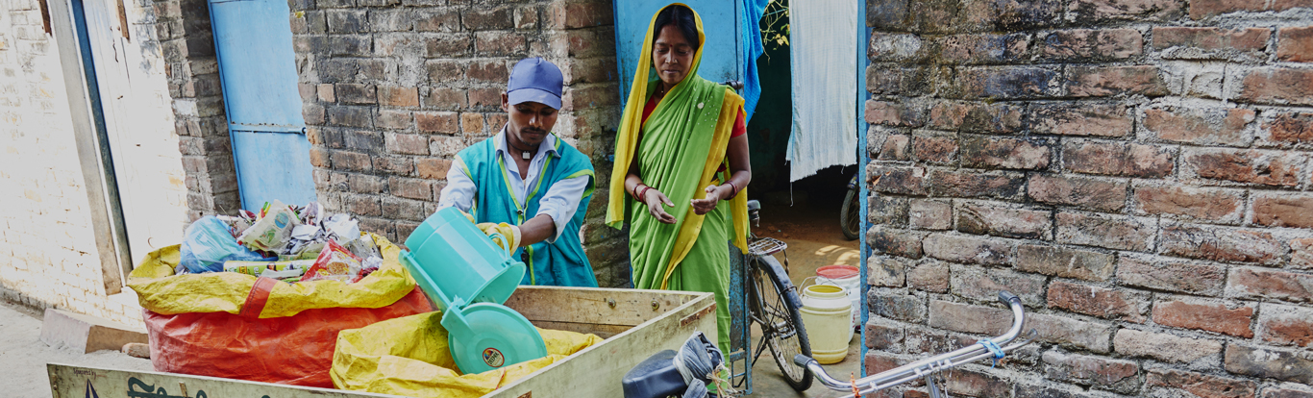
Case study Municipal Solid Waste in Saharanpur, India
Door-to-door collection and primary segregation
Secondary segregation at the WM site employing 100 rag pickers
90% recovery of waste
Primary segregation at Saharanpur

Slide 8
Need for financial incentives:
Tipping fee: charged for unloading waste at a treatment facility for treatment
Concession agreements
Low-cost debts and Taxation incentives
Viability Gap Funding: supports a percentage of a PPP-based project’s capital expenditure. Can be disbursed based on actual performance.

Slide 9
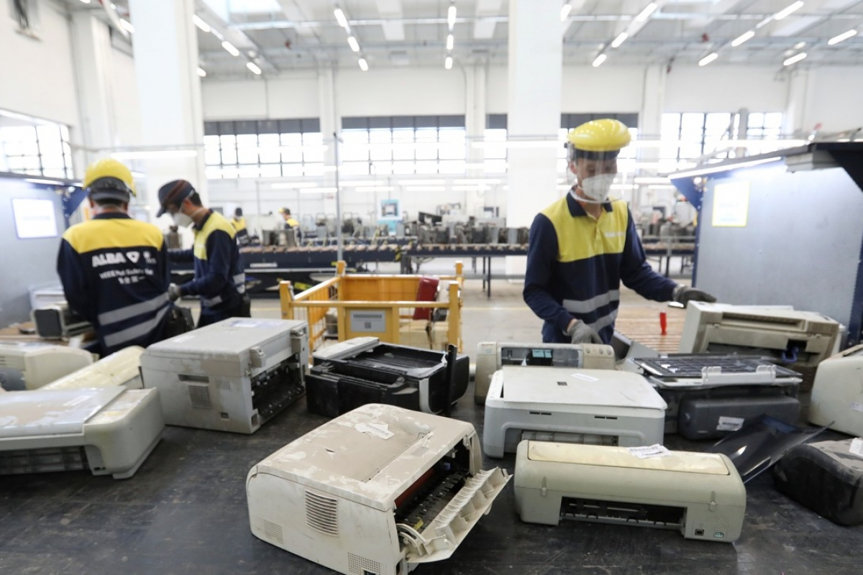
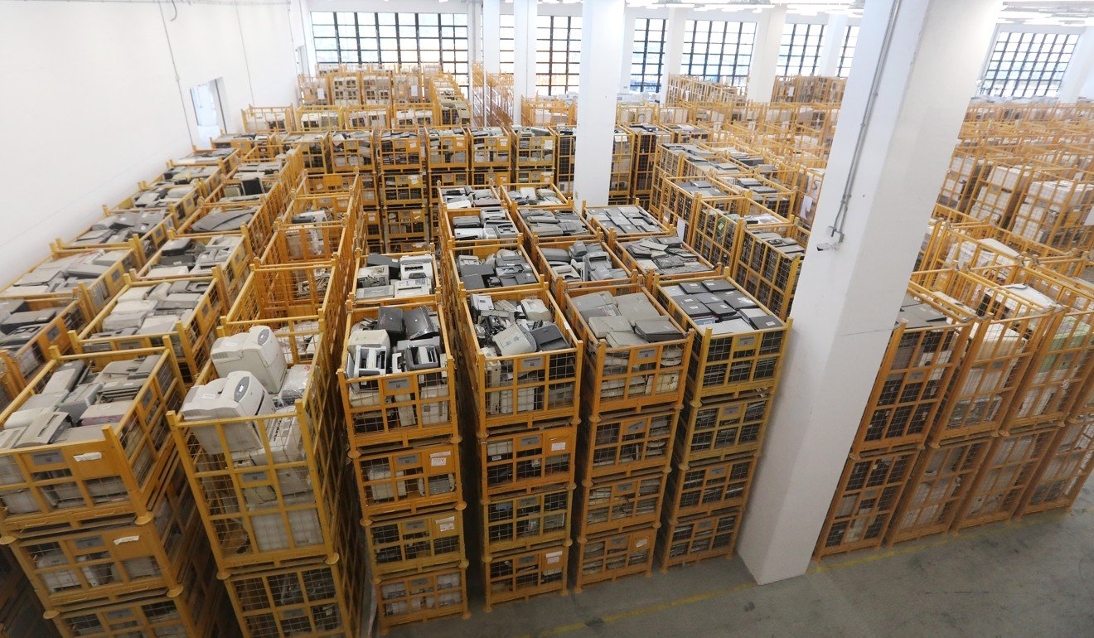
E-waste PPP in Hong Kong
- Started 2018
10 Year contract between ALBA and Gov’t of Hong Kong
Re-use, refurbish, disassemble, material recycling
Contract worth 318 million Euros
Capacity estimated at 60,000 tonnes/year

Slide 10
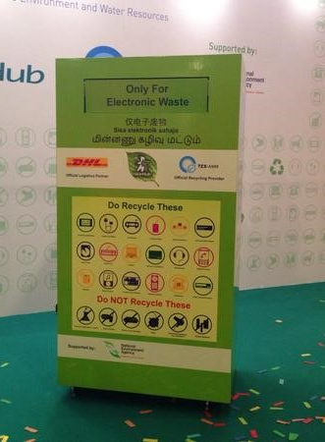
E-waste voluntary partnership
Singapore
Started 2015, now 17 partnerships
ReCYCLE by SingPost and SingTel
small IT collection boxes, and free mail-in service
RENEW
400 E-waste bins across the country
- Downside: Mainly targets small electronics

Slide 11
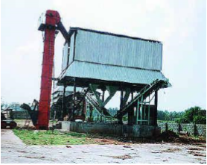
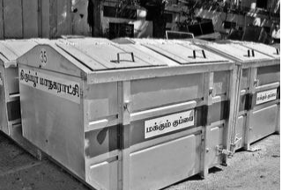
Case study 3. Municipal Solid Waste in Tirupur, India
Tirupur Municipal Corporation
Provision of land on lease
Provision of waste
Payment of Rs. 5.20 per tonne of waste in case of default
Payment of Rs> 3.5 per tonne of waste supplied
Buyers of Compost
Payments
IVR Infrastructures & Projects Ltd.
Monitoring
Peace Committee
Compost

Slide 12
Risk-sharing | Local Community Involvement | Multiple concessionaires
+ Collection and Transportation concessionaire (here the Municipality) bears the demand risk - 2000: implementation of new MSW Rules. Need to review the concession agreement after construction of the plant: - legislation needs to be stable and consider Private partners | - Villagers strike led to: + Creation on the “Peace Committee” + Hiring and training local ‘rag-pickers’: Creates stable employment Improves compliance with primary sorting | - Tipping fee to the ‘collection and transportation’ concessionaire based on the quantity of waste - Revenue for the ‘processing and disposal’ concessionaire based on the content of waste

Slide 13
Conclusion
PPP projects can be a solution for developing recycling infrastructure in e-waste, however it needs to be designed carefully in regards to:
Legislations and Regulations
Financial and Organizational Risks
Local Community Involvement
Financial Incentives

Slide 14
References
ADB, 2018, Creating an enabling environment for public-private partnerships in waste-to-energy projects, ADB Sustainable Development Working Paper Series (58)
ADB, 2010, Municipal Solid Waste Treatment: Case Study of Public-Private Partnerships (PPP) in Wenzhou
ASSOCHAM Council on Climate Change & Environment, 2018
Athena Infonomics India Pvt. Ltd., Public Private Partnerships in Municipal Solid Waste Management
HP Planet Partners, available on: https://www8.hp.com/us/en/hp-information/environment/product-recycling.html
International Finance Corporation, 2014, Waste PPPs, Handshake issue #12
Jackson, C., 2019, Samoa Launches Public-Private Partnership on E-Waste, available on: https://sdg.iisd.org/news/samoa-launches-public-private-partnership-on-e-waste/
Mohan, G., 2016, Managing of Solid Waste through Public Private Partnership Model, Procedia Environmental Sciences, 35
StEP, 2009, White Paper: E-waste Take-Back System Design and Policy Approaches

Slide 15
Thank you
Daniel Ternald – UNEP IETC

