Slide 1
Session 5
Insights from a Regional Study on Building Resilient National ICT Infrastructure
Christine Apikul
2 September 2024
Masterclass on Inclusive and Resilient Broadcasting Development

Slide 3
Village Knowledge Centre in Pondicherry, India
Source: Julian Swindell, "The Village Knowledge Centres of Pondicherry: Rural Empowerment through Access to Knowledge", 21 November 2013. Available at https://www.slideshare.net/slideshow/the-village-knowledgecentresintroduction/28489983.

Slide 4
Source: https://en.m.wikipedia.org/wiki/File:2004_Indian_Ocean_earthquake_-_affected_countries.png.

Slide 5
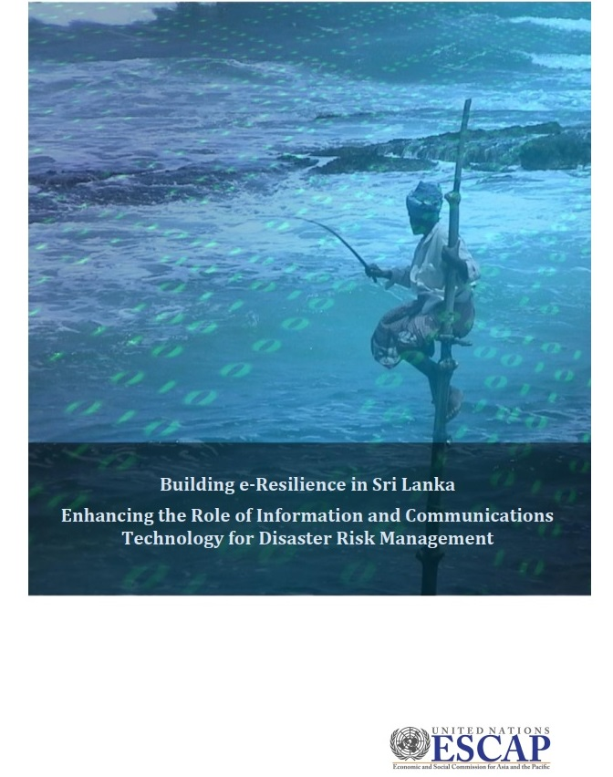

Slide 6
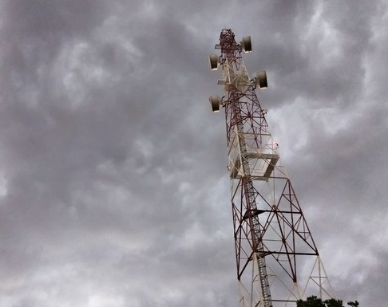
Building Resilient National ICT Infrastructure in Asia and the Pacific

Slide 7
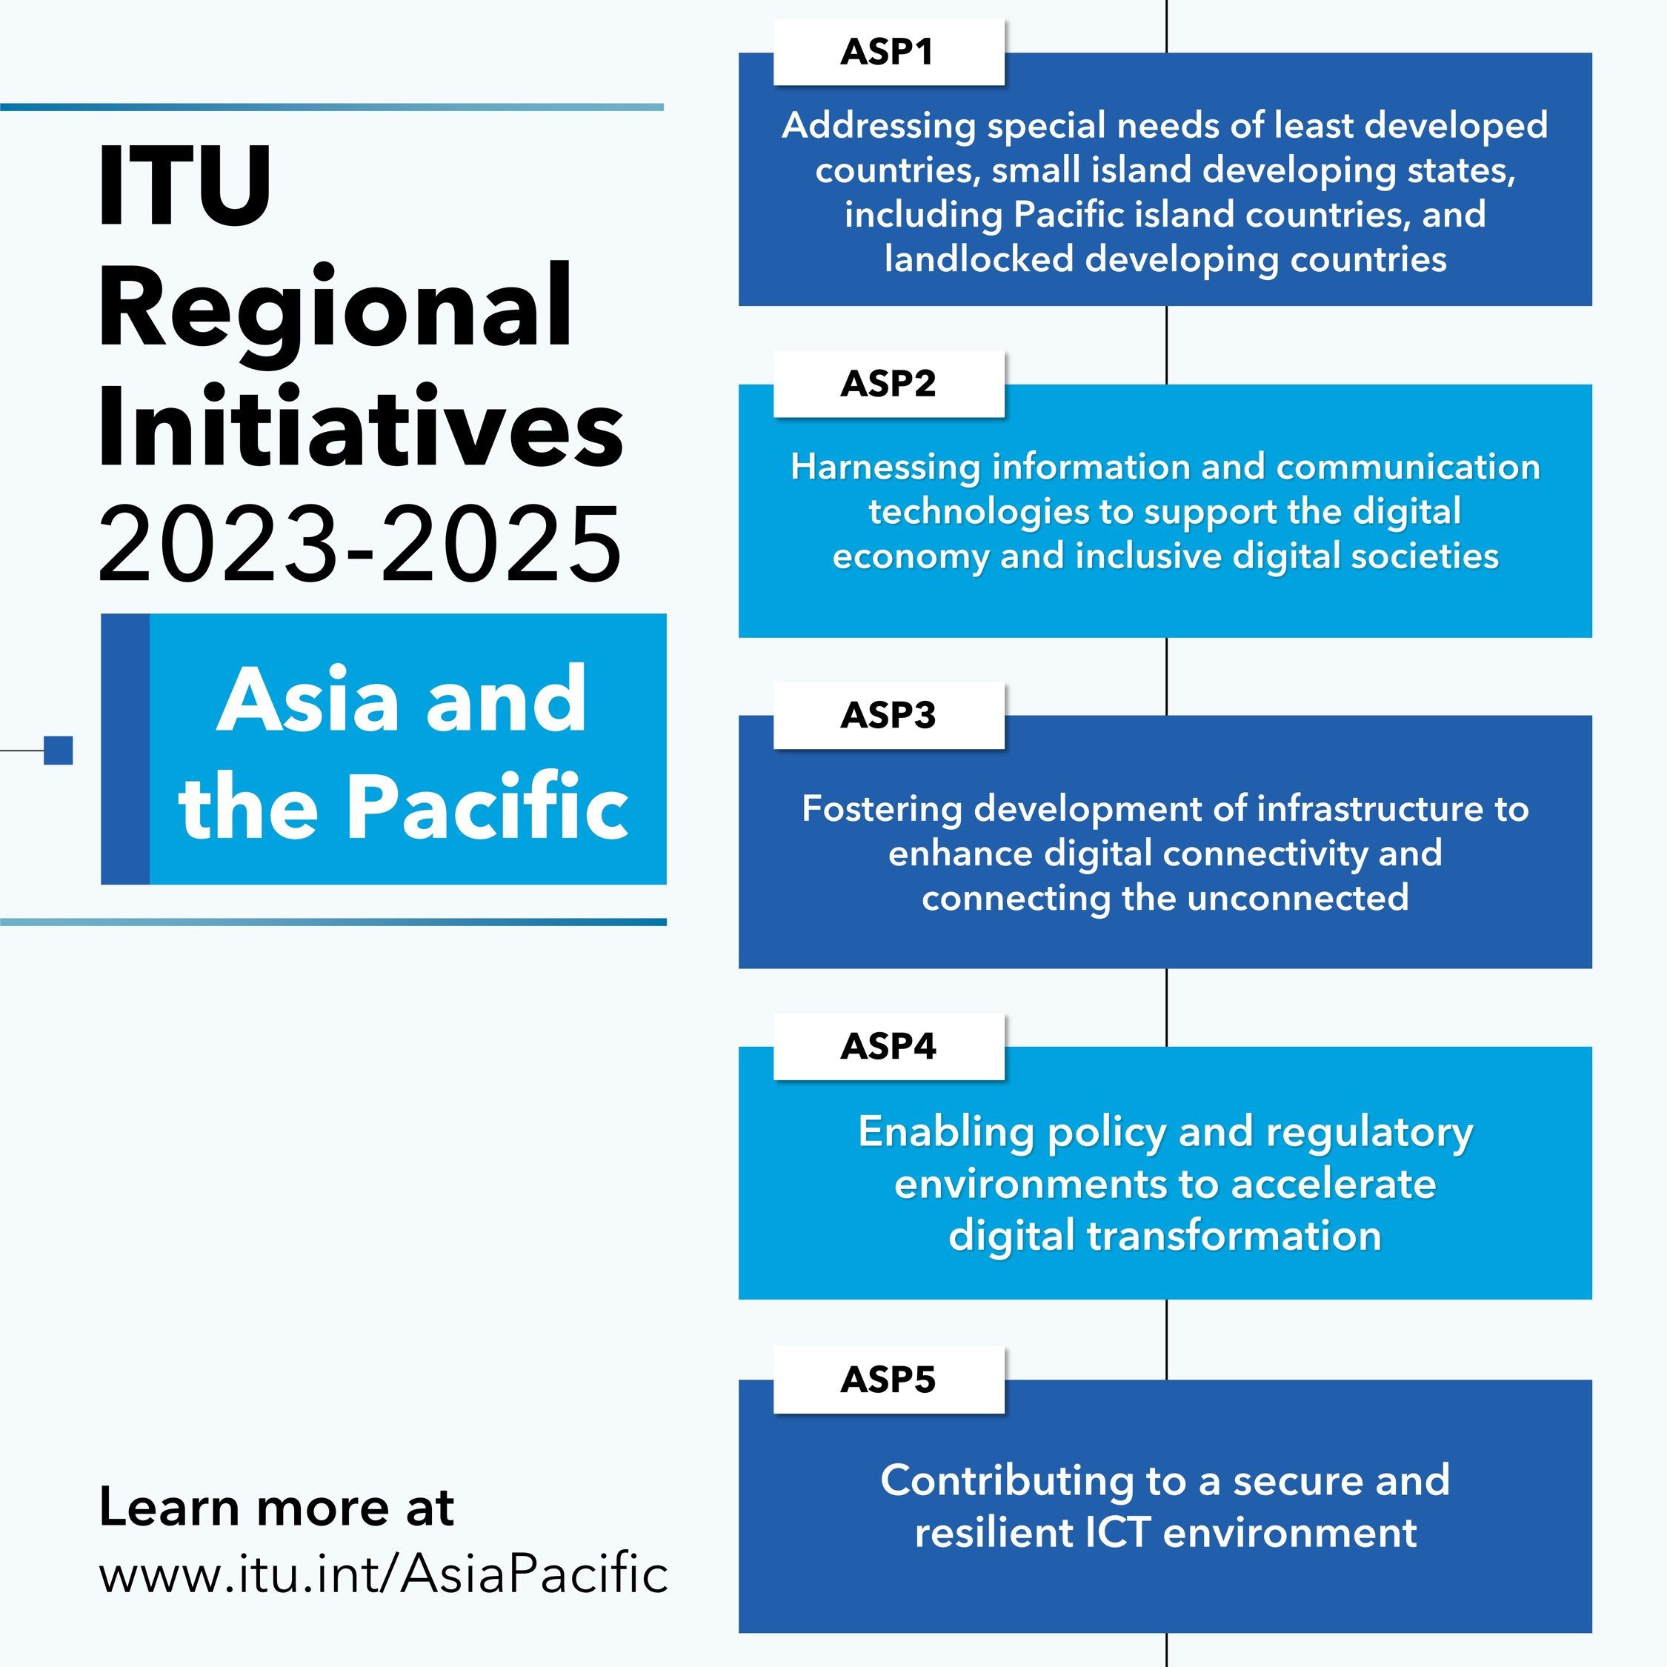
Alignment with ITU Regional Initiatives
Connect2Recover aims to:
Assist member countries in assessing the gaps in resilience and affordability of licensed national ICT infrastructure and services.

Slide 8
ITU Framework for Assessing the Resilience of National ICT Infrastructure
Network Resilience
Affordability of ICT
Emergency Preparedness
Early Warning
Types of connectivity available in the first, middle and last mile, and usage rates
No. of IXPs and location
No. of data centres and tier level
DNSSEC validation
Spectrum allocation for:
Public protection and disaster relief agencies
Amateur radio
Global maritime distress and safety system
Mobile data and fixed-broadband prices, relative to end-users’ income
Cost of smartphones and feature phones, relative to end-users’ income
Market competition – number of players and regulations
Infrastructure and spectrum sharing arrangements
Rural connectivity policy
Universal access fund
Cybersecurity policy
Data protection and privacy policy
Procedures for business continuity and disaster recovery
Assessment of ICT infrastructure resilience
National emergency telecommunication plan
Quality of service standard
Name server redundancy
Adaptive network – restoration and reallocation
Predictive analytics
Redundant power supply
Dissemination and Communication
Governance of EWS – national authority, legislations, standard operating procedures, stakeholders, adoption of CAP
EWS infrastructure – testing, upgrade, maintenance, use of cell broadcasting and/or location-based SMS system
Inclusive EWS – assessment, testing and tailoring of EWS for vulnerable groups, multi-channel communication
Quality and trust of EWS – awareness, drills, community engagement, feedback

Slide 9
Outline
Network Resilience
Affordability of ICT
Emergency Preparedness
Early Warning
Highlight common gaps
Showcase good practice or case study for addressing the gaps

Slide 10
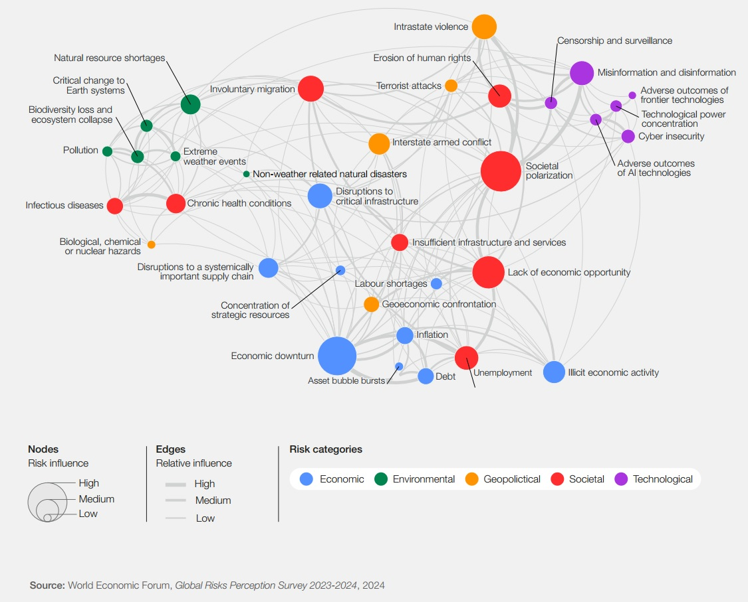
Global Risk Landscape
Interconnectedness of potential incidents
Resilience to these risks must address the interconnectedness in a holistic manner
Based on a survey of 1,490 experts across academia, business, government, the international community and civil society on their perception of risks.

Slide 11
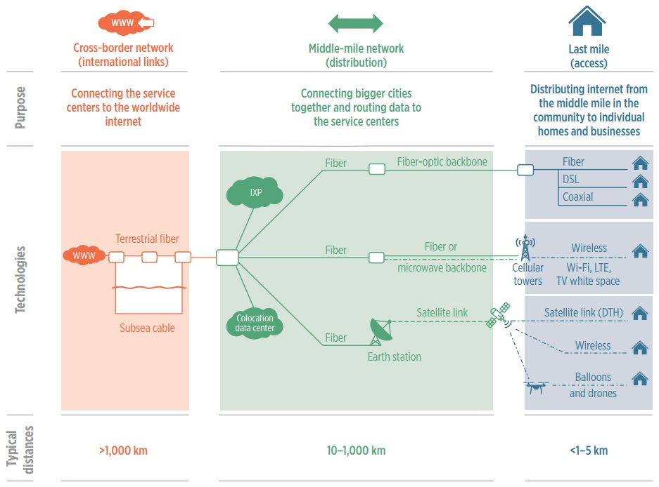
ICT Infrastructure
Notes: DSL = Digital Subscriber Line; DTH = Direct-to-Home; IXP = Internet Exchange Point; LTE = Long-term Evolution; WWW = World Wide Web (Internet).
Source: World Bank, World Development Report 2021: Data for Better Lives (Washington DC, 2021). Available at https://wdr2021.worldbank.org/.

Slide 12
Insights
Network Resilience
Indicators | Bhutan | Lao PDR | Nepal | Philippines
Access Availability | DSL, FTTH, 3G/4G/5G | DSL, FTTH, 3G/4G/5G | FTTH, 3G/4G, and a small number of satellite terminals for private licensees | FTTH, DSL, fixed wireless, 3G/4G/5G, and VSAT in some rural areas
Fixed Household Penetration | 1% | 11% | 43% | 29%
Mobile Data Penetration | 99% | 84% | 96% | 112%
No. of IXPs (Location) | 1 (Thimphu) | 1 (Vientiane) | 1 (Lalitpur and Kathmandu) | 10 (Manila and Cebu)
No. of Data Centres (Tier Level) | 3 (Tier 2) | Few (not tier certified) | 7 (Tier 3) | At least 8

Slide 13
Insights
Network Resilience
Indicators | Bhutan | Lao PDR | Nepal | Philippines
Terrestrial Network | Parts of the network have diverse routes. | Critical nodes have been identified and a ring topology provides network resilience. | Critical nodes upgraded and a ring topology provides network resilience. | Two major operators have built domestic fibre and microwave networks in self-healing loops.
International Network | Two international gateways but both connect to Siliguri, India. A third gateway that connects to Bangladesh is being negotiated. | There are multiple points of connections to Cambodia, China, Myanmar, Thailand and Viet Nam. | Limited international gateways, relying on submarine cables through India. | Connected to 11 international submarine cables. New cables such as Bitfrost and TPU will add more capacity and route diversity.

Slide 14
Insights
Network Resilience
GAPS
Countries can do more to diversify network routes and connectivity choices, and improve network quality (especially in preparation for pandemics like COVID-19 that is likely to require more connectivity and network capacity).

Slide 15
Percentage of Population Covered by at Least an LTE/WiMAX Mobile Network in Asia and the Pacific, 2015–2023
Source: ITU, “Statistics: Global and Regional ICT Data – Time series of ICT data for the world, by geographic regions, by urban/rural area and by level of development​ (2005–2023​)”, November 2023.

Slide 16
Insights
Network Resilience
GOOD PRACTICES
Leverage the potential of non-terrestrial networks for expanding broadband connectivity to unserved and underserved areas, and for emergency preparedness:
High-altitude platform station systems, balloons, drones (e.g., India conducting trials)
GEO, MEO and LEO satellite systems (e.g., Papua New Guinea reviewing regulatory framework and licensing process)

Slide 17
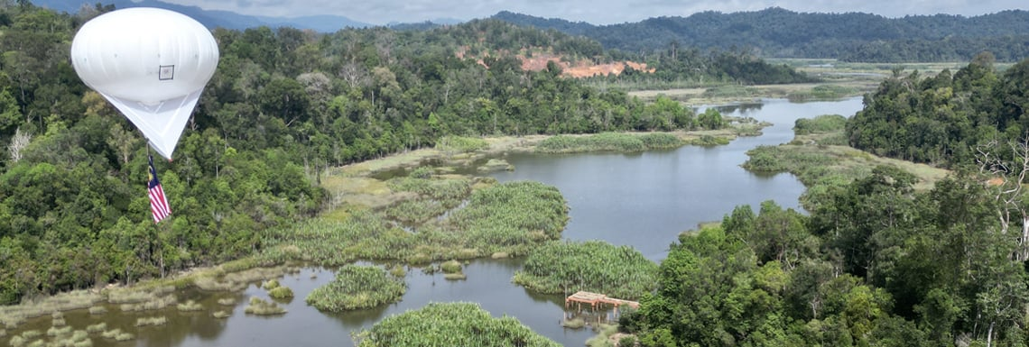
Connecting Tasik Chini, Malaysia
Source: APNIC Foundation, "Project Complete! Hybrid LoRa Network for Underserved Community Internet (LUCI)". Available at https://apnic.foundation/project-complete-hybrid-lora-network-for-underserved-community-internet-luci/.

Slide 18
Insights
Affordability of ICT
Indicators | Bhutan | Lao PDR | Nepal | Philippines
Market Concentration: Mobile HHI Fixed HHI | 5,288 2,467 | 3,926 4,975 | 5,242 1,421 | 4,463 3,532
Fixed Broadband Basket (GNI per capita) | 2.87 | 7.23 | 10.29 | 11.26
Mobile Data and Voice Low Consumption Basket (GNI per capita) | 1.18 | 4.03 | 2.48 | 2.32
Smartphone to Monthly Income Ratio | 17% | 13% | 9% | 13%

Slide 19
Insights
Indicators | Bhutan | Lao PDR | Nepal | Philippines
Infrastructure Sharing | Yes, only passive infrastructure | No | Yes, only passive infrastructure | Yes, only passive infrastructure
Rural Connectivity Policy | National Broadband Master Plan | - Ten-Year National Digital Economy Development Strategies (2021–2030) - Five-Year Technology and Communications Development Plans (2021–2025) | License obligations | National Broadband Plan indicates a rural technology roadmap
Universal Access Fund | Universal Service Fund | Rural Telecommunication Development Fund | Rural Telecommunication Development Fund | National Broadband Plan indicates creation of Universal Access Fund
Mobile Spectrum Availability | Spectrum for 5G has been awarded in the 2.6GHz, 3.5GHz and 26GHz bands | 538.8MHz assigned | 200.9MHz assigned | 530.9MHz assigned
Affordability of ICT

Slide 20
Insights
Affordability of ICT
GAPS
Lack of affordability of ICT services is one of the major barriers to access to critical information and services, especially for LDCs, LLDCs and SIDS, for rural and remote areas, and for women and other vulnerable groups.

Slide 21
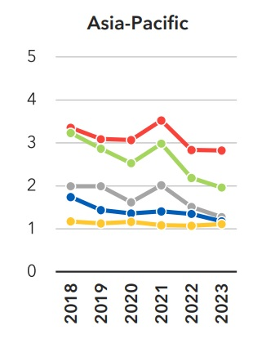
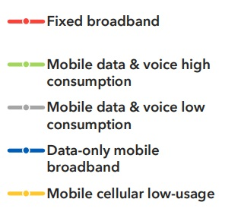
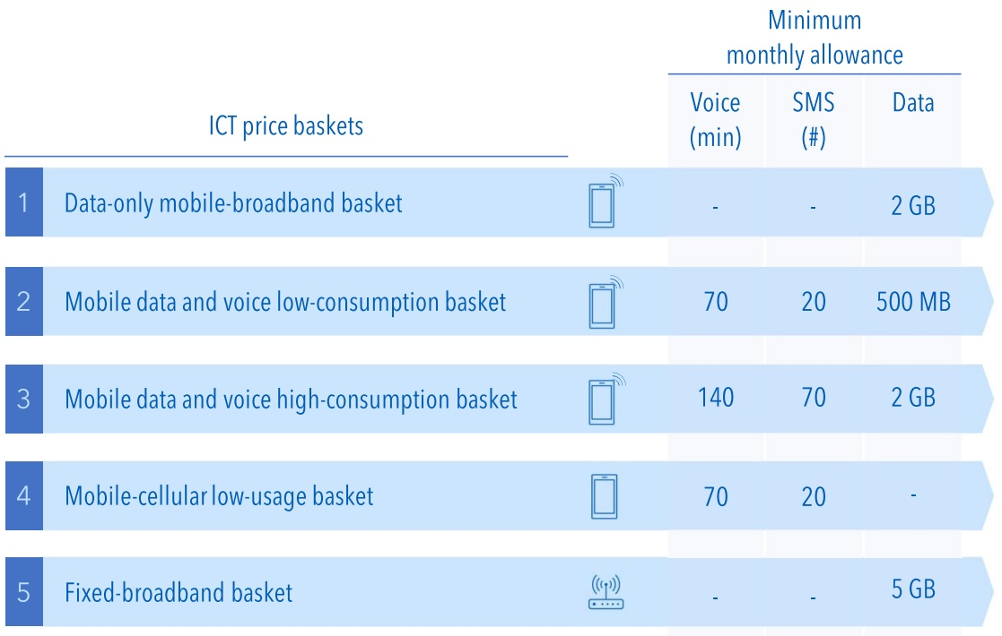
Affordability of ICT as Percentage of GNI per Capita, 2018–2023
Source: ITU, “The affordability of ICT services 2023” Policy Brief, March 2024.

Slide 22
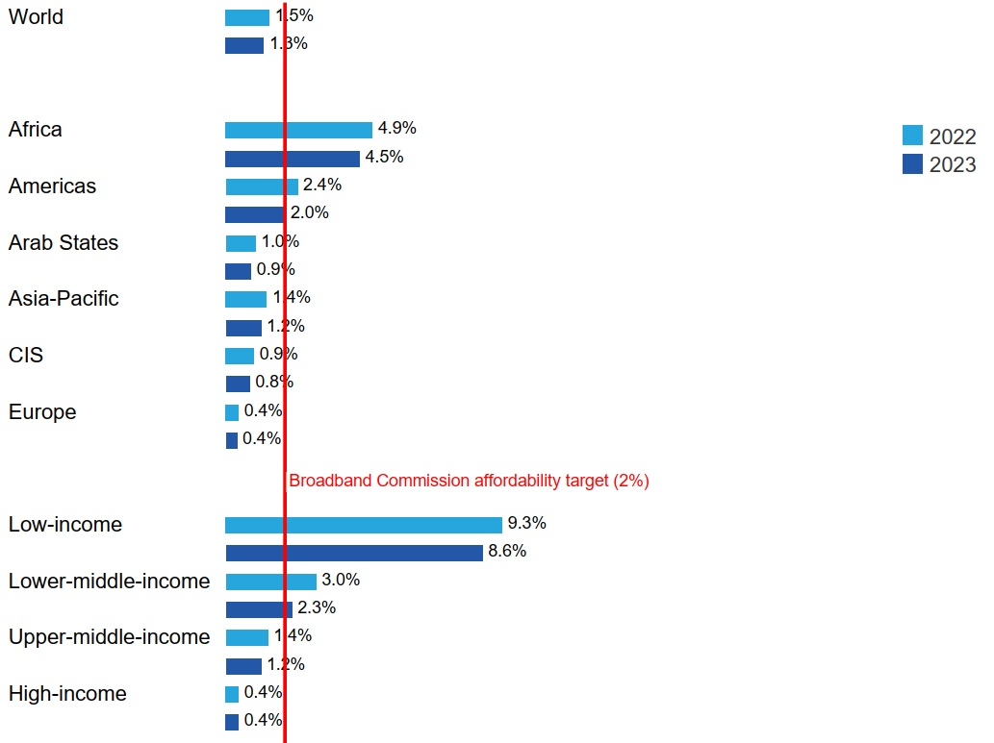
Data-only mobile broadband (2GB) basket prices as percentage of GNI per capita, 2022-2023
Source: ITU, Measuring Digital Development – Facts and Figures: Focus on Least Developed Countries (Geneva, 2023).

Slide 23
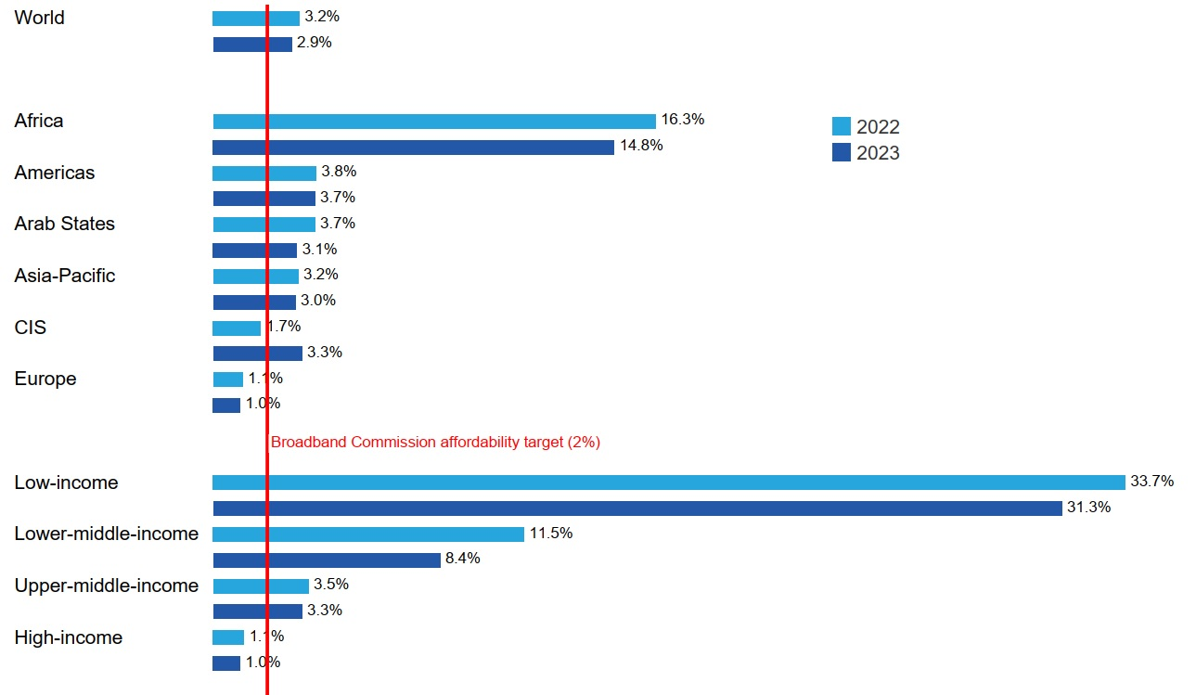
Fixed broadband (5GB) basket prices as percentage of GNI per capita, 2022-2023
Source: ITU, Measuring Digital Development – Facts and Figures: Focus on Least Developed Countries (Geneva, 2023).

Slide 24
Insights
Affordability of ICT
GOOD PRACTICES
Promote a competitive market environment and infrastructure sharing to drive down ICT prices and improve the quality of ICT services
Improve ease of doing business
Reduce taxes and tariffs
Support users in financing devices and data

Slide 25
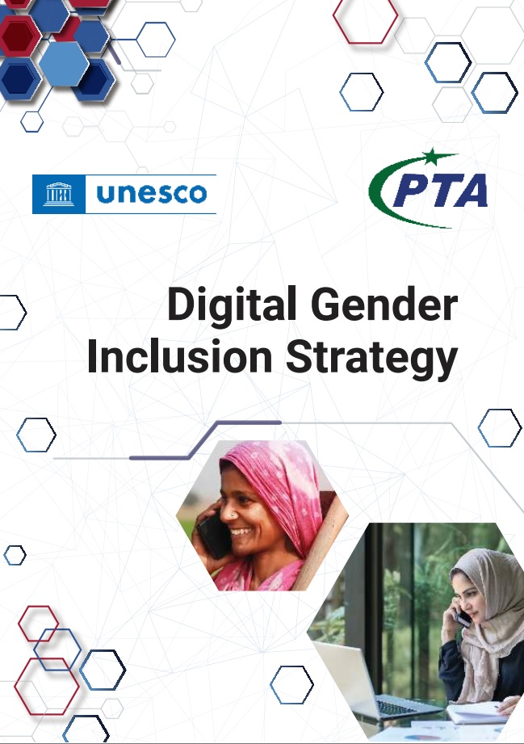
Pakistan’s Digital Gender Inclusion Strategy
Key Takeaways
Universal ICT coverage does not guarantee access and use for all.
Multiple interrelated barriers to access and use are gendered and must be addressed holistically:
Affordability of devices and data
Digital literacy and skills
Relevant content and services
Safety and security
Regressive and harmful gender and social norms
Source: PTA, Digital Gender Inclusion Strategy (2024). Available at https://pta.gov.pk/category/digital-gender-inclusion-strategy-1520570539-2024-07-13.

Slide 26
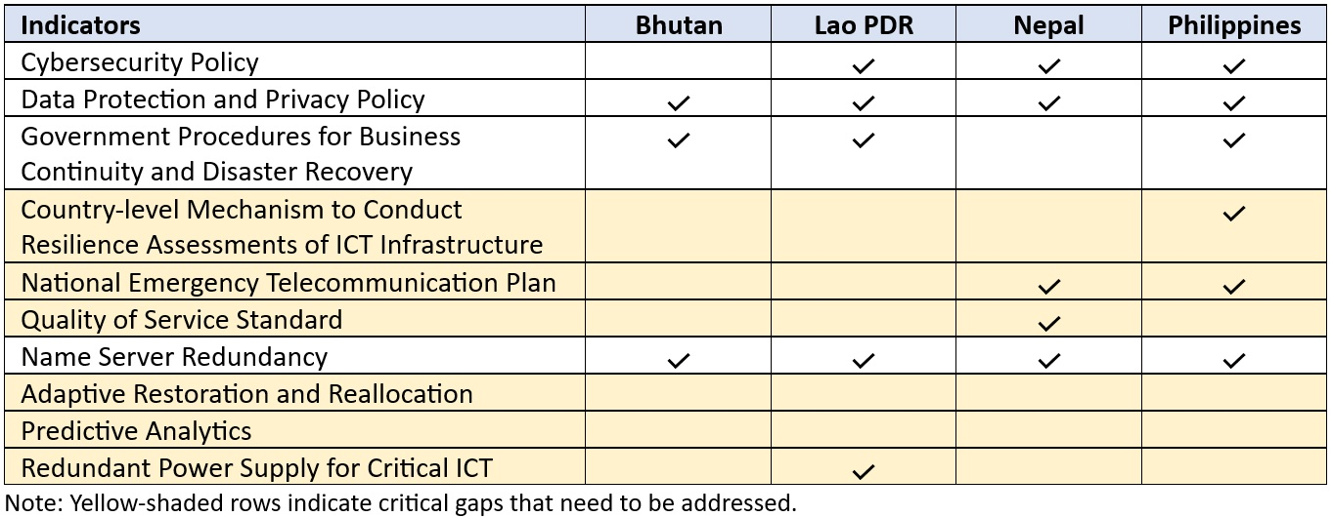
Insights
Emergency Preparedness

Slide 27
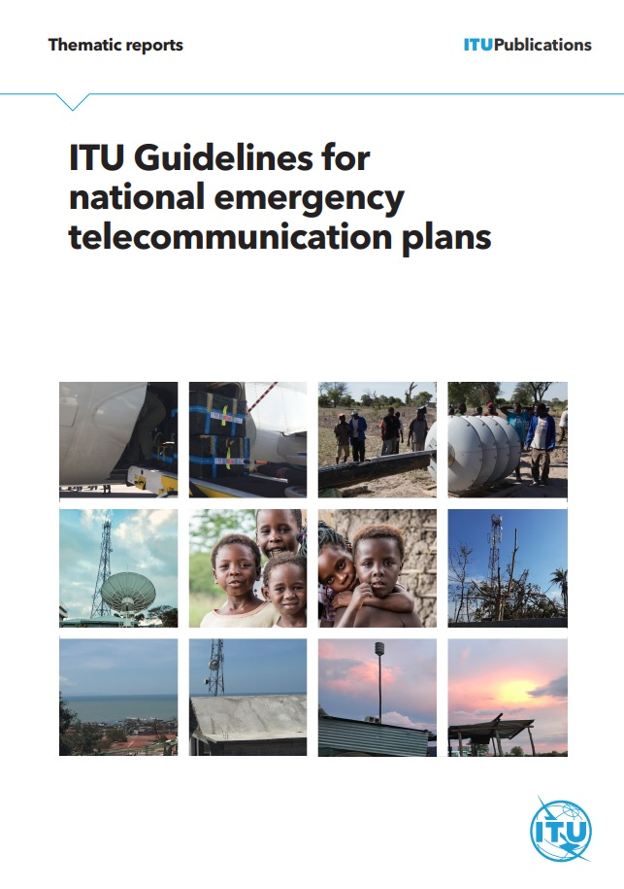
National Emergency Telecommunication Plan (NETP)
Source: ITU, ITU Guidelines for National Emergency Telecommunication Plans (Geneva, 2020).

Slide 28
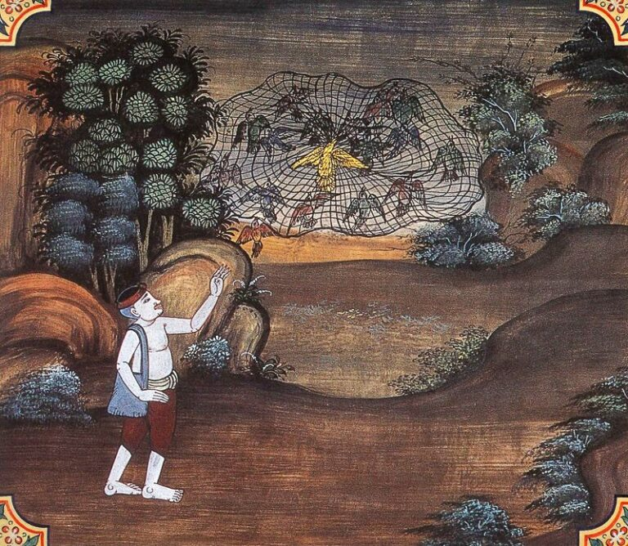
Source: https://thejatakatales.com/wp-content/uploads/2021/03/33-Sammodamana-Jataka-768x668.jpg.

Slide 29
Four Pillars of the Early Warnings for All Initiative

Slide 30
Sub-pillars of Early Warning Dissemination and Communication
Early Warning
Dissemination and Communication
Governance of EWS – national authority, legislations, standard operating procedures, stakeholders, adoption of CAP
EWS infrastructure – testing, upgrade, maintenance, use of cell broadcasting and/or location-based SMS system
Inclusive EWS – assessment, testing and tailoring of EWS for vulnerable groups, multi-channel communication
Quality and trust of EWS – awareness, drills, community engagement, feedback

Slide 31
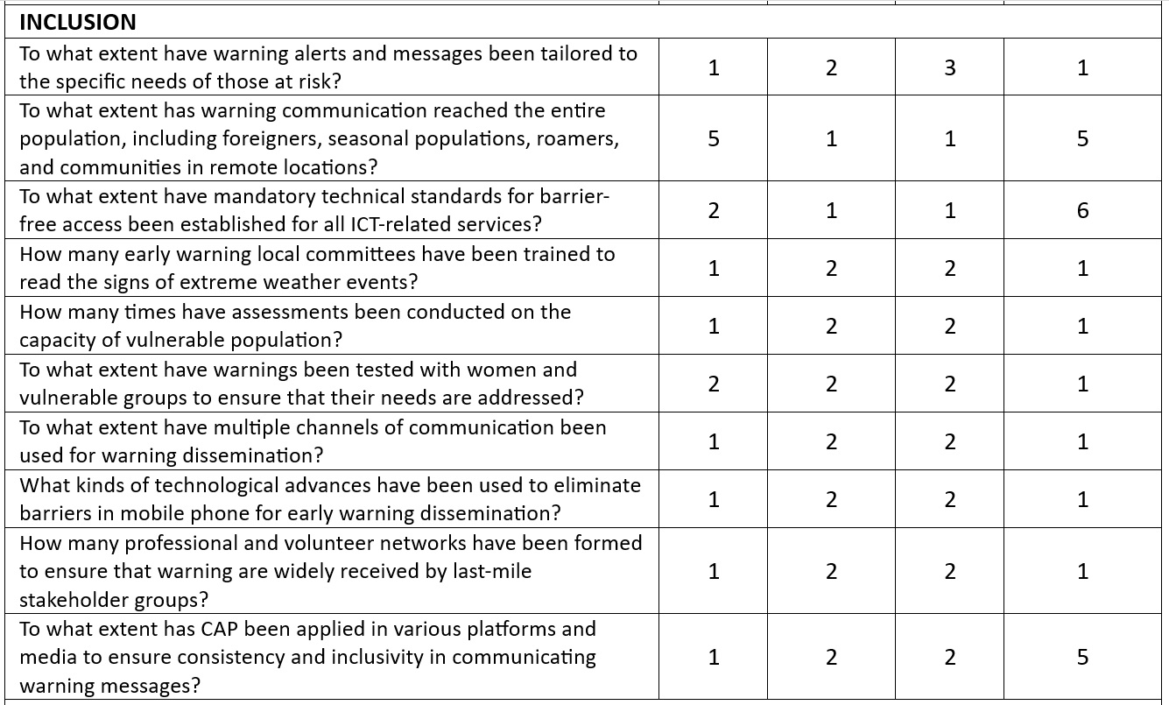
Insights
Early Warning
0 = No Response
1 = Not Known
2 = Not Started
3 = Nascent Stage
4 = Intermediate Stage
5 = Developed Stage
6 = Mature Stage

Slide 32
Insights
Early Warning
GAPS
Lack of data on vulnerable groups – who they are, where they are located, their access to early warning, and their ability to understand and act on the early warning messages.

Slide 33
Insights
Early Warning
GOOD PRACTICES
Continuous engagement with vulnerable groups in designing and improving early warning systems.
Translating technical information into user-friendly and locally-relevant messages for the community.
Delivering early warning messages through multiple channels, while ensuring that messages across channels are consistent.

Slide 34
Smong: A Traditional Poem/Song from Simeulue Islands, Indonesia
Please listen to this story
One day in the past
A village was sinking
That’s what has been told
Starting with earthquakes
Followed by a giant wave
The whole country was sinking
Immediately
If there is a strong earthquake
Followed by the lowering of seawater
Please find in a hurry
A higher place
This is called Smong
A story of our ancestors
Please always remember
The message and the instruction
Smong is your bath
Earthquake is your swing bed
Thunderstorm is your music
Thunderlight is your lamp

