Slide 1

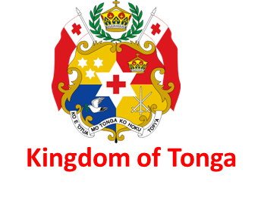

Pomaama Liu
Engineer Telecom/Radio
Communication Department
MEIDECC
Communication Department - MEIDECC
Leveraging Digital Networks for Early Warning Dissemination

Slide 2

PRESENTATION OUTLINE
Where is Tonga
About Tonga
Communication Department
AI in Predictive Analytics for Disaster Management
Disaster Occurrences Status.
Disaster Connectivity Maps (DCM)Disaster Prevention and Mitigation Initiatives
Adoption of Cell Broadcast
Policy and Collaboration
Non-Terrestrial Networks (NTN) & D2D Solutions
Conclusion

Slide 3
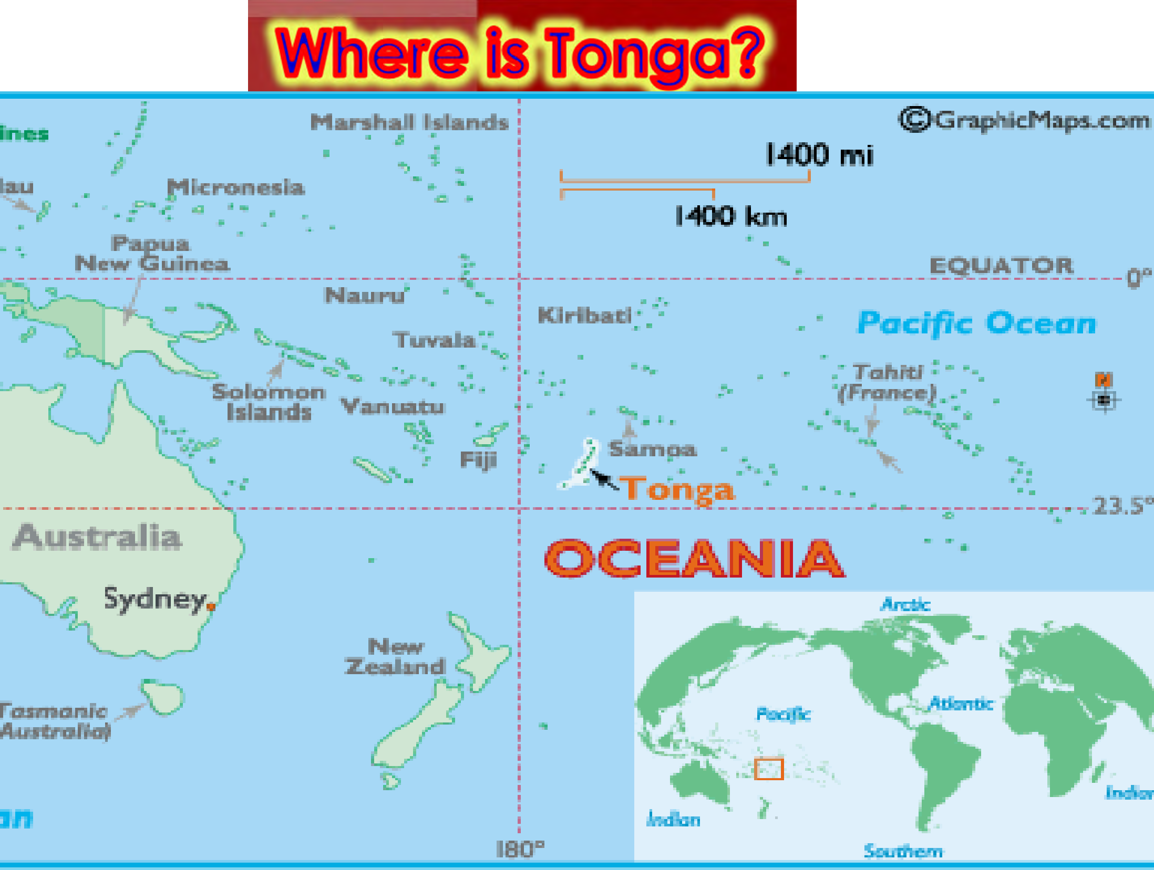

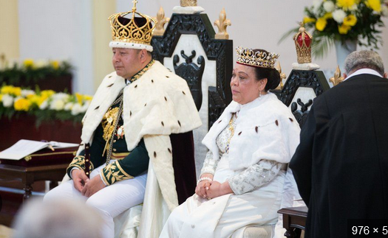

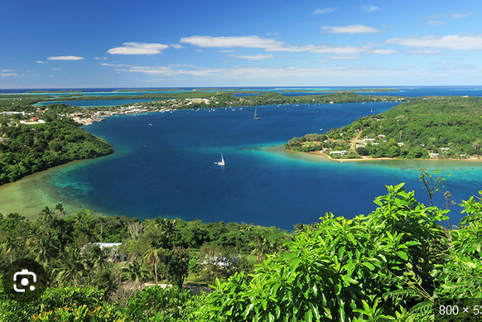



Slide 4

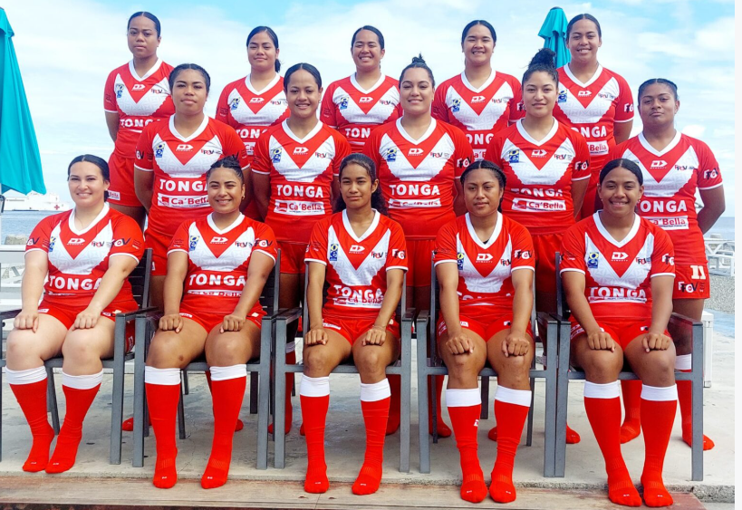
The Pride of Tonga : Our sporting Heritage

Slide 5




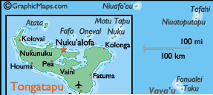




Total number of islands : 171
3 main islands are, Tongatapu, Vava’u Group and Ha’apai Group.
Total population: 105,323
Total land area in sq kms: 750
Capital: Nuku’alofa
King: Tupou VI
Currency: Tongan Pa’anga
Continent: Oceania

Slide 6


The Ministry of MEIDECC, Energy, Information, Disaster Management, Environment, Climate Change and Communications (MEIDECC) is made up of eight Departments. These Departments are governed by various Laws & Regulations within the Laws of Tonga
Communication Department MEIDECC
The eight departments are vested under the one umbrella of MEIDECC which defines the portfolio of the Minister for MEIDECC, Hon. Duty PM Taniela Fusimalohi

Slide 7
Advise the minister on all matters concerning the national communications sector policies
Perform functions and exercise powers conferred on the Ministry under this Act and other applicable laws;
Oversee and manage the allocation of the Government’s orbital satellite slot interests;
Ensure the observation and enforcement of international communications conventions and practices;
Liaise with foreign governments on communications sector and other related matters;
Enforce section 96 of this Act i.e. directing licensees to comply with the provisions of the Act upon Minister’s approval
Perform such other functions or exercise such other powers conferred on the Ministry by this Act
Subject to the powers and functions conferred on the Regulator under this Act to perform any other functions consistent with the objects of this Act, as notified by the Minister from time to time.
CORE DUTIES OF THE DEPARTMENT

Slide 8
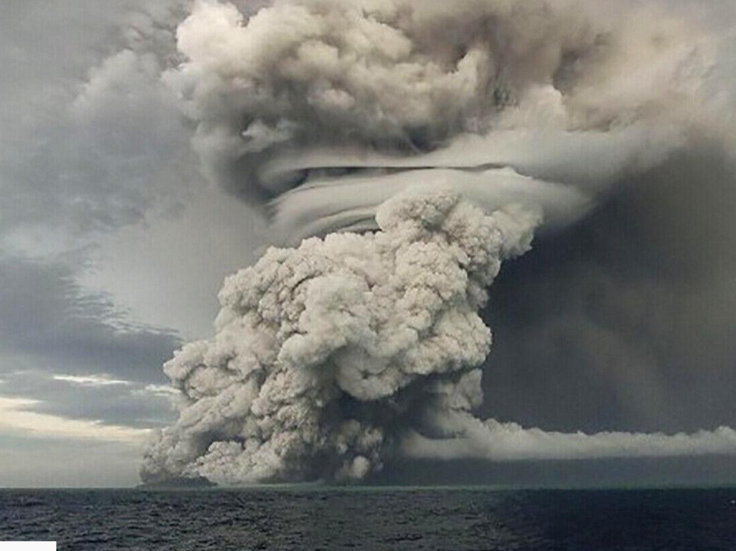
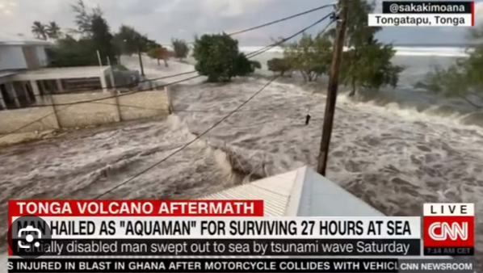
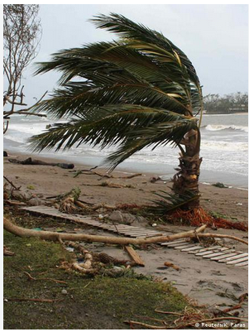
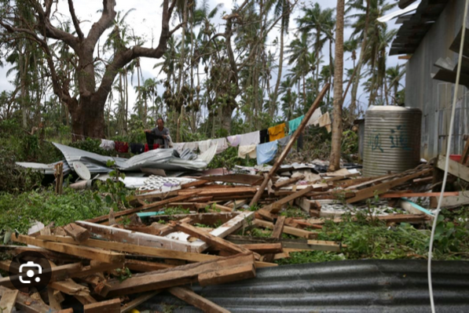
Disaster Occurrence Status

Slide 9
Tonga is highly vulnerable to cyclones, tsunamis, and volcanic eruptions
Effective early warning dissemination is vital for saving lives in remote islands
Digital networks can overcome geographic isolation and communication barriers.
INTRODUCTION

Slide 10
AI can analyse weather, seismic, and ocean data to predict cyclone, earthquakes, and tsunamis.
For Tonga, predictive analytics could help anticipate volcanic eruptions(like Hunga Tonga-Hunga Ha’apai 2022)
Early prediction allows better evacuation planning across scattered islands.
AI in Predictive Analytics for Disaster Management

Slide 11
Disaster Connectivity Maps (DCM)
Tonga has many outer islands where connectivity is limited.
DCM could help identify which islands lose communication first during a disaster.
Useful for prioritizing satellite back up and emergency communications.
Notes:
The new Act is to create a comprehensive legal, institutional, and regulatory structure for three critical aspects:

Slide 12
Adoption of Cell Broadcast
Tonga relies heavily on NEWS (RAR)on AM/FM radio , Siren and community announcements.
Cell Broadcast could ensure alerts reach all RAR radios & Siren instantly, even when networks are congested.
Example : Tsunami alerts could be delivered to every NEWS RAR radio and Siren within seconds.

Slide 13
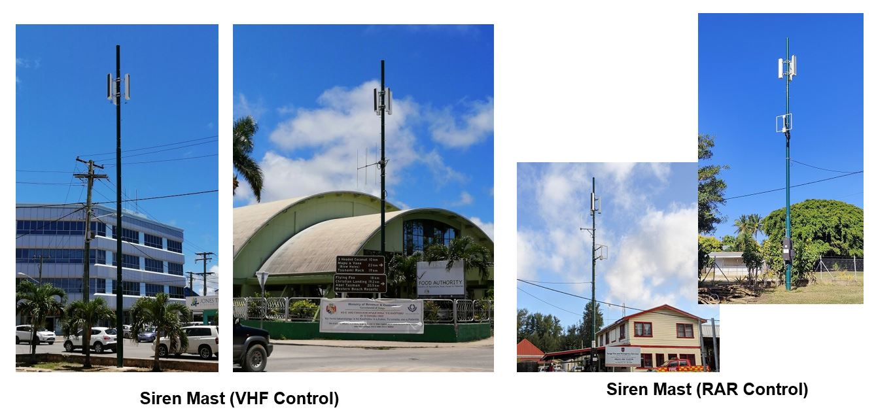
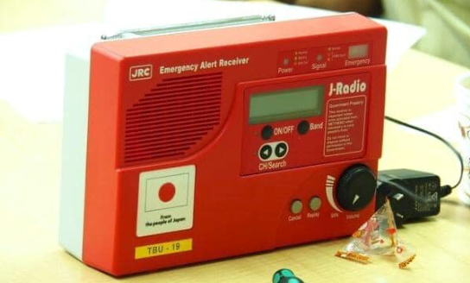
TONGA NATIONWIDE EARLY WARNING SYSTEM (NEWS)
REMOTED ACTIVATE RECEIVER

Slide 14
Disaster Prevention and Mitigation Initiative
Early warning systems and Communication networks
  Designed to detect and monitor potential disasters such as earthquakes, tsunami, hurricanes, floods, wildfires
  play a vital role in alerting communities about impending disasters, allowing them to take necessary precautions and evacuate if required.
  Telecom infrastructure and services – NEWS Project
    VHF and HF systems
    emergency sirens
    radio broadcast AM and FM
    Internet and ip link networks, towers
    communications channels such as SMS, cell broadcast, mobile apps, social media platforms
  Tonga is covered by the Pacific Tsunami Warning System (Center) based in Honolulu, monitoring seismographs and deep-sea gauges sensors to detect earthquakes and tsunami waves. Such Tsunami warning will be triggered from Meteorology office once received alert from PTWS.
Notes:
In saying these, Tonga ETC have fulfilled an EWS in country.

Slide 15
Policy and Collaboration
Collaboration needed between Tonga Government, Regulator (Depatment of Communication), Digicel, TCC and Wantok (Local Operators)
Clear policies for early warning alerts through telecom networks.
Partnership with Pacific Neighbors (Fiji, Samoa, New Zealand) for shared data and response.
Notes:
Objectives
Institutional strengthening at all level (policy, regulations, plans) and human resource development
Enhance community preparedness thru partnership with all stakeholders (TRC, NGO’s and the international communities…)
Strengthen Emergency Management system in the outer islands thru capacity building, training, resourcing
Mainstreaming Disaster Risk Management into Government processes/agencies – making DRM part of your core business (gender, disability inclusion)
Responsibilities
Examples of NEMO functions in the Disaster Management cycle
Prevention activities
Minimizing the effects of disaster
Focuses on a comprehensive approach to emergency management – including Cluster approach
Organises public information before, during and after emergencies
Designs and maintains a locally-based public education/awareness
Work with Education –
Work with Health & Statistics -
Preparedness activities
Planning how to respond
Maintains the National Emergency Management System operations
Develops and maintains the National Emergency Management Plan
Runs and trains staff of the National Emergency Operations Centre
Readiness – warnings – activation of National / District Emergency Operations Centre
- EVENT –
relief - prepositioned stocks
Response activities
Run the National / District Emergency Operations Centre
Provides a 24/7 duty officer for alerts
Co-ordinates support to response agencies
Co-ordination of reconnaissance and post-impact assessment
Provides secretariat support to the National Emergency Management Committee
Recovery activities
Returning the community to normal.
Provides secretariat support to the National Emergency Recovery Committee
Short-term before it goes back into usual Govt strategies
Set up for “building back better”

Slide 16
Non-Terrestrial Networks (NTN) & D2D Solutions
During the 2022 volcanic eruption, Tonga lost internet Connectivity for a 4 to 5 months.
Non- Terrestrial Networks (Satellite) are critical as back up.
Direct-to-Device (D2D)satellite messaging can reach villages even without local towers.
Notes:
The new Act is to create a comprehensive legal, institutional, and regulatory structure for three critical aspects:

Slide 17
Conclusion
Tonga’s Island geography and disaster risks make early warning vital.
Adopting AI,DCM,Cell Broadcast, NTN, and D2D strengthens national resilience.
Strong policies and collaboration will ensure Tonga is better prepared for the next disaster.

Slide 18


