Slide 1

US National Satellite Regulatory Program
ITU – ITTLLDC Seminar 2025
Ulaanbaatar, Mongolia, August 2025

Slide 2
Outline
U.S. Government Agencies
FCC Licensing
NOAA Licensing
Orbital Debris Considerations
Novel Space Activities

Slide 3
U.S. Government Agencies
Spectrum
  Federal Communications Commission (FCC)
Space Object
  Department of State (DoS)
Remote Sensing (Earth Imaging)
  Department of Commerce (DoC)/National Oceanic and Atmospheric Administration Commercial Remote Sensing Regulatory Affairs (NOAA CRSRA)
Launch and Payload Safety/Human Spaceflight
  Department of Transportation/Federal Aviation Administration (FAA)
Mission Authorization
  Department of Commerce - Novel Space Activity Authorization (upcoming pursuant to recent EO)

Slide 4
FCC.

Slide 5
FCC Satellite License Application
Rules and resources
47 C.F.R. Part 5 (experimental) or 25 (commercial)
Space Bureau Transparency Initiative
Availability of applications, licenses, and orders
What information should be provided?
Mission description
Timelines
Ownership (10% or greater; foreign/domestic)
Key information assessed
Interference
Orbital debris mitigation
Jurisdiction
Radiofrequency use

Slide 6
Applications
Part 25 – Standard
Commercial
STA or conventional
Part 25 – Small Satellite/Spacecraft
Commercial
Conventional
Part 5 – Experimental
Not for commercial purposes
STA* or conventional
NIB
ITU Filing
Covers space stations controlled by commercial entities
“Facilities-based” license to operate space station using spectrum – separable hosted payloads may have separate license
US licenses
FCC submits to ITU
*Also currently used for launch

Slide 7
FCC Licensing
 | 47 C.F.R. Part 5 Experimental License (Space Stations) | 47 C.F.R. Part 25 GSO License | 47 C.F.R. Part 25 Standard NGSO License | 47 C.F.R. Part 25 Streamlined Smallsat/Spacecraft NGSO License
Filing Fee FY2024 | $140 | $3,965 | $16,795 | $2,425
Bond Requirement | None | $1M-$3M | $1M-$5M | One-year grace period (50% system)
Annual Fee FY2024 (2025+ TBD, new NGSO tiers) | None | $144,155 | $441,925 (“less complex”) $964,200 (“other”) | $12,215 per license (also applies to OOS / RPO / OTV )
Constellation | Limited number of satellites | One satellite | No defined limit | Ten or fewer satellites; Max. in-orbit lifetime of 6 years 180/500 kg limit per satellite/spacecraft Orbit and disposal requirements
License Term | 2-5 years (renewable) | 15 years (renewable) | 15 years (renewable) | 6 years (not renewable, but can reapply)
Commercial Use Limitation | Experimental in nature; Market trials permitted | None | None | None
Bureau | Office of Engineering & Technology (+ Space Bureau) | Space Bureau | Space Bureau | Space Bureau
Processing Time | ~6 to 12 months (space stations) | ~6 to 12 months | ~9 to 12 months | ~6 to 12 months
Spectrum Coordination | Required | Required | Required | Required
Orbital Debris Considerations | Yes | Yes | Yes | Yes

Slide 8
Application Lifecycle
Step 1: Application is Filed
File all required application materials, including ITU documents
Pay application fee on CORES
Step 2: Public Notice (Commercial Licenses); Post-Filing Advocacy
Commercial filings generally to be put on 30-day Public Notice once filing deemed complete. Parties may file objections during this time. Certain STAs do not require Public Notice.
After filing, answer FCC questions.
Step 3: Frequency Information Sharing (Federal Spectrum)
If using spectrum shared with federal operators, coordinate use with spectrum managers for concurrence on spectrum use

Slide 9
Application Lifecycle
Step 4: Grant
Step 5: Milestone and Bond Requirements
Commercial earth stations must commence operations within one year of grant
Commercial NGSO space stations must deploy 50% of authorized stations within 6 years, other 50% within 9 years; 5 years for GSO
Step 6: License Expires
STA (Experimental and Commercial): 6 Months
Experimental: Generally 2 years, up to 5 with justification
Grant may take 6-12+ months, depending on complexity
Commercial space stations must post a bond within 30 days (plus one year for streamlined licenses. If 50% of streamlined satellites launched within grace period, no bond required)
Commercial: Generally 15 years*
*The FCC may issue a license for less than 15 years

Slide 10
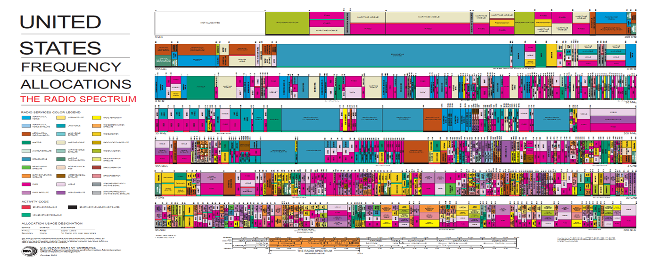
Spectrum Selection
International and Domestic Table of Frequency Allocations
Service Allocations
    Radionavigation-Satellite Services (RNSS)
    Fixed-Satellite Service (FSS)
    Earth Exploration-Satellite Service (EESS)
    Space Operations (Space Ops)
    Space Research
  Spectrum Coordination
    Coordination with federal spectrum managers for use of shared federal and non-federal spectrum
(Image Credit: National Telecommunications and Information Administration)

Slide 11
FCC International Aspects
US Department of State
International Telecommunications Union
Space Object Registration
API / CR Filings
All spacecraft must be entered into the United Nations Register of Objects Launched into Outer Space.
Outer Space Treaty Article VI – “The activities of non-governmental entities in outer space, including the moon and other celestial bodies, shall require authorization and continuing supervision by the appropriate State Party to the Treaty.”
Advance Publication Information (API) and/or Coordination Request (CR) information is submitted by the FCC to the ITU.
Satellite operators (through their licensing administration) address coordination letters received via the ITU process.

Slide 12
NOAA.

Slide 13
NOAA Satellite License Application
Rules and resources
15 CFR Part 960
What information should be provided?
Mission description
Key information assessed
Imaging capability
“U.S.” satellite with imaging capabilities
Jurisdiction
Guidance circulars (non-binding)
Technical capabilities of the sensors
Ownership (10% or greater foreign)
No publicly available applications, licenses, or orders
Forms
Resources & Forms

Slide 14
NOAA Licensing
Imaging (Private Remote Sensing License)
Initial Contact Form
  Non-binding
  Intended to help NOAA assess whether a license would be required for a proposed satellite system
  Kicks off consultation process to discuss proposed application
  Begins process to determine if sensors qualify for “mission assurance” exception
  Avoids delays before formal submission
Application Fee | None
Annual Fee | None
Processing Time | ~2 months
License Term | Operational life of the system (unless determined that the license is not in compliance with license regulations or terms)
Compliance Requirements | Annual compliance certification License modifications and materiality Enforcement

Slide 15
NOAA Satellite License Application
Tier system
1 – substantially same as data available commercially from non-U.S. system
2 – substantially same as data available commercially from U.S. system
3 – not substantially same as data available commercially from U.S. or non-U.S. system

Slide 16
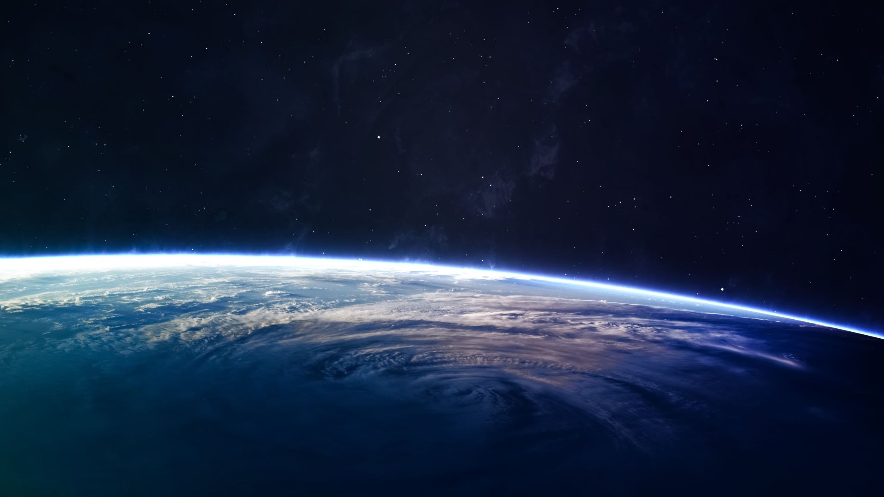
Orbital Debris – FCC v NOAA
FCC
Regulates orbital debris as part of spectrum license
Requires disclosure of orbital debris mitigation plan
Includes requirements on risk of collision, probability of successful post-mission disposal, casualty risk if re-entry to Earth, maneuverability and depressurization capability and requirements on trackability, identification, and ephemeris sharing
5-year deorbit requirement (2022)
NOAA
NOAA defers to FCC on orbital debris to avoid duplicative regulation
2024 RFI on remote sensing satellite disposal requirements considering not all NOAA-licensed satellites hold FCC licenses

Slide 17
Novel Space Activities
Novel Space Activities
In-space servicing, assembly, and manufacturing (“ISAM”)
Lunar exploration
Commercial destinations
Hosted payloads
Rideshares
Orbital transfer vehicles
Spectrum Needs
Spectrum availability
Allocations & authorized services
Coordination
Potential new uses
Frequencies for RPO activities
Frequencies for lunar activities
Direct to device
Licensing Considerations
Example: ISAM Regulations
ISAM vs Communications Operations

Slide 18

Thank you.
Questions?
Emma Marion
Associate
emma.marion@us.dlapiper.com
18

