Slide 1


^{WORLD TELECOMMUNICATION}
^{DEVELOPMENT CONFERENCE}
BB connectivity from the space
ITU - ITTLLDC Seminar – 2025
Ulaanbaatar, Mongolia
28 – 29 August 2025

Slide 2
What to expect in slides
Options to connect from space
Trends in space connectivity
Cooperation for a sustainable future
Challenges

Slide 3
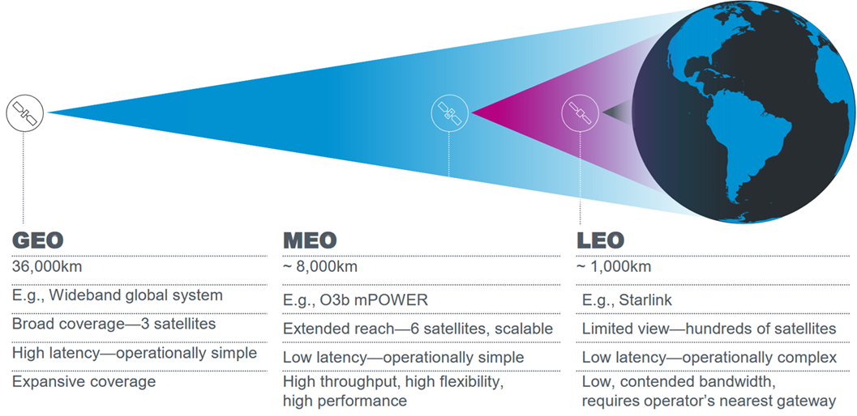
Orbits at a glance 1/3
Source: ITU RRS-ASP 2024

Slide 4
Orbits at a glance 2/3
 | GEO | MEO | LEO
Altitude | 35 800 km | 8 000-20 000 km | 400-2 000 km
Orbital period | 24 hours | 4-12 hours | 1-2 hours
Footprint | Large | Medium | Small
Satellite cost | High | Medium | Low
Satellite lifetime | Long | Long | Short
Latency | Medium (~700 m/s) | Low (~150 m/s) | Very low (~50 m/s)
Earth coverage | Very large | Large | Small
Satellites required* | 3 | 6 | Hundreds
Gateways | Few and fixed | Regional and flexible | Local and numerous
Antenna | Stationary | 1-hour slow tracking | 10-minute fast tracking
Source: ITU RRS-ASP 2024
Notes:
While the historical roles of GEO, MEO, and LEO satellites were relatively well-defined and separated, new trends are blurring these lines. Satellites in all three orbits are becoming more versatile, capable, and integrated, fuelled by technological innovations and growing commercial interests.

Slide 5
Orbits at a glance 3/3
Source: ITU Digital regulation platform
Notes:
We endorse an inclusive, people-centered approach that uses existing community-based infrastructures and locally-led feedback mechanisms to ensure messages are understandable and actionable.

Slide 6
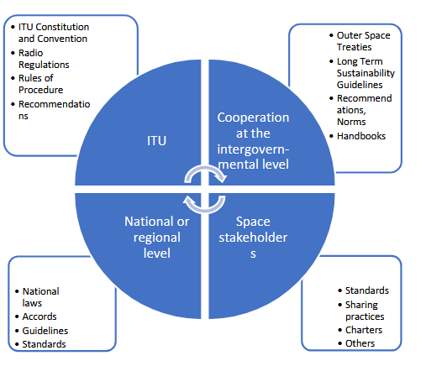
Regulatory landscape and the role of institutions
Legal and regulatory frameworks among space
stakeholders

Slide 7
What to expect in slides
Options to connect from space
Trends in space connectivity
Cooperation for a sustainable future
Challenges

Slide 8
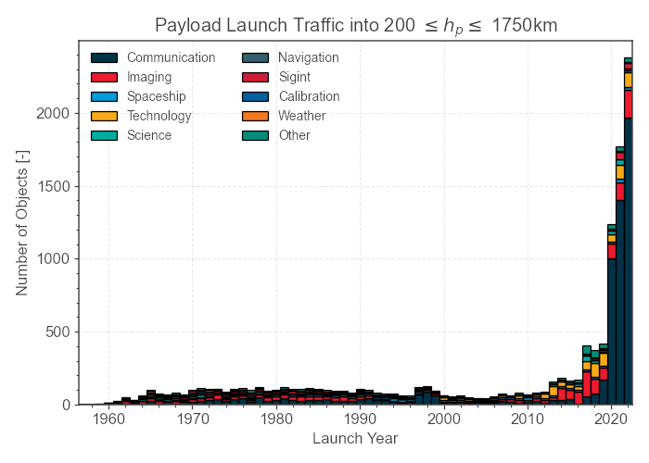
Increasing demand of satellites
High-throughput satellite (HTS) capacity demand will grow from 1.9 Tbps in 2022 to 46.1 Tbps in 2032
NGSO share will go from 21% to 52% of that total capacity.
Source: Northern Sky Research (NSR)
Source: ITU Digital regulation platform
Notes:
As of 1st September 2023, there is an estimate of 8 496 active satellites circling Earth, in various orbits, 90% of them being in LEO^{[4]}.
Satellite communications are widely recognized as a vital catalyst of market dynamics within the field of telecommunications, either as a stand-alone system or as an integrated satellite-terrestrial network. Satellite systems enhance and complement existing networks by offering backhaul applications or global coverage in areas where ground-based infrastructure is either absent or impractical. According to NSR^{[5]} the high-throughput satellite (HTS) capacity demand will grow from 1.9 Tbps in 2022 to 46.1 Tbps in 2032, and the NGSO share will go from 21% to 52% of that total capacity.
In 2022, 2 409 new, tracked payloads (primarily satellites) entered orbit around Earth, more than ever before.

Slide 9
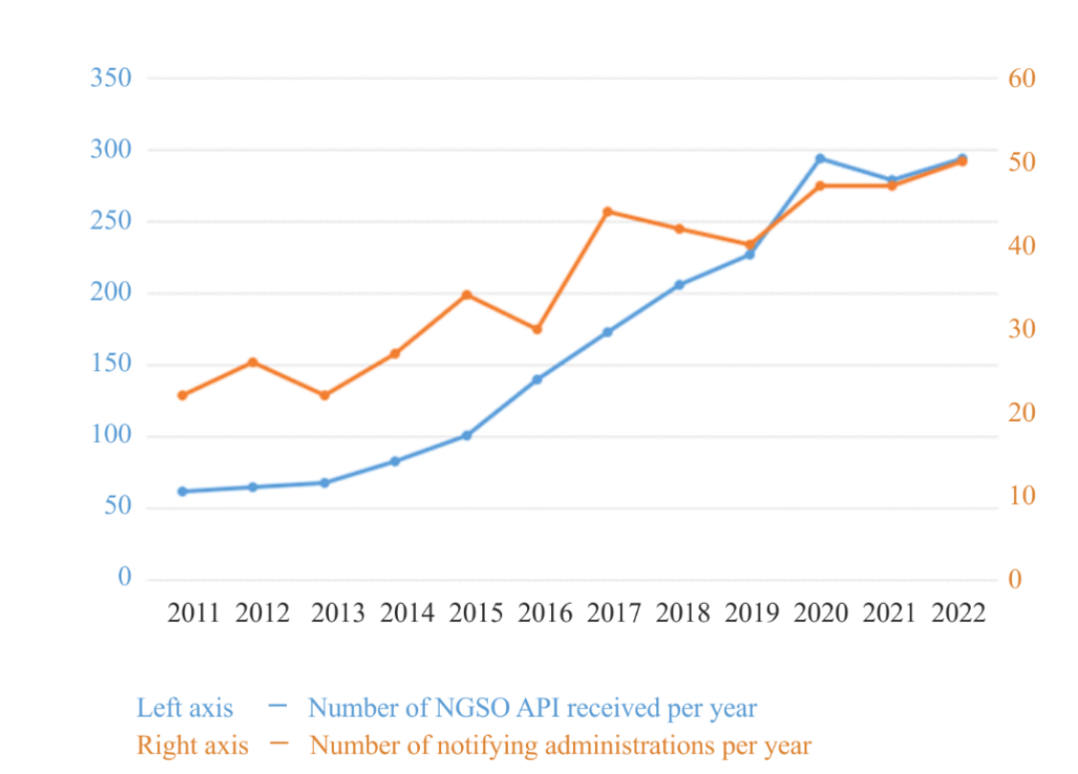
Submission of Non-GSO API for satellite networks or systems not subject to coordination
Source: ITU Handbook on Small Satellites
Notes:
In recent years, there has been a significant surge in the number of API submissions for non-geostationary satellite networks that are not subject to coordination procedures. While the number of such submissions has been moderately increasing since 2011, the rate of increase has accelerated since 2015, and currently ITU BR is receiving six times the number it was receiving in 2011. This increase from approximately 50 cases in 2011 to nearly 300 cases per year since 2020 appears likely to continue to be growing. In addition, the number of administrations submitting API information for non-GSO systems has also been steadily increasing, with the number of administrations submitting since 2020 being twice that of those submitting in 2011

Slide 10
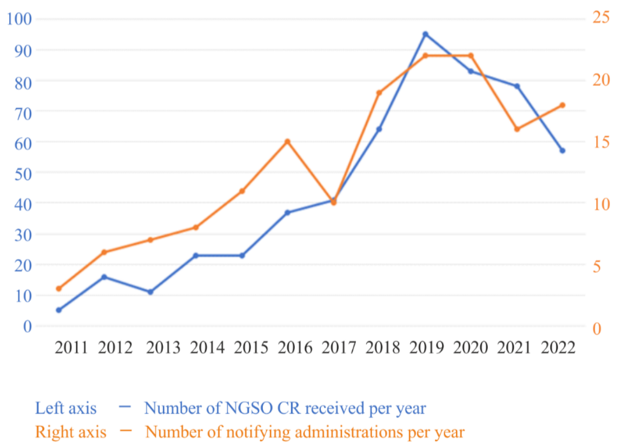
Submission trends for non-GSO coordination request (CR/C)
Source: ITU Handbook on Small Satellites
Notes:
With regard to coordination requests for non-geostationary (non-GSO) satellite systems, prior to 2011, the number of requests remained relatively constant and extremely low with just few cases per year, as very few administrations were submitting such requests. Since 2011, the Bureau has observed a generally upward trend in the number of coordination requests received. As shown in Fig. 7 below, there were five non-GSO coordination requests received by the Bureau in 2011, but 95 cases in 2019, and 83 cases in 2020. In the last two years, the number has decreased slightly, but still remain at a fairly elevated level. Currently, the number of non-GSO coordination requests is approximately three times the amount submitted in 2014 and 201

Slide 11
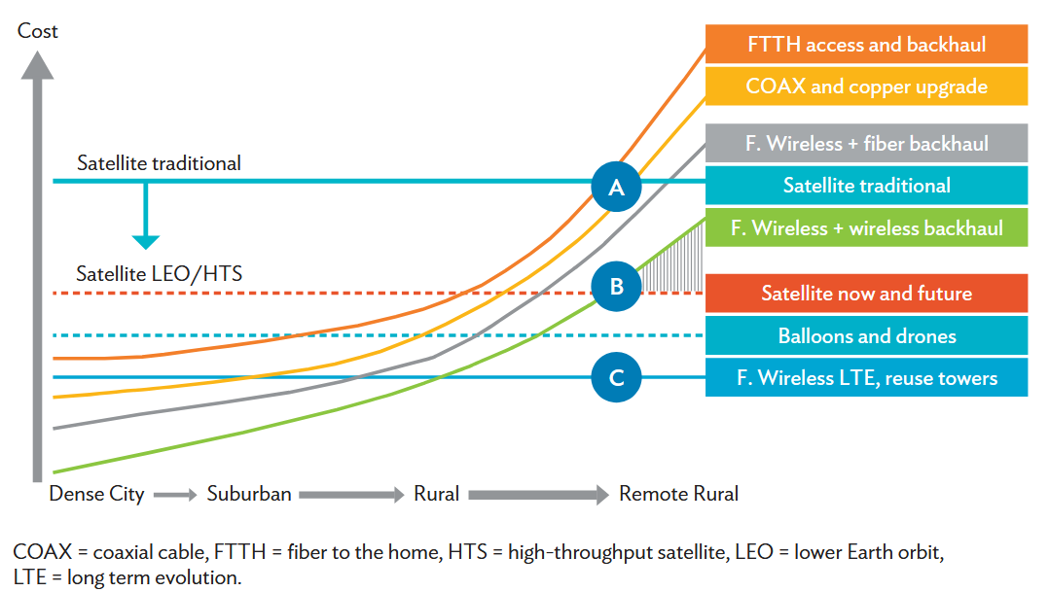
Technologies compared by costs and population density
Source: Adapted from World Bank, “Innovative Business Models for Expanding Fiber-Optic Networks and Closing the Access Gaps”, 2019: https://openknowledge.worldbank.org/handle/10986/31072

Slide 12
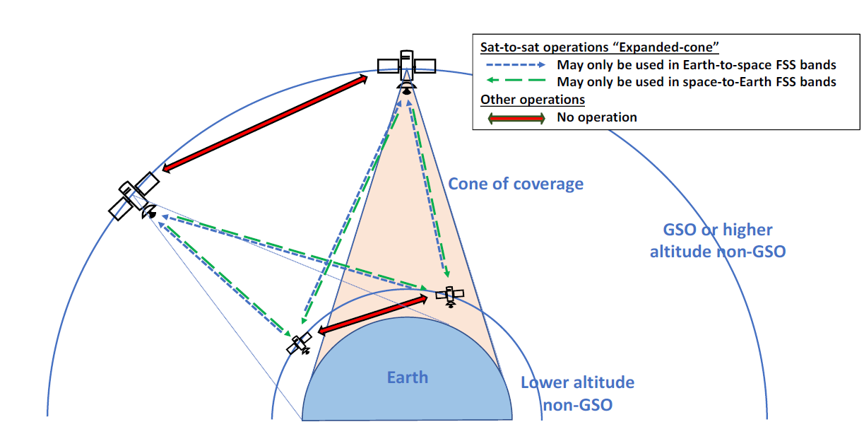
Communication advancements
ISL (Inter Satellite Link)
Allows satellites to communicate directly with each other without having to route signals through a ground station first.
Especially useful for constellations in LEO or MEO, where frequent handovers between satellites are needed to maintain continuous coverage.
ISLs be established through either radio frequencies or optical means.
  RF ISLs are more traditional and have lower data rates, but they are generally more robust against atmospheric conditions. Commonly used frequency bands include Ka-band (26.5-40 GHz), Ku-band (12-18 GHz) and the V-band (40–75 GHz)
  Optical ISLs, on the other hand, can offer higher data rates and lower power consumption but are more susceptible to interference from atmospheric conditions like clouds.
Besides reducing latency, ISLs also increase the redundancy, reliability and resilience of the satellite network. E.g. reroute data through ISLs in case of earth station failure
Source: ITU Digital regulation platform
Notes:
ISLs can be established through either radio frequencies or optical means (see next section). Radio frequency ISLs are more traditional and have lower data rates, but they are generally more robust against atmospheric conditions. Commonly used frequency bands include Ka-band (26.5-40 GHz), Ku-band (12-18 GHz) and the V-band (40–75 GHz)^{[90]}. Optical ISLs, on the other hand, can offer higher data rates and lower power consumption but are more susceptible to interference from atmospheric conditions like clouds.
Besides reducing latency, ISLs also increase the redundancy and resilience of the satellite network. In the event that a ground station fails or experiences downtime, satellites can use ISLs to reroute data through other satellites to reach its destination, making the whole communication network more robust and fault-tolerant.
As satellite constellations grow in size and complexity, especially with the advent of mega-constellations like SpaceX’s Starlink or OneWeb, the role of ISLs is expected to become increasingly critical for maintaining high levels of performance and reliability in satellite communications. Agenda Item 1.17 of WRC-23 precisely discussed new ISL service allocation in specific frequency bands.

Slide 13
WRC-23 Agenda item 1.17
AI 1.17 - inter-satellite links in K_{a} band
Primary allocation of 18.1-18.6, 18.8-20.2 and 27.5-30 GHz to inter-satellite service. Limited to space research, space operation and/or EESS, and data transmissions of from industrial and medical activities in space. Res. 679 (COM5/8)
Implications: facilitate satellite to satellite data traffic, mainly from/to NGSO satellites which generate the data, e.g. during space, earth science, human exploration missions
Notes:
AI 1.17 satisfied growing spectrum needs of intersatellite links. For example: a study estimates data volume transmitted by satellites by 2030 is 175 Tbit/day covering 31 missions. This data are manly generated by NGSO satellites during space, earth science, human exploration missions. To transmit the dats they should be relyed through other satellites. In this respect, WRC-23 made primary allocation in Ka band to inter-satellite service

Slide 14
Communication advancements
Optical communications
Use of laser light to transmit data from Earth to Space or Space to Space (ISL), offering a significant leap in terms of data throughput
Allows making use of QKD (commonly known as Quantum Cryptography)
  Conventional encryption is facing an increasing risk of being compromised as hacking techniques evolve, in particular due to the emergence of quantum computing. This is where QKD technology comes into play by making it possible for operators to encrypt data in such a way that it remains immune to future attacks by quantum computers.
Implication for SATCOM: Could require updates in regulations to address specific spectrum allocations for quantum signals, manage interferences to ensure the integrity of quantum states, and develop standards to safeguard quantum-based transmissions from eavesdropping or other forms of intrusion.
SDR (Software Defined Radio)
Transformative technology that shifts much of the signal processing from hardware to software.
  This shift allows for unprecedented flexibility in communications, for both ground stations and in-orbit satellites. In traditional hardware-based systems, modifying the functionality often requires physical changes to the equipment.
  Implication for SATCOM One of the significant benefits is the ability to reconfigure the satellite’s communication systems while it is already in orbit.
Source: ITU Digital regulation platform
Notes:
QKD uses quantum properties of photons, the elementary particles of light, to encrypt secret keys that can be shared by two parties to protect their communications. The technique, deemed unhackable since any attempt to eavesdrop on the communication changes the state of the photons and destroys the keys, is already proven in fiber optic networks and starts to be experimented for satellite communications.
As part of the European Quantum Communication Initiative (EuroQCI)[92], the European Commission is currently working with ESA on the specifications of a first constellation of EuroQCI satellites. It will build on the first prototype satellite Eagle1, developed by ESA and an industrial consortium, and due to be launched in late 2024. The ESA is also working on the Quantum Key Distribution Satellite (QKDSat)[93] project to demonstrate how a space-based quantum infrastructure can be used to keep secure the exchange of sensitive information between several parties.
With SDR, adjustments can be made via software updates, making it far easier to adapt to new communication protocols, data rates, or encryption methods.

Slide 15
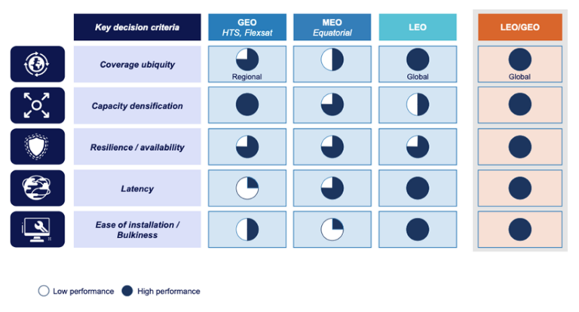
Benefits of GEO/LEO hybrid networks.
Source: Eutelsat
Notes:
By leveraging Software-Defined Wide-Area Networking (SD-WAN), the flow of data can be dynamically shifted among LEO, MEO, GEO, and land-based networks to meet specific application requirements, enhance reliability, or expand coverage. This adaptive approach allows telecommunications companies, mobile service providers, and large enterprises to take advantage of the proven benefits of multiple orbital layers, rather than being confined to a single orbital altitude.

Slide 16

Interoperability – Terrestrial Satellite integration
5G and the expansion of LEO satellite constellations, seamless integration between ground and space-based networks
combining the high-capacity, low-latency benefits of terrestrial networks with the global coverage of satellite systems to create a hybrid network that can deliver high-speed internet and other communications services almost anywhere on Earth.
Telco – Satco partnerships
Using satellite backhaul to connect remote 5G base stations
offering Direct-to-Cellular device (D2D) services, further blurring the line between terrestrial and satellite services.
emergency and basic messaging
Examples
Apple & Globalstar,
Qualcomm & Iridium,
T-Mobile & SpaceX.
Notes:
Some of these providers rely on 3GPP protocols, while others have their own proprietary technology. By using the 3GPP-based Non-Terrestrial Network (NTN) framework along with the sub-2GHz band spectrum outlined in Rel-17, it is possible to achieve downlink speeds reaching tens of Mbps^{[81]}. Combined with a LEO satellite network that can enable round-trip delays of just tens of milliseconds, such service will soon extend beyond supporting only IoT, text, and emergency calls to enable more data-intensive services like video calls on handheld devices, as demonstrated in Ericsson’s simulated video call demo at the 2023 Mobile World Congress^{[82]}.
A few companies ambition to provide direct-to-device mobile communication services, allowing standard cellphones to connect to satellites in remote areas without traditional infrastructure.
Advancing seamless terrestrial-satellite network communications relies on the proactive engagement of regulators in regards to spectrum management. Meanwhile, enhancements to 5G NTN protocols within 3GPP Rel-17 and 18 are set to enable the full integration of satellites in the 3GPP ecosystem and define a global standard for future satellite networks^{[83]}, ultimately revolutionizing terrestrial communications and supporting everything from IoT deployments, to connecting the unconnected, protecting lives in emergency situations, and connecting autonomous vehicles.

Slide 17
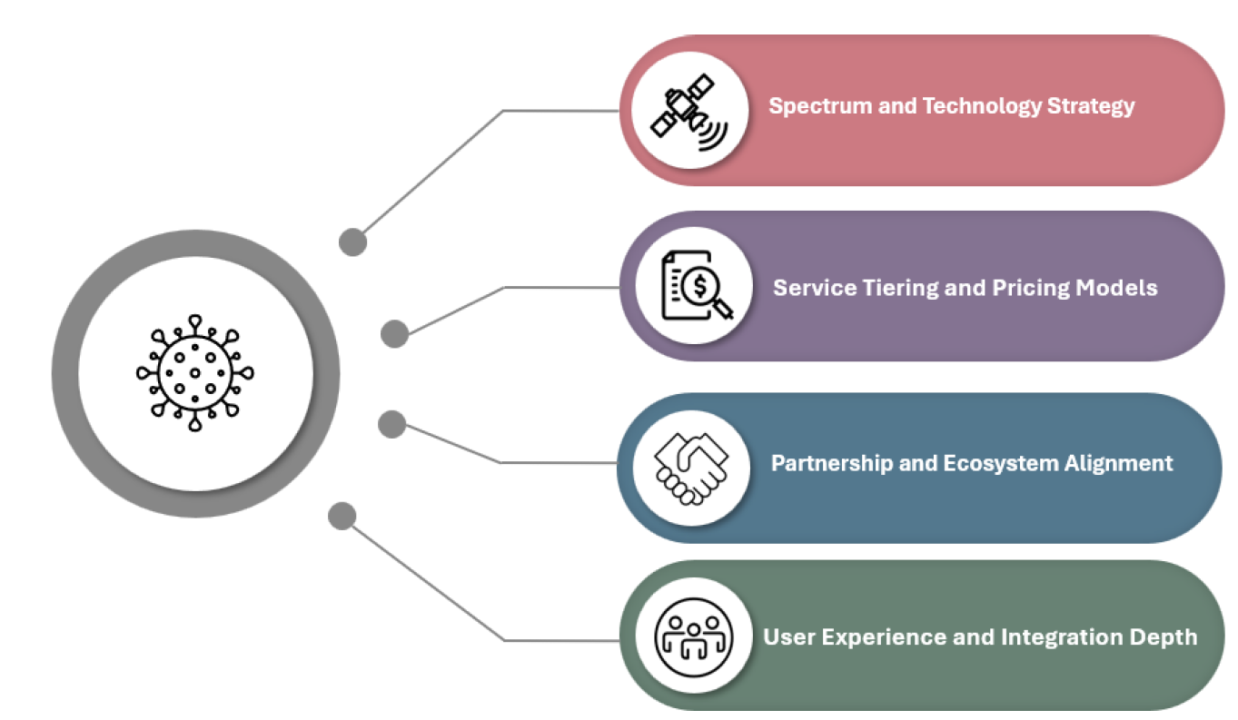
D2D strategic choices for satellite connectivity
Source: Analysys moon
Notes:
The first decision revolves around spectrum and technology strategy. MNOs must determine whether to pursue D2D by transferring their spectrum assets to partner satellite operators such as Starlink, AST or Lynk, or to partner with providers that have access to mobile-satellite service (MSS) spectrum like Skylo. Each path carries trade-offs in terms of interference, regulatory complexity, device compatibility, technology, and time to market. Additionally, there is a large opportunity cost for MNOs using terrestrial spectrum assets for satellite services when originally intended for terrestrial coverage. The resulting satellite services revenue would need to meet the high thresholds envisioned when the spectrum assets were originally purchased or the MNO would likely face a large accounting write down of their spectrum assets. This places a high burden on the revenue that must be derived from satellite services delivered via terrestrial spectrum and therefore a higher cost to the consumer is likely in this approach.
In many parts of the world, there is no regulatory framework currently in place or a pathway laid out for a regulatory framework similar to Supplemental Coverage from Space (SCS) in the United States that would allow MNOs to pursue D2D by transferring spectrum assets to satellite operators. This issue can be a major impediment to adoption in key markets and should be explored in further detail. Similarly, OEMs face a choice between aligning with 5G NTN standards or pursuing proprietary integrations that offer speed but risk future fragmentation. It should be noted that pursuing a 3GPP Release 18 standards-based solution that relies solely on an SCS-type regulatory framework may limit adoption as standards in some cases are progressing faster than regulatory frameworks in certain geographies.
Pricing and service tiering are closely linked. D2D capabilities can be bundled with existing plans or charged independently. Some operators are currently experimenting with freemium models. Verizon is offering emergency SOS and SMS use for free to consumers with compatible devices. MNOs such as T-Mobile in the US are upselling these services at $10 per month and higher. Others might prefer to bundle the service in their premium plans. The right model will vary by market, but differentiation and clarity of value proposition are essential as these services evolve to include appDATA and voice.
Underlying both spectrum and service models is the importance of ecosystem alignment. The most successful players will be those who secure the right satellite partnerships early, align on device roadmaps, and deeply understand the timelines and implications of regulatory frameworks in key markets around the world. For OEMs, chipset selection and certification with satellite networks is a critical enabler, supporting the standards and bands that will unlock future use cases and global scale.
Finally, the quality of user experience will be key to D2D adoption. Native integration, where satellite messaging works seamlessly through the phone’s default SMS and apps, ensures familiarity and ease of use. In contrast, OTT models that rely on third-party apps create friction and limit everyday usage. To drive mass adoption, MNOs and OEMs should focus on built-in, app-free functionality that feels like a natural extension of cellular service. The goal should be to minimize any changes to user behaviour in order to maximize adoption. Seamless usability matters as much as technical capability.
In summary, direct-to-device satellite connectivity represents a paradigm shift in mobile access. It is extending the boundaries of coverage by combining terrestrial and satellite infrastructure into one seamless experience. For MNOs and OEMs, now is the time to make strategic decisions on spectrum options, standards and technology roadmap, regulatory approach and timelines, pricing and business model, partnerships, device integration, and user experience. These decisions will define their success in the satellite D2D fast-growing opportunity.

Slide 18
Direct to Device: Two variations
D2D in MSS bands
Uses MSS spectrum
Dedicated, harmonized spectrum simplifies national and international spectrum management
Leverages 3GPP NTN and TN standards
Implements standard features in RAN & UE
Compatibility and interoperability assured
Current regulatory framework sufficient]
Roadmap for complete satellite and terrestrial integration in 6G
Leverages terrestrial and Satellite component of IMT
D2D in MS bands
Uses MS spectrum
National interference management to share with terrestrial in-band use International use requires RR No. 4.4
Leverages 3GPP TN standards
Uses non-standard features to connect to orbiting base stations
Compatibility and interoperability not tested
New regulatory frameworks in development
Source: https://gsoasatellite.com/reports_and_studies/the-future-of-satellite-connectivity-various-approaches-to-direct-to-device-services/
Notes:
D2D in MSS bands WRC (AI 1.14)
D2D in MS bands WRC (AI1.13)

Slide 19
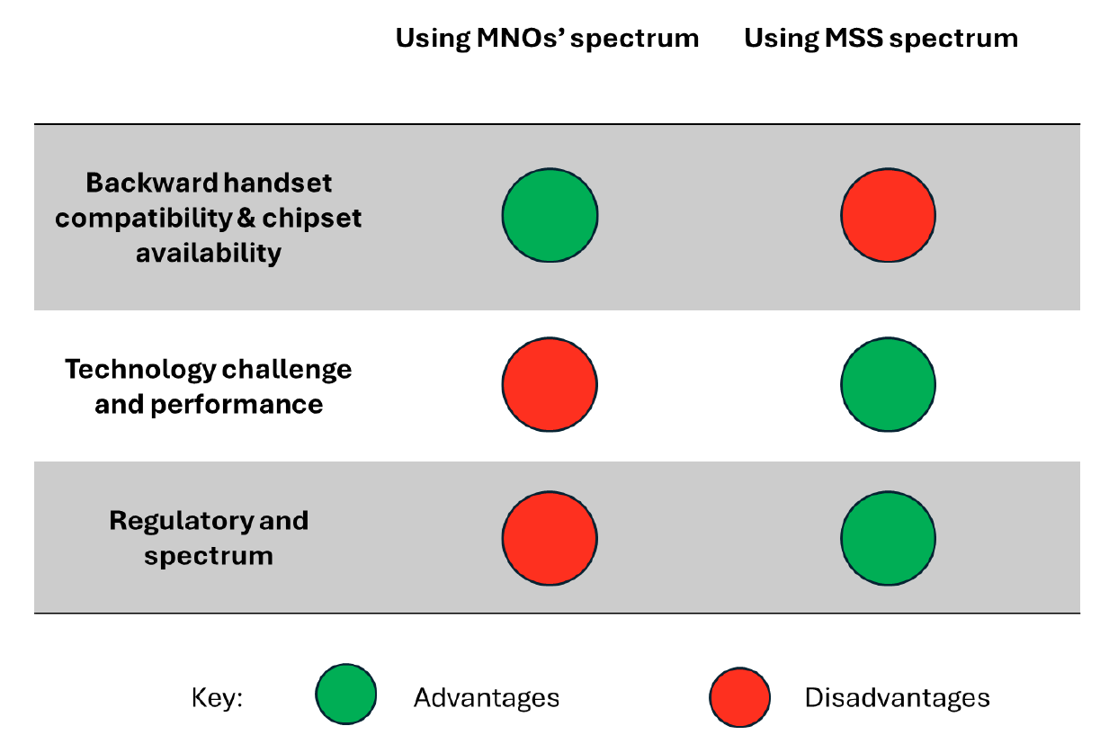
Direct to Device: Two variations
Implications for the different selection of satellite D2D spectrum options
Source: Analysys moon
Notes:
The adoption of MSS spectrum offers regulatory certainty and performance advantages, while using terrestrial spectrum from space offers certain level of backward compatibility
There are two spectrum strategy options for deploying satellite D2D services. One involves using spectrum assigned to mobile-satellite services (MSS) while the other involves repurposing MNO-licensed terrestrial spectrum. The two options offer very different pathways to market. Among them, MSS spectrum stands out as the most immediately viable.

Slide 20
D2D and WRC - 27
D2D IMT allocations (WRC-27 agenda item 1.13) | New MSS allocations (WRC-27 agenda items 1.12 and 1.14)
694/698 MHz up to 2.7 GHz | 1 427-1 432 MHz 1 645.5-1 646.5 MHz 1 880-1 920 MHz 2 010-2 025 MHz 2 120-2 170 MHz
WRC-27 agenda items 1.12, 1.13 and 1.14 studies are considering possible frequency spectrum allocations that could foster the proliferation of D2D services.

Slide 21
What to expect in slides
Options to connect from space
Trends in space connectivity
Cooperation for a sustainable future
Challenges

Slide 22
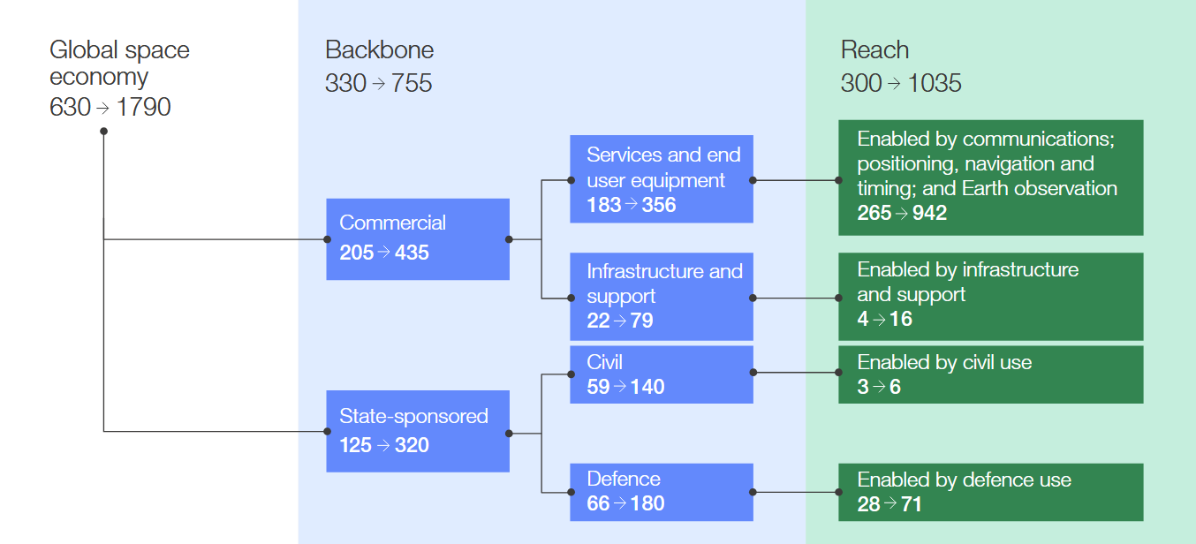
Growth of Global space economy (2024 vs 2035 (predicted))
Source: Weforum Space: The $1.8 Trillion Opportunity for Global Economic Growth
Notes:
By 2035, reach will grow 1.5x faster than backbone (11% p.a.), becoming the main driver of the space economy. This report estimates that it will make for nearly 60% of the total space economy in 2035, affecting a wide range of industries. In parallel, the backbone will continuously grow to provide the underlying infrastructure and commercial applications, though at a slower pace (7% p.a.)

Slide 23
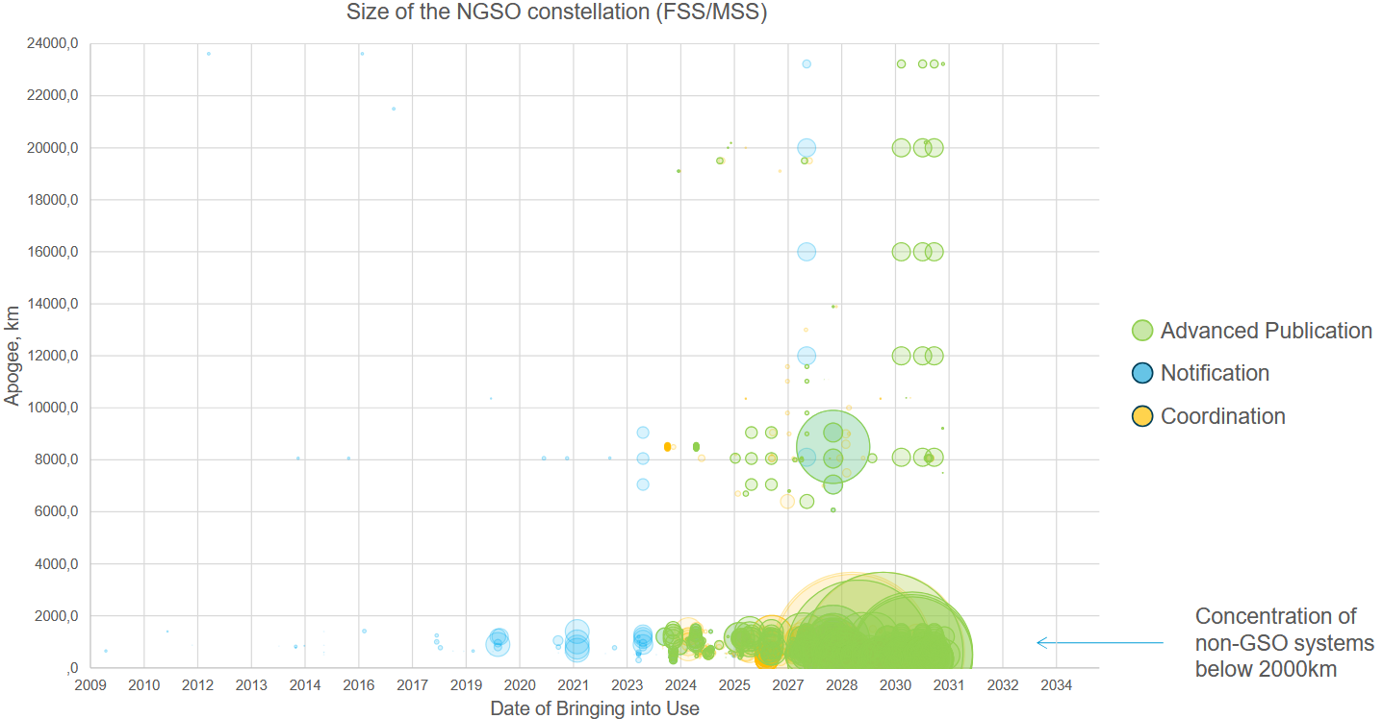
Sustainable Space connectivity
Proliferation of large LEO constellations has concerns for orbital sustainability, and spectrum congestion resulting into challenges for new entrants
Notes:
By 2035, reach will grow 1.5x faster than backbone (11% p.a.), becoming the main driver of the space economy. This report estimates that it will make for nearly 60% of the total space economy in 2035, affecting a wide range of industries. In parallel, the backbone will continuously grow to provide the underlying infrastructure and commercial applications, though at a slower pace (7% p.a.)

Slide 24

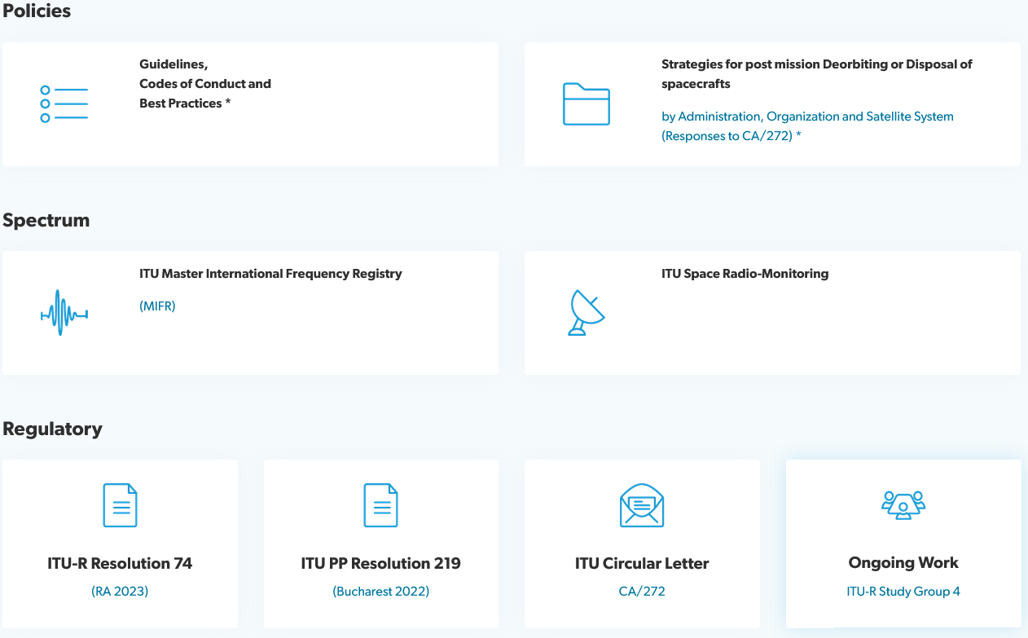
Sustainable Space connectivity
https://www.itu.int/space-sustainability/
Notes:
By 2035, reach will grow 1.5x faster than backbone (11% p.a.), becoming the main driver of the space economy. This report estimates that it will make for nearly 60% of the total space economy in 2035, affecting a wide range of industries. In parallel, the backbone will continuously grow to provide the underlying infrastructure and commercial applications, though at a slower pace (7% p.a.)

Slide 25
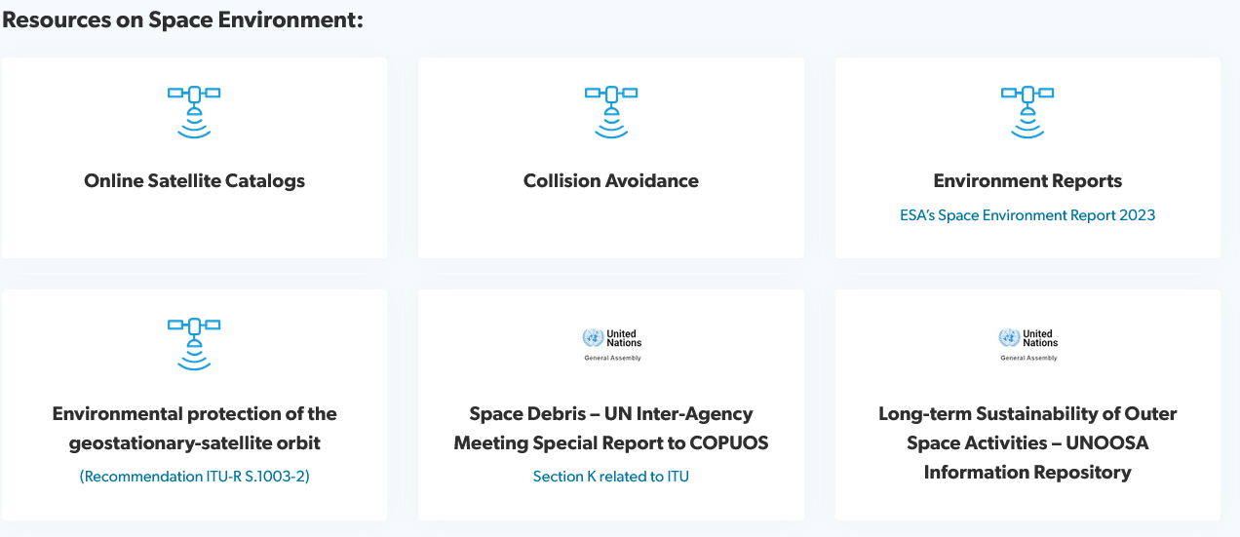
Sustainable Space connectivity
https://www.itu.int/space-sustainability/
Notes:
By 2035, reach will grow 1.5x faster than backbone (11% p.a.), becoming the main driver of the space economy. This report estimates that it will make for nearly 60% of the total space economy in 2035, affecting a wide range of industries. In parallel, the backbone will continuously grow to provide the underlying infrastructure and commercial applications, though at a slower pace (7% p.a.)

Slide 26
What to expect in slides
Options to connect from space
Trends in space connectivity
Cooperation for a sustainable future
Challenges

Slide 27
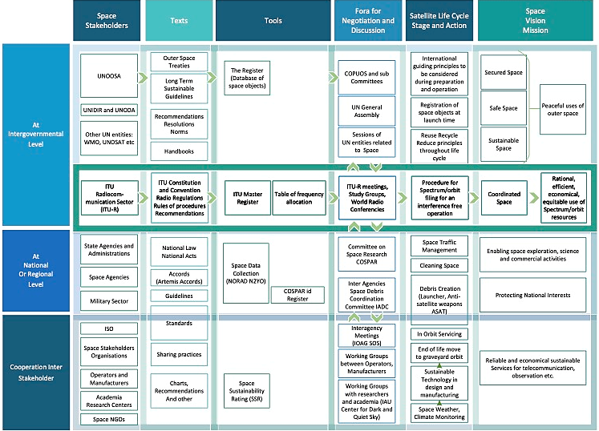
Regulatory landscape and the role of institutions
Overview of the main stakeholders
Source: ITU Digital regulation platform
Notes:
Globally, the United Nations international entities like the United Nations Office for Outer Space Affairs (UNOOSA) or ITU establish overarching guidelines and principles. Regional bodies, such the European Space Agency (ESA), adapt these principles to coordinate policies and actions suited to their specific contexts and member states. National agencies, like the Agence Nationale des Fréquences (ANFR), the Telecom Regulatory Authority of India (TRAI) or the UK Space Agency, implement and comply with these standards, considering global and regional inputs while tailoring policies to meet domestic needs and objectives. Continuous dialogue, collaboration, and negotiation among these regulatory levels ensure coherent and effective governance, fostering sustainable and responsible use of outer space. During the 2022 International Astronautical Congress (IAC) in Paris, a research paper^{[53]} mapped the roles and interactions of the main space stakeholders, highlighting the rising complexity of the ecosystem, as seen below.

Slide 28

Objectives of WRCs
Prevention of radio interference
The WRC ensures that radio services operated in accordance with the Radio Regulations are internationally compatible, either through power limits or through coordination mechanisms among countries.
Equitable Access
The WRC aims at ensuring that all countries, regardless of their developmental status, have equitable access to the radio-frequency spectrum and associated satellite orbits. Concerning space services, it is notably implemented through three Space Plans and a number of Resolutions.
Harmonization:
The WRC establishes international regulations that ensure harmonization in the use of the radio-frequency spectrum and satellite orbits. This further reduces the likelihood of harmful interference among different communication services and countries;
Inclusivity:
By involving all ITU member states in the decision-making process, the WRC ensures that radiocommunication regulations cater to a wide array of needs, balancing the interests of different countries and regions;
Forward-looking
The WRC addresses current challenges in the radiocommunication sector while also setting the stage for embracing emerging technologies and their associated requirements;
Notes:
The first decision revolves around spectrum and technology strategy. MNOs must determine whether to pursue D2D by transferring their spectrum assets to partner satellite operators such as Starlink, AST or Lynk, or to partner with providers that have access to mobile-satellite service (MSS) spectrum like Skylo. Each path carries trade-offs in terms of interference, regulatory complexity, device compatibility, technology, and time to market. Additionally, there is a large opportunity cost for MNOs using terrestrial spectrum assets for satellite services when originally intended for terrestrial coverage. The resulting satellite services revenue would need to meet the high thresholds envisioned when the spectrum assets were originally purchased or the MNO would likely face a large accounting write down of their spectrum assets. This places a high burden on the revenue that must be derived from satellite services delivered via terrestrial spectrum and therefore a higher cost to the consumer is likely in this approach.
In many parts of the world, there is no regulatory framework currently in place or a pathway laid out for a regulatory framework similar to Supplemental Coverage from Space (SCS) in the United States that would allow MNOs to pursue D2D by transferring spectrum assets to satellite operators. This issue can be a major impediment to adoption in key markets and should be explored in further detail. Similarly, OEMs face a choice between aligning with 5G NTN standards or pursuing proprietary integrations that offer speed but risk future fragmentation. It should be noted that pursuing a 3GPP Release 18 standards-based solution that relies solely on an SCS-type regulatory framework may limit adoption as standards in some cases are progressing faster than regulatory frameworks in certain geographies.
Pricing and service tiering are closely linked. D2D capabilities can be bundled with existing plans or charged independently. Some operators are currently experimenting with freemium models. Verizon is offering emergency SOS and SMS use for free to consumers with compatible devices. MNOs such as T-Mobile in the US are upselling these services at $10 per month and higher. Others might prefer to bundle the service in their premium plans. The right model will vary by market, but differentiation and clarity of value proposition are essential as these services evolve to include appDATA and voice.
Underlying both spectrum and service models is the importance of ecosystem alignment. The most successful players will be those who secure the right satellite partnerships early, align on device roadmaps, and deeply understand the timelines and implications of regulatory frameworks in key markets around the world. For OEMs, chipset selection and certification with satellite networks is a critical enabler, supporting the standards and bands that will unlock future use cases and global scale.
Finally, the quality of user experience will be key to D2D adoption. Native integration, where satellite messaging works seamlessly through the phone’s default SMS and apps, ensures familiarity and ease of use. In contrast, OTT models that rely on third-party apps create friction and limit everyday usage. To drive mass adoption, MNOs and OEMs should focus on built-in, app-free functionality that feels like a natural extension of cellular service. The goal should be to minimize any changes to user behaviour in order to maximize adoption. Seamless usability matters as much as technical capability.
In summary, direct-to-device satellite connectivity represents a paradigm shift in mobile access. It is extending the boundaries of coverage by combining terrestrial and satellite infrastructure into one seamless experience. For MNOs and OEMs, now is the time to make strategic decisions on spectrum options, standards and technology roadmap, regulatory approach and timelines, pricing and business model, partnerships, device integration, and user experience. These decisions will define their success in the satellite D2D fast-growing opportunity.

Slide 29
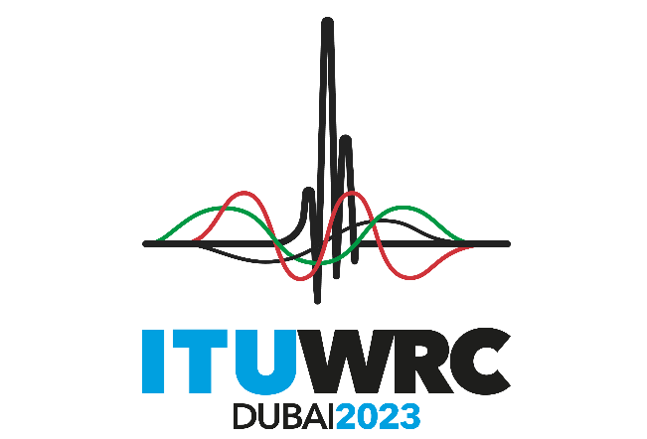
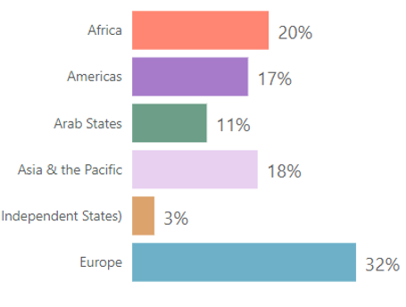
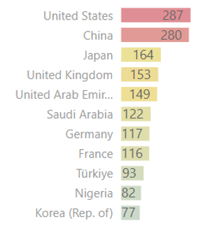
WRC-23 in numbers
163
Member States
967
Docs.
4 weeks
3987
Delegates
151 observers
6 024
proposals
Notes:
WRC-23 was the largest ever conference. Around 4000 delegates from 163 MS and 151 SM and observers, 967 documents were discussed during 4 weeks with some night sessions. Asia Pacific was well represented with 18 % of all participants and with 2 out of biggest delegations (CHN and J) on the right side

Slide 30
Agenda item 1.4 – High-altitude platform stations as IMT base stations (HIBS)
Agenda Item 1.13
  WRC-23 identified for HIBS the following bands:
< 1 GHz
2 GHz
2.5 GHz
470 – 694 MHz
694 – 960 MHz
R1
1 710 – 1 980 MHz
Global
2 500 – 2 690 MHz
R1,2
694 - 2700 MHz
698 – 960 MHz
R2 + 6/R3
2 010 – 2 025 MHz
R1,3
3 300-3 400 MHz
2 500 – 2 655 MHz
R3
parts of 703 – 960 MHz
8/R3
2 110 -2 160 MHz
Global
3 600-3 800 MHz
Resolution 218 (COM4/4)
Resolution 213 COM4/3
2 160 – 2 170 MHz
R1,3
4 800-4 990 MHz
MOD Resolution 221 (Rev. WRC-23)
6 425-7 025 MHz
  Implications: HIBS – a new platform to provide mobile broadband with minimal infrastructure using the same frequencies and devices as IMT networks. Extending IMT coverage in remote and rural areas. Maintaining connectivity in case of natural disasters
10.0-10.5 GHz
Notes:
Under AI 1.4 Conference identified frequency bands for High-altitude platform stations used as IMT base stations (HIBS). The advantage of this technology is it requires minimal infrastructure because it uses the same frequencies and devices as terrestrial IMT networks. HIBS obtained Identifications in the UHF band, 2 GHz and 2.5 GHz bands, including for your region 3 obtained. Such identifications are subject to strict conditions. Including limitation of transmission to uplink or downlink, pfd limits. In some bands, e.g. the 2 GHz and 2.5 GHz bands, HIBS shall not claim protection from existing primary services, but No. 5.43A does not apply.
All These conditions are listed in Resolutions.
proponents of HIBS clame that HIBS will allow to extend IMT coverage in remote and rural areas and allow maintaining connectivity in case of natural disasters. Hopefully we will see operational HIBS soon

Slide 31
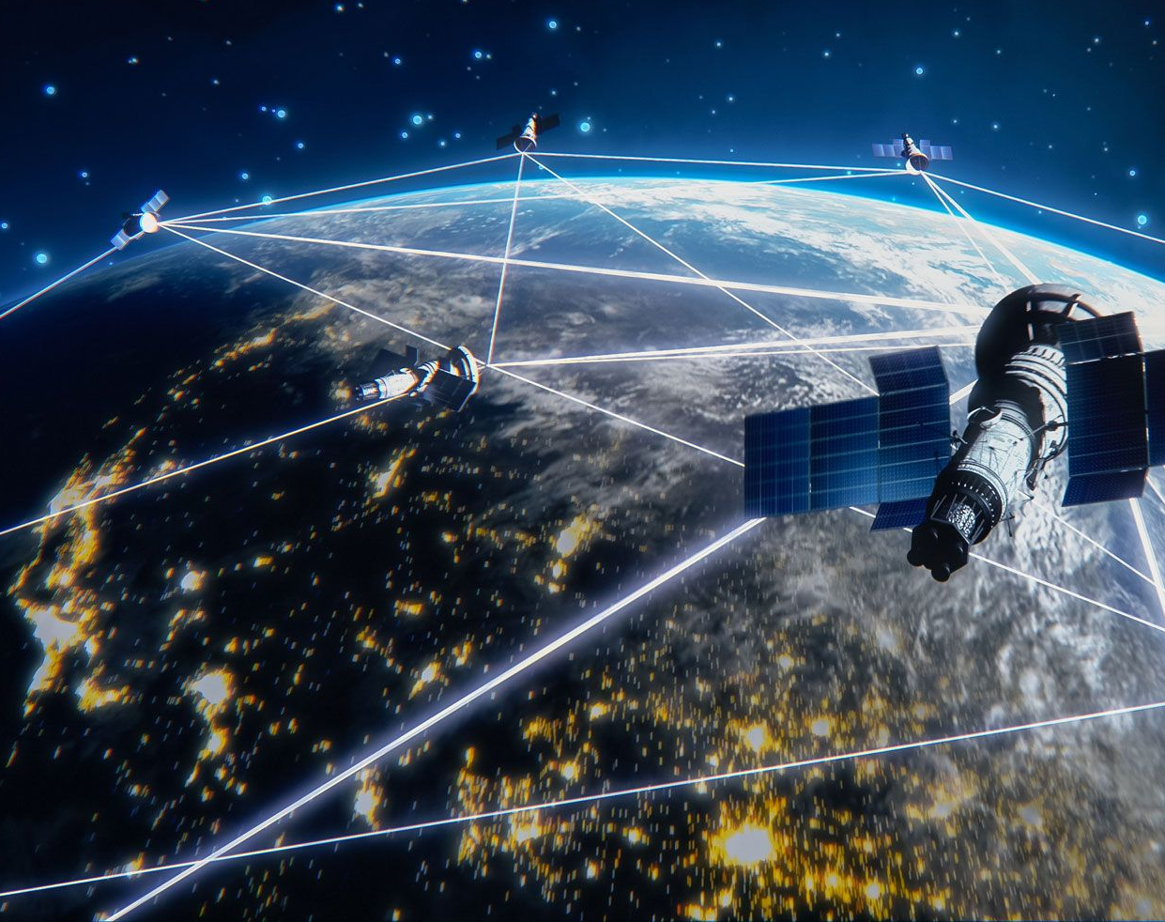
WRC-27 AIs
Satellite Services
MSS, BSS, FSS, GSO, NGSOs

Slide 32
WRC-27 – FSS, BSS and Satellite regulatory issues
No. | WRC-27 Agenda Item | Description | WRC-23 Resolution | Responsible ITU-R Group
1.1 | Aeronautical/maritime ESIMs 47.2-50.2 GHz / 50.4-51.4 GHz | Studies for M-ESIMs/A-ESIMs, actions at WRC-27 to meet increasing needs in mobile satellite broadband | 176 | WP 4A
1.2 | FSS earth stations with smaller antenna in 13.75-14 GHz | Revise sharing conditions in 13.75-14 GHz to allow FSS ES with smaller antennas, to provide for more spectrum | 129 (COM6/1) | WP 4A
1.3 | Enabling gateway stations in 51.4-52.4 GHz for NGSO FSS | Revise conditions in 51.4-52.4 GHz to enable FSS NGSO gateways for broadband services | 130 (COM6/3) | WP 4A
1.4 | FSS/BSS allocations in 17 GHz in Region 3 | FSS allocation in 17.3-17.7 GHz and BSS in 17.3-17.8 GHz in R3, to globally harmonize FSS, provide BSS spectrum | 726 (COM6/24) | WP 4A
1.5 | Unauthorized operation of NGSO earth stations | Limit unauthorized operation of NGSO earth stations of FSS/MSS and associated issues of the service area | 14 (COM6/6) | WP 4A
1.6 | Equitable access to FSS in 40 GHz, 42GHz, 48GHz, 50 GHz | Technical, regulatory measures for equitable access to FSS 37.5-42.5 GHz/42.5-43.5 GHz/47.2-50.2 GHz/50.4-51.4 GHz | 131 (COM6/7) | WP 4A

Slide 33
WRC-27 – Mobile Satellite Services
No. | WRC-27 Agenda Item | Description | WRC-23 Resolution | Responsible ITU-R Group
1.11 | Space-to-space links in MSS bands 1.5/1.6 GHz, 2.5 GHz MHz | Space-to-space links in MSS bands 1.5/1.6 GHz, 2.5 GHz, for near-real time relay of data to or from the ground | 249 | WP 4C
1.12 | MSS allocations for IoT developments | MSS allocations in 1 427-1 432 MHz, 1 645.5-1 646.5 MHz, 1 880-1 920 MHz for development of IoT through NGSO | 252 (COM6/8) | WP 4C
1.13 | MSS – IMT direct to device connectivity | MSS allocations in 694 - 2 700 MHz for direct connectivity between space stations and IMT terrestrial devices | 253 (COM6/9) | WP 4C
1.14 | Additional MSS allocations | Additional MSS allocations in 2 010-2 025 MHz, 2 160-2 170 MHz in R1&3 and in 2 120-2 160 MHz globally | 254 (COM6/10) | WP 4C

Slide 34

WRC 27 AIs
Science services
Space Research
Radio Astronomy
EESS
Space weather sensors

Slide 35
WRC-27 – Science services
No. | WRC-27 Agenda Item | Description | WRC-23 Resolution | Responsible ITU-R Group
1.15 | Space research Services (SRS) for lunar communications | New/modified SRS allocations for systems on lunar surface and between systems in lunar orbit and on lunar surface | 680 (COM6/4) | WP 7B
1.16 | Radioastronomy operating in specific Radio Quiet Zones | Protection of radioastronomy from NGSO systems in Radio Quiet Zones in some bands between 10.6 and 134 GHz | 681 (COM6/11) | WP 7D
1.17 | Space weather sensors | Allocations to MetAids service for receive-only space weather sensors and developing protection criteria | 682 (COM6/12) | WP 7C
1.18 | EESS and Radioastronomy above 76 GHz | Protection of EESS (passive) and radio astronomy above 76 GHz from unwanted emissions of active services | 252 (COM6/8) | WP 7C
1.19 | EESS (passive) in 4 200-4 400 MHz and 8 400-8 500 MHz | Global allocations to EESS in 4200-4400 MHz, 8 400-8 500 MHz for measurements of sea surface temperature | 674 (COM4/8) | WP 7C

Slide 36










Agenda item 10 – agenda for WRC-27
FIXED-SATELLITE AND BROADCASTING-SATELLITE
MOBILE-SATELLITE
1.1
Aeronautical/maritime earth stations in motion
47.2-50.2 GHz / 50.4-51.4 GHz
Space-to-space links
1 518-1 544 MHz / 1 545-1 559 MHz
1 610-1 645.5 MHz / 1 646.5-1 660 MHz 1 670-1 675 MHz / 2 483.5-2 500 MHz
1.11
1.2
13.75-14 GHz – FSS earth stations with smaller antennas
1.3
51.4-52.4 GHz – Gateway earth stations for NGSO FSS
1.4
17.3-17.7/8 GHz – FSS/BSS allocations in 17 GHz in Region 3
MSS - IoT development
1427-1432 MHz / 1645.5-1646.5 MHz 1880-1920 MHz / 2010-2025 MHz
1.12
1.5
Unauthorized operations of NGSO earth stations
1.6
Equitable access to FSS in the bands
37.5-42.5 GHz / 42.5-43.5 GHz / 47.2-50.2 GHz / 50.4-51.4 GHz
MSS - IMT- direct connectivity
1.13
7
Satellite regulatory issues
MSS – additional allocation
1.14
FIXED, MOBILE AND RADIOLOCATION
SCIENCE
1.15
1.7
Lunar communications
4400-4800 MHz / 7125-8400 MHz / 14.8-15.35 – IMT
Radio Quiet Zones
1.16
1.8
231.5-275 GHz / 275-700 GHz – Radiolocation
Space weather sensors
1.17
1.9
Aeronautical mobile (OR) high frequency modernization
≥ 76 GHz – Earth exploration and radio astronomy
1.18
1.10
71-76 GHz / 81-86 GHz – Power flux-density / power limits
Earth exploration-satellite service
4200 – 4400 MHz / 8400-8500 MHz
1.19
Notes:
AS you know every WRC establishes agenda for the next conference and preliminary agenda for the subsequent one.
Here is an overview of the topics for consideration by the next conference . There will be 19 AIs. They can be grouped into usual 5 categories . You may see the WRC-27 Agenda has a high focus on Satellite and Science issues. Totally 80% of all AIs are satellite ones.

Slide 37

WTPF-26 Draft report by ITU SG
    Section 7
    What challenges, trends and developments in space-based connectivity contribute to an inclusive, sustainable, resilient, affordable and innovative digital future? How can governments, the public sector, the private sector, and civil society, each in its respective role, build upon these developments?
    How can space connectivity bridge digital divides and contribute to sustainable development, particularly in historically underserved and unserved communities, while addressing various stakeholder priorities including accessibility, affordability, resilience of communications, and appropriate safeguards?
    How can administrations act at the national, regional, and international levels to create an enabling policy and regulatory environment for the deployment and use of space-based connectivity? How can regulatory frameworks be harmonized across different countries to facilitate the seamless deployment and operation of space-based connectivity systems?
    How can complementarities among different space-based connectivity systems and between space-based connectivity systems and terrestrial networks contribute to an inclusive and innovative digital future? How can policymakers help enable viable business models that evolve from these complementarities and what regulatory mechanisms can be put in place to prevent market distortions and to protect existing terrestrial networks?
    Recognizing the mandate of ITU and its regulatory framework and sectors, particularly the world radiocommunication conferences, how can international coordination and collaboration be improved to manage the allocation and use of radio frequency spectrum for space-based services, ensuring equitable access to space resources for all countries, minimal interference and optimal usage?
    What regulatory frameworks need to be established to ensure effective Space Traffic Management (STM) and prevent overcrowding in orbit? How can countries collaborate to develop and implement space traffic coordination systems that ensure the safety and sustainability of space activities?
    How to promote widespread affordable access to space-based connectivity solutions, particularly in developing and least developed countries and low-income and remote communities, by encouraging competition, innovation, private investment, and public-private partnerships, among other mechanisms?
    How can the environmental impact of satellite launches and operations be minimized, and what regulations are needed to ensure environmentally sustainable practices in the space industry? Recognizing the respective mandates of different UN entities related to the outer space, such as ITU, UNOOSA and COPUOS, what policies can be implemented to address the growing issue of space debris, and how can international cooperation be enhanced to ensure sustainable space operations? What innovative approaches are being considered to mitigate these challenges related to environmental risks and space debris?
    What policies can support ongoing innovation and research in space connectivity technologies, and how can these policies ensure that advancements benefit all sectors of society?
    What policy and regulatory measures countries can take to ensure data sovereignty, security, and privacy protection regarding space-based services for communication? How can these measures be standardized internationally?
https://wtpf.itu.int/2026/documents/

Slide 38
Key messages – ITU-ITTLLDC seminar 2024 Satellite Services, National Regulatory Frameworks and Partnerships
  Implement streamlined licensing procedures to encourage private sector participation in space activities.
    regulatory framework for spectrum allocation, charging and management specific to satellite communications and services.
    Importance of regulatory sandbox testing
  Develop public-private partnership models to attract investment in space infrastructure and services.
    innovative funding mechanisms, such as space bonds or dedicated space investment funds, to support long-term space program development and sustainability.
  Prioritize the development of applications that address specific national challenges, such as agriculture, disaster management, or environmental monitoring.

Slide 39
Key messages – ITU-ITTLLDC seminar 2024 Satellite Services, National Regulatory Frameworks and Partnerships
  Facilitate/ integration of satellite systems with terrestrial 5G and future 6G networks as a key development in ensuring communication resiliency.
    Hybrid network approach including, NTN, LEO, MEO, GEO, combines the global coverage of satellites with the high capacity of terrestrial networks.
  Engage in regional and international space cooperation initiatives to access shared resources and knowledge.
  Participate actively in international forums to ensure national interests are represented in global space governance discussions.

Slide 40

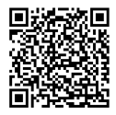

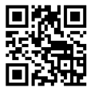


Remain Connected with us!
Linkedin URL:
https://www.linkedin.com/company/itu-regional-officefor-asia-and-the-pacific/?viewAsMember=true
THANK YOU
Twitter Handle:
@ITU_ASP (https://twitter.com/ITU_ASP)
ituasiapacificregion [at] itu.int

Slide 41


WRC process
ITU Member States
ITU-R Sector Members
RA
Radiocommunication Assembly
Final Acts
Rec ITU-R
Recommendation
CPM
Report
World Radiocommunication Conference
(WRC)
RR
Radio Regulations
RRB
Radio Regulation Board
CPM
Conference Preparatory Meeting
Next WRC Agenda
Adopted by ITU Council
Radiocommunication Bureau
RoP
Rules of Procedure
ITU-R Study Groups

Slide 42






WRC Cycle
WRC-27
WRC-23
Modified the RR (2020),
Defined the agenda for WRC-27
CPM27-1
Allocated the work of the agenda items to relevant working parties of ITU-R Study Groups, defines chapter Rapporteur and the structure of the CPM Report
ITU-R Study Groups
Conducts studies for 4 years and prepares draft CPM text
CPM27-2
Consolidates the results of studies in CPM text that includes the methods to solve each agenda item
RA-27
Appoints the chairmen and vice chairmen of the Study Groups, revises the structure of the Study Groups, approves ITU-R recommendations, revises ITU-R resolutions
Modifies the RR (2024) (e.g. allocates frequencies), Defines the agenda for WRC-31
ITU-R Study Groups:
SG-1: Spectrum management
SG-3: Radiowave propagation
SG-4: Satellite services
SG-5: Terrestrial services
SG-6: Broadcasting service
SG-7: Science services
Regional Groups / Multi-countries Consolidates Regional and multi-country proposals
WRC-27

