Slide 1

ITU Area Office for South Asia and Innovation Centre in Delhi
Akanksha Sharma
akanksha.sharma@itu.int

Slide 2
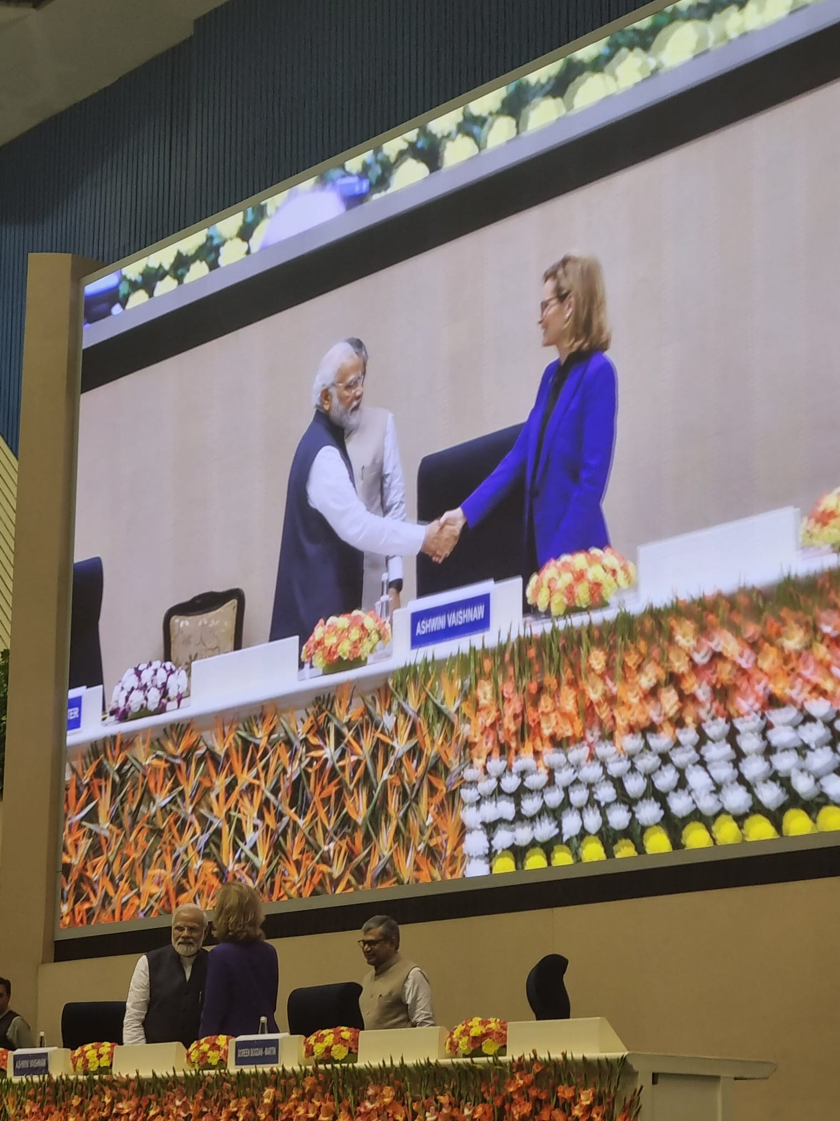
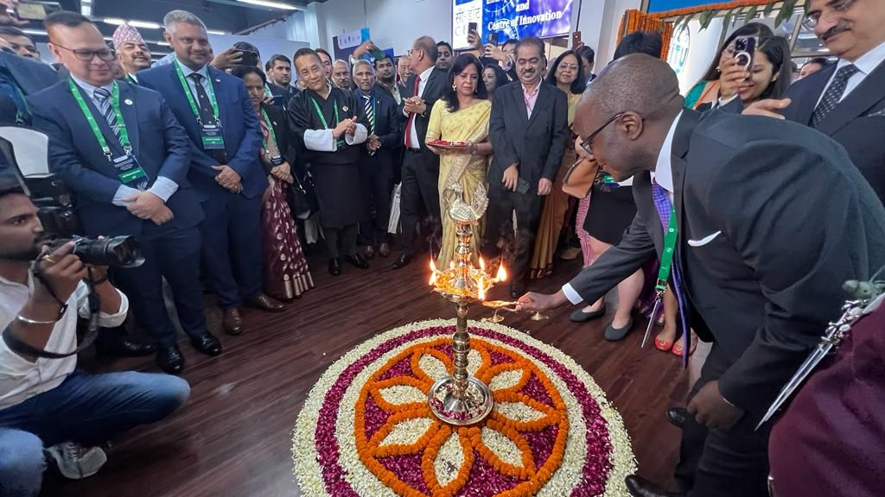
ITU Area Office for South Asia and Innovation Centre
The ITU Area Office for South Asia and Innovation Centre was inaugurated at the highest levels by ITU’s Secretary General and the PM of India on 22nd March 2023.
It is fully funded and hosted by the Government of India.
The objectives of the area office are:
  Promoting the introduction of advanced technologies​
  Contributing to the development of ICT/telecommunication networks and services
  Providing TA to infrastructure, e-governance, and cross-sectoral ICT applications
  Assisting with human resources and capacity development
  Conducting other activities related to ITU's mandate to connect the world

Slide 3
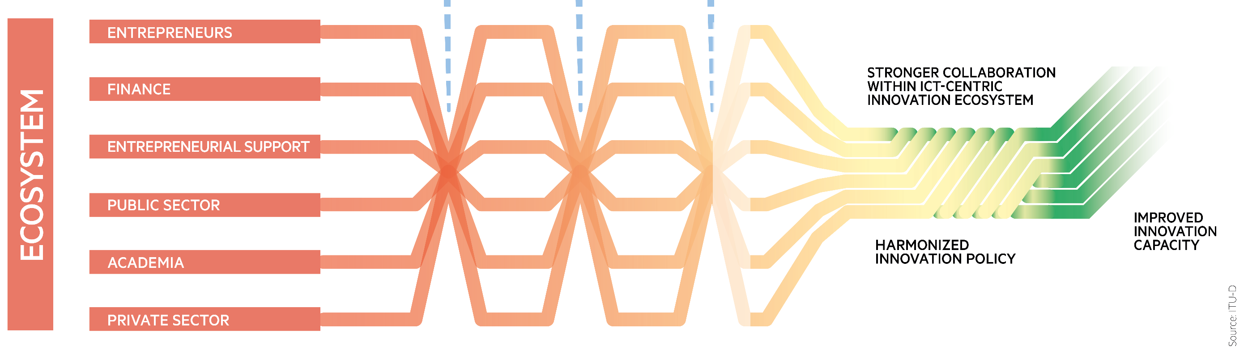
The Global Technology Acceleration Center will be a critical enabler for countries and will accelerate Digital Development
Mainstreaming emerging technologies and digital innovation in critical aspects of inclusive and sustainable digital transformation regionally and globally to reduce technological inequities
A global center to reduce technological inequities
Spotlight the Indian ecosystem
Support ITU’s mission with new capabilities
Accelerate Digital Development
Innovation Centre

Slide 4
Innovation Café
The objective of ITU iCafé is to unlock hidden opportunities for the Innovation Centre and serve the member states , in partnership with global stakeholders who are at the forefront of technology and innovation.
Regular collaboration: Breaking down silos and fostering mutli-stakeholder cooperation.
Action-oriented discussions: The process of an iCafé will blend open dialogue with a call to action ensuring that each session leads to at least one actionable outcome.
Sustained momentum: To keep pace with the growing demand from member states, it is highly crucial that ITU iCafé can churn ideas at a fast pace.
Safe environment: The idea is to create a space where all stakeholders feel free to express themselves, explore ideas, and collaborate. It’s therefore important to maintain an informal setting.
Experimentation : The purpose behind innovation cafés is to provide an informal conversational space to ITU stakeholders to brainstorm opportunities for cooperation. The experimentative nature of iCafe’s is key to fostering an ecosystem that leads to innovation led development.
iCafé as a Hub: By turning the iCafé into a monthly network, innovation becomes an ongoing practice rather than a one-time event.

Slide 5
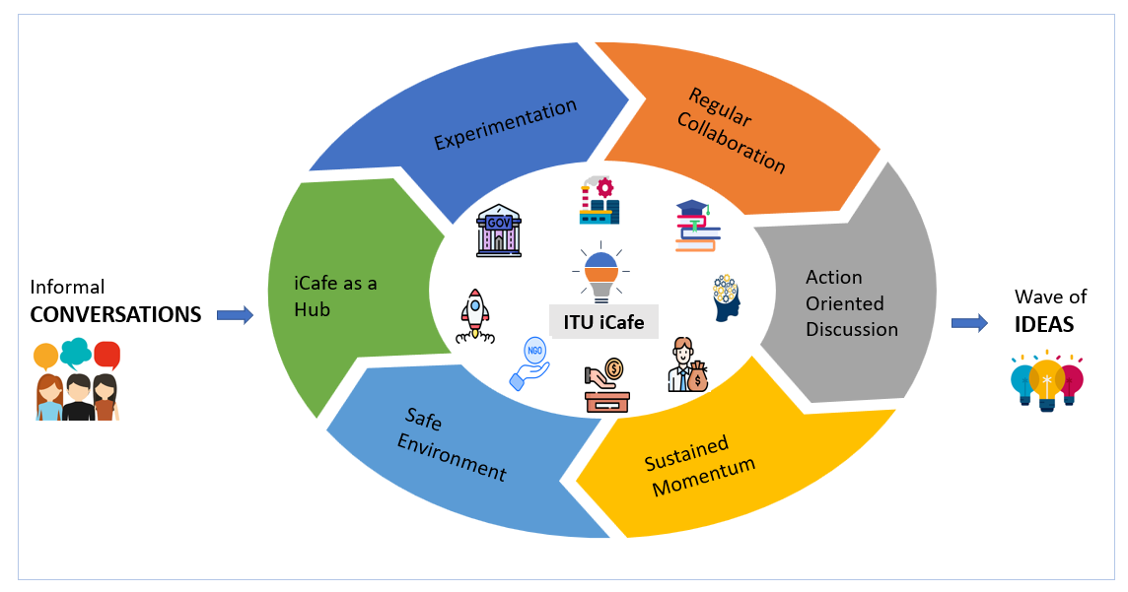
Proposal to host Innovation Café

Slide 6
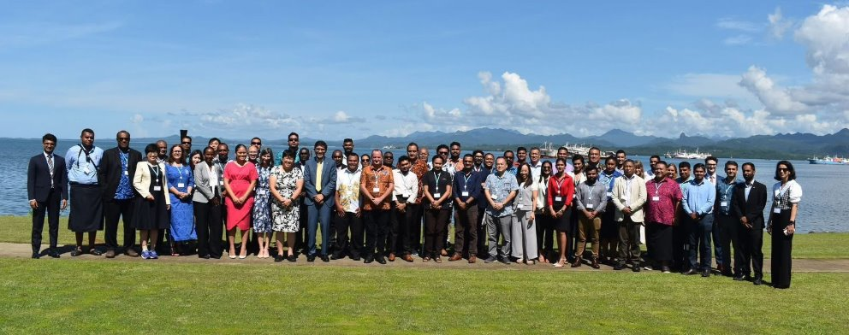
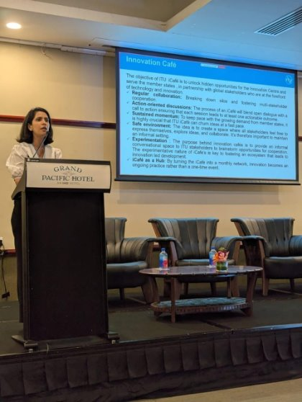
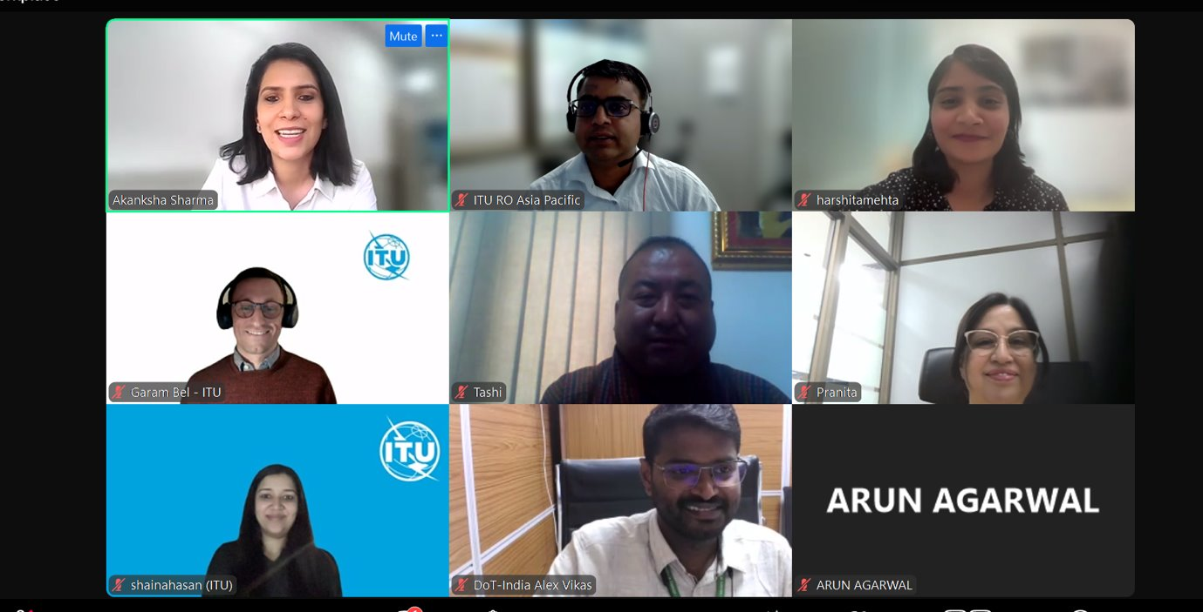
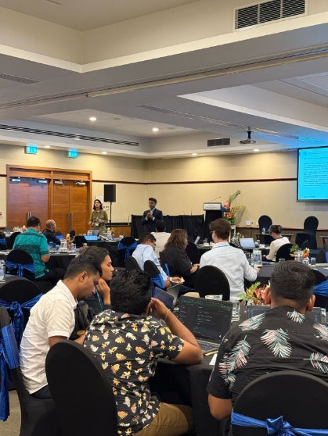
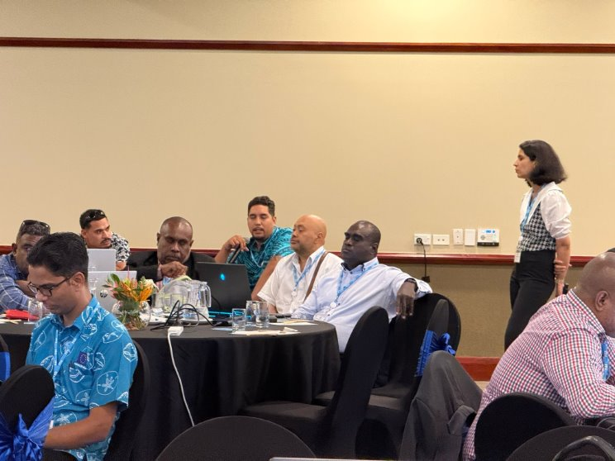
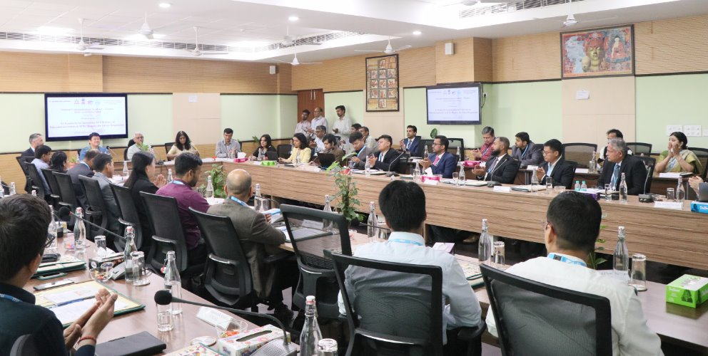
ITU Innovation Café – so far
Turning abstract innovative ideas into tangible outcomes through action-oriented discussions​
6 innovation cafes conducted on AI & IoT, Digital ID, Sustaining Smart Islands initiative through innovative solutions, Ewaste, AI & Standards for Dx and Future of AI.​
Attended by over 160 participants from 16 countries.​
Highlight strategic opportunities for ITU – including the need for knowledge-sharing initiatives on AI and Digital ID; the revision of WTDC Resolution 66 on e-waste; and the importance of innovative solutions for the sustainability of smart islands.​
Upcoming innovation cafes: Ewaste (2nd in the series), Digital Connectivity, AI series (climate, health, capacity building)

Slide 7


Innovation Café on Role of innovation to enhance digital connectivity in LLDC’s
What are the most pressing connectivity challenges that LLDCs face today, where innovative approaches either technological or policy could be useful?
How could upcoming satellite technologies, such as Non-Terrestrial Networks (NTN) and Direct-to-Device (D2D) services, be creatively integrated with terrestrial networks to expand reach and resilience?
How do you think the increasing competition in satellite-based connectivity offering will impact affordability of terrestrial international connectivity?
What innovative strategies could LLDCs adopt to ensure their digital infrastructure is resilient to unavailability while remaining adaptable to future technologies?

Slide 8



Thank you!
United Nations specialized agency for information and communication technologies – ITU
Contact Us
ITU Regional Office for Asia and the Pacific:
ituasiapacificregion@itu.int
Twitter URL:
https://twitter.com/ITUAsiaPacific
Official Twitter account:
@ITUAsiaPacific
Official LinkedIn account:
ITU Regional Office
for Asia and the Pacific

