Slide 1

Bridging Borders: Pakistan’s International Submarine and Terrestrial Connectivity
Ministry of IT & Telecommunication

Slide 2
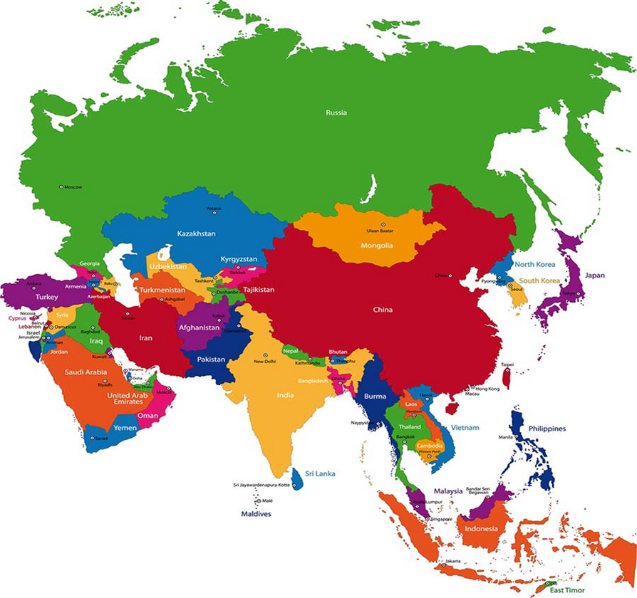
Pakistan Geo-strategic Location
Pakistan lies at a critical junction between South Asia, the Central Asia, and Middle East, providing natural access to major east–west submarine cable routes
Karachi and Gwadar, being coastal hubs, can serve as landing points for multiple regional and intercontinental cables, enhancing redundancy and regional connectivity
CAR
Mongolia
SA
Arabian Sea

Slide 3
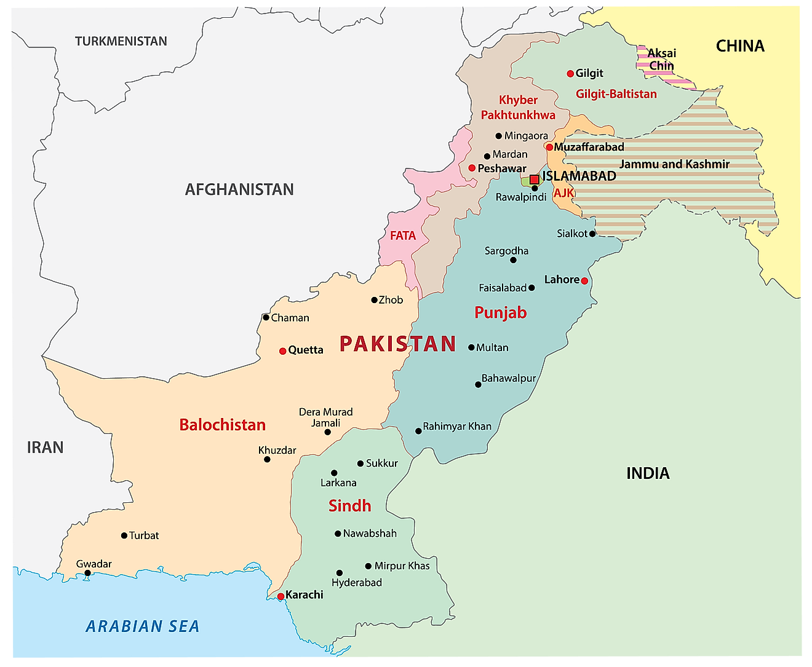
Pakistan’s Interconnect Points
Khunjrab
          China. Khunjerab
          Afghanistan. Torkham, Chaman, Ghulam Khan
          Iran. Taftan and Jiwani
          CAR. Through China and
          Afghanistan
          Mongolia. Through China
Torkham
PC OFC Ph - 1
G Khan
IIOJ&K
Chaman
Taftan
6 x Cables
TWA1
SEAMEWE 5
AAE1
SEAMEWE 4
IMEWE
PEACE
5 x Cables in Plan
Africa 1 (2026)
Africa 2 (2025)
SEAMEWE 6 (2026)
PEACE (2026)
Makran Gulf Gateway
Jiwani
Submarine cables

Slide 4
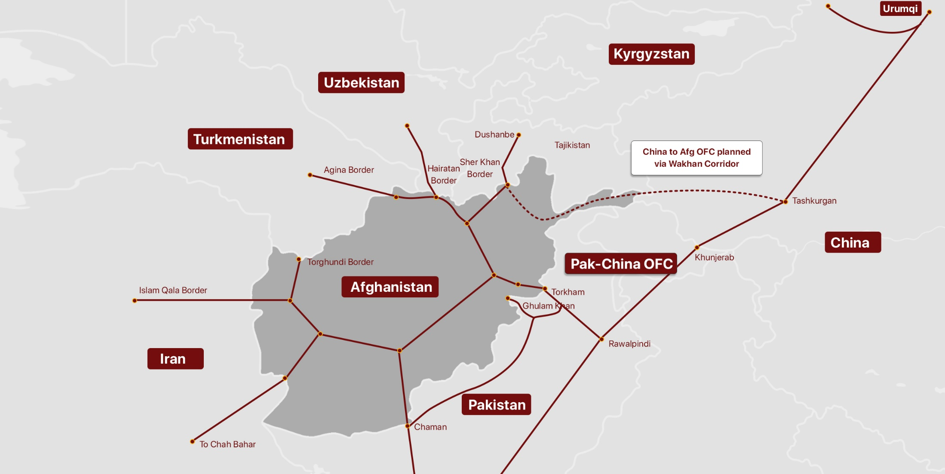
Afghanistan International Connectivity

Slide 5
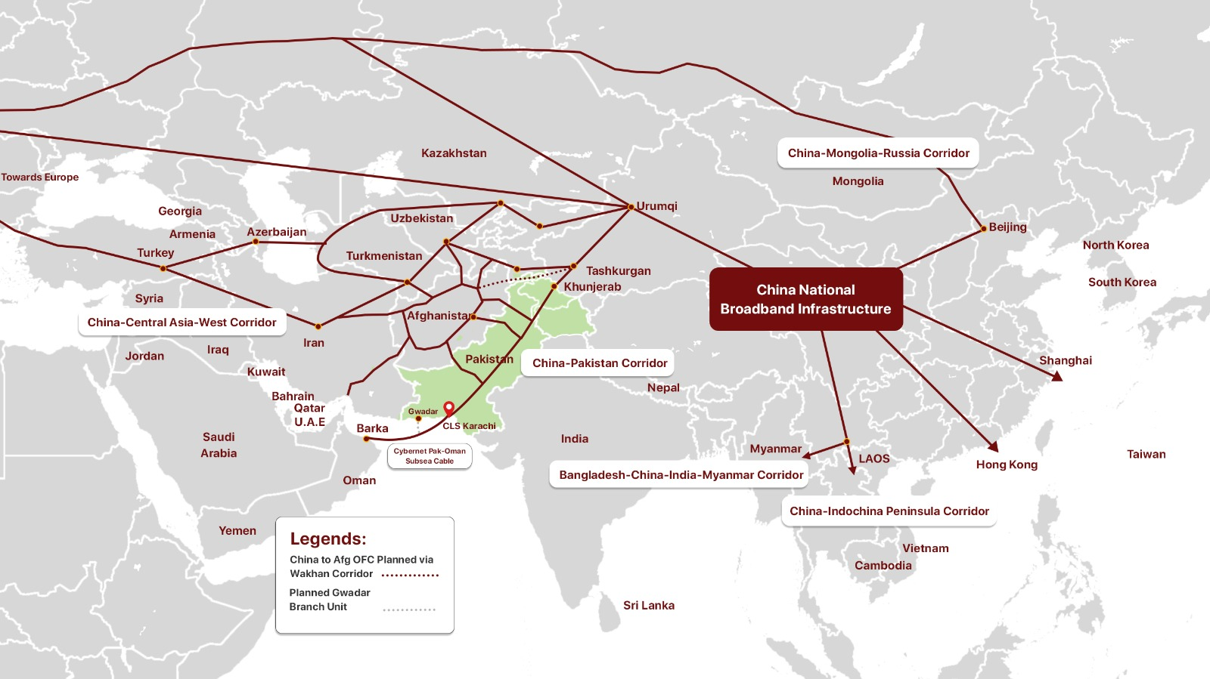
CAR International Connectivity

Slide 6
Current Fixedline Telecommunication Infrastructure
International Connectivity – Submarine and Terrestrial Cables
  PTCL Cable Landing Station(s) (CLS) - 3 x
  TWA’s CLS - 2 x
  Cybernet’s CLS - 1 x
  SCO’s (Terrestrial Cable – Pak China OFC) - 1 x
  Planned CLS - 6 x
Total Deployed OFC in Pakistan
  Long-haul OFC - 75,967 Km
  Metro OFC - 135,506 Km
  Total - 211,473 Km

Slide 7
Current Fixedline Telecommunication Infrastructure
07 x Deployed Upstream Routes (Cable Landing Stations/Systems)
Sr. No. | Int’l Cable System | Operator | In service | Installed Capacity (Tbps) | Activated Capacity (Tbps) | Main Routes
1 | SMW4 | PTCL | 2005 | 2.549 | 2.08 | Southeast Asia – Middle East – Western Europe
2 | IMEWE |  | 2010 | 2.8 | 1.9 | India, UAE, Egypt, etc
3 | AAE1 |  | 2017 | 4.79 | 2.9 | Asia, Middle East, Europe
4 | TWA1 | TWA | 2006 | 2.8 | 2.6 | UAE, Global
5 | SMW5 |  | 2016 | 1.7 | 1.7 | Asia, Middle East, Europe
6 | PEACE | Cybernet | 2022 | 1.6 | 0.8 | East Africa and Europe
7 | Pak China OFC Cable* | SCO | 2019 | 1 | 0.4 | China
Total = 7 |  |  |  | 17.239 | 12.12
* Terrestrial Cable (Pak China OFC)

Slide 8
Fixedline Telecommunication Infrastructure
06 x Planned Upstream Routes (Cable Landing Stations/Systems)
Sr. No | Int’l Cable System | Operator | Planned Capacity (Tbps) | Status | Ready for Service | Main Routes
1 | AFRICA 1 | PTCL | 6.5 | Permit in Principal (PIP) Issued. | 2026 | Europe, Middle East, Africa
2 | SMW6 | TWA | 6
 |  |  |  |  | 2026 | Europe, Middle East,
 |  |  | 10 |  | 2025 | Europe, Middle East, Africa, Asia
3 | 2AFRICA
4 | PEACE | LINKdotNET | 2 |  | 2026 | East Africa and Europe
5 | Makran Gulf Gateway (MGG-1) | Cybernet | 2 |  | 2026 | Oman
6 | Pak China OFC* | Zeta | 1 |  | 2026 | China
Total = 6 |  |  | 27.5
* CLS @ Terrestrial Cable (Pak China OFC)

Slide 9
Key Takeaways
  Pakistan provides the shortest, secure, low latency route for connectivity for CAR, Mongolia and Afghanistan to ME, Europe, Far East, Africa and vice versa
  Availability of dedicated & alternate digital corridor (OFC link) passing through Pak to Arabian Sea (6 high capacity submarine cables)
  Reduces dependency on other available routes

Slide 10
THANK YOU

