Slide 1


Cybersecurity
4 November
Post Session
Implementation of the ITU Regional Initiatives in Asia and the Pacific
(2019-2020)

Slide 2
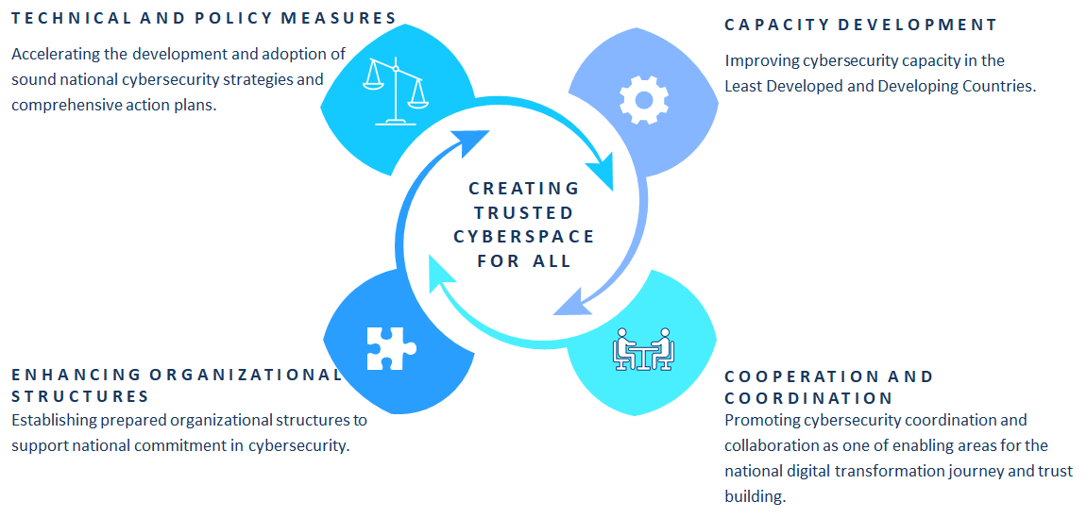
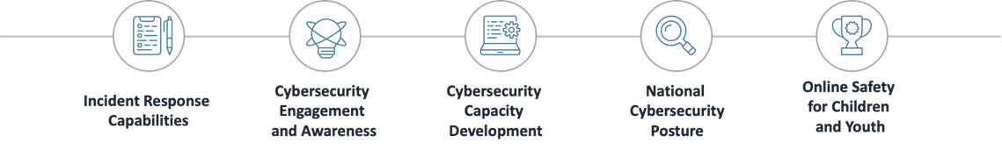
Modern and secure telecommunication/ICT Infrastructure: Foster the development of infrastructure and services, including building confidence and security in the use of telecommunications/ICTs
Cybersecurity
FOCUS AREAS
CO-19
Delivery Mechanism

Slide 3
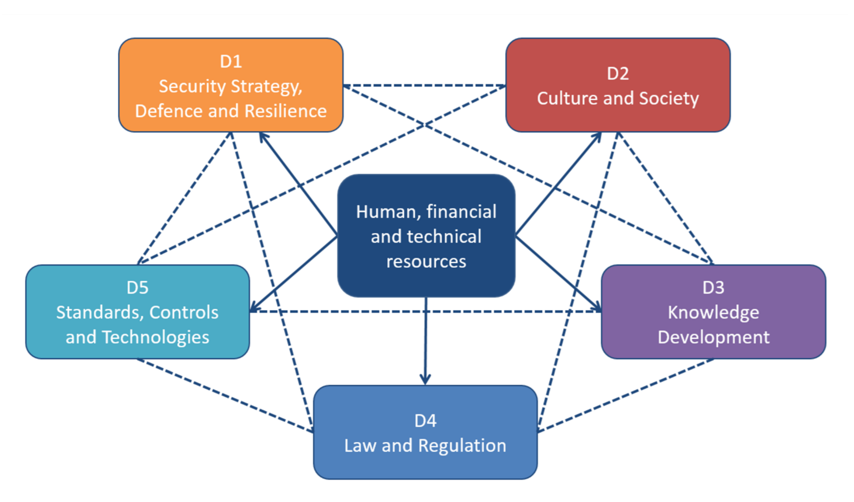
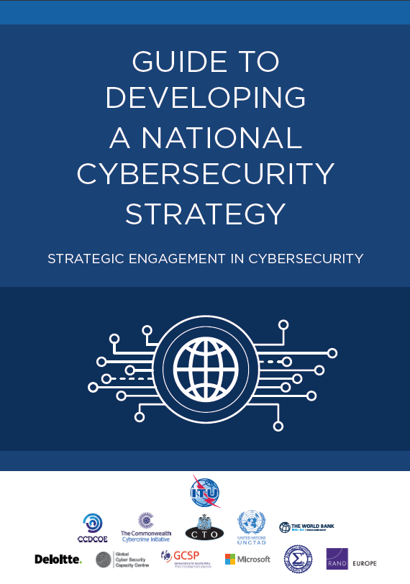
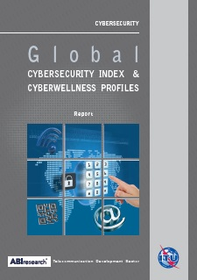

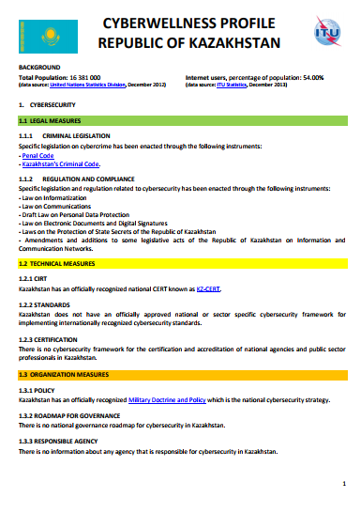


National Cybersecurity Strategy (NCS) & Global Cybersecurity Index (GCI) and National Cybersecurity Assessment -CMM

Slide 4
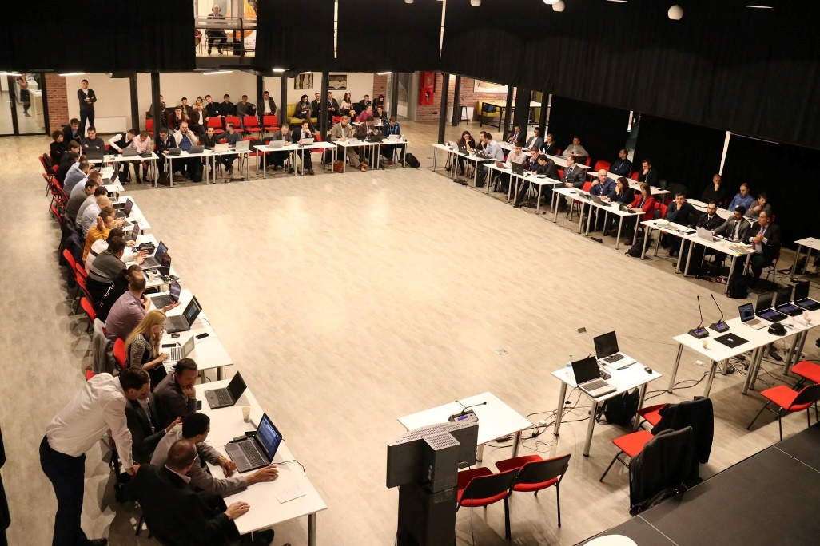
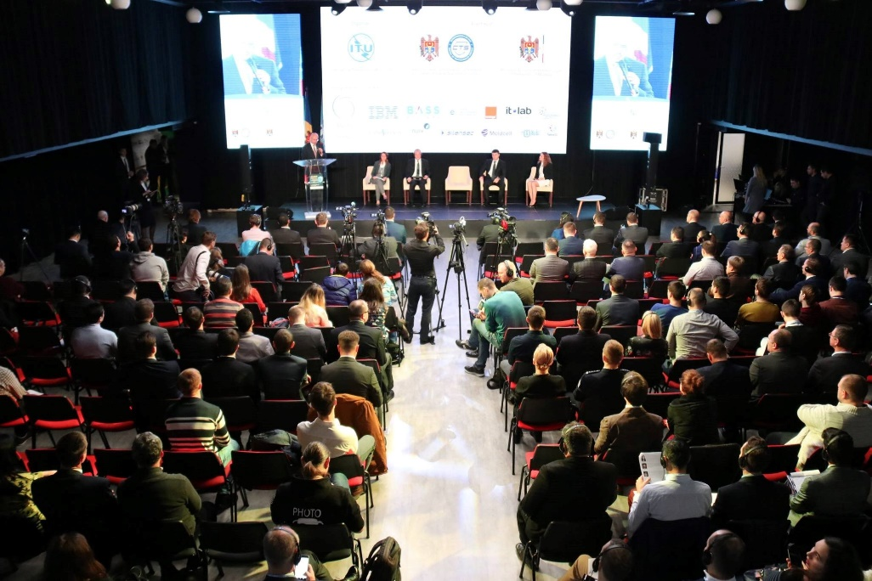
CIRT and CyberDrills
14
30
Exercises were​conducted
CIRT Project Implementations
115 +
80
Countries participated in our Cyberdrills
CIRT readiness assessments
8
Ongoing CIRT Projects
Malawi , Barbados , Botswana , Gambia, Burundi, Kenya, Bahamas, Bermuda, Suriname, Guyana

Slide 5
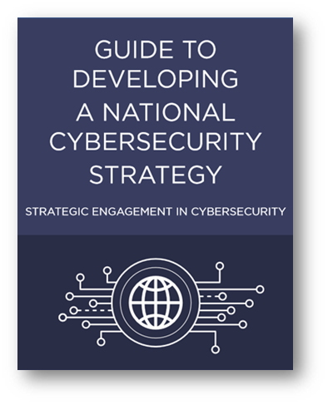
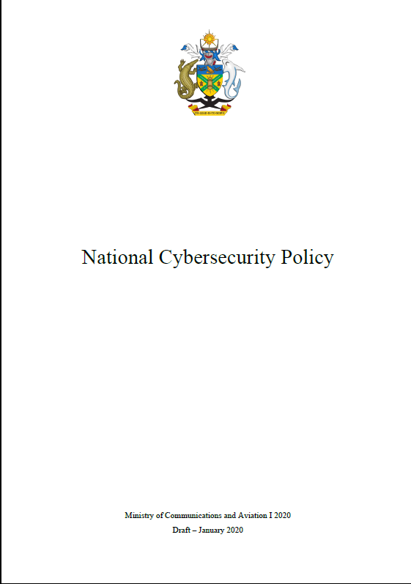


Cybersecurity
National Cybersecurity Strategies
CIRT Assessments
Cyber Drills
Capacity Building
Bhutan, Kiribati, Solomon Islands, Pakistan, Fiji
PNG, Samoa, Tonga, Vanuatu, Myanmar, Nepal
Cross Regional Cyber Drill ,Global Cyberdrill,
Pacific Cyber Drill
Regional Training :Indonesia, Iran, Tabletop Exercise, Australia, Vietnam
Post session on 4 November 2020 from 14:45-15:45 on Cybersecurity

Slide 6
Other Upcoming Programs
Cyber4Good
The ITU builds capacity through cybersecurity insights into action
We are enabling private sector actors, civil society, and academia to better develop cybersecurity capacity in countries
EWC Mentorship
Building on the success of the CyberDrill2020 Engaging Women in Cybersecurity webinar, we are launching with FIRST a mentorship program for women in cyber

Slide 7
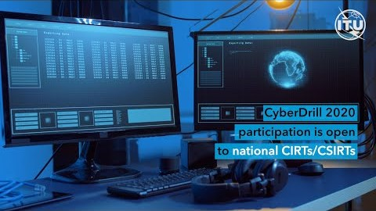
Notes:
CyberDrill 2020
Presenter: Maxim or Marwan

Slide 8
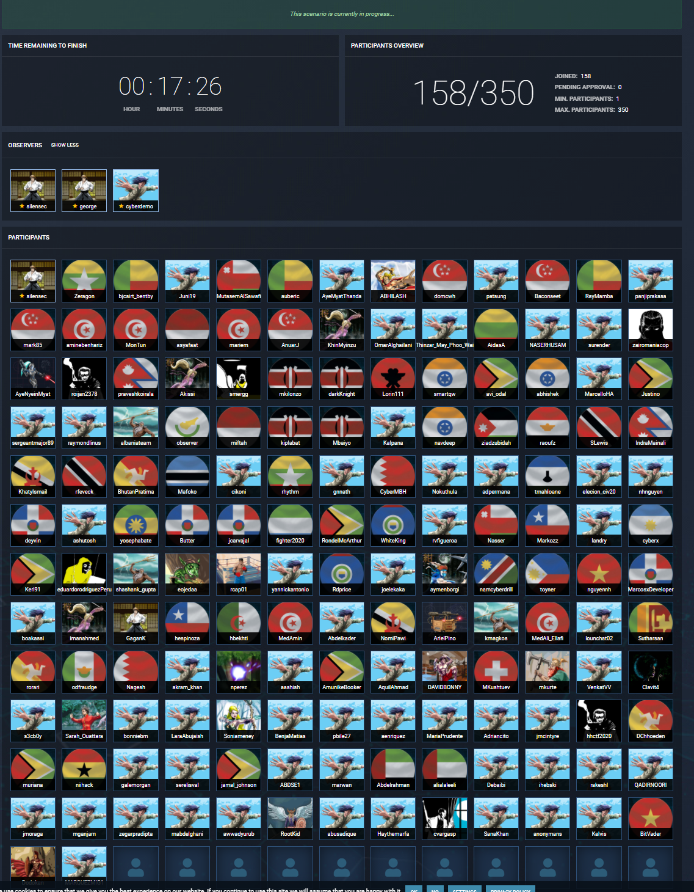

Slide 9




Join our efforts in creating world a safer place!
THANK YOU
FOLLOW
ITU REGIONAL OFFICE FOR ASIA AND THE PACIFIC
ON SOCIAL MEDIA:
2- 5 NOVEMBER
For more information,
please contact:
ituasiapacificregion@itu.int
itu.int/go/RDF-ASP2020
#RDFASP2020

