Slide 1
National Spectrum Management & its Automation
Training on SMS4DC
Vientiane, Lao P.D.R
12 – 14 February 2019

Slide 2
AGENDA
Automation of National Spectrum Management
RF and its internati8onal Management
National Spectrum Management
Additional study:
ITU SM tools
Examples of Structure of SM authorities

Slide 3
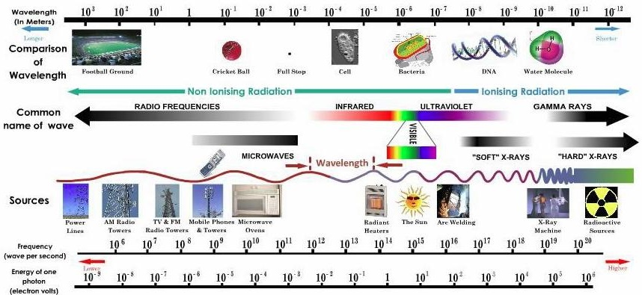
Radio-Electric Spectrum
Portion of Electromagnetic Waves, used for Communications
Artificial boundary, based on technologic development

Slide 4
Radio-Electric Spectrum: General Technical Usage
Band | Frequency range | Range | Common use | Bandwidth
VLF (myriametric waves) | 3-30 kHz | 1 000 km | Long-range radionavigation | Very narrow
LF (kilometric waves) | 30-300 kHz | 1 000 km | Long-range radionavigation | Very narrow
MF (hectometric waves) | 300-3 000 kHz | 2-3 000 km | Long-range radionavigation | Moderate
HF (decametric waves) | 3-30 MHz | Up to 1 000 km | Fixed point-to-point, Global broadcasting | Wide
VHF (metric waves) | 30-300 MHz | 2-300 km | Broadcasting, Mobile, WAN | Very wide
UHF (decimetric waves) | 300-3 000 MHz | < 100 km | Broadcasting, Mobile, Satellite | Very wide
SHF (centimetric waves) | 3-30 GHz | 30-2 000 km | Fixed, Broadcasting, Mobile, WAN, Satellite communications | Very wide up to 1 GHz
EHF (millimetric waves) | 30-300 GHz | 20-2 000 km | Broadcasting, Fixed point-to- point, Mobile, Satellite communications | Very wide up to 10 GHz

Slide 5
RF Spectrum as a National Resource
Features | Natural Resource
 | Spectrum | Land | Oil | Water
Is the resource varied? | YES | YES | Not very | Not very
Is it scarce? | YES | YES | YES | YES
Is it renewable? | YES | Partially | NO | YES
Can it be stored for later use? | NO | NO | YES | YES
Can it be exported? | NO | NO | YES | YES
Can it be traded? | YES | YES | YES | YES
Can it be made more productive? | YES | YES | YES | NO
Notes:
Radio spectrum - a most crucial resource to ensure stable operation and unrestrained development of plethora of wireless communication services and applications: from high-tech interstellar science research to humble garage door openers

Slide 6
Spectrum Management (SM)
Key Terms
 | Allocation | Allotment | Assignment
Definition | Allocation (of a frequency band): Entry in the Table of Frequency Allocations of a given frequency band for the purpose of its use by one or more terrestrial or space radiocommunication services or the radio astronomy service under specified conditions. This term shall also be applied to the frequency band concerned. | Allotment (of a radio frequency or radio frequency channel): Entry of a designated frequency channel in an agreed plan, adopted by a competent conference, for use by one or more administrations for a terrestrial or space radiocommunication service in one or more identified countries or geographical areas and under specified conditions. | Assignment (of a radio frequency or radio frequency channel): Authorization given by an administration for a radio station to use a radio frequency or radio frequency channel under specified conditions.
Frequency Distribution to | Services | Areas or Countries | Stations

Slide 7
International roles of SM
International/Regional framework
National framework
Civil/business
Defense/security
Notes:
The governance of spectrum use on a global basis is a core responsibility of the International Telecommunication Union ITU and, in particular, its Radio communication SectorITU-R , The mission of the ITU-R sector is, inter alia, to ensure rational, equitable, efficient and economical use of the radio frequency spectrum by all radio communication services, including those using satellite orbits and to carry out studies and adopt recommendations on radio communication matters.

Slide 8
ITU and Spectrum Management
The Radio Regulations govern the use of the radio-frequency spectrum and the geostationary satellite and non-geostationary-satellite orbits.
Article 5 of the Radio Regulations deals with regulations for frequency allocation and contains the (international) Table of Frequency Allocations.
The Table of Frequency Allocations reflects decisions made on the purpose or purposes to which particular frequencies will be put.

Slide 9
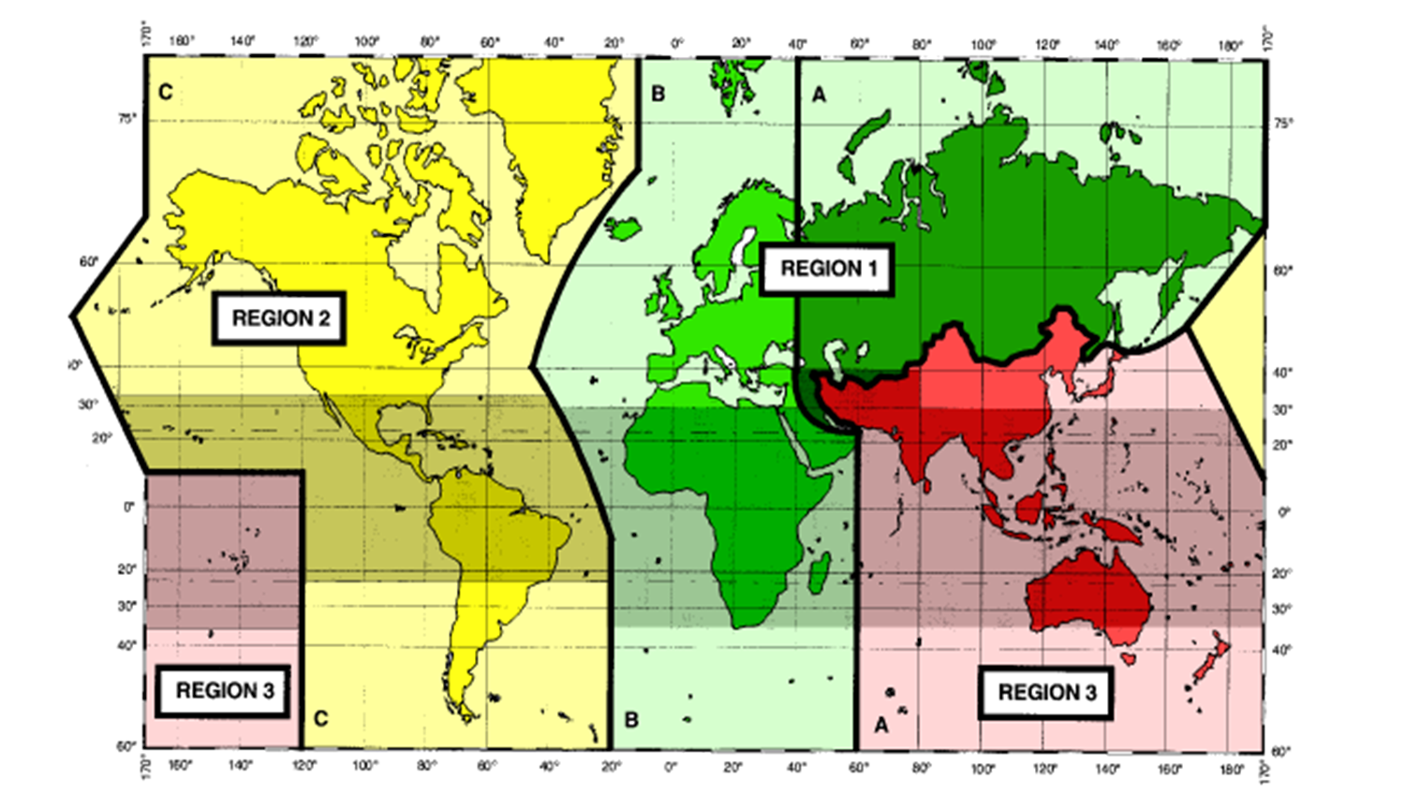
International Frequency Allocations
The shaded part represents the Tropical Zones as defined in Nos. 5.16 to 5.20 and 5.21

Slide 10
Regional Organizations
Exchange information and experiences to foster the harmonization of spectrum management rules
Prepare common positions to be presented to regional, then global instances
Facilitating efficient and flexible use of the spectrum
Regional co-ordination on spectrum Management
Managing interference by establishment of a common framework
Coordinating the Use of Technical Standards across Regions

Slide 11
Regional Organizations
Name | Official website
APT - Télécommunauté Asie-Pacifique - Asia-Pacific Telecommunity - Telecomunidad Asia-Pacífico, BANGKOK, Thailand | www.apt.int
ASMG- Arab Spectrum Management Group | http://asmg.ae
ATU - Union africaine des télécommunications - African Telecommunications Union - Unión Africana de Telecomunicaciones, NAIROBI, Kenya | www.atu-uat.org
CANTO - Association des entreprises nationales de télécommunications des Caraïbes - Caribbean Association of National Telecommunication Organizations - Asociación de Organizaciones Nacionales de Telecomunicaciones del Caribe, PORT OF SPAIN, Trinidad and Tobago | www.canto.org
CEPT - Conférence européenne des Administrations des postes et des télécommunications - European Conference of Postal and Telecommunications Administrations - Conferencia Europea de Administraciones de Correos y Telecomunicaciones, VALLETTA, Malta | www.cept.org
CITEL - Commission interaméricaine de télécommunications - Inter-American Telecommunication Commission - Comisión Interamericana de Telecomunicaciones, WASHINGTON, D.C., United States | www.citel.oas.org
COMTELCA - Commission technique régionale des télécommunications - Telecommunications Regional Technical Commission - Comisión Técnica Regional de Telecomunicaciones, TEGUCIGALPA, M.D.C., Honduras | www.comtelca.org
COPTAC - Conférence des Postes et Télécommunications de l'Afrique centrale - Conference of Posts and Telecommunications of Central Africa - Conferencia de Correos y Telecomunicaciones de África Central, YAOUNDE, Cameroon | n/a
CTU - Union des télécommunications des Caraïbes - Caribbean Telecommunications Union - Unión de Telecomunicaciones del Caribe, PORT-OF-SPAIN, Trinidad and Tobago | http://www.ctu.int/
ETSI - Institut européen des normes de télécommunication - European Telecommunications Standards Institute - Instituto Europeo de Normas de Telecomunicaciones, SOPHIA ANTIPOLIS CEDEX, France | www.etsi.org
LAS - Ligue des Etats Arabes - League of Arab States - Liga de los Estados Árabes, CAIRO, Egypt | www.arableagueonline.org
RCC - Communauté régionale des communications - Regional Commonwealth in the Field of Communications - Comunidad Regional de Comunicaciones, MOSCOW, Russian Federation | www.rcc.org.ru

Slide 12
Bilateral
Bilateral Agreements
Cross-border co-ordination by harmonizing the use of frequency spectrum.
develop means of resolving instances of unexpected harmful interference

Slide 13
National Spectrum Management

Slide 14
Spectrum management
Spectrum Monitoring
Rules and Regulations
Enforcement
Spectrum Engineering
Spectrum Planning and Allocations
Licensing and Assignment Administration
Frequency Coordination
Standardization
Elements of Spectrum Management
National Spectrum Management (SM)
Spectrum management is a combination of administrative and technical activities for efficient utilization of spectrum by users without causing harmful interference in their service area

Slide 15
National SM Framework
Telecom ACT /Law
Spectrum Policy
National Table of Frequency Allocation

Slide 16
Spectrum Management
National SM Actions
Planning: Defining the use of different bands
  provides direction and cohesion in support of policy formulation, and support future steps to achieve optimal spectrum use. Major trends and developments in technology and the needs of both current and future users of the frequency spectrum should be closely monitored and mapped.
Licensing: Authorizing of emissions, and technical conditions
  Involves assigning specific frequencies to users, allotting certain frequency bands or sub-bands to specific users under certain specified conditions and in accordance with the national and international table of frequency allocations.
Spectrum Engineering
  Involves the development of electromagnetic compatibility standards for equipment that emits or is susceptible to radio frequencies.
Enforcement: Verifying the use of spectrum in conformity with licensing
  Involves the monitoring of the use of the radio spectrum and the implementation of measures to control unauthorized use

Slide 17
National Spectrum Management
Adherence to
  National Telecom ACT and Spectrum policy
  International Radio Regulations
  Regional frequency allotments and allocations
Covers
  Current and Future demands of different category of users
  Telecommunication technology growth and trends
Major National Document
  National Table of Frequency Allocation
Requires
  Regular Update Especially after World (or Regional) Radiocommunication Conference (WRC/RRC)

Slide 18
Role of National Spectrum Manager
Allocate radio frequencies / authorise their use
Encourage efficient use of the radio spectrum
Promote access to services for all
Work to avoid harmful interference and safeguard the spectrum
Manage disputes between parties
Work to achieve quality services
Promote social development including social cohesion and safety of life
Play a part within regional and national bodies as appropriate

Slide 19
National Table of Frequency Allocations (NTFA)
A national Level Document that:
Divides portion of all allocable spectrum into number of frequency bands for use and/or reservation for future use.
Defines Primary, Secondary, Co-Primary usages of band and the bands reserved for specific services
Details the national policy on preparation of band plans that are consistent with corresponding spectrum allocations and with existing national and international allotment plan.
Other parameters for frequency assignment;

Slide 20
National Table of Frequency Allocations (NTFA)
Primary Basis:
  means that in accordance with the nature of a right granted to the assignee of a particular spectrum (band or spot frequency), the assignee is the only entity to use the identified spectrum and is entitled to protection from:
  harmful interference caused by any other spectrum user who may be authorized to use same spectrum on secondary basis; and
  claims of harmful interference by any such spectrum user
Secondary basis:
  means the nature of a right granted to the assignee of a particular spectrum (band or spot frequency), is subject to the condition that the entity does not cause any harmful interference to, or claim protection from any harmful interference caused by, other licensees who have been granted the right to use same frequency bands on primary or co primary basis.

Slide 21
National Table of Frequency Allocations (NTFA)
Co-primary Basis:
  means that nature of the right granted to the assignee of a particular spectrum (band or spot frequency), to use the specified frequency bands is subject to the condition that
  the entity must coordinate with other co-primary licensees in order to limit harmful interference to existing links and services operating in the relevant frequency bands, and to facilitate the introduction of additional links and services in the relevant frequency bands.
  Co-primary user must refrain from causing harmful interference to, and may not require protection from operations of other co-primary user in relevant band.
  Co-primary usage of band is subject to protection from:
    harmful interference caused by any other spectrum user that may be authorized to use the same spectrum on secondary basis,
    claims of harmful interference by holders of licenses granting secondary status with respect to frequency bands covered

Slide 22
NTFA Example : Samoa

Slide 23
Generic contents list for the NTFA document
FAT |  | RR REFERENCE
Chapter 1 | Meaning of abbreviations
 | Terms and definition
 | General terms | RR 1.2 – 1.15
 | Frequency management | RR 1.16-1.18
 | Radiocommunication services | RR 1.19-1.60
 | Radio stations and systems | RR 1.61- 1.115
 | Operational terms | RR 1.116-1.136
 | Characteristics of emissions and radio equipment | RR 1.137-1.165
 | Frequency sharing | RR 1.166-1.176
 | Technical terms relating to space | RR 1.177-1.191
Chapter 2 | Frequency bands | RR 2.1-2.2
Chapter 3 | Technical characteristics of stations | RR 3.1-3.14
Chapter 4 | Assignment and use of frequencies
 | General rules for assignment and use of frequencies | RR 4.1-4.9
Chapter 5 | Frequency allocations | RR 5.1-
 | Regions and areas | RR 5.2-5.9
 | Categories of services and allocations | RR 5.23-5.44
 | Footnotes of RR | RR 5.53-5.565
 | Plan of Frequency Bands Allocations in the [Country] (National Frequency Table) | National footnotes and general information
 | National Frequency Table

Slide 24
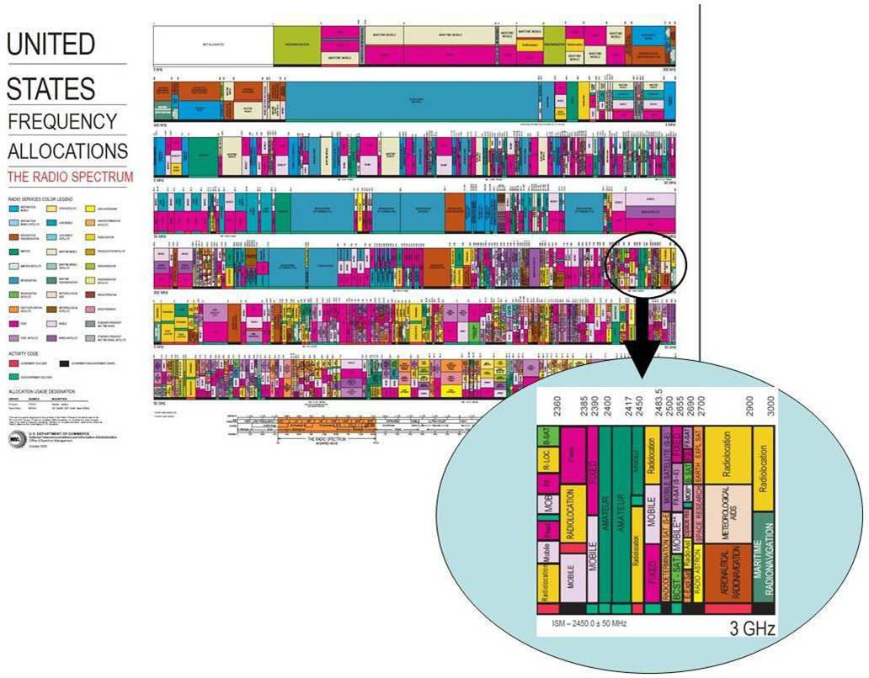
NTFA Graphical Representation
Useful for public consumption and a quick overview of the use of the radio spectrum

Slide 25
Regional NTFA:
European Frequency Information System (EFIS)
The ERO (part of CEPT) is developing an on-line searchable FAT covering the whole of the CEPT region http://www.efis.dk
EFIS is the tool to fulfill EC Decision 2007/344/EC on the harmonised availability of information regarding spectrum use in Europe and the ECC Decision ECC/DEC/(01)03
Similar initiative by APT for Asia-Pacific Regioncalled AFIS

Slide 26
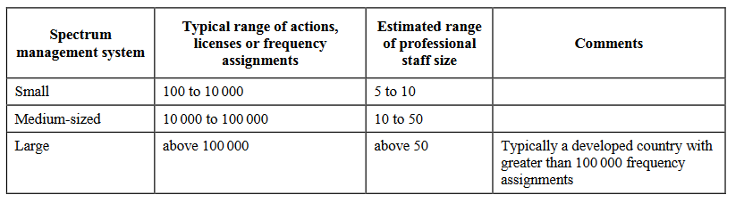
Organizational Structure of National Spectrum Management Department
Source:
Handbook on National Spectrum Management 2015

Slide 27
Organizational Structure of National Spectrum Management Department
Source:
Handbook on National Spectrum Management 2015
Small Economies
  5 to 10 staffs
  Not enough for professional functions
Spectrum Management chief
(2 staffs)
Spectrum Planning
(2 staffs)
Planning, Regulations,
Allocations, Allotments,
Coordination
Frequency Assignment
(3 staffs)
Application processing,
Technical examination,
Frequency assignment,
Licensing
Engineering
(3 staffs)
Engineering studies,
Spectrum monitoring,
Interference measurements

Slide 28
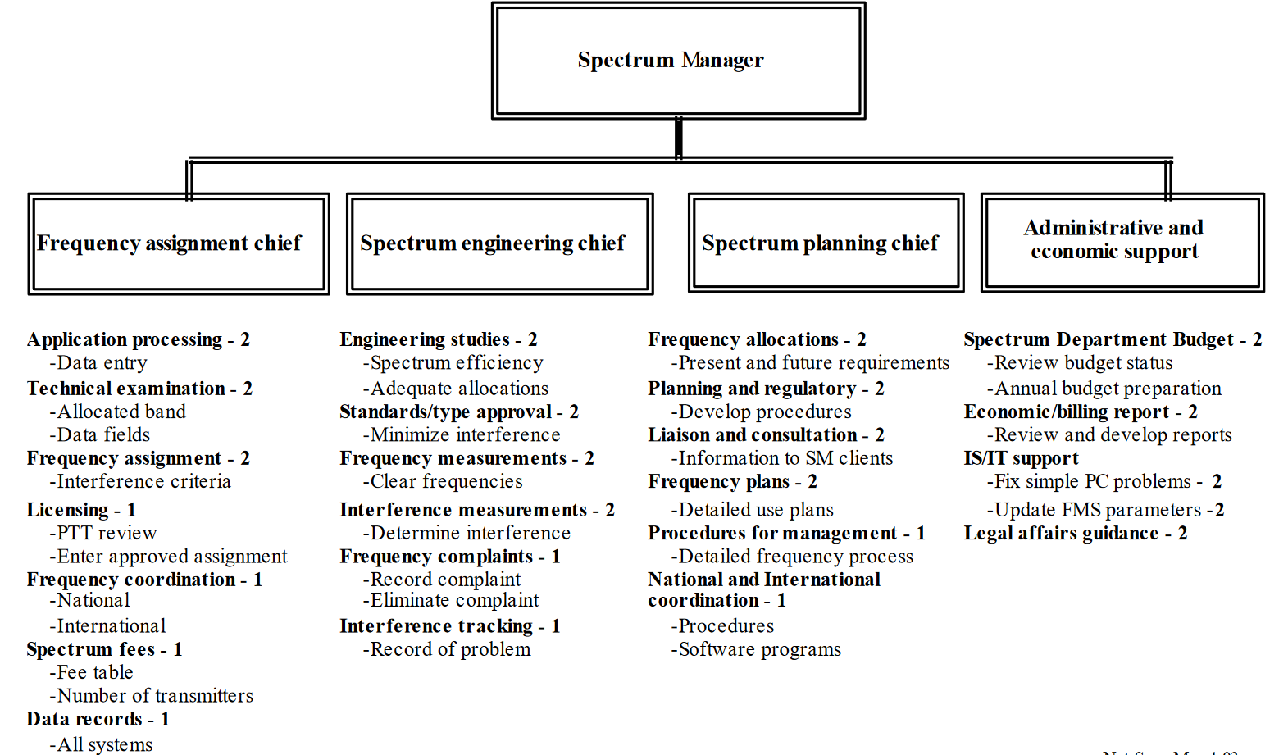
Organizational Structure of SM Department
Medium sized organization
There are different ways for arrangement
75,000 total frequency assignment records and 1,000 applications monthly
10 to 50 staffs
Source:
Handbook on National Spectrum Management 2015

Slide 29
ITU Recommendations on NRAs (SM-1047) – (1)
That the development of national spectrum management programmes should address the following subject areas:
  Spectrum management fundamentals
  Spectrum planning (short/long-term planning, strategic planning, spectrum use planning, spectrum management system planning, service or network planning)
  Spectrum engineering practices (coordination, technical analysis, interference mitigation, etc.)
  Frequency authorization (spectrum rights, allocations, assignments, licensing, etc.)
  Spectrum use (including spectrum efficiency and spectrum demand)
  Spectrum control (inspection and monitoring)
  Automation of spectrum management and integration with spectrum monitoring systems
  Spectrum economics (spectrum fees)
  Standards and equipment authorization

Slide 30
ITU Recommendations on NRAs (SM-1047) – (2)
The use of formats for recording national frequency assignments should be compatible with those used by the Radiocommunication Bureau for electronic notification of frequency assignments
That administrations are guided by the appropriate sections of the ITU-R Recommendations, Reports and ITU Handbooks
That administrations are guided by the appropriate sections of the Radio Regulations, Radiocommunications Data Dictionary, the ITU-R Recommendations, Reports and ITU Handbooks
That the development of staff skills and knowledge is a continuous process to enhance effective spectrum management

Slide 31
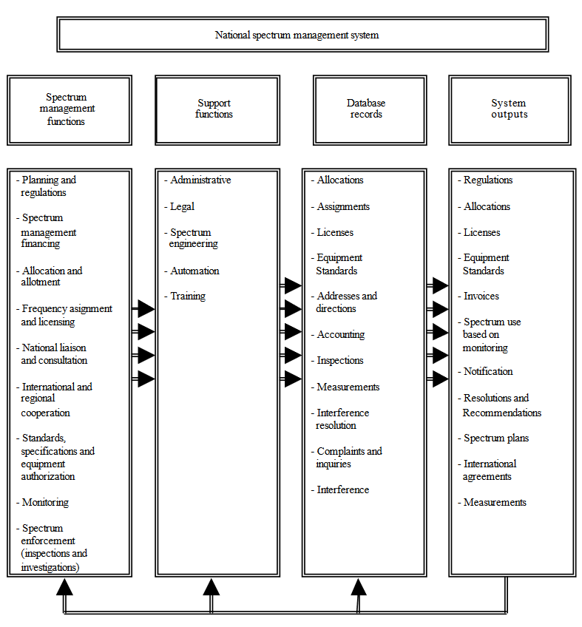
National SM functions based on functional responsibilities

Slide 32
General Procedure for Licensing
License &
invoice
sending
Spectrum
User
Frequency
is not
available
Rejection
of request,
reasonably
License
Request
Registra-
tion
Adminis-
trative
study
EMC
Analysis
Coordina-
tion
Notifica-
tion in
ITU DB
License &
invoice
generation
Frequency
assignment
Official
request
Folder
Creation
Processing,
administrative and
technical analysis
Coordination study
& submission to ITU*
Fee calculation and
licensing,
collection of some fees
* ITU notification is not required for each cases, and that a bi/multilateral agreement is stronger than the RR (see Article 6 of the RR)

Slide 33
Automation of National Spectrum Management

Slide 34
Background
The use of computers in the spectrum management process has become crucial for most Administrations that are faced with the ever-increasing use of the radio frequencies.
Some crucial aspects in the establishment of a computer-aided spectrum management are:
  Technical analysis (propagation, coverage, interference prevention etc.)
  Administrative procedures (registration and issuing of licenses)
  Regular Spectrum fee invoicing
  Frequency coordination
  Notifications of assignments to the ITU according to the Radio Regulations
Is it really needed?
The definitive answer in every case is “Yes”
However, it shall be properly designed

Slide 35
Introduction
  Computer techniques can help in at least two ways:
  Managing and examining large amounts of data.
  Performing calculations, whether complex, or simple but repetitive.

Slide 36
Advantages of computer-aided SM
  Compliance with policies/legilation
  Verification of the compliance of frequency assignment requests with the NTFA, RR (intl. and regional) etc.
  Compliance with Type Approval Conditions
  Verification that the equipment to be used has the required national certification or meets other mutual recognition agreement standards;
  Accurate Technical planning and Monitoring response
  More accurate and optimized response to assignment requests, through selection of appropriate channels taking into account details such as terrain characteristics;
  Appropriate treatment of radio monitoring data (See ITU-R Monitoring Handbook);
  Decentralization of repetitive processes
  Automatic and decentralized on-line issue and renewal of licenses and invoices (law must allow for electronic signatures);
Notes:
Computer-aided techniques have become commonplace in administrations in order for them to be able to manage data and to perform the necessary analytical studies associated with spectrum management.
Administrations may benefit from an integrated system through timeliness and effectiveness of the following tasks:

Slide 37
Advantages of computer-aided SM
  Faster Administrative processing of applications
  E.g.: expeditious and fully documented, timely billing of spectrum users
  Increased transparency and data availability to users inside and outside the administration.
  More accurate preparation and electronic submission of notification forms to be sent to ITU
  Example of automation of ITU activities related to coordination: The BR’s Terrestrial Analysis System (TeRaSys) and the Space Network System (SNS) are the computerized tools used by the Bureau to process the frequency assignment notices submitted by administrations.
  The availability of electronic exchange of data between administrations or between an administration and the ITU

Slide 38
Spectrum Management Data
Following describe relationships and properties pertaining to types of entities of interest in spectrum management
  Frequencies and radio services (frequency allocations)
  License holders (Administrative data)
  Frequency assignments and licenses
  Stations and equipment
  Geography of the administration and the surrounding areas
  Levels of emissions (monitoring)
  Other data
    License fee schedules.
    Interference complaints filed by license-holders
    Violations of national or international radio regulations by a license-holder
    Inspections of stations

Slide 39
System architecture
ITU
Tools and Databases
Network
Monitoring System
Spectrum Management System
Monitoring
Database
Technical modules
Data processing modules
Geographical Information System
Spectrum Management Database
Digital Maps
(e.g. Digital Elevation Model)

Slide 40
Database Management Systems (DBMS)
The database management system (DBMS) is a computerized system that maintains spectrum management data and makes it available to a variety of users.
  A well-designed, modern database will allow easy input and modification of data and provide useful “views/reports” of data to users without the users having to understand the details of the DBMS
  DBMS should be designed to minimize redundancy across the database, provide validation of data, provide security for sensitive data, provide data backup to avoid catastrophic losses in the event of system failures.
  When considering the design of a DBMS, an administration should consider systems used by administrations with which they must often exchange data, as well as systems used by the BR.
  A DBMS can be implemented such that files containing the reference administrative and technical parameters in a central location are replicated or “mirrored” at the user sites. This technique, while transparent to the users, improves response time.
Notes:
The significant task of initial data input can be simplified somewhat with advanced data input techniques (e.g. a graphical user interface) or by requiring licensees and equipment suppliers to provide data in an electronic form that is compatible with the database.

Slide 41
Geographic Information Systems (GIS)
Geographic information systems (GIS) can be integrated with the DBMS to help administrations to account for environmental effects (terrain, population, etc.) in spectrum management.
  Usually offer two-dimensional geographic information representation and often three-dimensional capabilities as well (especially for antenna patterns).
The ITU Digitized World Map (IDWM), available at http://www.itu.int/pub/R-SOFT-IDWM,
  Include databases for geographical (coastlines, seas, islands, lakes), political (country borders and regional boundaries), meteorological (rain and climatic zones) and technical information (ground conductivity areas, noise zones, allotment areas, maritime zones, broadcasting CIRAF zones and propagation zones).
  Many other mapping sources of varying capabilities, such as the GTOPO30 database and the NASA database, are available online.
Notes:
CIRAF Zones - Conferencia Internacional de Radiodifusión por Altas Frecuencias. Spanish - because these zones were defined at the World Administrative Radio Conference held in Mexico in 1948. It defines areas to be served by each shortwave broadcaster. Continuing HFCC meetings are held to refine such agreements. Each CIRAF target zone has a number.

Slide 42
Examples of Automated SM tools

Slide 43
RR App. 7
  Coordination distance calculations based on RR Appendix 7
  Automated methods are applicable to the procedure outlined in RR Appendix 7 for determining the coordination area around an earth station in frequency bands between 100 MHz and 105 GHz shared by space and terrestrial services.
  Computer programs developed by the BR and other administrations are available in the BR software packages and are used to calculate coordination distances during technical examination of frequency assignment notices.
  A coordination diagram has been automatically drawn on a computer-generated map

Slide 44
Online calculation services
  Online BR calculation services for testing purposes and assisting in coordination
  The BR has implemented a fully automated system which allows TIES users to perform calculations on-demand for testing purposes and assisting in coordination.
  The system is composed by a web front-end portal (for input data submission and display/download of calculation results) and a back-end system composed of services (for managing the calculation workload) and a database (for queuing requests and storing input data and calculation results).
  The system is accessible from the URL:
  http://www.itu.int/ITU-R/eBCD/MemberPages/eCalculations.aspx

Slide 45
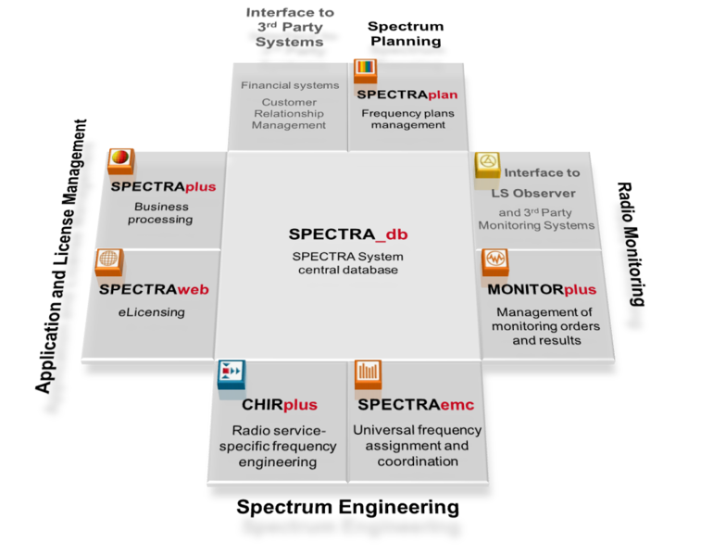
SPECTRA
  The SPECTRA system, developed by LS telcom AG, Germany, is comprehensive and advanced automated spectrum management systems covering the whole range of administrative and technical functionalities for all radio services.

Slide 46
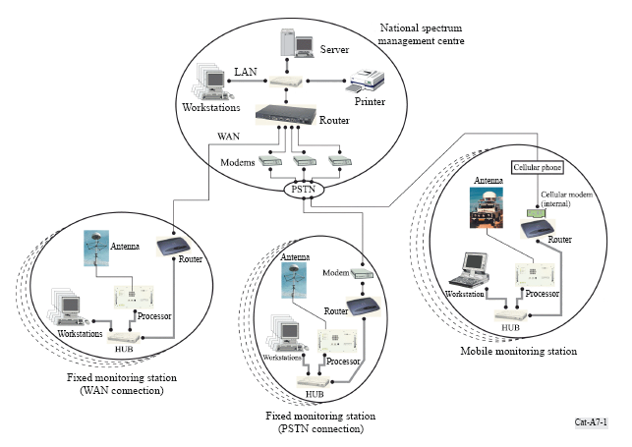
TCI ASMS solutions
TCI provides fully automated and integrated spectrum management and monitoring systems.
A complete system typically consists of a national spectrum management center, with its database server and workstations, and multiple fixed and mobile monitoring stations, each with a measurement server and one or more workstations.
TCI Integrated Management and Monitoring System

Slide 47
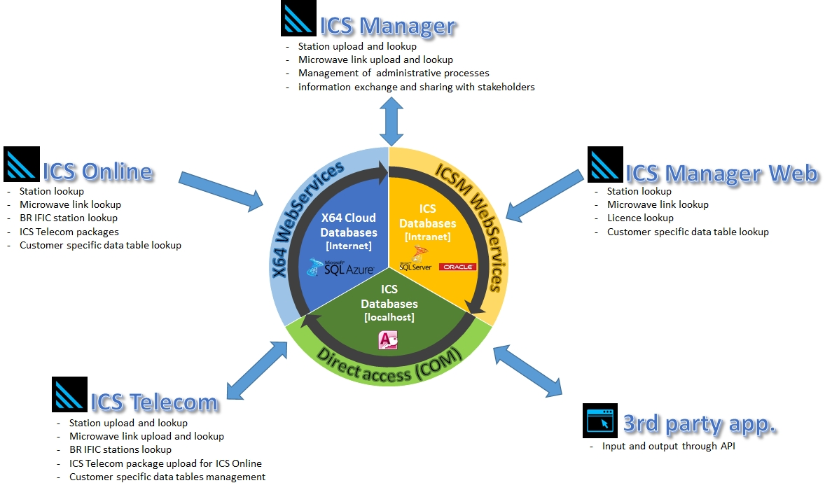
ATDI
ATDI has modular solutions covering various automated functions and services including
  ICS telecom for RF planning
  ICS manager Data basing functions
  HTZ warfare Spectrum engineering, radio network planning and communication electronic warfare
  Spectrum E: Spectrum Engineering Online

Slide 48
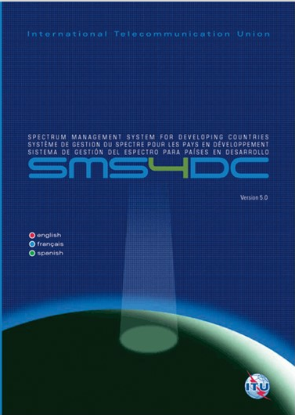
ITU Spectrum Management System for Developing Countries (SMS4DC)
SMS4DC is software designed by ITU based on ITU recommendations
Developed to assist the administrations of developing countries to undertake their spectrum management responsibilities more effectively;
SMS4DC covers terrestrial fixed, mobile, sound and television broadcasting services in the bands above 30 MHz, including GE-06 as well as frequency coordination of Earth stations

Slide 49
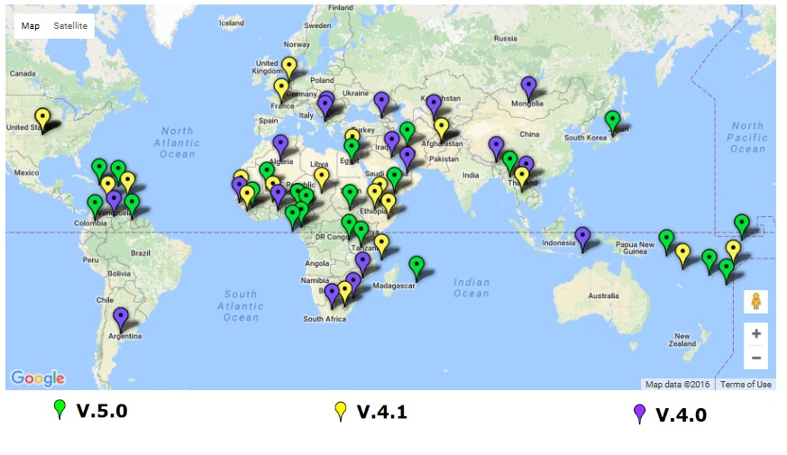
SMS4DC subscribers
  Until Dec 2016

Slide 50
For further reading:
ITU Handbook - Computer-Aided Techniques for Spectrum Management (CAT), 2015
ITU Handbook on National Spectrum Management, 2015
SMS4DC 5.0 User Guide
ITU Handbook on Spectrum Monitoring, 2011
Recommendation ITU-R SM 1370
Recommendation ITU-R SM 1537
Recommendation ITU-R SM.1604

Slide 51
“Committed to
connecting the WORLD”
I Thank U

Slide 52
Further Reading: Examples of NTFA

Slide 53
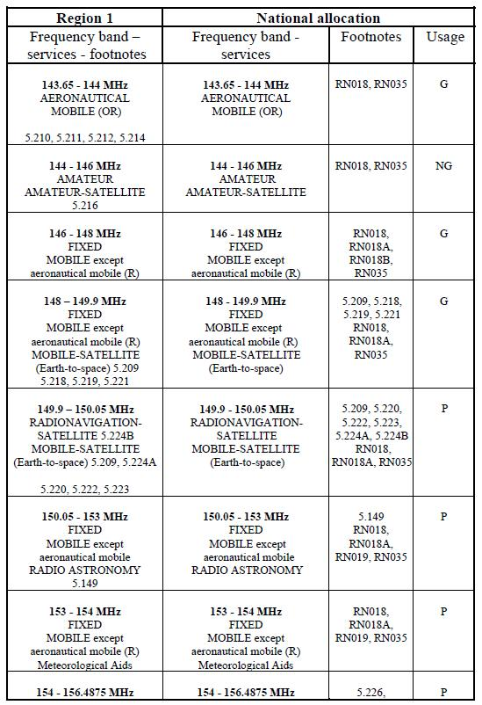
Example 1: Moldova
A simple table showing direct alignment with ITU and simple categorisation of usage (P=shared)

Slide 54
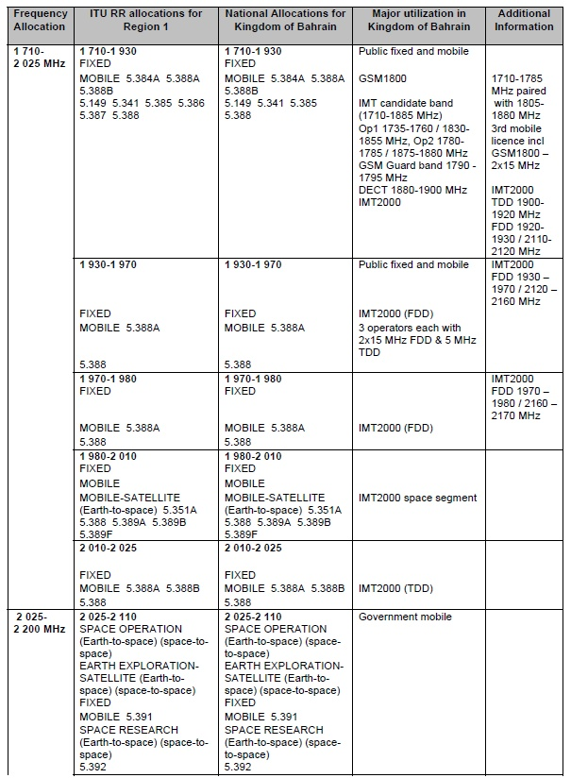
Example 2: Bahrain
Somewhat more comprehensive providing more details of utilisation and some additional information

Slide 55
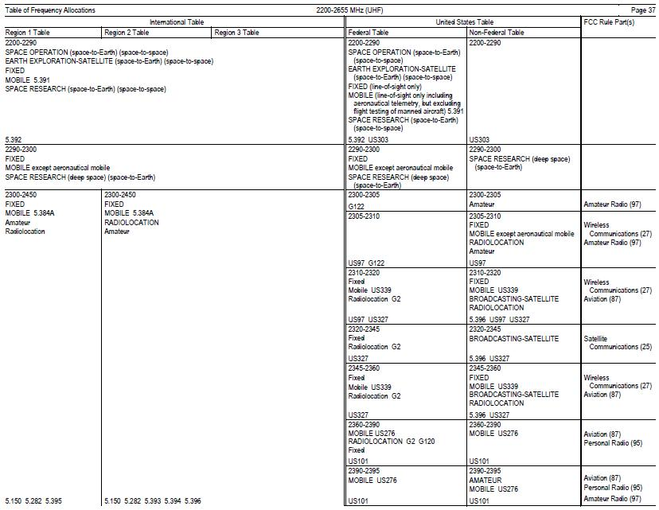
Example 3: USA
A slightly different arrangement split between Federal (Government) and non-Federal. Helpful identification of any FCC rules that apply to the band

Slide 56
Further Reading: Examples of NRA structures

Slide 57
The structure of the regulator - overview
The general objectives of spectrum management do not vary from country to country
  Spectrum management must serve the national interest, promote the country’s economic and social development and ensure safety of life
  Those objectives are not always spelled out explicitly in the national texts
The legal approaches to meeting those objectives tends to vary according to national factors such as the country’s geography, society, radiocommunication history and economic maturity – explored in more detail in the following slides
Generally speaking, spectrum management is the organization of frequency band allocations between users/services and the implementation of means to ensure respect for those allocations. In some countries, only one entity has that responsibility. In other countries, it may be shared
  A careful balance is needed in dividing spectrum between government and commercial purposes

Slide 58
Various legal frameworks
In some countries (France, Switzerland, etc.), the legislation regulating telecommunications network and services organizes spectrum management
In some other countries (United Kingdom, Japan, Australia, India, Korea, etc.), there is in addition a radiocommunications act that covers all aspects of radiocommunications and often precedes telecommunication legislation
The ITU-R Handbook on National Spectrum Management (2005) recommends the adoption of a radiocommunications act. The radio-frequency spectrum is a shared resource and its use must be legally framed, especially when market forces influence spectrum management
Spectrum management (planning) should be a prerequisite for licences/authorizations (regulation of the telecommunications and audiovisual markets)

Slide 59
Geography and politics (1)
A major factor influencing the legal approach to spectrum management is the country’s physical and human geography. The priorities and consequent investments and the management structure will vary depending on whether or not the country has neighbours (border coordination), is landlocked (the risk of radio link interference from ships at sea), covers a large or small area, has a high or low population density (saturation, organization of spectrum monitoring), is mountainous or covered in vegetation
The greater the level of radio usage then the more likely it will be that the spectrum management authority will require dialogue with neighbouring countries and the international radio community

Slide 60
Geography and politics (2)
A small country at the heart of Europe (e.g. Luxembourg) cannot have a spectrum policy that is independent of those of its neighbors. That is not the case of island countries (Australia, New Zealand) or countries covering a large area, whose border areas may be sparsely populated and have reduced economic activity and hence low frequency use
Independence can limit the potential benefits of economies of scale and the capacity for interoperability associated with regional or global harmonization of frequencies

Slide 61

Culture
Radiocommunications have not
developed at the same pace
everywhere
Spectrum management may
remain divided in few states between telecommunications and broadcasting for historical reasons
The way the society is organized can also influence the legal approach to the spectrum
  Federal systems tend to favour decentralized organization of spectrum management and lean towards flexibility and reactivity
  Centralized countries guarantee a public service and favour medium and long-term planning

Slide 62
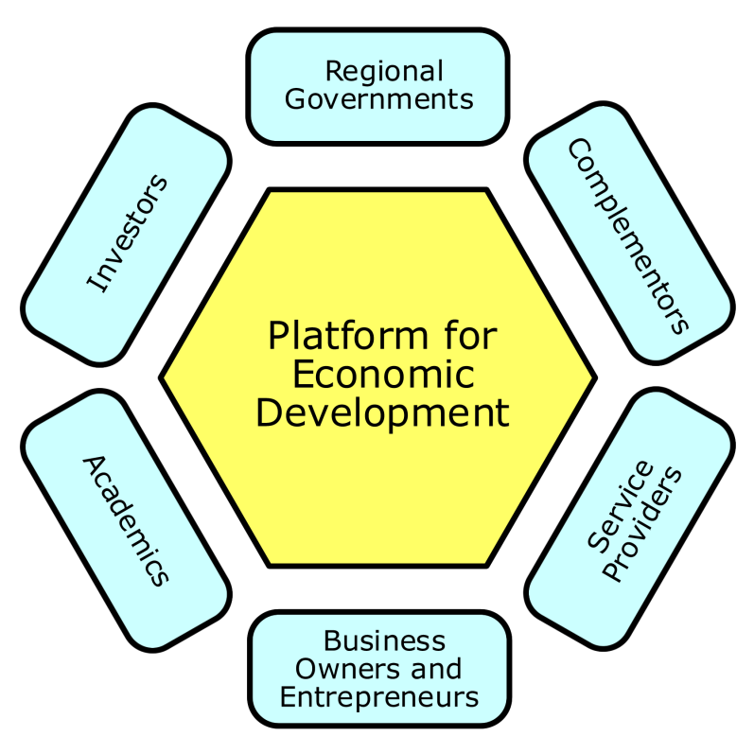
Level of economic development
Industrial, and in particular technological, development has an impact on the relative priorities to be taken into account in national spectrum management (future projects, standards to be disseminated, development of the national market and global expansion)
In less developed countries spectrum is not yet scarce. But the preparation of frequency plans, national tables and user conditions should be given priority, because of their importance over the long term to the development of radiocommunications

Slide 63

Best practices (1)
Establishing and maintaining a
national spectrum management
organization, either independent or
part of the telecommunication
regulatory authority responsible for managing the radio spectrum in the public interest
Promoting transparent, fair, economically efficient, and effective spectrum management policies, taking into due account the need to avoid harmful interference and the aim to maximize the contribution made to GDP from using spectrum
Making public national frequency allocation plans and frequency assignment data to encourage openness, and to facilitate development of new radio systems

Slide 64
Best practices (2)
Maintaining a stable decision-making process that permits consideration of the public interest in managing the radio frequency spectrum, i.e., providing legal certainty by having fair and transparent processes for granting licenses for the use of spectrum, using competitive mechanisms, when necessary
Providing in the national process, in special cases where adequately justified, for exceptions or waivers to spectrum management decisions
Having a process for reconsideration of spectrum management decisions
Minimizing unnecessary regulations

Slide 65
Best practices (3)
Encouraging radiocommunication policies that lead to flexible spectrum use, to the extent practicable, so as to allow for the evolution of services and technologies using clearly-defined methods
  (a) eliminating regulatory barriers and allocating frequencies in a manner to facilitate entry into the market of new competitors
  (b) encouraging efficiency in the use of spectrum by reducing or removing unnecessary restrictions on spectrum use, thereby encouraging competition and bringing benefits to consumers, and
  (c) promoting innovation and the introduction of new radio applications and technologies
Assuring open and fair competition in the marketplaces for equipment and services, and removing any barriers that arise to open and fair competition
Harmonizing, as far as practicable, effective domestic and international spectrum policies, including of radio-frequency use and, for space services, for any associated orbital position in the geostationary-satellite orbit or of any associated characteristics of satellites in other orbits

Slide 66
Best practices (4)
Working in collaboration with regional and other international colleagues to develop coordinated regulatory practices
Removing any regulatory barriers to free circulation and global roaming of mobile terminals and similar radiocommunication equipment
Using internationally recommended data formats and data elements for exchange of data and coordination purposes
Using “milestone” management steps and phases to monitor and control lengthy radiocommunication system implementation

Slide 67
Best practices (5)
Adopting decisions that are technologically neutral and which allow for evolution to new radio applications
Facilitating timely introduction of appropriate new applications and technology while protecting existing services from harmful interference including, when appropriate, the provision of a mechanism to allow compensation for systems that must redeploy for new spectrum needs
Considering effective policies to mitigate harm to users of existing services when reallocating spectrum
Where spectrum is scarce, promoting spectrum sharing using available techniques (frequency, temporal, spatial, modulation coding, processing, etc.), including using interference mitigation techniques and economic incentives, to the extent practicable

Slide 68
Best practices (6)
Using enforcement mechanisms, as appropriate, i.e., applying sanctions for non-compliance with obligations and for inefficient use of radio frequency spectrum under relevant appeal processes
Utilizing regional and international standards whenever possible, and where appropriate, reflecting them in national standards
Relying to the extent possible on industry standards including those that are included in ITU Recommendations, in lieu of national regulations

Slide 69

France (1)
In France, radio spectrum is considered as
the State public domain which cannot be sold. The Prime Minister formally allocates frequency bands to radiocommunication services, to be managed by government departments or agencies and independent authorities
Entities involved in national spectrum organization:
  The Prime Minister
  The Direction Générale de l’Industrie, des Technologies de l’Information et des Postes (DiGITIP) which answers to the Ministry for Economic, Financial and Industrial Affairs
  The Agence Nationale des Fréquences (ANFR), a public administrative body
  The administrations and authorities to which frequencies have been allocated, i.e. the governmental authorities utilizing frequencies and two independent authorities, the telecommunications regulatory authority – Autorité de Régulation des Télécommunications (ART) and the broadcasting authority – Conseil Supérieur de l’Audiovisuel (CSA)

Slide 70
France (2) – Tasks and Prerogatives
The Prime Minister approves the FAT submitted by ANFR
DiGITIP prepares the government’s positions on postal and telecommunication matters
ANFR plans, manages and monitors the utilization of frequencies in the public domain. It draws up the FAT and defines and coordinates the action of representatives in international negotiations on frequencies. It also coordinates the establishment on the national territory of radio stations
The administrations and authorities to which frequencies have been allocated manage the frequencies allocated to them, in part or in whole, under the national frequency allocation table. They are full members of the ANFR Board of Directors
ART acts as the regulator for the telecommunication sector. It applies legal, economic and technical provisions
CSA manages broadcasting frequencies. It issues broadcasting licences, is the regulatory authority for terrestrial and satellite broadcasting, for cable, and for program contents

Slide 71

New Zealand (1)
Entities involved in national spectrum
organization:
  The Minister of Communications
  The Ministry of Economic Development. Policy development and spectrum planning are undertaken in the Resources and Networks Branch, with Licensing, Compliance and Registry functions being undertaken in the Radio Spectrum Management Group of the Business Services Branch
Their tasks and prerogatives are as follows:
  The Minister provides formal notices of Government policy and any associated directions in regard to granting licenses
  The Resources and Networks Branch develop policy advice and recommendations for Government and undertakes international and national planning activities associated with spectrum utilization and auction allocations
The Radio Spectrum Management Group of the Business Services Branch undertakes licensing of users and compliance activity. The Branch also maintains a public register of radio-frequency licenses issued

Slide 72
New Zealand (2) – Legislative framework
The 1989 Radiocommunications Act provides the overall regime for spectrum management in New Zealand
Spectrum is managed in one of two distinct frameworks, either an administrative framework or a property rights framework
  The administrative framework (termed radio licenses) is operated solely by the Ministry and typically has annual licenses which are renewed on payment of an administrative fee
  The property rights framework allows for a management right to be created over a specific frequency range, which can be either held by the Ministry or allocated commercially to private interests
The holder of the management right can issue licenses as they deem appropriate. Management rights and spectrum licenses have legal certainty, are fully tradable, and are established for periods of up to 20 years
When spectrum is managed by the Ministry, licenses are typically allocated by auction.
The Act is accompanied by the Radiocommunications Regulations, which details the administrative framework, provides for control of non-radio “interfering equipment” and sets the fees payable to the government

Slide 73
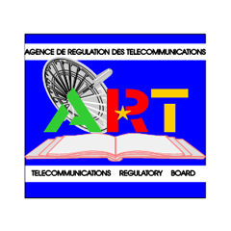
Cameroon (1)
Entities involved in national spectrum
organization:
  The Ministry of Posts and Telecommunications
  The Inter-Ministerial Frequency Band Allocation
  Board (Organe Interministériel d’Attribution des
  Bandes de Fréquences) (to be set up) under the supervisory authority of the Ministry of Posts and Telecommunications
  The Telecommunication Regulatory Board (TRB) (or Agence de Régulation des Télécommunications (ART)), a public corporation with independent legal status and financial and decision-making autonomy
  The Ministry of Communications (MINCOM)

Slide 74
Cameroon (2)
Their tasks and prerogatives are as follows:
The Ministry in charge of Telecommunications is responsible for defining policy and drafting sector rules at the level of legislation
The IFMB will be charged with assigning segments of the radiocommunications frequency band to the various assignees in accordance with the provisions of Article 5 of Radio Regulation and with specific national needs; it can also prescribe any technical provisions required to iron out any interference between different services
The TRB manages the frequencies allocated to the telecommunications sector including assignment and control
The Ministry of Communications follows up the planning of radio frequencies allocated to the various public and private radio and television broadcasting stations; it is responsible for issuing operator’s licences to audiovisual sector operators stating the technical conditions for network use and contribution to the frequency management costs: in liaison with the technical services in charge of telecommunications, it carries out compliance monitoring operations on equipment

Slide 75
Cameroon (3)
Legislative and regulatory framework:
The Federal Law 67/LF/20 of 12 June 1967 regulating private radio electricity and fixing the charges corresponding thereto
The Law No. 98/14 of 14 July 1998 which created the TRB and the IFMB, and its implementing instruments signed by the Head of State and the Decree N°98/197 of 8 September 1998) on the organization and functioning of the TRB
The decrees on the rules governing the authorization to operate telecommunications networks (Decree N°2001/830/PM of 19 September 2001) and on the rules governing the granting of authorizations to provide telecommunications services (Decree N°2001/831/PM of 19 September 2001)
The Law No. 90/52 of 19 December on the freedom of social communication and the Decree N°96/260 of 19 October 1996 and Decree N°2000/158 of 3 April 2000 which all define the powers of the Ministry of Communication with regard to spectrum management

Slide 76

Brazil (1)
The National Telecommunications
Agency (Anatel) acts as the regulator
for the telecommunication sector,
concerning the legal, economic and
technical aspects to ensure the continuity and expansion of telecommunication services throughout the country
Anatel’s tasks and prerogatives are as follows:
  Management of the spectrum (including the organization of the national allocation table) and the station license issues (granting, modification, prescription, renewals, etc.)
  Management of the military spectrum in coordination with the Ministry of Defense
  Definition of spectrum for safety and security
  Working out, implementation and enforcement of rules and regulation related to the telecommunication services
  Inspection and monitoring of radio stations
  Solving problems of interference in national and international basis (border cases)
  Granting telecommunication service authorization, except for broadcasting service
  Granting technical certification of telecommunication equipment
  Working out, implementation and enforcement of broadcasting technical regulations and inspection of broadcasting radio stations
  Representation of the Brazilian Administration in international organizations

Slide 77

China (1)
The Ministry of Information Industry (MII) is the national authority in charge of spectrum management in China. Under the direct supervision of provincial governments and professional guidance of MII, radio regulatory agencies at provincial level are responsible for spectrum management within their respective jurisdictions. Radio Regulatory Department (RRD) of MII takes the responsibility of routine management of national spectrum

Slide 78
China (2)
Duties of RRD
  To formulate the principles, policies and administrative regulations for spectrum management
  To establish rules and common standards for spectrum management
  To plan radio-frequency spectrum and exploit radio-frequency resource rationally
  To be responsible for the assignment and regulation of the radio-frequency resources
  To be responsible for management of radio stations
  To be responsible for radio monitoring
  To coordinate affairs concerning the radio interferences and maintain the order of radiocommunications
  To execute the radiocommunication traffic control
  To be responsible for satellite coordination
  To attend various international conferences and take charge of foreign-related matters for radio management under authorization

Slide 79
China (3)
Duties of radio regulatory agencies at provincial level
  To implement the principles, policies, regulations and rules for spectrum management
  To formulate specific rules and regulations applicable to that area concerned
  To examine, under their respective authority of examination and approval, the sites of the radio stations to be built and their distribution as a whole, assign frequencies and call signs, and issue licenses to radio stations
  To undertake radio monitoring within their respective jurisdiction

Slide 80
China (4) – Legislative framework
The Radio Regulations of the People’s Republic of China, which were issued by the State Council in 1993, is the main legal guidance for spectrum management in China. The main contents of these Regulations include:
  Major principles of radio management in China such as unified leadership and planning with managerial work divided among radio regulatory agencies of different levels with responsibilities delegated to them; the radio-frequency spectrum owned by the state and the central government planning its use in a centralized manner, exploiting it rationally, managing it scientifically and providing frequencies on a chargeable basis
  Responsibilities of radio regulatory agencies at different levels
  Requirements for operating radio stations and procedures on how to apply for station licenses
  Duties and procedures for regulatory agencies on how to allocate radio frequency and how to reduce frequency interference
  Frequency requirements, band requirements and other technical requirements for development, manufacture, sale and importation of radio transmission equipments
  Duties and procedures for radio regulatory agencies in radio monitoring and supervision
  Categories of illegal actions involved with spectrum use consequent punishments

Slide 81
Summary
Each country must have a NRA who’s function as a minimum is to manage the radio spectrum
Key aspects of this include developing a FAT, managing assignments and dealing with interference
Many NRAs do much more with varying priorities depending on the national situation
A key attribute of an NRA is transparency – without this it is difficult for stakeholders to make investments
A list of best practices is provided by the ITU as a useful checklist

Slide 82
Further Reading: ITU tools for SM

Slide 83
ITU tools
The ITU makes available a wide range of tools in the following categories:
  Space Services Software
  Terrestrial Services Software
  SG3 Databanks
  Global Administration Data System (GLAD)
  Maritime Mobile Access and Retrieval System (MARS)
  SMS4DC
These are available for download from the ITU website either for free or at a relatively low cost
We look briefly at some of the major tools in the following slides

Slide 84
Space (1)
AP7Capture - Capture system for AP7 Input parameters
  Software package which allows the capture and modification of data that is relevant to the AP7 Analysis
Electronic submission of graphical Data
  Description of the format for electronic submission of graphical data related to satellite networks
GIBC - Graphical Interface for Batch Calculations
  Software package which provides the user with the ability to carry out calculations on satellite networks which allow determining the coordination requirements
GIMS - Graphical Interference Management
  Software package which allows the capture and modification of graphical data relating to the electronic notification of satellite networks
SAM - Space Applications Manager
  This software provides the user with a unique tool to easily run all installed BR Space Applications software from a global, menu-driven list, rather than searching for and starting applications individually

Slide 85
Space (2)
SNL – Space Network List
  Planned or existing space stations and earth stations giving information on the use of the frequency spectrum, and orbits
SNS – Space Network Systems
  Online data-retrieval system containing AP4 data of almost 10500 GSO filings, 1100 non-GSO filings and 8000 earth station filings
SpaceCap – Space data capture
  Data capture software for electronic notification of satellite networks and earth stations in the space radiocommunications services
SpaceCom - Capture system for comments on Special Sections
  Stand-alone application designed to assist administrations and the Bureau in the management of the comments
SpacePub – Space Publication
  Software for printing satellite networks / Earth stations from SRS database
SpaceQry – Space Query and Extract System
  Software package which provides access to the Radiocommunication Bureau's Space Radiocommunication Stations database

Slide 86
Space (3)
SpaceRefdb – Space Reference Tables
  Software to install an up-to-date copy of the BR Reference tables
SpaceVal – Space Filings Validation Software
  Software for validating electronic notices captured by the BR SpaceCap software - provides interactive validation facility in SpaceCap
SPS – Space Plans System (MSPACEg)
  The SPS computer system has been developed to allow determination of the coordination requirements for the Plans for space networks in Appendices 30 and 30A of the Radio Regulations
SRSConvert – Database Conversion Utility
  Utility which allows the user to convert the data contained in an existing SRS-formatted database from a version 5 database into a version 6 database
SRSFixDB – Fix Electronic Notification Database Utility
  Utility that was created to correct certain information in electronic notification databases that were sent to the BR

Slide 87
Terrestrial
Propagation and compatibility calculations for HF broadcasting
  HFBCANT - Calculations of HF antenna patterns
  HFBCREQ - Preparation of electronic file for submission
  HFBCVAL - Validation of electronic file of HF requirements
  eNotices - Preparation of electronic notices for broadcasting services
  GE84PLN - Interference calculations and frequency search for VHF-FM services in relation to the GE84 Agreement
  GE06Calc - Coordination and conformity calculations in relation to the GE06 Agreement
Web-based software eBCD - A portal for broadcasting services
  eQry - Broadcasting data
  ePub - Special Sections and MIFR broadcasting publications
  eTools - Broadcasting planning tools on the web
  MyAdmin - Portal for individual Administration providing information on broadcasting assignments and results of requested studies
  SRTM3 - calculations of antenna effective height using data from publicly available SRTM3 digital terrain model

