Slide 1
The Big Data Platform of Universal Service for Targeted Poverty Alleviation
Meimei Dang
CAICT, China
08/2019

Slide 2
1
Background
2
Technical infrastructure of the big data platform
CONTENTS
3
Big data platform shows progress of universal service
2

Slide 3
1. Background

Slide 4
2. Technical infrastructure of the big data platform

Slide 5
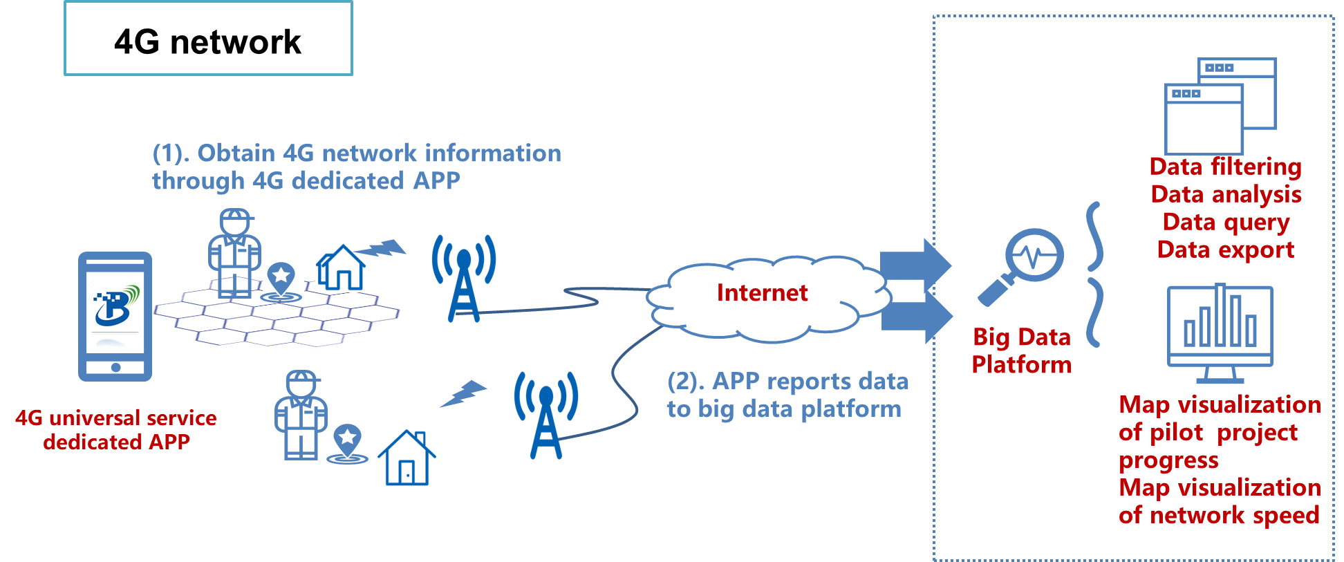
2. Technical infrastructure of the big data platform

Slide 6
3.1 Progress of China broadband universal service

Slide 7
3.2 Achievement of China broadband universal service
The first three batches of pilot projects:
cover 326 cities in 27 provinces
130,000 administrative villages are connected to fiber network, including 43,000 impoverished villages.

Slide 8
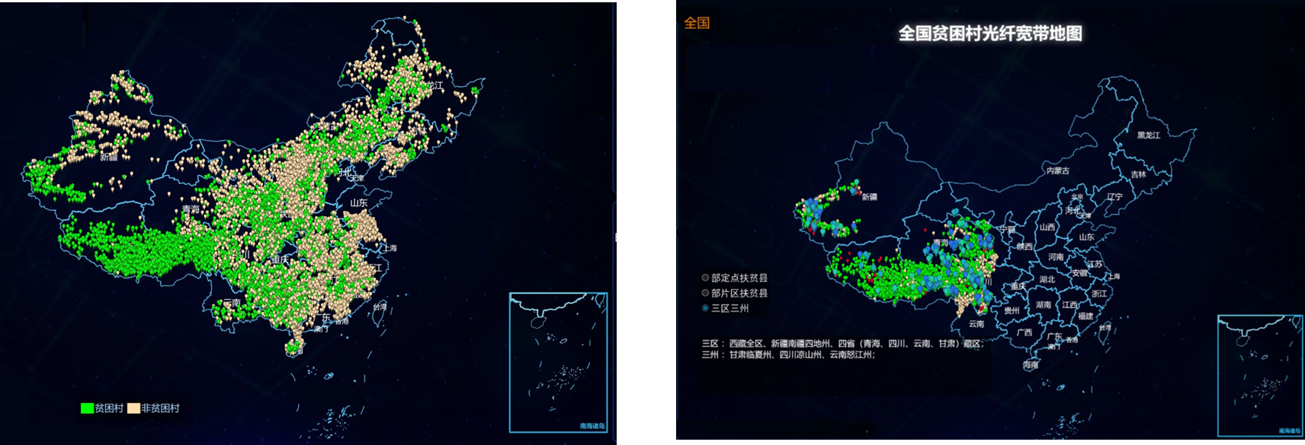
3.3 Rural Broadband network capacity has increased dramatically
Since the implementation of the pilot project, 98.8% impoverished villages are covered with fiber optic broadband network, increased from less than 70%.
In severely impoverished areas, 98% impoverished villages have access to broadband network, increased by 70 percentage point.
8

Slide 9
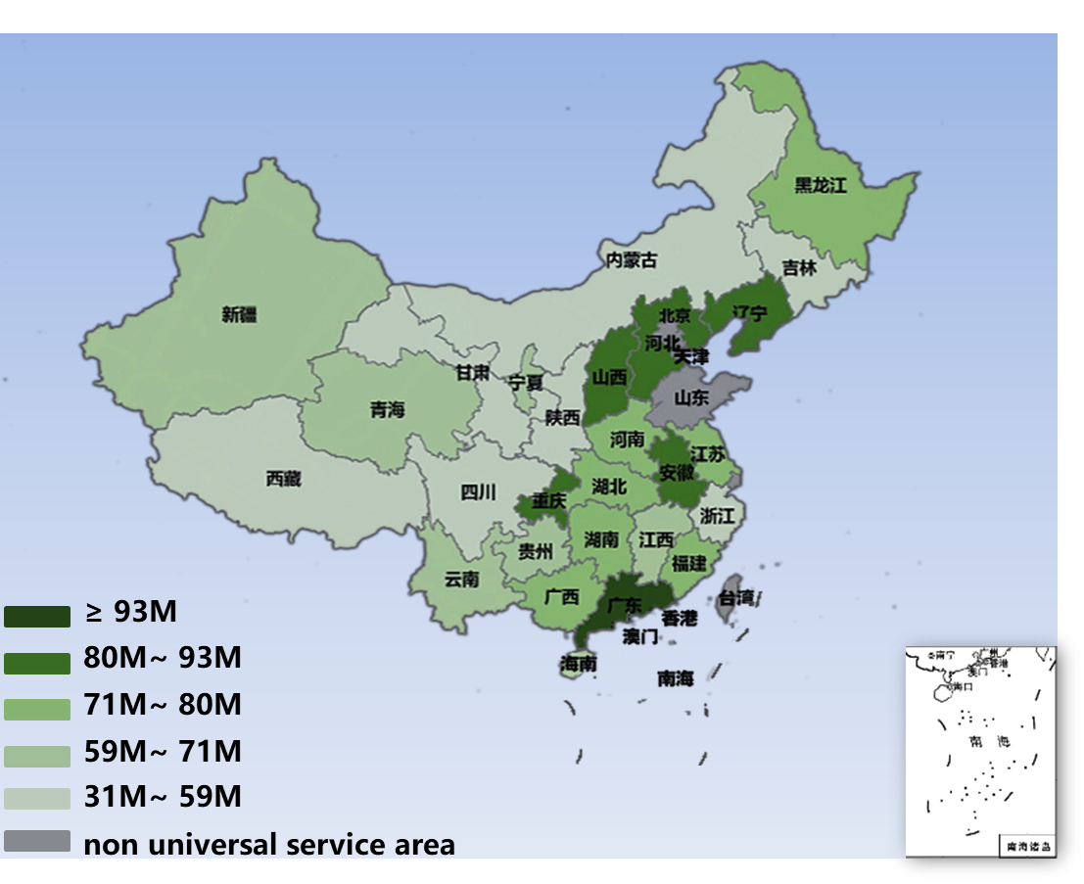
3.4 Network speed of universal service supported rural areas
The average broadband network speed of the administrative villages has exceeded
70
Mbps

Slide 10
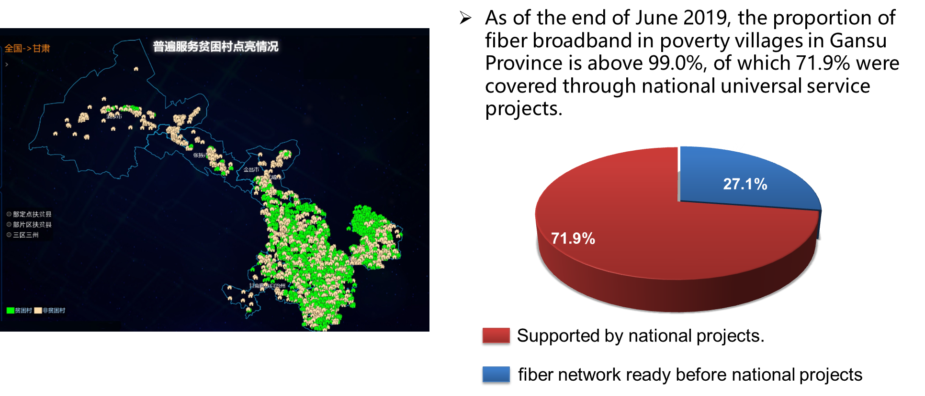
3.5 Achievement of universal service in Gansu Province

Slide 11
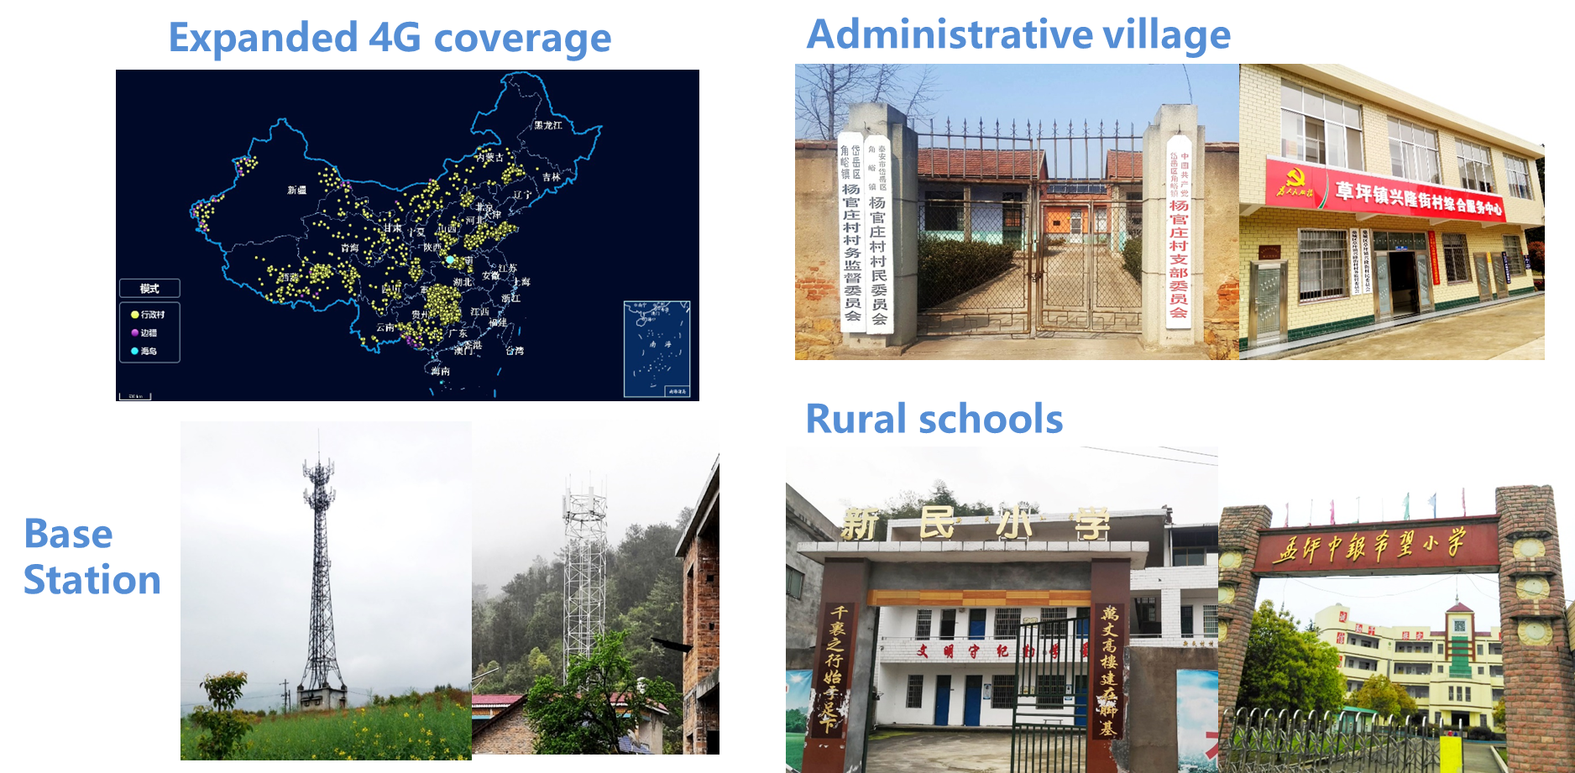
3.6 Expanded 4G network coverage in rural areas

Slide 12
Summary

Slide 13
THANK YOU FOR YOUR LISTENING!

