Slide 1
Improve the Level of Information Facilities
Boost Rural Affluence of People and Revitalization of Industries
Su Shaolin, Guangdong Communications Administration

Slide 2
Contents
Focus on development differences, and strengthen the sense of accountability
Deepen the construction, and improve the level of information facilities
Stick to application orientation, and boost rural affluence of people and revitalization of industries

Slide 3
1.1 Overview of Guangdong Province
Guangdong Province is abbreviated as Yue in Chinese, and its capital city is Guangzhou. It is located on the south of Nanling Mountains and the coast of South China Sea, adjacent to Hong Kong and Macao.
By regional location, it is divided into Pearl River Delta, East Guangdong, West Guangdong and North Guangdong, with 21 prefecture-level cities, 119 county-level administrative areas, 19,000 administrative villages, and 142,000 natural villages with more than 20 households.
As the most populated province in China, as well as a key inheriting region of Lingnan culture, Guangdong Province has unique styles in language, customs, history and culture.
It has joined hands with Hong Kong and Macao to build the Guangdong-Hong Kong-Macao Greater Bay Area, aiming to become one of the world's four largest bay areas together with the New York, San Francisco and Tokyo Bay Areas.
Map of China
Map of Guangdong
Notes:
广东省根据区位划分为珠三角、粤东、粤西和粤北四个区域，下辖21个地级市（其中副省级城市2个），119个县级行政区（60个市辖区、20个县级市、36个县、3个自治县），1.9万个行政村，14.2万个20户以上自然村。
“两步走”工作方针
第一步：着重解决行政村通光纤工作，建立行政村信息基础设施示范桥头堡；
第二步：以行政村为中心点，着重解决20户以上自然村光纤宽带通达。

Slide 4
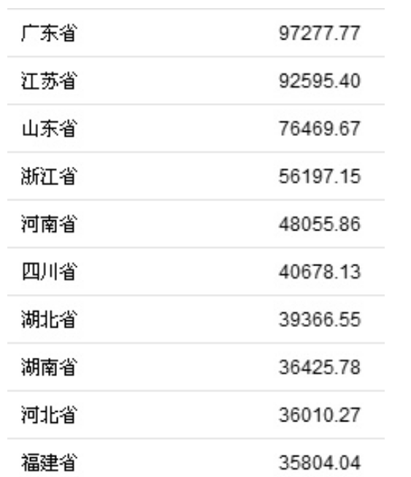
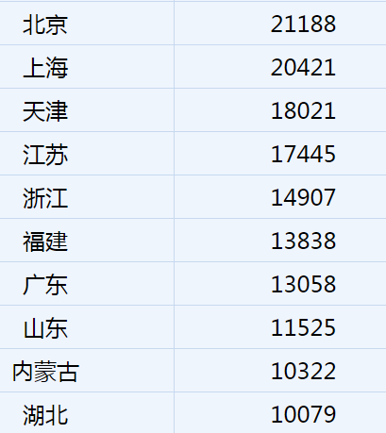
1.2 Regional development is not balanced
Rankings of GDP by province and per capita in 2018 (top 10)
Guangdong's GDP totaled 9.73 trillion yuan in 2018, retaining No. 1 in the country for 30 successive years; per capita GDP was 87,000 yuan, ranking No. 7 in the country.
Guangdong
Beijing
Jiangsu
Shanghai
Shandong
Tianjin
Jiangsu
Zhejiang
Henan
Zhejiang
Fujian
Sichuan
Hubei
Guangdong
Hunan
Shandong
Hebei
Inner Mongolia
Fujian
Hubei
Notes:
广东省根据区位划分为珠三角、粤东、粤西和粤北四个区域，下辖21个地级市（其中副省级城市2个），119个县级行政区（60个市辖区、20个县级市、36个县、3个自治县），1.9万个行政村，14.2万个20户以上自然村。
“两步走”工作方针
第一步：着重解决行政村通光纤工作，建立行政村信息基础设施示范桥头堡；
第二步：以行政村为中心点，着重解决20户以上自然村光纤宽带通达。

Slide 5
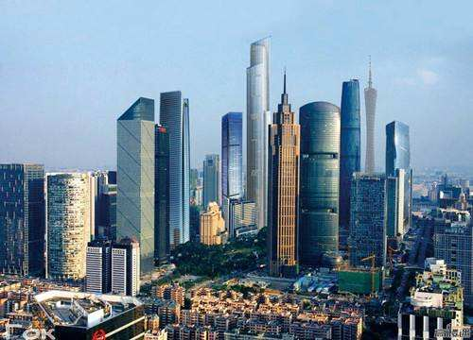
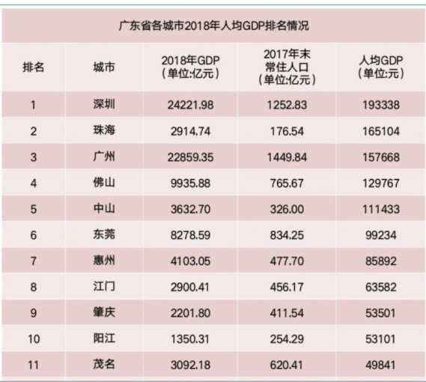
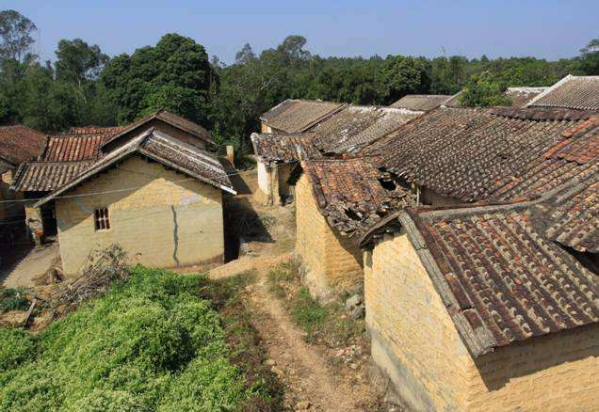
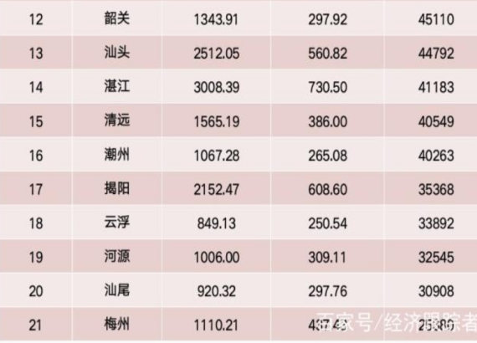
1.2 Regional development is not balanced
Per capita GDP in prefecture-level cities in 2018
The economy in regions such as Guangzhou, Shenzhen, Foshan and Dongguan is relatively advanced, but per capita GDP in 14 cities, including Jiangmen, is lower than the national average level (64,520 yuan), while that in Yunfu, Heyuan, Shanwei and Meizhou is only half of the national average level.
Guangzhou CBD
Poverty-stricken villages in
North Guangdong
Notes:
广东省根据区位划分为珠三角、粤东、粤西和粤北四个区域，下辖21个地级市（其中副省级城市2个），119个县级行政区（60个市辖区、20个县级市、36个县、3个自治县），1.9万个行政村，14.2万个20户以上自然村。
“两步走”工作方针
第一步：着重解决行政村通光纤工作，建立行政村信息基础设施示范桥头堡；
第二步：以行政村为中心点，着重解决20户以上自然村光纤宽带通达。

Slide 6
1.3 Information and communications development is not balanced and sufficient
As a large province in communications and network, Guangdong Province accounts for 1/10 of the national network capacity, carries 1/9 of the national telecom users, and creates 1/8 of the national telecom business revenue.
In 2018, the business volume of telecom services reached 779 billion in Guangdong province, with a year-on-year increase of 117.5%, accounting for around 20% of the national total amount; revenue of telecom service was 171.62 billion yuan, up 4.4% from a year earlier, accounting for 13% of the national amount; the number of value-added telecom enterprises above a certain size (revenue reaches over 3 million yuan) increased to 1,095, who achieved telecom business revenue of 290.46 billion, up 26.55/ year on year.
Large but not excellent, and large but not powerful. The information and communication development is not balanced between regions, between urban and rural areas, and between the spaces of a city. Particularly in remote mountainous regions of the northwest of East Guangdong, high costs, low returns and high difficulty have become the major problems of information infrastructure construction.
Notes:
广东省根据区位划分为珠三角、粤东、粤西和粤北四个区域，下辖21个地级市（其中副省级城市2个），119个县级行政区（60个市辖区、20个县级市、36个县、3个自治县），1.9万个行政村，14.2万个20户以上自然村。
“两步走”工作方针
第一步：着重解决行政村通光纤工作，建立行政村信息基础设施示范桥头堡；
第二步：以行政村为中心点，着重解决20户以上自然村光纤宽带通达。

Slide 7
1.3 Information and communications development is not balanced and sufficient
Development is balanced between urban and rural areas
Development is balanced between regions
Development is balanced between spaces of a city
Nine cities in the Pearl River Delta account for 70% in the province in terms of telecom business revenue, 4G mobile users, fixed broadband access users, fiber access users and mobile communications base stations, while the other 12 cities represent around 30%.
Till 2018, there are still three national poverty-stricken counties, 13 provincial counties in special poverty, 12 poverty-stricken counties in mountainous areas and 2,277 relatively poor villages centralized in remote areas, which has restricted the information and communications development. The fiber rates are slow, and the depth of coverage is insufficient in administrative villages.
The broadband access in urban villages in big cities such as Guangzhou and Shenzhen has a chaotic order and poor quality, and the prominent problem of copycat broadband has restricted the improvement of urban information technology levels.
Notes:
广东省根据区位划分为珠三角、粤东、粤西和粤北四个区域，下辖21个地级市（其中副省级城市2个），119个县级行政区（60个市辖区、20个县级市、36个县、3个自治县），1.9万个行政村，14.2万个20户以上自然村。
“两步走”工作方针
第一步：着重解决行政村通光纤工作，建立行政村信息基础设施示范桥头堡；
第二步：以行政村为中心点，着重解决20户以上自然村光纤宽带通达。

Slide 8
1.4 Sense of responsibility facilitates balanced development
Under the guidance and support of MIIT and Guangdong Province, the provincial information and communications industry has strengthened its sense of responsibility, actively assumed responsibility and acted, consolidated the advantages, and made up for the shortcomings, so as to boost the balanced development of information and communications.
Development is balanced between regions
Issued the Three-Year Action Plan for Information Infrastructure Construction in Guangdong Province (2018-2020)
Development is balanced between urban and rural areas
To build cities with access to Gbps-level fiber network Before the end of 2020, the access rate of users living in residential buildings covered with fiber network will be generally lifted to over 100M of fiber broadband, while 3,000 1000M fiber network demonstration communities are expected to be built across the province, so as to basically achieve the goal of “bringing 1000M fiber broadband to communities and 100M fiber broadband to households”.
100M fiber broadband will reach the countryside. Guangdong will focus on 2,277 provincial poverty-stricken villages, and gradually push forward fiber broadband connections of natural villages with more than 20 households. To guide telecom operators to cut the charges of rural users. Before the end of 2020, the access rate of rural fiber broadband users will generally rise to over 100M.
To boost in-depth coverage of 4G network. Before the end of 2020, 4G network will be fully and successively covered in urban and rural areas across the province, and fully covered in administrative villages.
To develop the new generation of mobile communications network, and promote the coverage of mobile IoT.

Slide 9
1.4 Sense of responsibility facilitates balanced development
Deeply pushed forward the crackdown on illegal
access to copycat broadband
Development is balanced between spaces of a city
Guangdong Province has launched a special campaign on crack down on copycat broadband, and established a long-term mechanism on the campaign. By the end of 2018, a total of 18 cities have investigated 2,149 suspicious dens of illegal broadband, and 20 cities have offered 662 clues, and recognized 227 clues, with 246,000 households estimated to be involved in illegal broadband; 16 cities have cracked down on 656 illegal broadband dens, and three basic enterprises and other broadband access providers have taken over 110,000 households.
By the first quarter of 2019, the fiber broadband coverage has reached 100% in administrative villages across the province and 91.1% in natural villages with more than 20 households; the 4G network coverage has reached 100% in administrative villages across the province and 98.5% in natural villages with more than 20 households.
Guangdong Province has gradually addressed the three imbalance issues through the coverage of fiber broadband, wireless broadband and mobile IoT.

Slide 10
Contents
Focus on development differences, and strengthen the sense of accountability
Deepen the construction, and improve the level of information facilities
Stick to application orientation, and boost rural affluence of people and revitalization of industries

Slide 11
2.1 Complete universal service pilot projects in advance
In combination with the actual situation, through fiber broadband upgrading and transformation, Guangdong province has steadily improved fiber access levels of administrative villages and natural villages.
Fiber broadband upgrades in administrative villages
Universal telecommunication service
Usefulness
Affordablity
Satisfaction
Natural villages with more than 20 households get access to fiber broadband
Rural network lifts speed and cut fees
Notes:
广东省根据区位划分为珠三角、粤东、粤西和粤北四个区域，下辖21个地级市（其中副省级城市2个），119个县级行政区（60个市辖区、20个县级市、36个县、3个自治县），1.9万个行政村，14.2万个20户以上自然村。
“两步走”工作方针
第一步：着重解决行政村通光纤工作，建立行政村信息基础设施示范桥头堡；
第二步：以行政村为中心点，着重解决20户以上自然村光纤宽带通达。

Slide 12
2.1 Complete universal service pilot projects in advance
Since 2016, Guangdong has completed three batches of universal telecommunication service pilot projects in advance, and put more emphasis on improving the information infrastructure level in remote mountainous areas in the northwest of East Guangdong. The central fiscal support has totaled 28.25 million yuan, and enterprises have invested 490 million yuan. Those pilot projects have benefited 2444 administrative villages in 9 cities, covering 119.6 million rural households, with the number of fiber broadband users increasing by 267,000 households.
Average bandwidth in pilot administrative villages
exceeds 100M
2018.11
Completed the third batch of pilot projects covering 1,041 administrative villages
2017.06
Completed the second batch of pilot projects covering 667 administrative villages
2017.05
Completed the first batch of pilot projects covering 736 administrative villages

Slide 13
2.2 Further advance fiber broadband access in natural villages with more than 20 households
On the basis of the coverage of three batches of universal telecommunication service pilot projects in administrative villages, Guangdong will put more emphasis on pushing forward the fiber broadband coverage in natural villages with more than 20 households.
With an investment of 250 million yuan from provincial finance as well as 1 billion yuan from enterprises, the province plans to give subsidies of 20,000 yuan to each natural village, and achieve fiber broadband connections in natural villages with more than over 20 households. Among the investment:
In 2019, the provincial finance will subsidize 130 million yuan, while enterprises will invest 510 million yuan;
In 2020, the provincial finance will subsidize 120 million yuan, while enterprises will invest 490 million yuan.
Basic telecom enterprises have signed the Responsibility Agreement on the Construction of Information Infrastructure to implement the construction responsibility.

Slide 14
2.2 Further advance fiber broadband access in natural villages with more than 20 households
By the end of 2018, the number of natural villages with more than 20 households covered with fiber broadband has reached 128,000, with the fiber broadband access rate of 90.1%.
In 2019, the figure is expected to increase by more than 5,000, with the fiber broadband coverage of over 94.1%.
Access rate of fiber broadband reaches 90.1% in natural villages
128,000 villages covered by fiber broadband
14,000 villages not covered
4G network coverage reaches 98.5%
Not covered by fiber broadband
Covered by fiber broadband
By the end of 2018

Slide 15
2.3 Network speed lift and fees cut boosts rural broadband network
While addressing the usefulness of rural broadband network, Guangdong Province is also lowering network charges, and solving the affordability problem.
Measure 1: Universal fees reduction Universally cut fees in pilot areas, with the charges of 100M fiber broadband basically maintaining at 10 yuan/month.

Slide 16
2.4 Network speed lift and fees cut boosts rural broadband network
Measure 2: Targeted fees reduction Give the biggest discount on basic communications service fees of archived poverty-stricken households, which is expected to benefit 100,000 households at the end of 2019.
By the end of December 2018, the comprehensive charge of telecom business was 52% lower than that of the previous year. The drop is even larger in rural areas, and villages in universal service pilot areas can save broadband connection fees of more than 600 yuan each year.

Slide 17
Contents
Focus on development differences, and strengthen the sense of accountability
Deepen the construction, and improve the level of information facilities
Stick to application orientation, and boost rural affluence of people and revitalization of industries

Slide 18
“Combine construction with application, and promote construction through application.” Guangdong province has successively launched a batch of desired, easy-to-use, superior and acceptable services and applications for farmers, and on the basis of usefulness and affordability, ensured their satisfaction with rural broadband network, so as to provide more impetus for rural economic development.

Slide 19
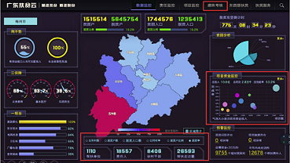
3.1 Serve the government’s targeted poverty alleviation with network technology
Poverty alleviation big data and cloud platforms in Guangdong
China Mobile Guangdong Branch has exerted its advantages in information technology to build a visualized, multi-layer and precisely managed big data cloud platform for poverty alleviation in Guangdong Province. Gathering data of 40 industries such as education, disabled federation and medical care, the platform is designed to provide targeted poverty alleviation information services with more than 1.6 million poverty-stricken households across the province. It is available for leaders at provincial and municipal levels, poverty relief units, 40,000 cadres stationed at villages and 320,000 assistance persons-in-charge.
One goal
Targeted poverty alleviation
Multi-dimensional realization
Four-dimensional management
Precision management
Precision recognition
Precision poverty alleviation
Procession assistance
Multi-functional support
Six-layer management and control
Poverty alleviation big data and cloud platforms
APP
Cloud computing and
big data technology
Big data on poverty alleviation
Big data on industries
Big data on communications
Big data on business

Slide 20
3.1 Serve the government’s targeted poverty alleviation with network technology
Poverty alleviation big data cloud platforms in Guangdong
Provincial and municipal leaders
Counterparts at municipal and county levels
Plan and control the overall situation of the poverty alleviation work, and decide and command the implementation and deployment of various tasks.
Monitor and control the progress of poverty alleviation, implement various provincial and municipal poverty alleviation tasks, and execute projects.
Poor objects
Grassroots poverty alleviation cadres
Assistance persons-in-charge
Social groups
Develop featured agriculture, and obtain poverty alleviation services through poverty relief e-commerce platforms and preferential policies.
Poverty alleviation teams can learn about the cause of poverty and the needs of poverty relief through platforms, and give assistance so as to achieve poverty alleviation targets.
Understand the poverty alleviation course and situation of assistance objects through the supervision over various assistance projects and capital implementation on the platform.
Purchase featured agricultural products through poverty alleviation e-commerce platforms, and support network-based poverty alleviation
Lingnan Life APP
Smart Poverty Alleviation APP
Big data platform
Cloud video conference platform

Slide 21
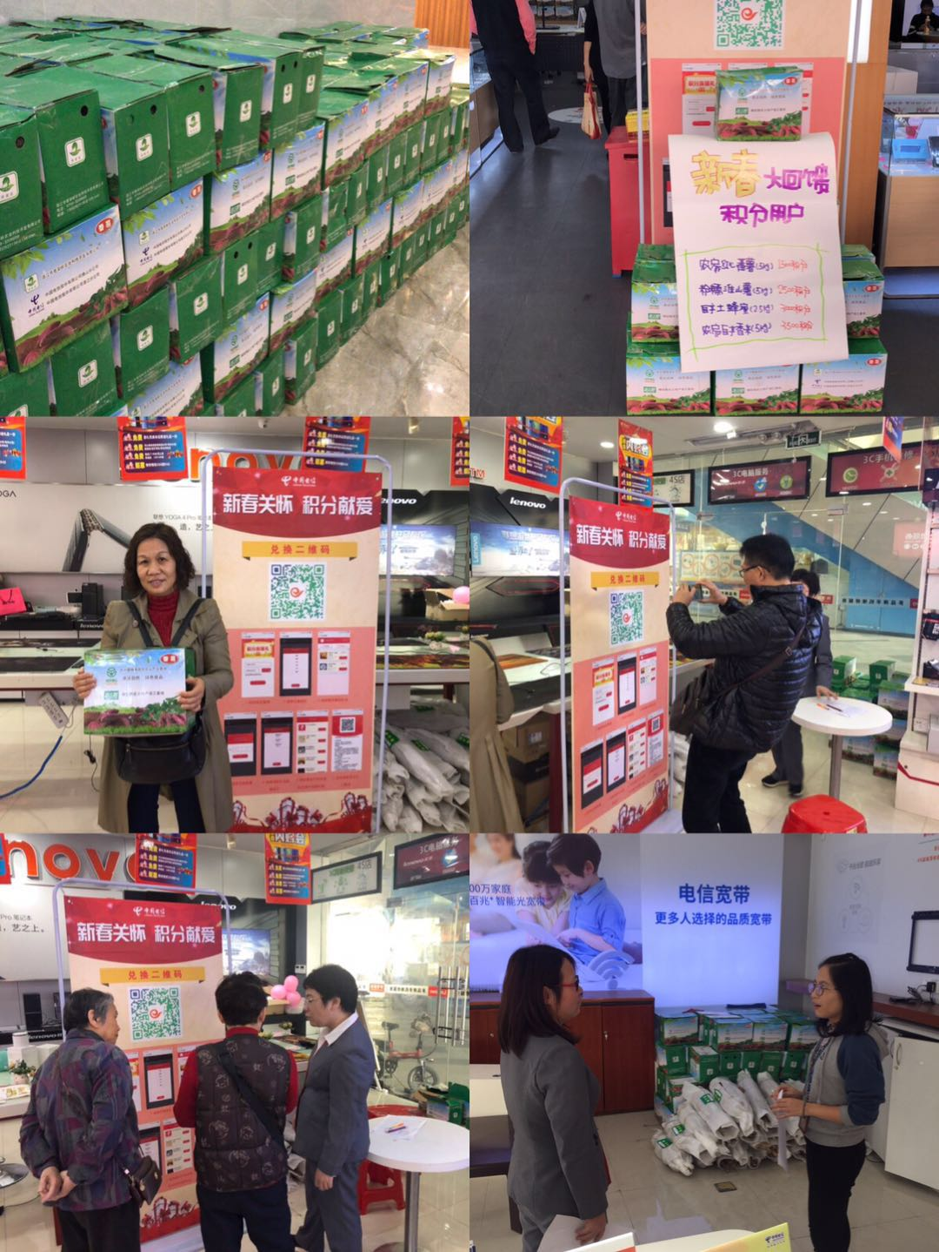
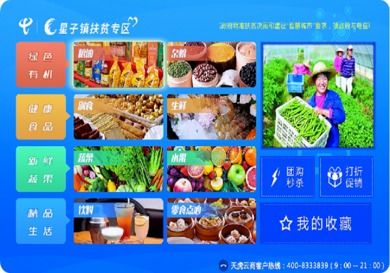
3.2 Network platforms are used to inspire the vitality of rural economy
“Farmer benefit e-commerce”
Based on the operation of the poverty alleviation venue of China Telecom, China Telecom Guangdong Branch has joined hands with the Department of Agriculture and Rural Affairs of Guangdong Province and Guangdong Radio and Television to build a new media platform for targeted poverty alleviation facing the whole province, and create a normal poverty alleviation ecology.
A special poverty alleviation column of “farmer benefit e-commerce” has been set up on the HD homepage of Guangdong E-surfing, which has covered more than 10 million E-surfing HD users across the province.
Push forward the building of a comprehensive village-level e-commerce service platform composed of Internet and targeted poverty alleviation.
Launch targeted poverty alleviation column for E-surfing Pay users.
China Telecom has teamed up with Shanzui Village of Zhanjiang city to launch a theme activity for the Spring Festival, enabling star-level customers to donate agricultural products of 3,300 cartons and 13,000 kg through the exchange of points.

Slide 22
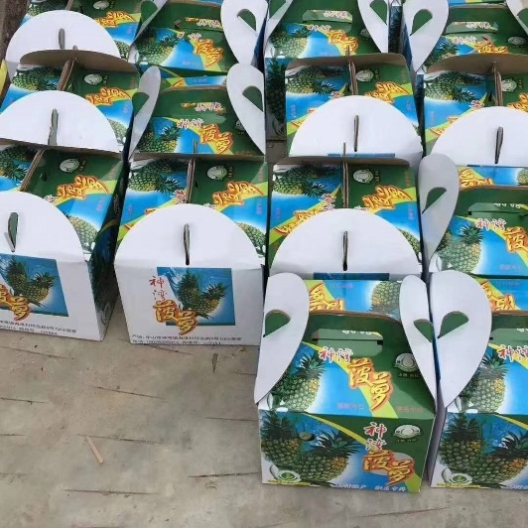
In Liushe Village of Meizhou, the rural e-commerce platform has addressed the poor sale issue of tea leaves, expanded the sales, and boosted tea leaf sales to surge to more than 2,000kg in a month, totaling 1.1 million yuan.
3.2 Network platforms are used to inspire the vitality of rural economy
Lingnan Life
China Mobile Guangdong Branch has offered the Lingnan Life e-commerce platform for pilot administrative villages for free, in an effort to boost the precise and effective match-making of superior agricultural and sideline products from the place of origin to the consumer market, and help poverty-stricken villages to create “one featured product for one village”. Sales of agricultural products have reached 225 million yuan on the platform, of which agricultural products of 62.64 million yuan come from specially poverty-stricken villages.
In Shenwan Town of Zhongshan, the rural e-commerce platform has redesigned the display of agricultural products, so as to improve users’ experience on pineapples. In a sales promotion activity for 29 days, 6,663 pineapples have been sold out, with the sales of up to 700,000 yuan.

Slide 23
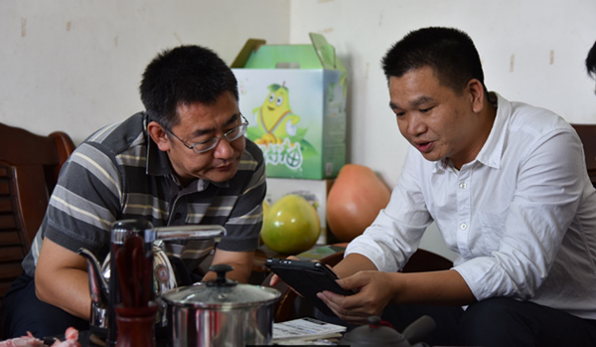
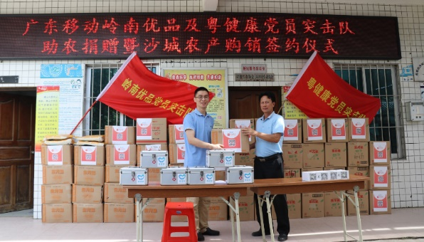
Dayushu Village of Meizhou is a national-level poverty-stricken village, and rich in honey pomelos. Since the access to broadband through universal telecommunication service, farmers are able to sell agricultural products on the Internet, and acquire more sufficient market information. The product profit has surged by nearly 80%.
3.2 Network platforms are used to inspire the vitality of rural economy
Lingnan Life
In Shacheng Village of Zhanjiang, farmers have established lotus root and potato bases through the model of “cooperative + poverty-stricken households + land transfer + Internet”, enabling poverty-stricken households to obtain dividends of 100,000 yuan. The project was also rated as one of “top 10 case studies of poverty alleviation through featured planting and breeding industries in Zhanjiang city” as well as one of “top 10 star products for poverty alleviation in Zhanjiang city.”
The e-commerce platform has designed sales promotion activities for a specialty - lotus root, which has sold more than 2,000 deals in a week, generating a revenue of 80,000 yuan.

Slide 24
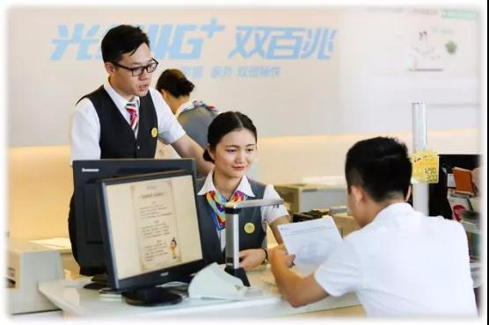
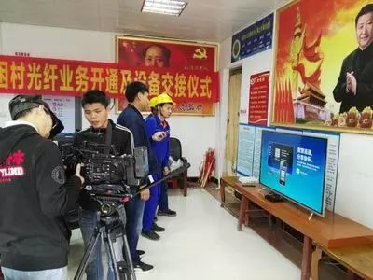
3.3 Enrich rural cultural life with the good use of network contents
Guangdong Province aims to help villagers obtain more network information and entertainment contents, and enrich their spiritual life through broadband network of universal telecommunication service.
In 2018, Guangdong Telecom launched 100M fiber broadband in 2,277 poverty-stricken villages and established 4K TV experience sites, so as to make up for the shortcomings of information technology in rural areas.
Guangdong Telecom has aided the construction of 4K TV experience sites in pilot national poverty-stricken villages through ultra-HD TV service packages with targeted preferences, so as to satisfy their experience needs for 4K TV.

Slide 25
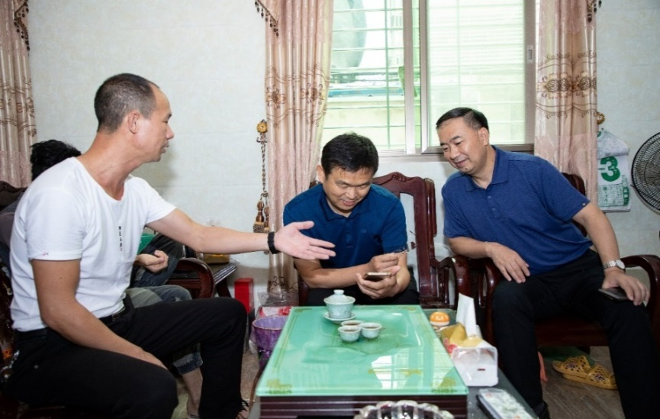
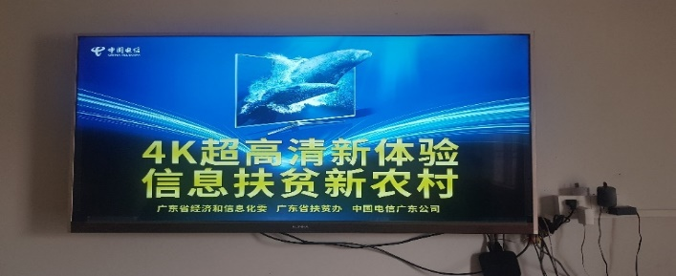
3.3 Enrich rural cultural life with the good use of network contents
Xipan Village in Yun'ao Town, Nan’ao County, Shantou
In less than a year since the access to the broadband network through universal telecommunication service, nearly 60% of the villager households have used high-speed broadband through universal telecommunication service, while 85.1% used broadband network to watch 4K ultra-HD TV.

Slide 26
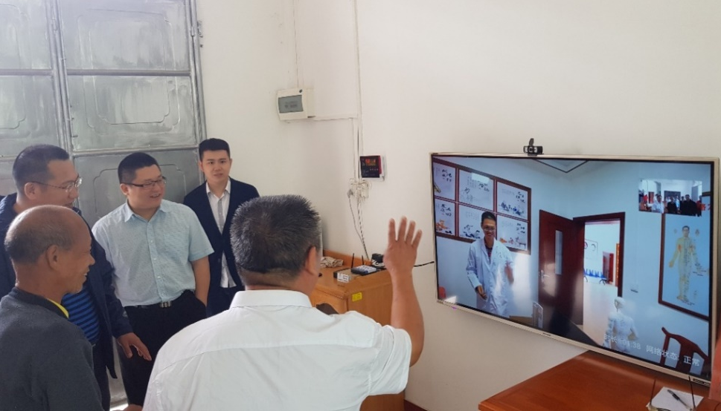
3.4 Facilitate rural public services with the good use of network facilities
Through high-speed broadband network, Guangdong Province has achieved online handling of affairs, remote service and smart management, promoted the equal access to rural public services, and constantly bridged the digital gap between urban and rural development.
Remote diagnosis
Guangdong Mobile provides “family doctor” diagnosis service through video conferencing for the senior citizen activity center of Beipeng Village, Meizhou city free of charge. The online facial diagnosis and counseling model via HD videos has enabled villagers to consult doctors at hospitals in the county without walking out of their houses, and allowed Guangdong to solve the difficult medical treatment problem of left-behind old people and children in rural areas with superior medical resources, so as to reduce the stress of rural health institutions on door-to-door services.

Slide 27
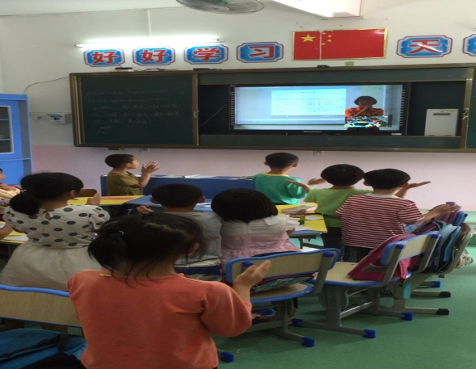
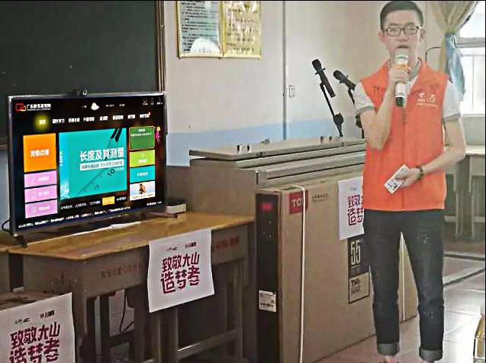
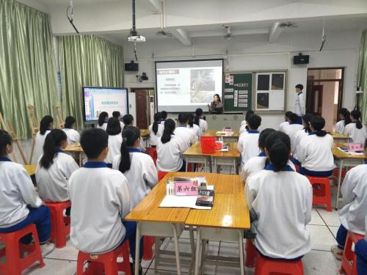
3.4 Facilitate rural public services with the good use of network facilities
Remote education
Guangdong Telecom has built the Guangdong education video network, in a bid to improve the rural teaching quality via the “Internet + education” model. It has covered 13,000 schools and 1.2 million users and achieved 300,000 clicks each month. Among them, users in the northwest region of East Guangdong account for 77%.
The Mashi Central Primary School in Shixing County, Shaoguan has utilized the “Internet +” teaching model to obtain superior education resources, and learn abundant course videos and teaching courseware, which are widely favored by students.
The simultaneous classroom in Maoming city has covered 500 classrooms in 150 schools of six counties and county-level cities, improved the teaching quality and promoted the balanced development of education through the launch between primary and secondary schools and teaching sites.
Qingyuan city has utilized fiber broadband to adopt the exchange model of e-schoolbag seminar platform in four schools through the power of “Internet + education”, so as to achieve the exchange and interaction between remote classrooms.

Slide 28
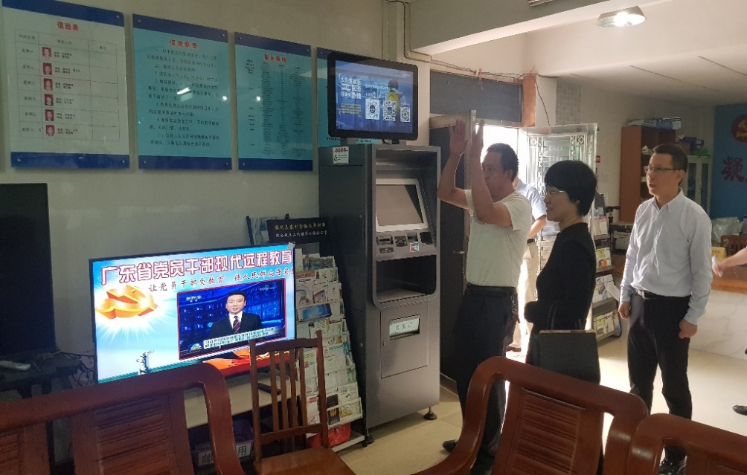
3.5 Enhance rural grassroots Party building with the good use of network battlefield
In rural areas, many villagers work outside the villages, which has restricted the centralized discussion, exchange and learning, so the online Party construction and rural affair management can effectively overcome the personnel dispersion problem.
Beipeng Village of Meizhou
Equip families with WiFi and mobile hot spots, and use network communication software to build work groups for Party building and villagers committee;
Host the “online micro-classroom” on the 15th day of each month, requiring the attendance of all Party members and cadre in the work groups;
The Party branch invites Party affairs personnel from related provincial and municipal departments to impart knowledge in the groups, while the villagers committee will assign daily tasks of village affairs.

Slide 29
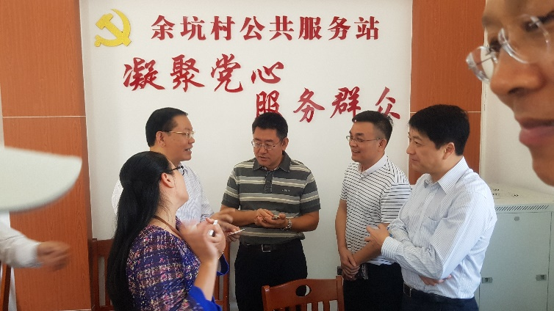
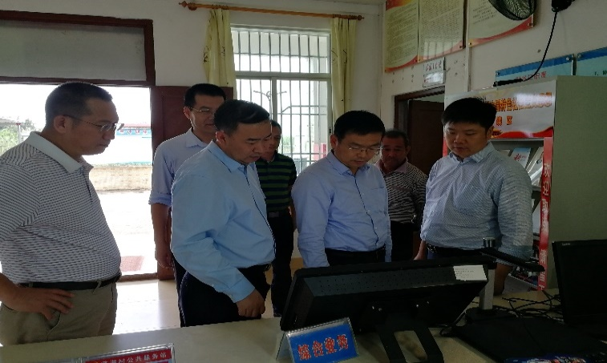
Conclusions
The Guangdong Communications Administration will firmly implement the requirements of the universal telecommunication service work, and insist on overall advancement and synchronous implementation with useful, affordable and satisfactory products. On the basis of usefulness, it aims to exert the unique advantages of network-based poverty alleviation with affordable and satisfactory products to build network platforms, foster rural industries, expand revenue increase channels, and develop rural economy, so as to boost rural revitalization of Guangdong.
In October 2017, the No. 7 Inspection Group of MIIT conducted field inspection
In October 2018, the discipline inspection and supervision group conducted an on-site survey

Slide 30
Conclusions
Universal telecommunication service has significantly improved the information technology level of rural areas, particularly remote mountainous areas, driven the development of rural economy, facilitated the improvement of people’s well-being, and satisfied farmers’ demands for information in the Internet age, receiving widespread praise of the society. While inspecting the universal telecommunication service work in Meizhou city, a local farmer has practically experienced the convenience and change brought by universal telecommunication service, and sincerely said: “Thank the Communist Party of China! Thank China Mobile!” Those simple words are the most straightforward recognition and inspiration for communications personnel.

Slide 31
Conclusions
“Farmers are the key to achieve moderate prosperity.” The Guangdong Communications Administration will continue to consolidate the outcomes of the pilot work, deepen network applications, improve the rural information technology level, promote rural affluence of people and revitalization of industries, and make more contributions to the building of a moderate prosperous society in all respects!

Slide 32
Thank You

