Slide 1

What Will the Children Harvest from the Network Extending into the Classrooms in Poor Counties?
Journalist of Bingdian Weekly, China Youth Daily
Cheng Mengchao

Slide 2
Can this screen change the fate?

Slide 3
“Remote students in one classroom” supported by high-speed network
Among them, 88 children from rural areas, counties and suburb areas have been admitted to Tsinghua University and Peking University
One Chengdu NO. 7 High School, benefits more than 200 high schools
02
04
1:200+
72000
88
20=>147
Over the past decade, 72,000 “remote students” have received the classroom education from Chengdu No. 7 High School
The number of students at Luquan No.1 Middle School qualified for the first batch of undergraduate admissions has increased from 20 in 2006 to 147 now
01
03

Slide 4
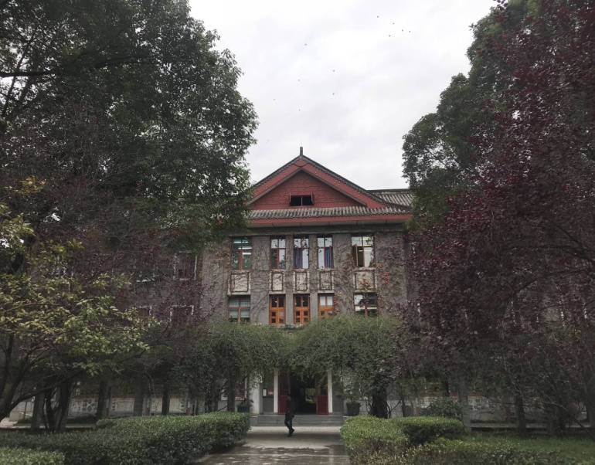
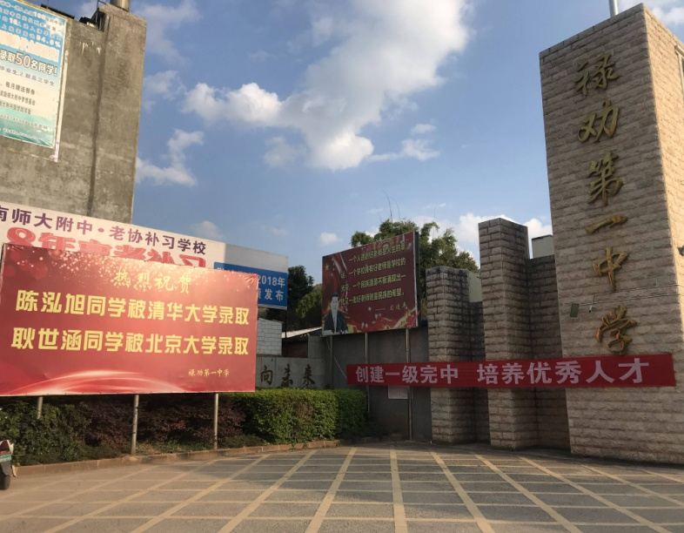

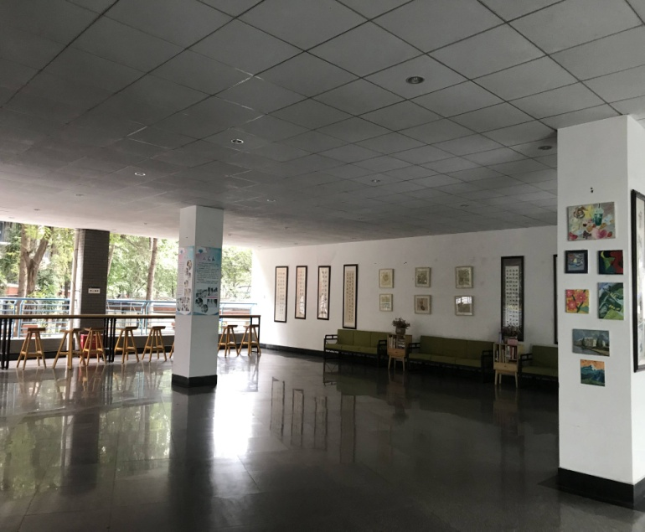
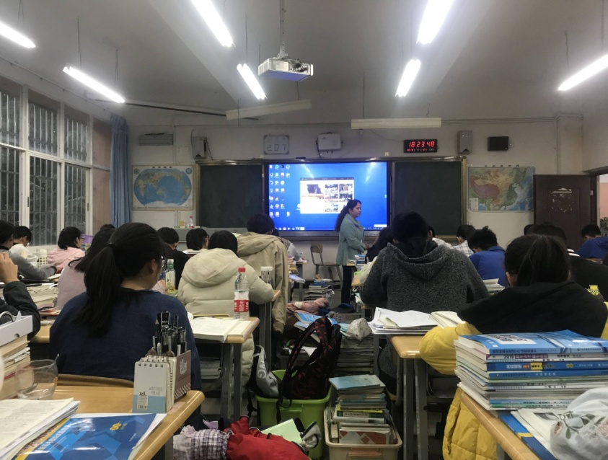
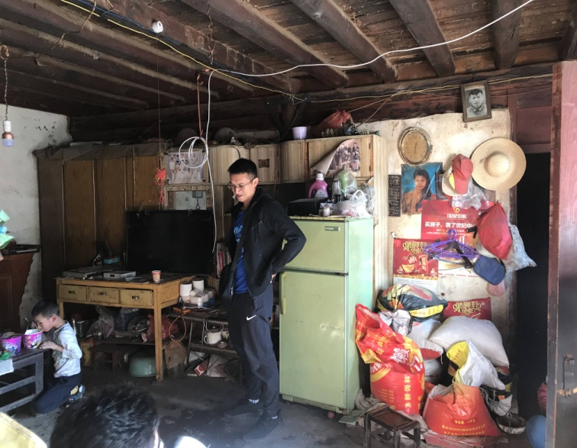
Silhouettes & comparison

Slide 5
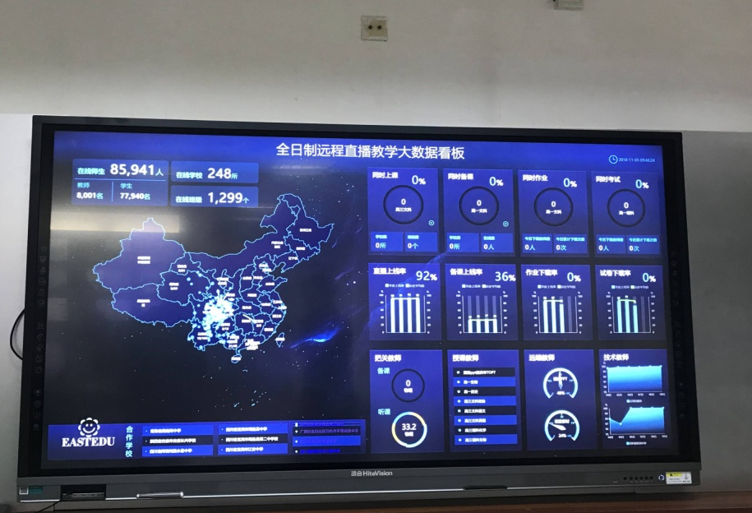
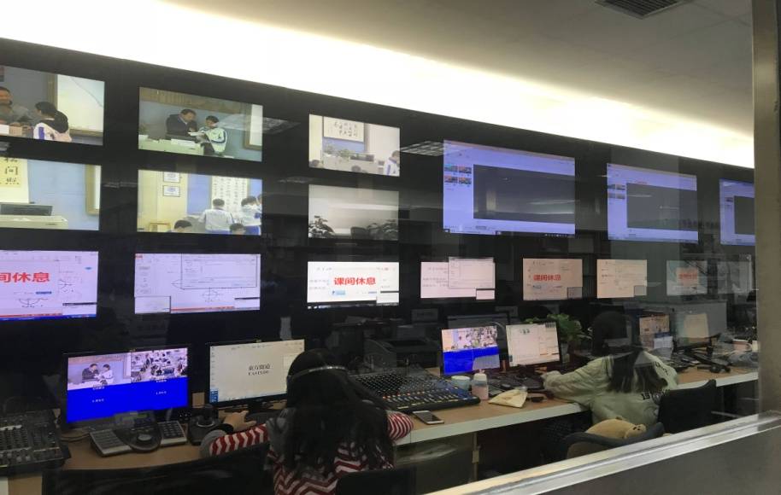
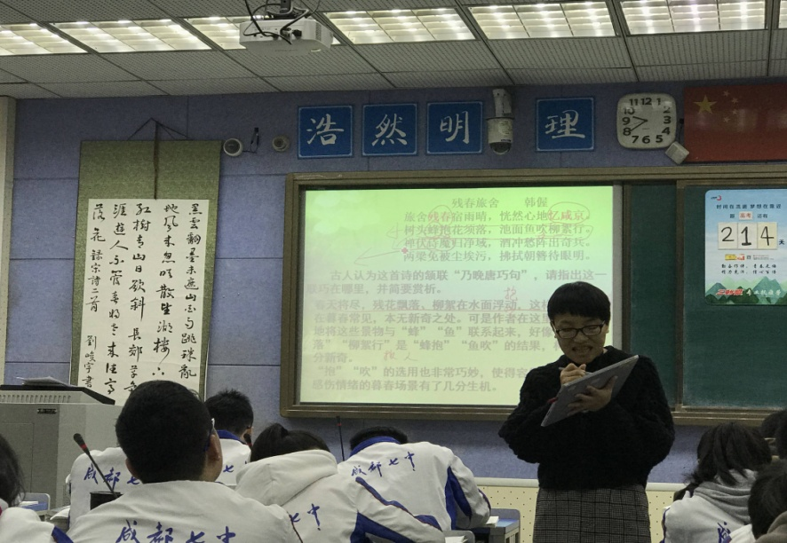
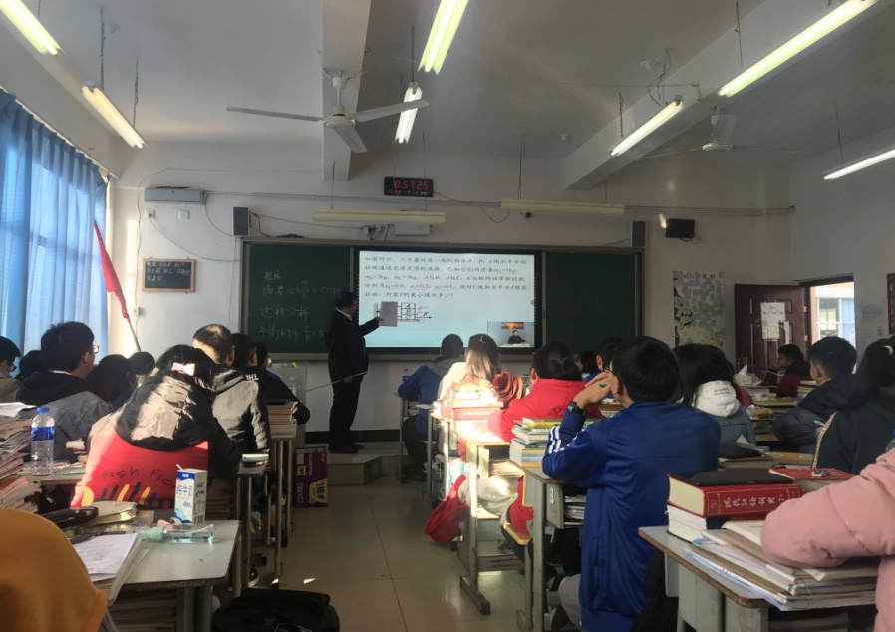
Silhouettes & comparison

Slide 6
Possibility of change??
Chengdu No. 7 High School
Average score: 105
Luquan No. 1 Middle School
Average score: 30

Slide 7
Internet brings offline changes
Scores steadily improve
Barely pass in grade one, and gradually increase from 100 to 110 and 120 in grade two, while get full scores in grade three.
Absorb superior contents of famous schools
From teaching concepts and methods to homework, exercises and exams, superior resources of Chengdu No. 7 High School are fully absorbed by poverty-stricken counties by means of scenarios built by Internet
Students study hard on a voluntary basis
At Luquan No. 1 Middle School, one of the key tasks of head teachers is to driven students still studying at the classrooms to dormitories at the midnight
Teaching methods change
Local teachers have changed their status - from teachers to assistant teachers, and also learned a lot of experience from famous teachers of Chengdu No. 7 High School
Teachers and students find the gap and hope
The school used to have a good learning atmosphere, but lacks methods for improvement. While seeing the gap, the school is also full of hope - this is the common situation for many grassroots county-level middle schools

Slide 8
Governance wisdom from director of county education bureau
A virtuous circle begins:
Teachers and students both make efforts and obtain returns, which will lift the school atmosphere, receive county-wide praise, achieve inflow of superior students, and attract attention and more support from superior departments
Guide teachers and students to
absorb and accept new technologies
Director: Promote the progress of people with technology!
Invest in new technologies
Magical scenes: Schools in rural areas carry out teaching activities with live broadcasting, tablets and smart classrooms
The poverty-stricken county investing in education see returns
Strive for excessive education appropriations
Fiscal revenue is almost 600 million yuan, but education expenditure reaches 1 billion yuan
Infrastructure is built in place, telecom network achieves coverage
The mountainous county also gets access to high-speed
network
The biggest cost problem has been addressed

Slide 9
Education Minister Chen Baosheng:
The number of screens changing the fate will continue to grow!

Slide 10
How do NPC delegates and CPPCC members view “one screen”?

Slide 11
In addition to “one screen”,
what else have telecom network done in education equity?
Junior high schools
Teaching with recorded broadcast can be carried out and stopped at any time, and dominated by local teachers, so as to reduce the acceptance difficulty
Ultimate vision
Enabling children all over the country to enjoy superior education
Primary schools and kindergartens
Provide video lessons for teachers, who will then teach students after absorption, so as to shore up teachers
Else
Classroom teaching
After-school tutoring
AI
........

Slide 12
Thank You
Journalist of Bingdian Weekly, China Youth Daily
Cheng Mengchao

