Slide 1
Leverage Universal Services for Getting Rid of Poverty
and Building A Well-off Society
China Mobile Communications Group Co.,Ltd.

Slide 2
1
Based on the Current Situation,
Continuously Improve the Capacity of Rural Broadband Network

Slide 3
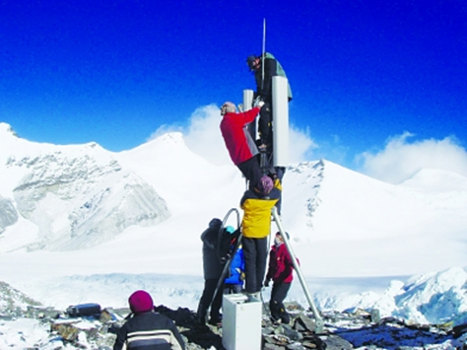
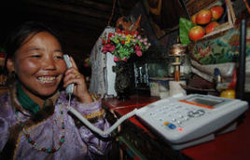
Village Access Project
Nov 2007
Everest Base Camp
The highest base station in the world
May 2010
Sansha Sea Area in the South China Sea
The southernmost base station of the motherland
Accumulative input: 45.8 billion yuan
Base station construction: 62,000
Telephone access: 122,000 natural villages
Broadband access:33,000 administrative villages
Industry share: 54 %
Dec 2010
Base station in Yanglong Qupa Village, Nyima County
Achieving 100% “telephone access”
Dec 2015

Slide 4
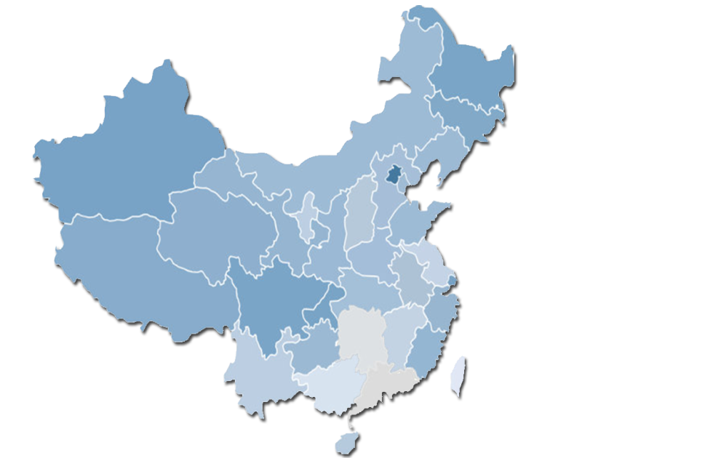
Village Access Project
Northernmost :
Mohe Township Base Station
Easternmost :
Heixiazi Island Base Station
Westernmost :
Irkeshtam Port Base Station
By the end of 2010:
a mobile base station was opened in Yanglong Qupa Village, Nyima County, Tibet Autonomous Region with an average altitude of 4,700 meters, achieving 100% “telephone access” in Chinese administrative villages
Highest :
Everest Base Station
2015: Realized 65% 4G network coverage of inhabited islands in Sansha City
Southernmost : Huayang Reef Base Station, Nansha Islands
Notes:
通宽带数量已更新

Slide 5
Telecom Universal Services Pilot Work
The first three batches:
wired broadband coverage
The 4th batch:
4G coverage
Involved: 23 provinces
Involved: 18 provinces
Broadband access: 38,300 administrative villages
4G access: 4,500 administrative villages
Industry share: 33 %
Industry share: 45 %

Slide 6
National-level Poverty-stricken Counties
Investments
(100 million yuan)

Slide 7
Network Infrastructure Construction Has Achieved Remarkable Results
Population coverage
99%
Administrative village coverage
Registered poor villages coverage
98%
96%

Slide 8
2
Looking Forward,
Continue to Give Play to the Advantages of the ICT Industry

Slide 9
"1+3+X" "Network + Poverty Alleviation" Model
Organization
Industry
Network poverty alleviation
Health
Funding
Employment
Education
Personnel
Consumption

Slide 10
Provide Tariff Reduction and Terminal Subsidies for Poor Subscribers
Tariff reduction:
260 million yuan
Subsidies:
42 million yuan
Poor subscribers: 3 million+
15,000 Yunnan subscribers
Terminal subsidies: 26 million yuan
Dataflow: 20 billion MB+
A4 and A5 phones
Voice: 2 billion mins+
Subsidies: 16 million yuan
Notes:
公司已为全国建档立卡贫困户推出18元、28元专属“扶贫套餐”，普通套餐全部享受4-5折优惠，每月免费赠送上网流量1GB、语音通话100分钟，各项优惠共惠及全国建档立卡贫困客户300余万，赠送和优惠流量超过200亿MB、语音通话20亿分钟，减免费用2.6亿元。在云南省向1.5万余贫困人口免费发放终端，让利2600余万元。面向贫困人群研发定制物美价廉的中国移动A4、A5致富手机，对建档立卡贫困户提供补贴40元/台，全年销售40万部、补贴1600万元。

Slide 11
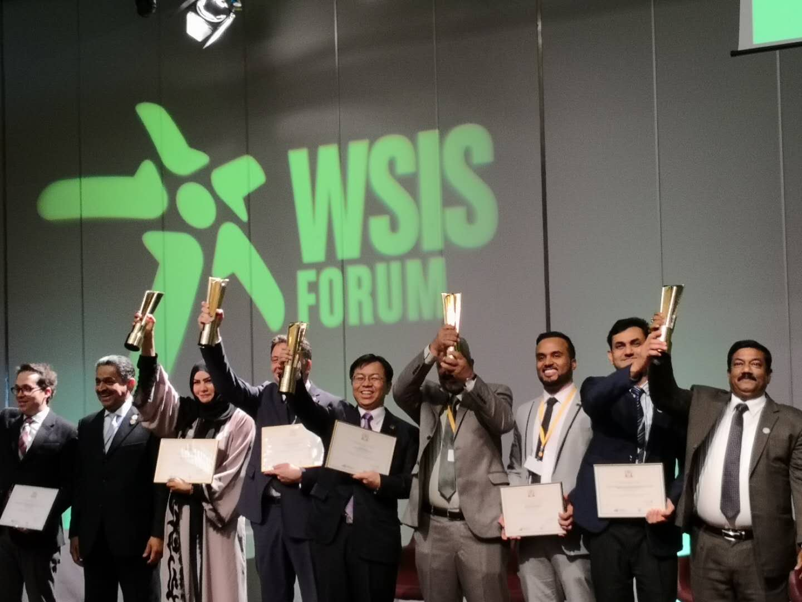
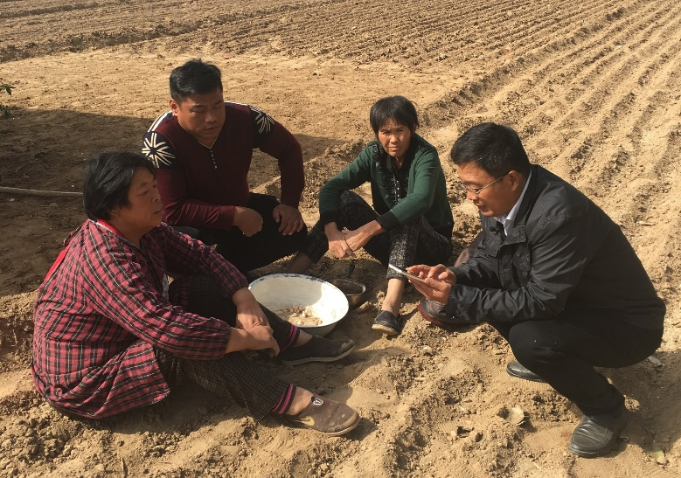
Targeted Poverty Alleviation System
In March 2018, the Targeted Poverty Alleviation System won the 2018 WSIS Highest Project Award, the only e-government product that won this award that year. The picture shows Li Huidi, Vice President of China Mobile Group, taking the stage and giving a speech.
The village-resident major secretary in Taiqian County, Henan Province, updated the information of poverty-stricken household population and income through the targeted poverty alleviation APP in the field, simplifying the complicated filling work in the past and improving the efficiency of village-resident work

Slide 12
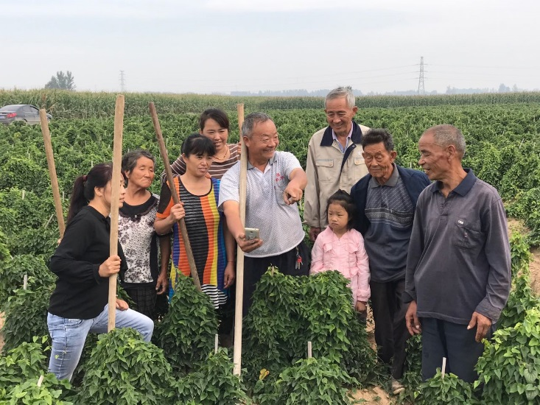
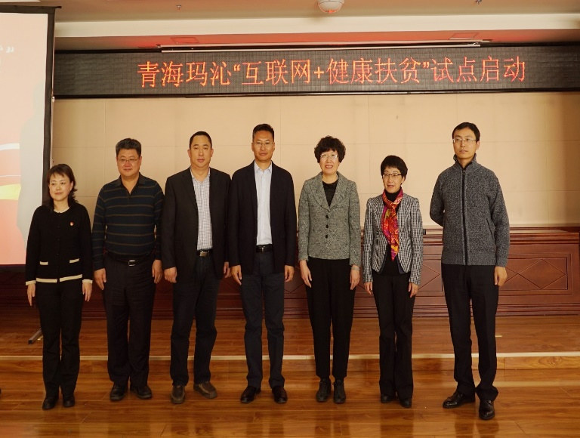
Industrial Poverty Alleviation and Health Poverty Alleviation
In the yam planting base of Shuangmiao Township, Qingfeng County, Henan Province, poor people can learn agricultural technology and find sales channels through mobile APP in the field. Since 2017, the system has helped the yam planting base to sell more than 10,000 kg of yam
The "Internet + Health Poverty Alleviation" pilot work was launched in Maqen County, Golog Tibetan Autonomous Prefecture, Qinghai Province. National Telemedicine Collaborative Platform achieved comprehensive collaboration and information sharing among 1 county-level hospital and 8 township hospitals, channeling high-quality medical resources to the grassroots level

Slide 13
Thoroughly implement the requirements of the Party Central Committee and the State Council
Join hands with brother companies to accelerate the promotion of telecom universal services and network poverty alleviation
Facilitate to build “digital villages” and create“ strong agriculture, beautiful rural environment, and increasing income for farmers”

Slide 14
Best Regards for You !
THANK YOU

