Slide 1
中国电信普遍服务探索与实践
Exploration and Practice of Telecommunications Universal Service in China
闻库
Wen Ku
工业和信息化部信息通信发展司
Information and Communication Development Department, MIIT
August 2019

Slide 2

一、中国电信普遍服务历史沿革
I. Historical Development of Telecommunications Universal Service in China
二、中国电信普遍服务政策与实践
II. Policies and Practices of Telecommunications Universal Service in China
三、工作成效及展望
III. Achievements and Prospects

Slide 3

宽带网络是经济社会数字化转型的重要驱动
Broadband network is an important driver of digital transformation of economic society
世界银行研究表明：宽带人口普及率每提高10%，平均带动国内生产总值增长约1.38%，发展中国家带动更高。
World Bank study shows that every 10% increase in broadband penetration leads to an average GDP growth of about 1.38%, which is higher in developing countries.
2013年，“宽带中国”战略首次将宽带网络和水、电、路一样，定位为”新时期战略性公共基础设施”。
In 2013, “Broadband China” Strategy first positioned broadband network as “strategic public infrastructure in the new era” like water, electricity and roads.
智能制造
基本公共
服务均等化
Intelligent manufacturing
互联网+
Equalization of basic public services
Internet+
宽带网络
大众创业
万众创新
信息消费
Information consumption
Broadband network
Mass entrepreneurship and innovation

Slide 4
农村宽带建设存在市场失灵，实施电信普遍服务是缩小城乡数字鸿沟的重要举措
Implementing telecommunications universal service is an important measure to narrow the digital divide between urban and rural areas.
中国现阶段电信普遍服务推进重点：支持并推动农村及偏远地区宽带网络建设覆盖。
At the present stage, We focus on the construction and coverage of broadband network in rural areas.
市场失灵 Market failure
建设维护成本高，成本回收周期长甚至收不回成本
Broadband network construction and maintenance costs are very high, cost recovery cycle is long, and even no cost can be recovered.
普遍服务是国际通行做法 Universal service is an international practice
根据国际电信联盟统计，全球超过159个国家和地区出台国家宽带规划，大部分都考虑了电信普遍服务。
More than 159 countries and regions have introduced national broadband plans.
农村经济基础薄弱
Weak rural economic foundation
农村地理环境较差
Poor rural geographical environment
农村人口居住分散
Scattered population in rural areas

Slide 5



中国政府高度重视弥合城乡数字鸿沟，在多项规划政策中明确电信普遍服务要求
Chinese government attaches great importance to bridging the digital divide between urban and rural areas and specifies the requirements for telecommunications universal service in various planning policies.
2000年《中华人民共和国电信条例》要求“电信业务经营者必须按照国家有关规定履行相应的电信普遍服务义务。
《国民经济和社会发展第十三个五年规划纲要》
The 13th Fiver-Year Plan for Economic and Social Development of the People’s Republic of China
Regulation of the People’s Republic of China on Telecommunications in 2000 stipulates that “telecommunication service operators shall fulfill corresponding telecommunications universal service obligations in accordance with the relevant national provisions.”
《“十三五”脱贫攻坚
规划》
Poverty Alleviation Plan for the 13th Fiver-Year Plan Period

Slide 6



中国开展电信普遍服务的历史沿革
Historical Development of Telecommunications Universal Service in China
2014
未通村
Villages without broadband
升级村
Upgraded villages
有线、无线宽带均未覆盖的行政村约5万个
About 50,000 administrative villages were not covered by wired or wireless broadband
宽带能力不足4Mbps的行政村约15万个
About 150,000 villages broadband capacity is less than 4Mbps
2004
2006
2010
Since 2015
实施“村通工程”，推进行政村通电话
将通宽带(512Kbps) 纳入”村通工程”内容，推进乡镇通宽带
开展“信息下乡”活动，促进通信终端进村入户
组织实施5批电信普遍服务试点，推动行政村通光纤和4G
Promote telephone communication in villages.
Promote the communication terminals to go into the villages and households.
Promote Broadband access (512Kbps) in villages and towns.
Promote optical fiber and 4G access in administrative villages.

Slide 7
一、中国电信普遍服务历史沿革
I. Historical Development of Telecommunications Universal Service in China
二、中国电信普遍服务政策与实践
II. Policies and Practices of Telecommunications Universal Service in China
三、工作成效及展望
III. Achievements and Prospects

Slide 8
中国开展电信普遍服务试点的总体思路
General thoughts on pilot telecommunications universal service in China
中央资金引导
Central Fund Guidance
地方协调支持
Local Goverment Support
企业为主推进
Enterprise-Oriented Promotion
明确标准 Clear Standards
“宽带中国”战略目标 2020年
"Broadband China" Strategy Objectives 2020
覆盖标准：光纤网络和4G信号至少覆盖村委会、学校、卫生室等主要公共机构。
速率标准：接入能力达到12Mbps以上。
Coverage standard: Fiber and 4G signals cover major public institutions such as village committees, schools and health clinics.
Speed standard: Access capability is over 12Mbps.
行政村通宽带
98
Broadband access in administrative villages
%
农村宽带接入能力
1 2
Broadband access capability in rural areas
Mbps

Slide 9
调动地方积极性——按区域进行资金补贴
Mobilizing local enthusiasm---subsidization by region
综合考虑管理效率和地理条件，按照东、中、西、自治区四类区域进行补贴，补贴包含建设费用和6年运行维护费用。
黑龙江
吉林
新疆
辽宁
Considering the efficiency and geographical conditions, we subsidized accordance with four regions of the East, the Central, the West and the Autonomous Region. Subsidies include construction costs and 6-year maintenance costs.
内蒙古
北京
天津
宁夏
河北
山西
山东
青海
甘肃
江苏
陕西
河南
西藏
安徽
上海
四川
重庆
湖北
浙江
湖南
江西
% | 东部 East | 中部 Central | 西部 West | 自治区 Autonomous region
补贴比例 Subsidies proportion | 15% | 20% | 30% | 35%
东部
East region
贵州
广东
福建
台湾
云南
广西
中部
Central region
澳门
香港
海南
西部
West region
自治区
Autonomous region

Slide 10



调动电信运营企业积极性——竞争招投标
Mobilizing enterprises’ enthusiasm--- bidding competition
吸引更多的参与主体：具有电信业务经营资质的企业均可以参与投标。
公开招投标：解决建设维护成本的信息不对称，推动企业报价不断接近真实成本。
Attracting more participants: Enterprises with qualifications in telecommunications service operation can participate in the bidding.
Public bidding: to promote the quotation of enterprise to be closer to the real cost.

Slide 11
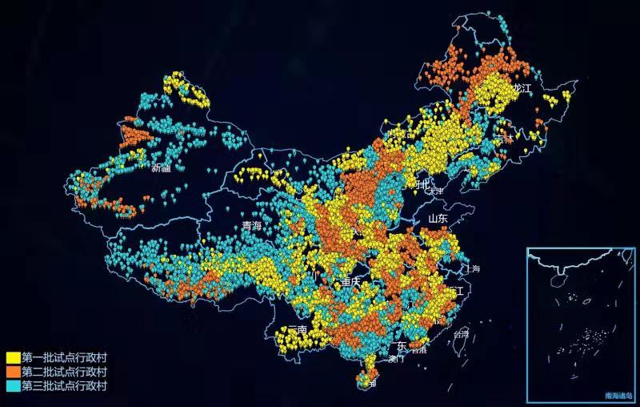
聚焦精准 Precision
精准到村：支持对象为行政村。
精准管理：在线监测网络建设完工情况和质量。
Precise to villages: Object is administrative village.
Precision management: Monitoring the network construction and quality online.

Slide 12
一、中国电信普遍服务历史沿革
I. Historical Development of Telecommunications Universal Service in China
二、中国电信普遍服务政策与实践
II. Policies and Practices of Telecommunications Universal Service in China
三、工作成效及展望
III. Achievements and Prospects

Slide 13



组织五批电信普遍服务试点，大幅提升农村宽带网络覆盖率
5 batches of pilot telecommunications universal services have been organized and broadband network coverage in rural areas have been greatly improved
前三批试点——支持光纤建设
The first three batches---supporting optical fiber construction
Over 98%
行政村通光纤比例
支持行政村数量
Number of administrative villages supported
Proportion of administrative villages with access to fiber
13万个
130,000
Less than 70%
行政村通4G比例
第四、五批试点——支持4G建设
The fourth and fifth batches---supporting 4G construction
Proportion of administrative villages with access to 4G
Over 98%
支持4G基站数量
Number of 4G base stations supported
贫困村通宽带比例
Proportion of poor villages with access to broadband
Over 98%
3.6万个
36,000

Slide 14
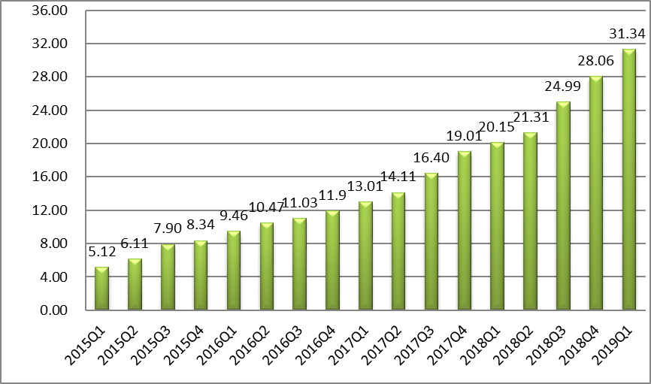

电信普遍服务试点推动农村宽带网络速率显著提升
Pilot telecommunications universal services have significantly increased the broadband network capability in rural areas
试点地区平均下载速率超过
远高于全国平均宽带下载速率。
70Mbps
Average download speed
in the pilot area exceeds
Much higher than the national average broadband download speed.
70Mbps
中国平均宽带下载速率（Mbps）
数据来源：宽带发展联盟
China’s average broadband download speed (Mbps)

Slide 15
中国全面进入“光网时代”，4G网络规模全球领先
China has entered the “Optical Network Era” and has the largest 4G network in the world
2019H1，FTTH用户渗透率达91%.
2019H1，4G基站数达到444.8万个，深度覆盖城市和乡村；4G用户渗透率达到77.6%。
In 2019H1, the proportion of fiber optic subscriber penetration reached 91%.
In 2019H1, the number of 4G base stations reached 4,448,000 and 4G user penetration reached 77.6%.
2019H1
中国固定宽带用户接入技术方式占比
数据来源：宽带发展联盟
中国3G/4G基站规模（万个）

Slide 16
中国宽带普及率大幅提升
China’s broadband penetration has increased substantially
2019Q1，中国固定宽带家庭普及率接近89%。
In 2019Q1, China’s fixed broadband household penetration was close to 89%.
2019Q1，中国移动宽带用户普及率达到96% 。
In 2019Q1, China’s mobile broadband subscriber penetration reached 96%
中国固定宽带用户普及率
数据来源：宽带发展联盟
中国移动宽带用户普及率

Slide 17

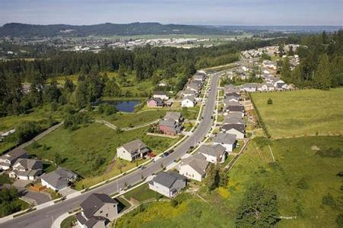
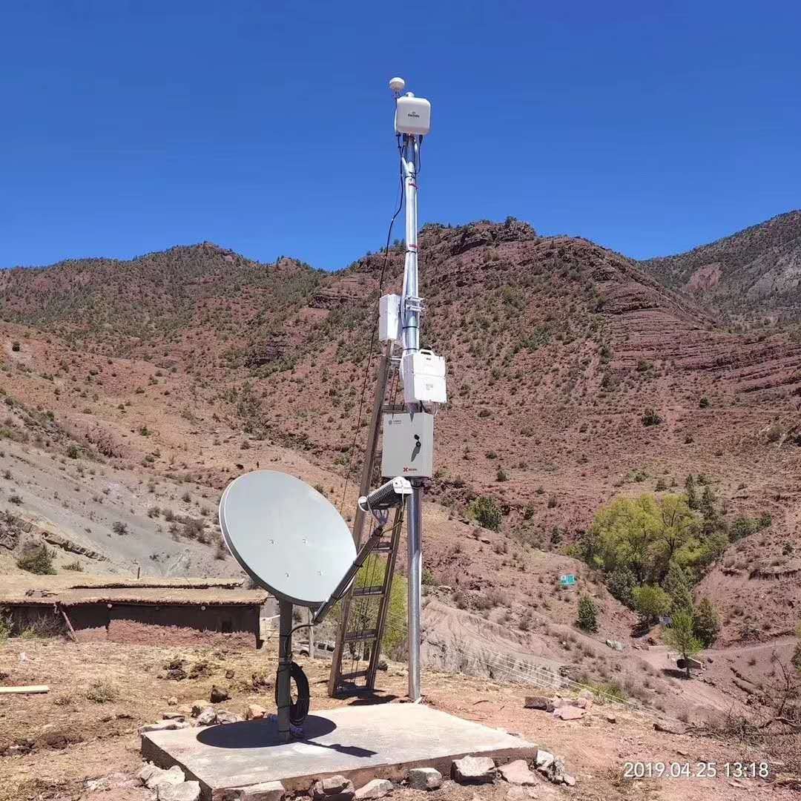
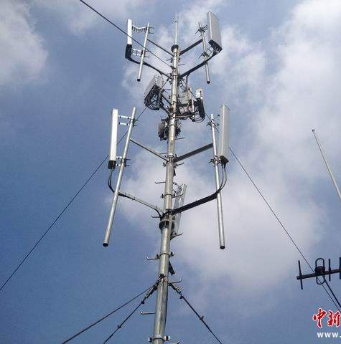
进一步完善机制，实现农村及偏远地区网络深度覆盖
Improving the mechnism to ensure broadband coverage in rural and remote areas.
扩大支持范围
Expand support area
扩展技术方式
Extend technology approach
支持农村20户以上人口聚居区4G信号覆盖
研究支持国道、省道等道路沿线和旅游景区、水库等重点区域4G信号覆盖
鼓励因地制宜，探索采用先进、多样、适用的信息通信技术。
Support 4G coverage in residential areas with more than 20 households.
Research to support 4G coverage along the main road and in key areas.
Encourage the application of advanced and applicable ICTs.

Slide 18
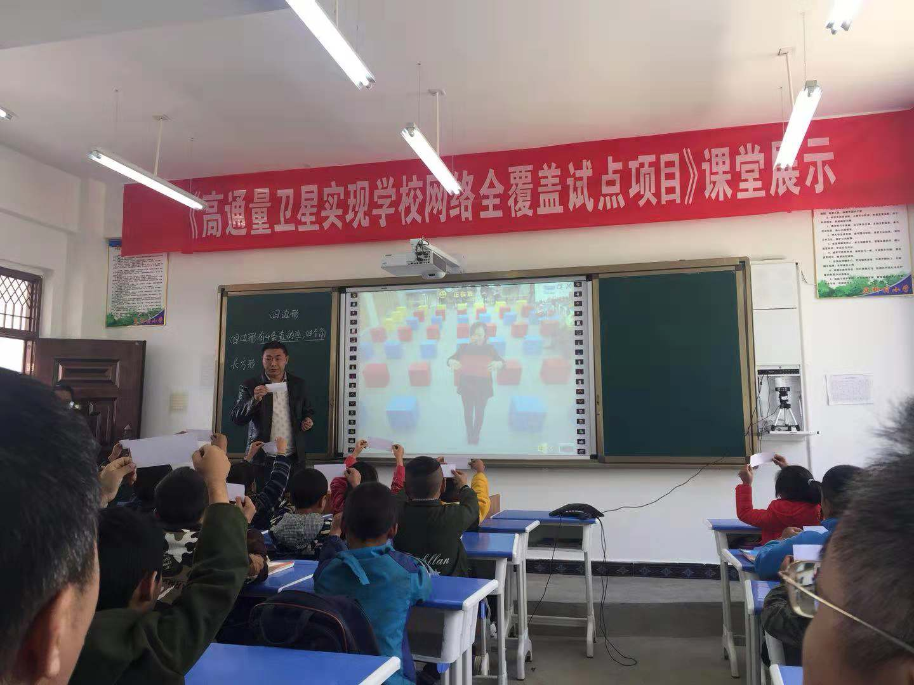
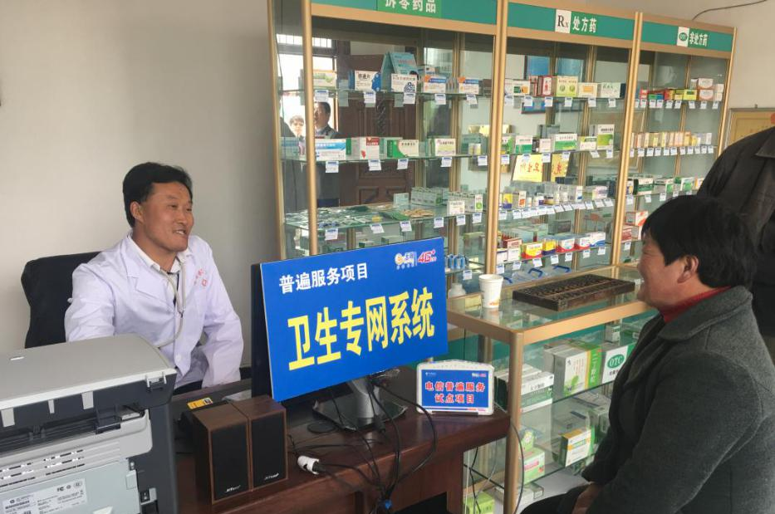
进一步强化应用，重点面向农村教育和医疗加大协同力度
Enhancing application to improve rural education and medical care.
互联网+教育，开展学校联网攻坚，推动优质教育资源在农村地区的共享应用。
互联网+医疗，完善农村卫生服务机构网络基础条件，让农民能够就近、低成本就医。
教育Education
医疗
Medical
Care
Internet+Education
Internet+Medical Care

Slide 19
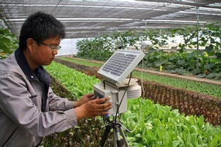


进一步鼓励创新，助力打赢脱贫攻坚战
Encouraging innovation to help winning the battle against poverty.
鼓励开发适合农村地区特别是少数民族边远地区特点和需求的APP。
互联网+农业
Internet+Agriculture
互联网+旅游
Internet + Tourism
Encourage the development of apps suitable for rural areas, especially remote areas.

Slide 20

谢谢大家！
Thank You!

