Slide 1
Telecommunications in the hour of need
Workshop Pacific Radio-communication Workshop 2019 (PRW-19)
Coral Coast - Fiji
11 – 12 April 2019

Slide 2
Scope
ICTs during emergencies and Post disaster
Activities of ITU
ICTs for DRR and Preparedness
Developing NETP
(some general slides from ITU workshop on NETP development in port-vila by Mr Don Wallace)

Slide 3
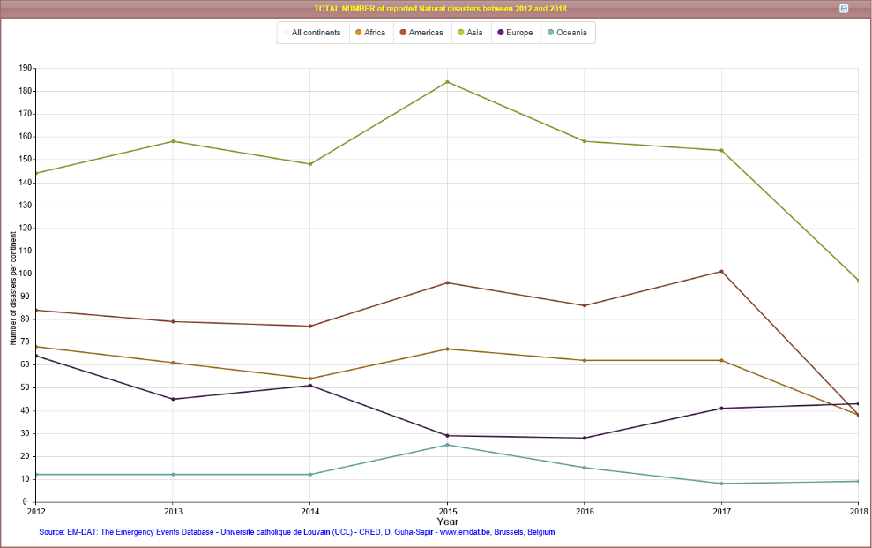
Number of Disasters worldwide (2012-2018)

Slide 4
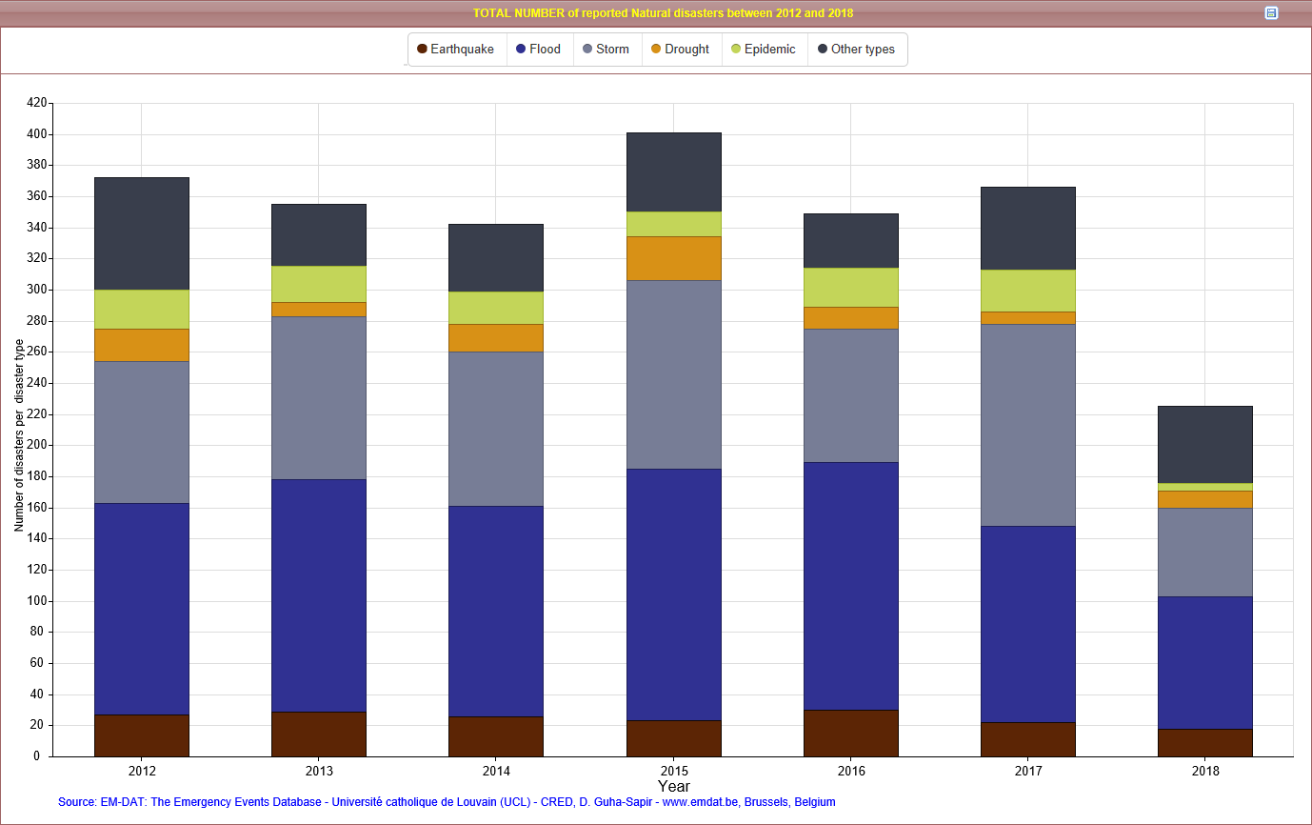
Number of disasters by type (2012-2018)

Slide 5
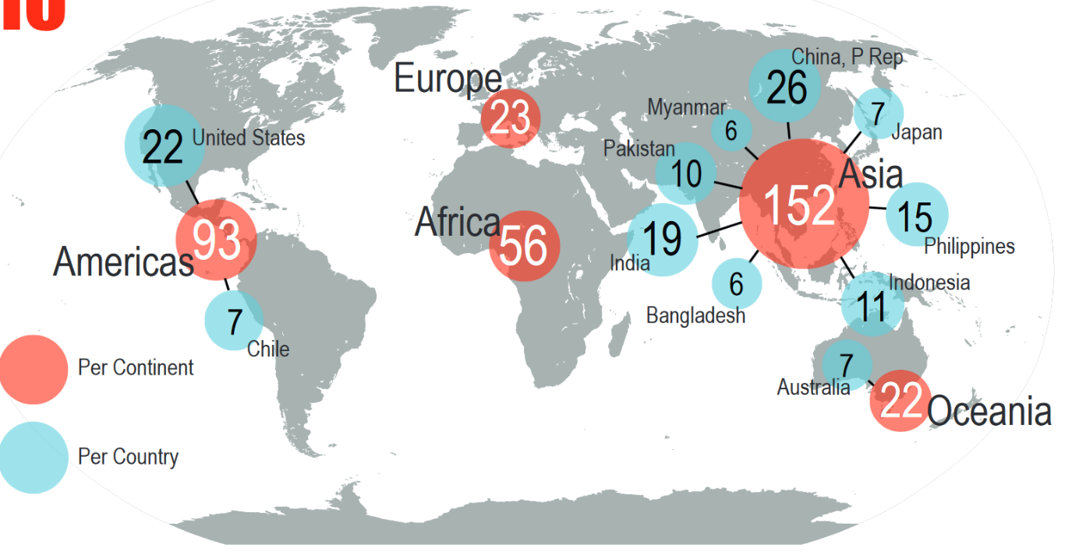
Disaster Relief (DR): Disasters Prone region
Source: UNISDR – 2015 Disasters in numbers *Epidemics and Infections not included
Notes:
UNISDR : UN Office for Disaster Risk Reduction

Slide 6
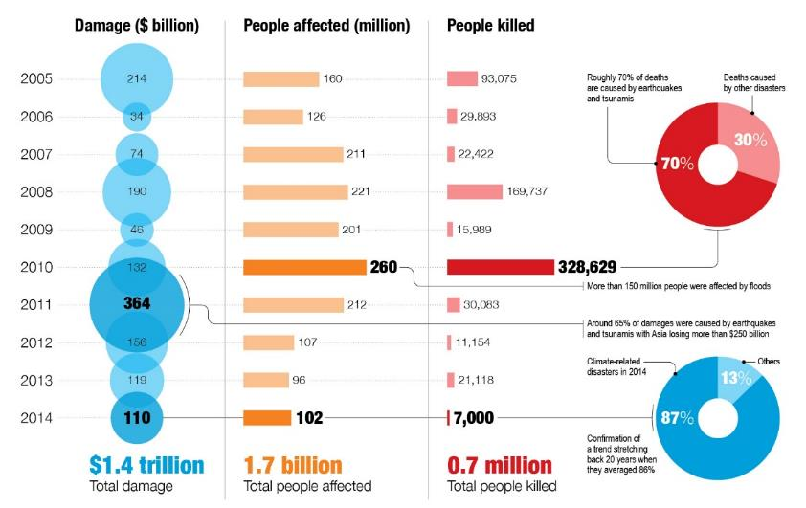
Disaster Relief (DR): Cost
Source: UNISDR – Human and Economic Impact of Disaster in last 10 years
Notes:
UNISDR : UN Office for Disaster Risk Reduction

Slide 7
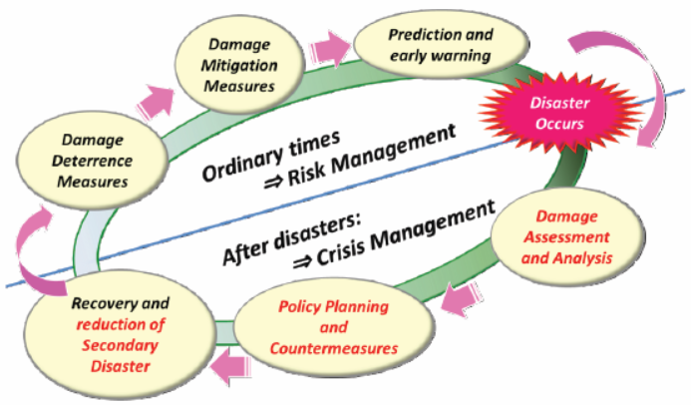
ICTs for DRR and Preparedness

Slide 8

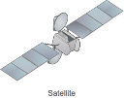

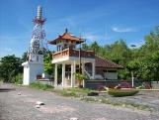
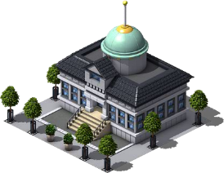
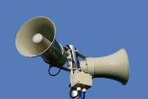






ET and DRR
Broadcasting
Hospitals
Beach public address system
Early
Warning
Centre
Disaster Management
Headquarters
Public Announcing System
Indoor receivers
Citizens
Government
authority
Public-Relations Vehicle
(Official Vehicles)
Public-Service
Vehicles
(Fire engines)
Fire Division
Headquarters
Notes:
As you can see form this image there are multi-stakeholders that communicate before/during and after a disaster. The role of Telecommunications and ICTs is important in delivering communications to the people at the last mile … emergency telecommunications role is critical to Saving Lives – available telecommunications during disaster is the most crucial component to ensure coordinated response from various stakeholders. Emergency Telecommunication infrastructure and resources have critical role to save lives.

Slide 9
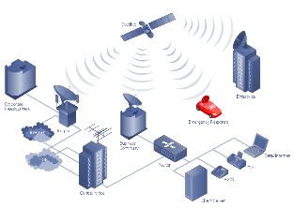
The role of ICTs in DRR and management
National emergency telecommunication plans linked to the national emergency plans
Information systems
Databases of human and institutional resources for emergency response
Multi-hazard EWS
Databases of equipment and skilled personnel to use such equipment
Information systems to manage, communicate and disseminate information to assist nation in preparedness and response
Backup energy systems
New technologies such as drowns
Satellite imagery
Preparedness
Response & Recovery
Mitigation
Various databases and systems for information on mitigation strategies, policies and legislations
Knowledge management solutions on best practices and lessons learnt.
Hazard mapping
Risks and vulnerability management systems
Damage and needs assessment
Provide ICT solutions to first responders
Provide telecommunications to affected population
Knowledge management solutions on best practices and lessons learnt
Building resilient ICT infrastructure
Coordinate with private sector
Importation of ICT equipment
Voice
Data
Video

Slide 10
Use of Telecommunications/ICTs in DM
Data collection
Data recording
Data analysis
Information Management Systems
Information Management
Dissemination
Decision Making
Lessons Learnt
Remote sensing, environmental monitoring, etc.
Record the sensing data, risk and hazard info, etc.
Use ICT tools for analysis, analytics and study
Information obtained, through analysis and studies, is made available via ICT systems
Knowledge obtained is stored, shared and managed via ICT platforms
Learning starts with sharing information and knowledge – ICTs are the fastest medium to disseminate knowledge.
ICT platforms can facilitate in decision making processes because they provide assess to the required information and knowledge
ICTs are used to record progress in development, implementation, etc.
Communication
ICTs are used as communication tools to plan, coordinate and respond to disaster situations
Notes:
What ICTs are used:
Web applications
Databases
Geographic information systems (GIS)
Sensors
Radio-communication
Amateur radio networks
Mobile networks
Satellite networks
Social media networks
Various software solutions
Hardware equipment
Purpose:
Collaboration and coordination platforms
Awareness Creation
Big data analytics
Risk management platforms
Resource management platforms
Hazard mapping and assessment
Water and land use planning

Slide 11
Preparedness and mitigation phases
Use of ICTs for:
Development of National Emergency Telecommunication Plans linked with the National Emergency Plan Development of Standard Operating Procedures Development of plans for risk avoidance and minimizing disaster impacts on human lives and economy Establishment of EW and Alerting systems Establishing national social, demographic and economic profiles Land, water and environment management plans Maintaining network coverage information services Map hazards, vulnerabilities and record high-risk zones Geological and hydro-meteorological current and historical information Risk assessment and management Awareness creation Development of drills and exercises to test the ICT networks put in place and all different kinds of technologies for communications
Notes:
Use GIS to record spatial and temporal variation in hazard severity, occurrence and likelihood and/or variations in vulnerability
Use Information systems to record identified services and infrastructure assets and gaps
Use ICTs to communicate high risk “hotspots” where disaster impacts are most likely to be severe
Use ICT solutions to evaluate appropriateness of land-use and development plans
Use ICTs to target public outreach campaigns and choose appropriate messages, sources, and channels
Through use of ICTs promote risk education among decision makers, highlighting how development decisions can impact risks
Climate change adaptation – food security, fishing, forestation, land and water management, etc.

Slide 12
Preparedness and mitigation phases
Use of ICTs for:
Develop drills and exercises Mapping hazards and vulnerabilities as well as high-risk zones and population at risk Sharing information on hazard profiles for better decision making Communicating information on locations of shelters and critical infrastructure damage prevention plans Maintain information on access to telecommunication and electricity services Recording information on equipment, emergency personnel and volunteers for disaster response Establishing national multi-hazard early warning and alerting platforms Implementation and monitoring of NAMA, NAPA, NEP or NETP
NAMA - Nationally Appropriate Mitigation Actions
NAPA - National Adaptation Programme of Action
NEP – National Emergency Plan
NETP - National Emergency Telecommunication Plan
Notes:
Use of GIS to record spatial and temporal variation in hazard severity, occurrence and likelihood and/or variations in vulnerability
Use Information systems to record dedicated places for stockpiling of resources and information on emergency operation centers
In Information systems record identified assets and gaps of services and infrastructure
To improve warning strategies by identifying appropriate channels, sources, and messages before an event (utilize CAP ITU-T X.1303)
To improve evacuation planning by identifying zones of shelters, routes and the location for citizens with special evacuation needs
Use ICTs to visualize hazards and impact scenarios during exercises
Conduct public education campaigns, including incorporating disaster risk awareness into school curricula
Conduct emergency exercises and drills

Slide 13
ICTs during Emergencies and Post disaster

Slide 14
Response phase
Use of ICTs for:
Ensure the availability of communication links for coordinating all the response efforts among different stakeholders Undertake a damage and needs assessment Sharing information on network and services availability Geospatial information on the disaster event: “Where is it? What is in the area? How do we get there?” Situational awareness and updates: affected communities, needs for rescue, roads repairs, shelter, etc. Connecting - families and friends Enabling call-centers for affected citizens
Notes:
Provide access to information about network coverage and estimated recovery of services
Use of GIS to record spatial and temporal variation in hazard severity, occurrence and likelihood and/or variations in vulnerability
Use Information systems to record dedicated places for stockpiling of resources and information on emergency operation centers
In Information systems record identified assets and gaps of services and infrastructure
To improve warning strategies by identifying appropriate channels, sources, and messages before an event (utilize CAP X.1303)
To improve evacuation planning by identifying zones of shelters, routes and the location for citizens with special evacuation needs
Use ICTs to visualize hazards and impact scenarios during exercises
Use ICTs do public education campaigns and awareness creation
Utilize ITCs to coordinate emergency exercises and drills

Slide 15
Recovery phase
Use of ICTs for:
Damage and needs assessment Infrastructure reconstruction Risk assessment and management Communication and coordination Build resilient ICT infrastructure Incorporate redundancy into ICT networks
Preparedness and DRR
Notes:
Use ICT platforms to record the identified locations for recovery assistance
Use satellite images to identify the extent of damage (next slides)
Record new baselines to identify potential new hazards or vulnerability
Use ICT platforms to track recovery activities and recovery progress implementation plan
Use ICTs to track proposed new prevention measures
Use ICTs to disseminate information on changes/updates in preparedness and response activities and processes/procedures
Use new data to create disaster impact scenarios
Use ICTs to coordinate reconstruction activities

Slide 16
Role of ITU in ET?

Slide 17
ITU’s ROLE
ICT Needs of Developing Countries for
Disaster Prevention Preparedness, Response and Recovery
Captures the unique needs of developing countries
Promulgates and promotes DRR solutions
Implements projects on disaster warning and alerting systems
Development and review of policies and regulations on emergency telecommunications and climate change adaptation
Promotes international cooperation and implementation of standards – Tampere Convention, Common Alerting Protocol (CAP)
Provides direct assistance during emergencies on telecommunications
ITU
ITU-D
ITU-R
ITU-T
Disaster management, network resiliency and recovery recommendations and best practices
Collects and documents information and concepts helpful to the work on disaster relief systems/ applications, network resilience and recovery from a telecommunication network perspective
Critical information infrastructure protection
Standards development and adoption such as common alerting protocol (cap, x.1303)
Energy efficient devices standards, etc.
Smart Cities, villages, etc.
Radiocommunications in DRR
Satellite services regulation – meteo services, earth observation, etc.
Develop recommendations and reports on radiocommunications for disaster management
Emergency frequency allocation best practices

Slide 18
ASIA-PACIFIC REGIONAL INITIATIVES
ASP1
  Addressing special needs of least developed countries, small island developing states, including
  Pacific island countries, and landlocked developing countries
ASP2
  Harnessing ICTs to support the digital economy and an inclusive digital society
ASP3
  Fostering development of infrastructure to enhance digital connectivity
ASP4
  Enabling policy and regulatory environments
ASP5
  Contributing to secure and resilient environment
Notes:
18

Slide 19
ITU’s Work in Emergency telecommunications (ET)
PROMOTION, AWARENESS AND PARTNERSHIP BUILDING:
Global forums (GET)
Regional workshops and forums
National workshops
STRATEGY DEVELOPMENT & IMPLEMENTATION:
Policy, legal & regulatory frameworks
Design and implementation of national emergency telecom plans
Best practices and knowledge exchange through study groups
ET PROJECT IMPLEMENTATIONS:
Setting up early warning systems
Establishment of emergency communication infrastructure
CAPACITY BUILDING:
Use of ICT for emergency response
Establishment of emergency communication infrastructure
Policy development and implementation, including NETP
BIG DATA:
ICT applications for emergency response (epidemic, natural disasters, etc.)
Big Data storage infrastructure
EMERGENCY RESPONSE:
Deployment of emergency telecommunication systems during emergencies
Expert support on site for communication restoration

Slide 20
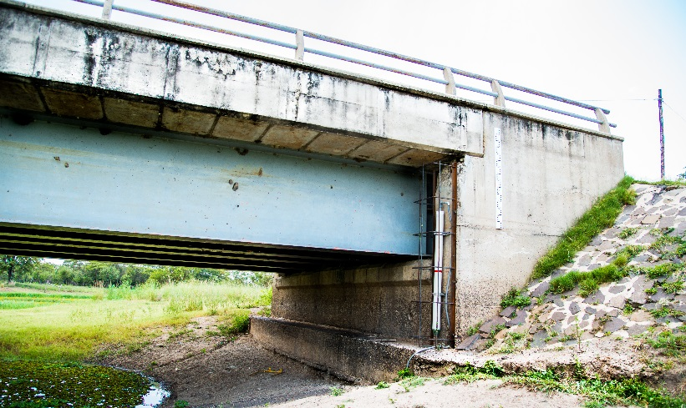
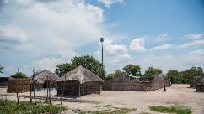
EWS Project Implementation
WATER LEVEL SENSOR

Slide 21
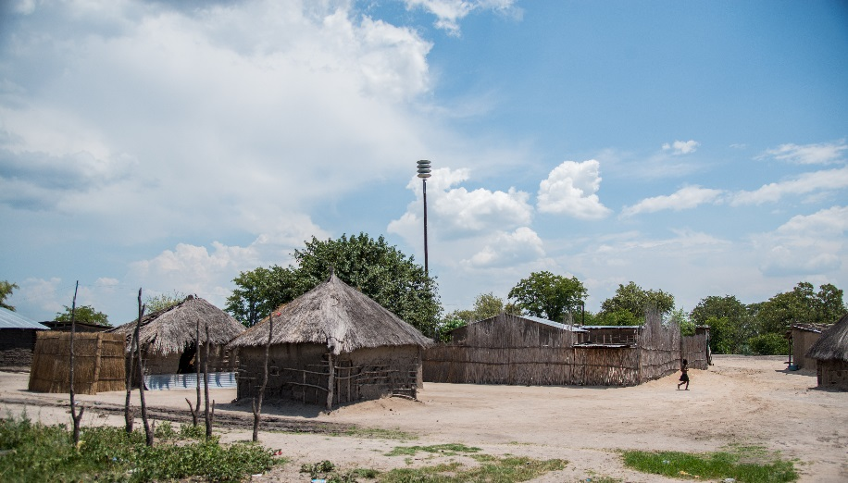

Disaster preparedness: early warning systems
Saving lives in Kasaya Village
Zambia
ALERT SPEAKER
Notes:
SIMILAR PROJECT HAS BEEN IMPLEMENTED IN UGANDA AS WELL.

Slide 22
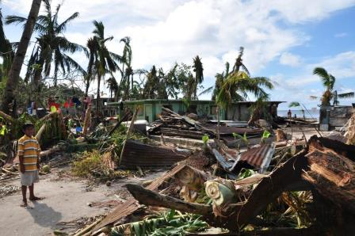
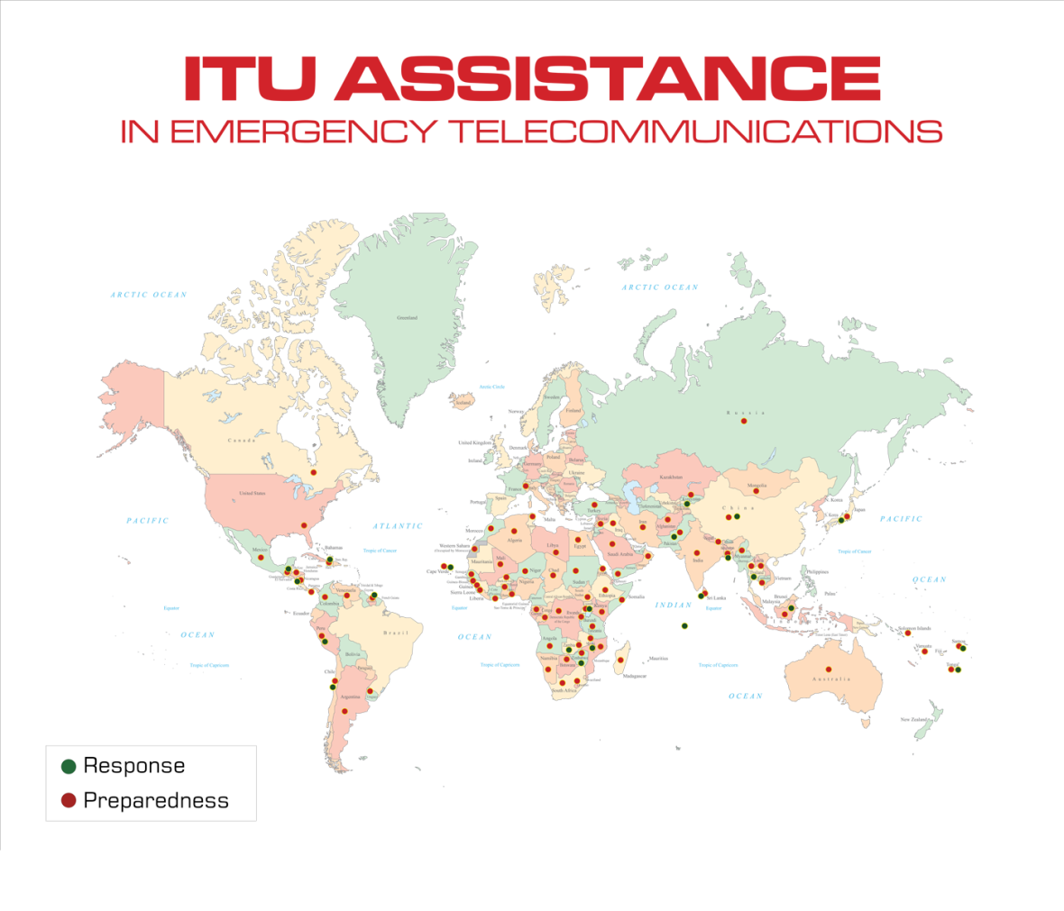
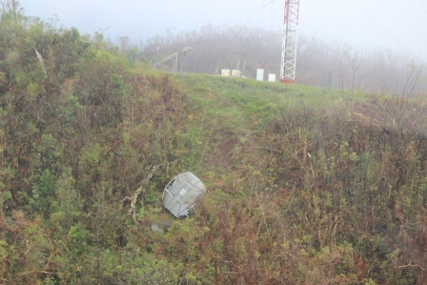
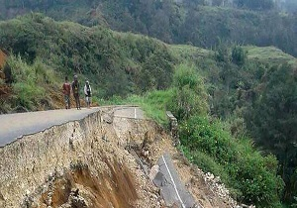
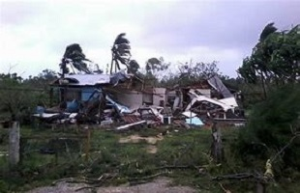
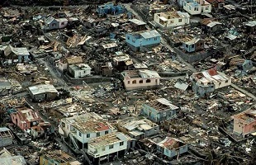
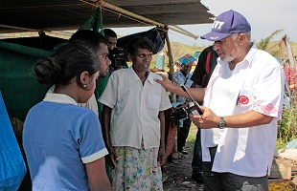
ITU Assistance in Emergencies
Micronesia 2015
ITU dispatched 30 satellite phones, 5 Broadband Global Area Network terminals and 25 solar panels to the Island nation to support relief coordination efforts.
Vanuatu 2015
ITU dispatched 40 satellite phones, 10 Broadband Global Area Network terminals and 35 solar panels to the Island nation
PNG Feb 2018
Satellite equipment sent to support government's needs for communication
Tonga Feb 2018
In response to Gita cyclone disaster, satellite telecommunications equipment was used to restore telecommunication links between the islands in order to coordinate response and recovery efforts
Caribbean Sep 2017
In response to disaster by Irma and Maria, Haiti, Dominica and Antigua and Barbuda, received emergency telecommunications equipment, including satellite phones, BGANs and VSAT to support humanitarian relief and recovery efforts
Fiji 2016
Response to Winston, ITU dispatched satellite phones and BGANS

Slide 23
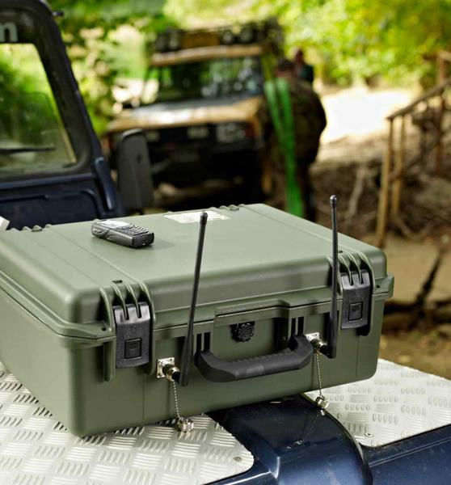
Tools used for Emergency Telecommunications by ITU
Satellite Phones
Satellite Broadband Terminals
VSATs
Private Mobile Network
Mobile and Wireless Networks
Radio Networks
ITU bears the costs for the delivery of equipment, service subscription and airtime charges.

Slide 24
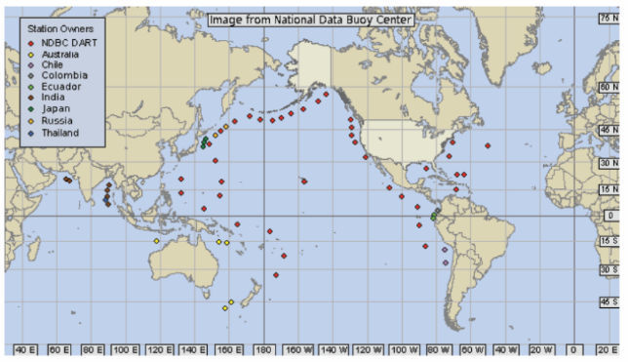
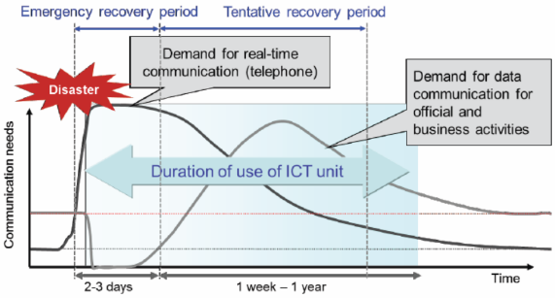
ITU Activities: Sharing of Case Studies and Best Practices
NTT Japan Technical Review, Vol. 12 No. 3 Mar. 2014.
Locations of DART II Tsunami Warning Buoys
Source: Final Report: ITU-D Study Group 2Utilization of telecommunications/ICTs for disaster preparedness, mitigation and response6th Study Period 2014-20172014-
Notes:
Deep-Ocean Assessment and Reporting of Tsunami (DART)
glacial lake outburst flood (GLOF)

Slide 25
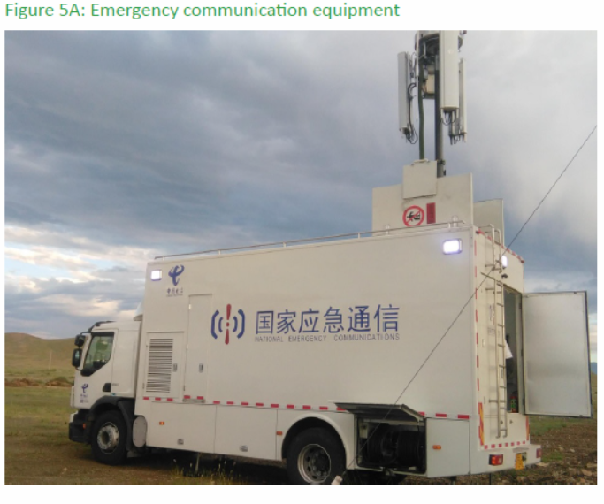
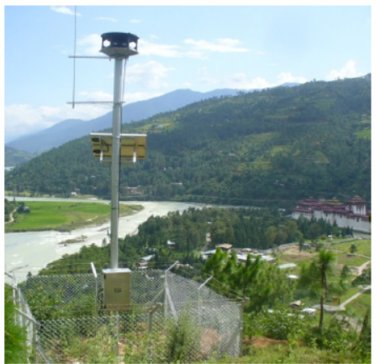
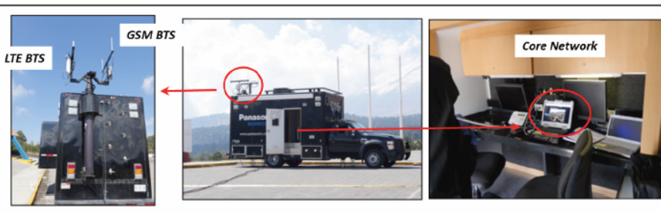
ITU Activities: Sharing of Case Studies and Best Practices
Emergency Telecommunication Equipment used by China
GLOF Early Warning System in Bhutan
Source:
Final Report: ITU-D Study Group 2Utilization of telecommunications/ICTs for disaster preparedness, mitigation and response6th Study Period 2014-20172014-
Example of a local cellular system for GSM and LTE services. This system provides GSM and LTE services via one PC-installed core network function. (Japan)
Notes:
glacial lake outburst flood (GLOF)

Slide 26
ITU Activities: Emergency Telecoms
Numbers for disaster relief:
  Country code 888 for OCHA (Office for Humanitarian Affairs)
  Recommendation ITU-T E.161.1 “Guidelines to select Emergency Number for public telecommunications networks”
  Recommendation ITU-T E.123 “Notation for national and international telephone numbers, e-mail addresses and Web addresses: Contact information in case of emergency for mobile telephones” Amendment 1 – Emergency contact number notation
Emergency Telecommunications Service (ETS)
  Recommendation ITU-T E.107 “Emergency Telecommunications Service (ETS) and interconnection framework for national implementations of ETS”
  Recommendation ITU-T M.3350 “TMN service management requirements for information interchange across the TMN X-interface to support provisioning of Emergency Telecommunication Service (ETS)”
International Emergency Preference Scheme (IEPS)
  Recommendation ITU-T E.106 “International Emergency Preference Scheme (IEPS) for disaster relief operations”
  Recommendation ITU-T E.106 “International Emergency Preference Scheme (IEPS) for disaster relief operations”
  Supplement 53 to ITU-T Q-Series Recommendations “Signalling requirements to support the International Emergency Preferential Scheme (IEPS)”
ITU-T SG17: Common Alerting Protocol
  Recommendation ITU-T X.1303 “Common Alerting Protocol (CAP V1.1)”
Focus Groups:
  Disaster Relief Systems, Network Resilience and Recovery (FG-DR&NRR) http://www.itu.int/en/ITU-T/climatechange/Pages/default.aspx
Notes:
CAP
The common alerting protocol (CAP) is a simple but general format for exchanging all-hazard emergency alerts and public warnings over all kinds of networks. CAP allows a consistent warning message to be disseminated simultaneously over many different warning systems, thus increasing warning effectiveness while simplifying the warning task. CAP also facilitates the detection of emerging patterns in local warnings of various kinds, such as might indicate an undetected hazard or hostile act. CAP also provides a template for effective warning messages based on best practices identified in academic research and real-world experience.

Slide 27























Power of Partnerships
UNOSAT
Notes:
One of the pillars of getting results in any situation is PARTNERSHIPS. ITU has been, and continues to champion a multi-stakeholder approach to emergency telecommunications. These are some of our current partners in this area. We encourage new partners to join us and co-finance activities for the benefit of people in need and countries in need.

Slide 28



on
National Emergency Telecommunication Plans
Emergency Telecommunication
Notes:
Country assessments
Design and implementation of national emergency telecommunication plans
Development of Regulatory and Legal Frameworks for the use of telecommunications during emergencies

Slide 29
Global Guidelines on
National Emergency Telecommunication Plans (NETP)
Purpose:
Better coordination for disaster management
Framework for national consultation and cooperation
Multi-stakeholder roles and responsibilities
Implementation of policy/legislation requirements
Processes/procedures
Structure of Guidelines:
Topology of disasters
Phases of disaster management
International cooperation and coordination
National disaster management
Telecommunications/ICTs for disaster management
ICT legislation and regulation
Capacity development and drills
Support for people with disabilities
NETP: step by step guide
Notes:
To guide countries in the area of disaster management activities, ITU is currently working on a set of global guidelines for the development of national emergency telecommunication plans. The purpose of these guidelines are to assist national authorities and policy-makers in the development of a National Emergency Telecommunication Plan (NETP) based on their own needs and in their national vision for the optimal use of ICTs for disaster management.
An effective implementation of the NETP provides a methodical way to engage stakeholders in thinking through the life cycle of a potential disaster, determine required capabilities for emergency response, and establish a governance framework for roles and responsibilities. It also provides an opportunity to identify shortcomings and to target gaps in emergency communications capabilities and use new technologies, for example in the area of monitoring and alerting.

Slide 30
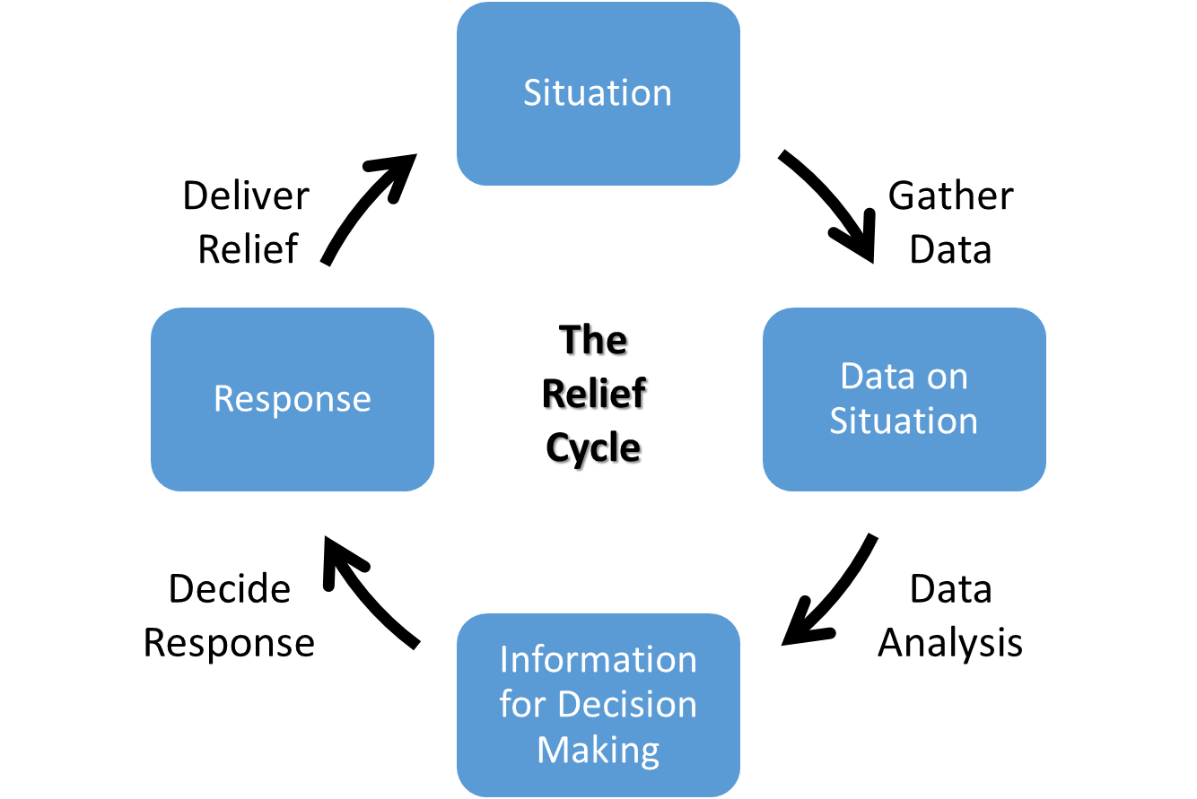
NETP
Aim: Develop the ability of the disaster and emergency response personnel to effectively communicate before, during and post disaster.
National ETC MUST work to adopt a National Emergency Telecommunication Plan.

Slide 31
Purpose of NETP
  The National Emergency Telecommunications Plan (NETP) describes how ICT and Telecommunications services will be used to help prepare for and respond to disasters.
  It is NOT a strategy for the development of these services – it is an operational plan.

Slide 32
NETP process – What do we need to know?
What Risks apply ?
  Cyclone
  Earthquake (local)
  Tsunami (from local or remote earthquake)
  Volcanic activity
  Heavy rain (flooding, landslides)
  …..
What Information and Communications Technologies are available?
  Broadcasting (e.g. AM, FM, TV)
  social media (e.g. Facebook)
  cellular (e.g. broadcast SMS)
  satellite (e.g. Iridium phones, Chatty Beetle)
  radio links (e.g. Police VHF, HF radio, Amateur Radio)
  sirens
  Non-ICT solutions such as:
    newspapers,
    word of mouth,
    village meetings,
    bells, etc.

Slide 33
NETP process – What do we need to know?
What are the strengths and limitations of each tool?
  Geography:
    everywhere,
    coastal locations,
    hillsides
  Remoteness:
    large population centres with well-developed infrastructure,
    remote villages with minimal communications facilities, etc.
  Ease of use:
    familiarity with tool,
    training required, etc.

Slide 34
NETP process – What do we need to know?
What Areas would be affected?
  Geography? (e.g. everywhere, coastal locations, hillsides, etc.)
  Remoteness:
    large population centres with well-developed infrastructure,
    remote villages with minimal communications facilities
  …
How should ICT be used in the
  Preparation Phase?
  Warning Phase?
  Response Phase?
  Recovery Phase?
What happens to ICT During the Incident? How are we going to make sure ICT can be used when it is needed?
  How will the tools survive the (previously identified) risks?

Slide 35
NETP defines ICT usage in different phases of disaster
ICT in the Preparation Phase | ICT in the Warning phase | ICT in the Response phase | ICT in the Recovery Phase
What information do the villages need to prepare? How can we get this information to the right people? | What information do we want to send? How can we get this information to the right people? | What information do we need to receive? How can we gather this information? How can we receive this information? | What information do we need to receive? How can we gather this information? How can we receive this information?
What information do we need centrally to prepare? How are we going to gather this information? How can we communicate this information? | Do we want to gather information? What information do we want to gather? How are we going to gather this information? How can we communicate this information? | What information do we want to convey? How can we transmit the information? | What information do we want to convey? How can we transmit the information?

Slide 36
ICT in the Preparation Phase – Example
The Risk The Location Information Communication
Cyclone
Major City
How to Prepare
Written reports
Pamphlets
Tsunami
Provincial Centre
Preparation Status
Broadcast Radio/TV
Earthquake
Remote Village
…
Village Meetings
…
…
…
…

Slide 37
ICT in the Warning Phase – Example
The Risk The Location Information Communication
Cyclone
Major City
Warning
?
Written reports
Cellular
Text
Tsunami
Provincial Centre
Weather Status
Broadcast Radio/TV
Earthquake
Remote Village
…
Sirens
…
…
…
…

Slide 38
ICT in the Response Phase – Example
The Risk The Location Information Communication
Cyclone
Major City
Gathering Information
Written reports
DMO VHF
Tsunami
Provincial Centre
Controlling teams
Cellular
Earthquake
Remote Village
Satellite Phone
…
…
…
…

Slide 39

“Committed to
connecting the WORLD”
I Thank U

