Slide 1
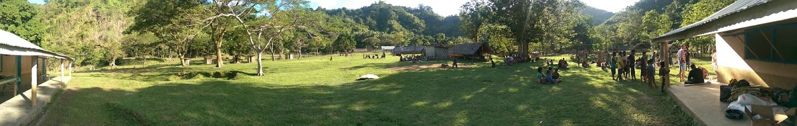


RF Management, IMT Bands and Type Approval Processes in
Vanuatu
Presented to Training participant,
Fiji
Date: 11th April 2019
The Government
of The Republic
of Vanuatu

Slide 2
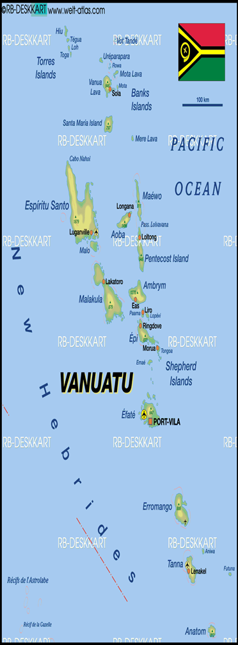

Vanuatu – Geopolitical Overview
Archipelago consisting of 83 islands of which 63 are inhabited
Population of approximately 272,500 (July 2017 mini census estimates)
  40% of the population are under 15
  75% of the population live in rural areas
GDP (2015) of $US767.4 million
Largest contributor to GDP is Services (tourism)
  Agriculture follows close behind
GNI per capita (2014) $US3,140
  5% of monthly income is $US13
  Cheapest unlimited fixed internet service is $US58 (512kbps)
  1.5Gb monthly prepaid mobile (3G/4G+) data is $US8.95
Challenges
  Political stability, economic development, natural disasters, high cost of logistics (transport and shipping), ICT literacy

Slide 3
Competitive Landscape
Two full service carriers (Telecom Vanuatu, Digicel)
  Significant microwave backhaul and spur infrastructures
  Minimal use of satellite technologies
  Both use licenced and unlicenced spectrum
There further 5 ISP players
  Telsat – WISP (unlicensed spectrum), HTS VSAT (Kacific)
  Wantok – WISP (fixed 4G licenced and unlicenced spectrum), HTS VSAT (Kacific)
  SPIM – Wireless hotspots (unlicenced spectrum)
  PGL – HTS VSAT (Kacific)
  PLL – Pacific Link Limited (VSAT)
Single Submarine Cable – Interchange Cable Limited
  Fiji – Vanuatu
  Ssecond cable in planning phase (RFS estimated late 2019 early 2020 ??)
    Planned route: Port Vila – Luganville - Honiara

Slide 4
Legal Framework
  TRR now TRBR was established by the government through the Telecommunications and Radiocommunications Regulations Act, No 30 of 2009, as amended by amendment 22 2018 (the Act).
  TRBR is established as an independent legal regulatory body, to provide for a regulatory framework for telecommunications, radiocommunications and broadcasting in Vanuatu.
  Legislation that mandates TRBR to managed the spectrum are;
  The Act;
  Spectrum Fees and Radio Apparatus License Fees regulation Order No. 157 of 2012;
  Telecommunication Licences;
The TRBR has also in place policies and guidelines on band planning for;
  Fixed services
  IMT services &
  Mobile services

Slide 5
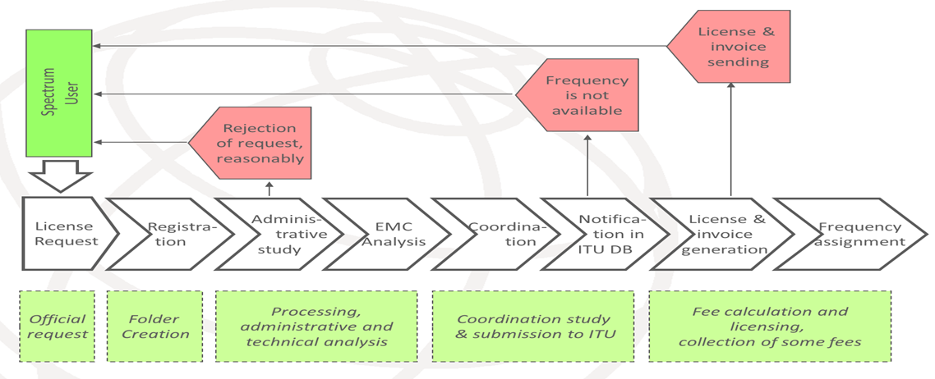
National Spectrum Management
TRBR issues licenses authorizing a person to
  Provide telecommunications and broadcasting services to end users to and from anywhere in Vanuatu;
  Operate radiocommunication devices; and
  Use the radio spectrum.
3 types of licenses
  Spectrum License
  Radio Apparatus Licence
  General User Radio Licence (GURL)
Existing Spectrum Management Tool
SMS4DC (ITU) – active database system for frequency assignments and registration of active frequency licensees
AFIS – most use for inputting spectrum data for information to the spectrum users (Publicly Available)

Slide 6
IMT Spectrum Bands
Spectrum for IMT is used for 2G, 3G and 4G+ services
Spectrum licences are renewed yearly
Current IMT spectrum bands in use
  APT700Mhz
    Fully assigned with exemption an incentive to encourage operators to use the band
  900MHz
    Fully assigned
  1800MHz
    Fully assigned
  2100MHz
    Assigned with spare capacity
Future bands to be investigated
  Band 5: 800MHz (APT review and PPDR)
  Band 2: 1900 MHz
  Band 40: 2300 MHz, Band 7: 2500 MHz, Band 38: 2500 MHz, Band 52: 3300 MHz, band 42: 3500 MHz and band 43: 3700 MHz (currently all WiMAX but little use)
  WRC19 identified bands

Slide 7
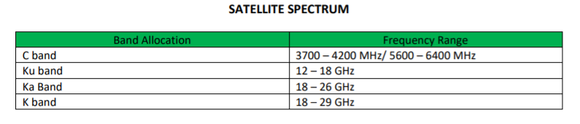
Satellite Spectrum
Little use of C-band FSS
  Both full service operators have C-band dishes but have effectively turned these off in favour of cable
  Can be used in backup situations if required
  Some C-band in use by USP, but declining
Increasing use of Ku/Ka VSAT FSS
  Kacific HTS services are used across the country
  Provide coverage into remote and rural areas
  Consideration of use for remote IMT backhaul (ie share the infrastructure)
Other satellite services/spectrum in use
  Meteorological
  TVRO
  Maritime services (GMDSS)
  Handheld iridium
  Portable BGAN services

Slide 8
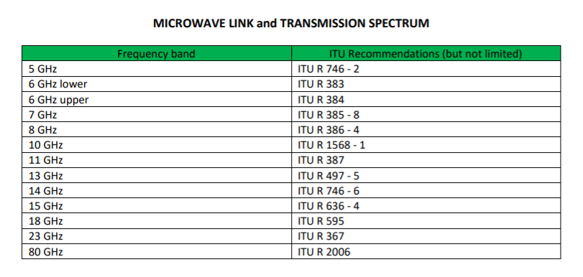
Radio Apparatus Frequency Bands
All Aeronautical & Maritime
Land Mobile (HF, VHF & UHF)
Broadcasting &
Fixed (Microwave etc…)

Slide 9
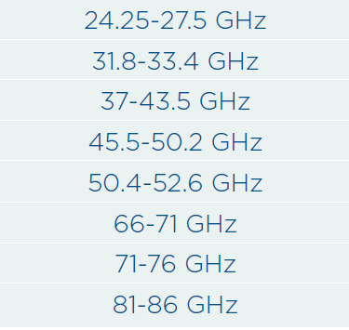
Future 5G Spectrum
Vanuatu is currently investigating the planning for those bands to be allocated
  Likely to remain unassigned in the short to medium term
Spectrum under consideration is inline with current APT recommendations to be proposed at WRC19
There does not appear to be any significant rationale to not proceed with the ITU recommended spectrum bands
Current demand scenarios are low
  Unlikely that there will be any rapid uptake of 5G services in Vanuatu in the short term

Slide 10
Current Spectrum Pricing
IMT Bands
  APT700MHz ($US788 per MHz)
  900MHz ($US788 per MHz)
  1800MHz ($US438 per MHz)
  2100MHz ($US236 per MHz)
  Digital TV bands
WiMax Bands
  2.3 GHz ($US149 per MHz)
  2.5 GHz ($US197per MHz)
  3.5 GHz ($US131 per MHz)
Digital TV bands
  500 – 690 MHz ($US59 per MHz)
Radio Apparatus Licence
  Aeronautical, Maritime, Amateur, Fixed, Land Mobile etc..
    Approved fees are charge per Radio Apparatus Device

Slide 11
Legal Frame work and Importance of Type Approval in Vanuatu
With the rapid increase in the uptake of mobile, internet, Pay-tv and radio services in Vanuatu, it is evident that the market is seeing an increase in the number of radiocommunications, telecommunications and Broadcasting devices and equipment from different vendors and suppliers. Some of which may be of low quality and may not be compliant with applicable international standards and requirements.
With the powers prescribed by the ACT, the TRBR has implemented the Telecommunications, Radiocommunications and Broadcasting Type Approval and Conformity to Technical Standrads Regulations Order No. 191 of 2018 which was gazette on the 23 of November 2018 to overcome any present or potential problems as the result of importing low quality non-compliant Radiocommunications and Telecommunications Terminal Equipment (R&TTE).
TRBR believes that verification of R&TTE equipment against the applicable international standards and requirements will ensure that the ICT equipment or R&TTE does not cause any interference, or long or short term damage to the radio and telco networks, the environment and also the general public.

Slide 12
Who can Apply for Type Approval in Vanuatu
TRBR understand that it is a challenge for a local company to apply for Type Approval Certification for certain reasons
TRBR accepts Type Approval Application form both Manufactures, Foreign agents and importers
TRBR will issued a Type Approval Certificate to a manufacture or a foreign agent, however this certificate cannot be used for clearance at the customs boarder control unit.
For a local company to import into Vanuatu they need another type approval certificate to use for clearance at the customs.
Local Company can used the manufacture certificate for an approved model to apply for a certificate to be issued to them for customs clearance
Currently there are no fees applied for Type Approval certifying process, however TRBR is looking to implement fees in the near future.
As of 1st January 2019, TRBR have received 20 Type Approval Applications

Slide 13
TRBR TYPE APPROVAL APPLICATION PROCESS
TRBR Received Application form from Manufactures, foreign Agent or local importer.
TRBR review Type Approval Application form, it is important that all the documents requested in application form must be submitted and are correctly labeled.
Documents provided are check making sure they are compliant to available international standards and requirements.
If equipment is compliance with international standards then TRBR will issue a type approval certificate to applicant.
The Certificate is issued for the life time of the model number/name that was approved (4 years)
Phones for personal used does not required type Approval, however if some individual is ordering more than 5 phone then they will need a type approval from TRBR

Slide 14
Questions ??

